Slide 1
ASSIGNMENT A2 · NS-3
ns-3 in Docker with a 3GPP XR Traffic Model
Install it, run it, and prove it: throughput and delay, a Wireshark capture, and the generated traffic checked against the 3GPP spec.
Student M11402804 · Ahmad Rifqi Fadhlurrahman
Spec 3GPP TR 26.926 V19.0.0 (ETSI TR 126 926) → TR 38.838 XR model

Slide 2
01 • SETUP
docker · ns-3.48
One Docker image, one pinned ns-3 release
▪ Docker image (Ubuntu 24.04) holds the toolchain, tshark and Python plotting — built in 3 min, 1.1 GB.
▪ ns-3 source lives in a host folder mounted into the container, so code and results survive the container.
▪ Pinned to ns-3.48, built optimized with examples and tests: ~2 000 targets in 21 min on 20 cores.
▪ Smoke test ./test.py --suite=udp → PASS.
ENVIRONMENT
Host Ubuntu 22.04.5, 20 cores
Docker 28.3.0
Container Ubuntu 24.04.5 LTS
ns-3 ns-3.48 (optimized)
Compiler g++ 13.3.0 · CMake 3.28.3
Tools Python 3.12.3 · Wireshark 4.2.2

Slide 3
02 • WHAT BROKE
and the fixes
What broke on the way — and how it was fixed
▪ Disk full: / at 100 % (398 MB free) blocked docker build → removed two unused images, freeing ~20 GB.
▪ Silent smoke test: ./ns3 run first prints nothing in the optimized profile (logging compiled out) → use test.py --suite=udp.
▪ Lost frames: one UDP datagram per frame failed silently above 65 507 B — only 407 of 600 frames arrived → fragment into 1400 B packets and count every failed send.
▪ Wrong truncation: frame size cut at ±3σ, but the spec says 50 %–150 % of the mean → fixed per Table 6.5.3.1-1.
▪ Wrong jitter: jitter accumulated into the inter-arrival time, but the spec adds it on top of periodic arrivals → schedule frame k at t₀ + k·T + J_k.
▪ Misleading decode: Wireshark showed port 5000 as protocol TAPA → moved the flow to port 40000.

Slide 4
03 • TRAFFIC MODEL
TR 26.926 → TR 38.838
The 3GPP XR downlink video model
▪ §6.4: 60 fps at 30 or 45 Mbit/s.
▪ §6.5.3.1, Table 6.5.3.1-1: frame size is a truncated Gaussian — STD 10.5 %, Min 50 %, Max 150 % of the mean.
▪ §6.5.3.2: jitter is a truncated Gaussian added on top of periodic arrivals (TR 38.838: mean 0, STD 2 ms, ±4 ms).
▪ §5.7.2: each frame is fragmented into IP packets — here ≤ 1400 B UDP payload, ~45 packets per frame.
▪ Delay budget: 10 ms per packet for VR.
FRAME k OF THE MODEL
t_{k} = t₀ + k·T + J_{k}
S_{k} ~ N(M, 0.105M) in [0.5M, 1.5M]
WHAT EACH SYMBOL MEANS
T frame period = 1/60 s = 16.67 ms
Jₖ jitter, N(0, 2 ms) cut at ±4 ms
Sₖ size of frame k
M R / (8·F) = 62 500 B at 30 Mbit/s

Slide 5
04 • RESULT
flowmonitor
30 Mbit/s delivered within the delay budget
n0 ── 200 Mbps · 5 ms ──▶ n1 UDP :40000 · 600 frames · 10 s · seed 1
30.04 Mbps
offered at the application (target 30)
27 119
packets sent = received, 0 lost
6.33 ms
mean one-way delay
0 pkts
over the 10 ms delay budget
▪ IP-layer throughput is 30.69 Mbps: payload plus 28 B of IP+UDP header on each of the 27 119 packets — exactly the received byte count.
▪ Delay = 5 ms propagation + serialization + queueing behind the other ~45 packets of the same frame.

Slide 6
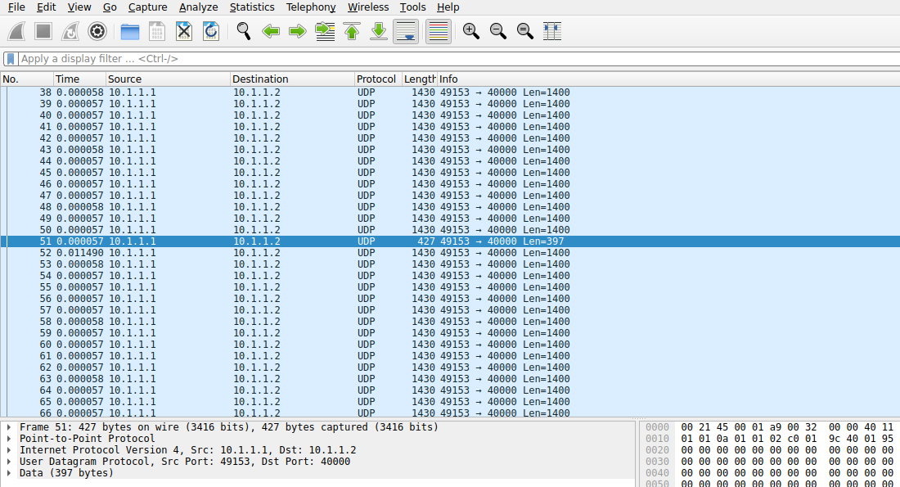
05 • WIRESHARK
a2-xr-0-0.pcap
In Wireshark, each frame is a burst of packets
▪ Packets 1–50: 1400 B, 57 µs apart.
▪ Packet 51: 397 B remainder → frame 0 is 70 397 B, the same as the generator log.
▪ Packet 52: 11.49 ms later — the next frame starts.
▪ Conversations: one UDP flow, 27 119 packets, 38 MB, 30 Mbps.

Slide 7
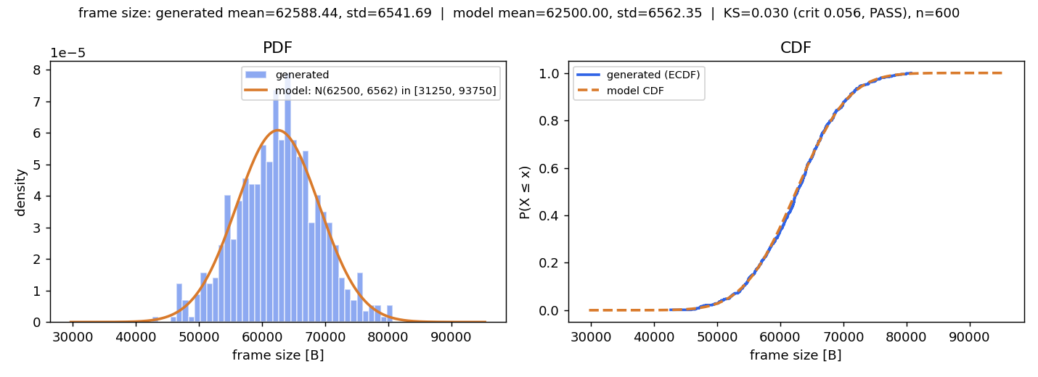
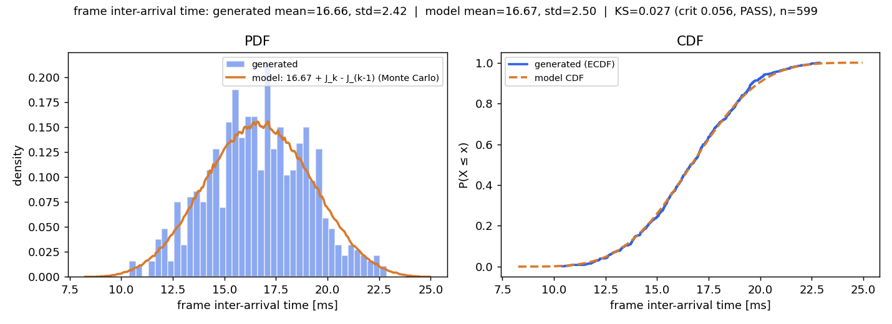
06 • VERIFICATION
frame level
Frame level: all three KS tests pass
FRAME SIZE
generated 62 588 / 6 542 B
model 62 500 / 6 562 B
KS 0.030 < 0.056 PASS
JITTER Jₖ
generated 0.04 / 1.70 ms
model 0.00 / 1.76 ms
KS 0.032 < 0.056 PASS
INTER-ARRIVAL
generated 16.66 / 2.42 ms
model 16.67 / 2.50 ms
KS 0.027 < 0.056 PASS

Slide 8
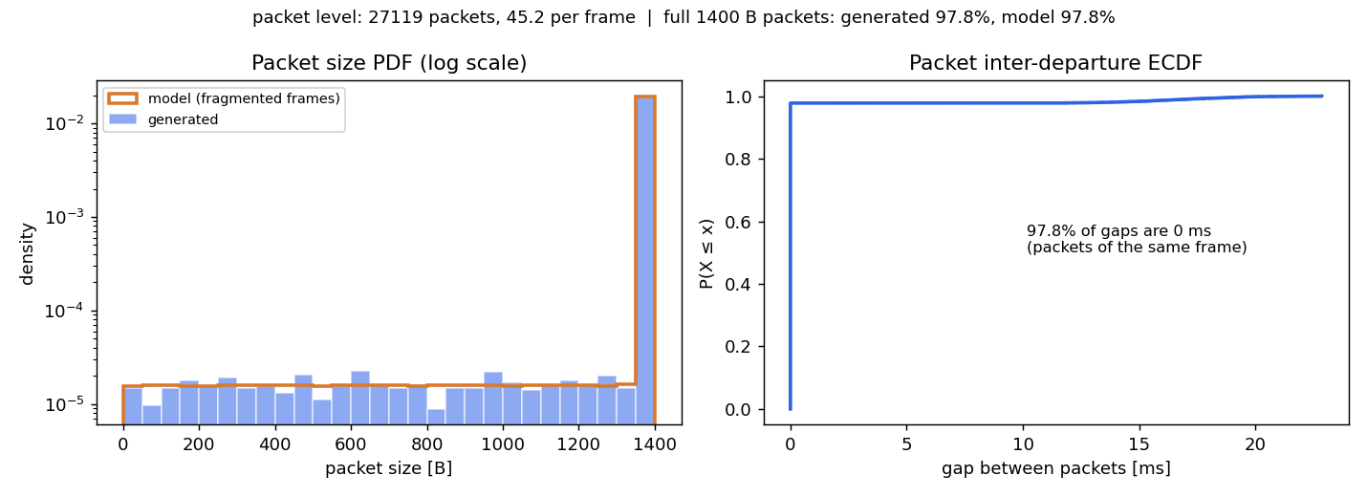
07 • PACKET LEVEL
pcap = csv
The wire carries what the generator made
▪ 97.788 % of packets are full 1400 B; the model predicts 97.787 %.
▪ 45.2 packets per frame; the rest are the per-frame remainders.
WIRE CHECK — PCAP VS GENERATOR LOG
PCAP 27 119 UDP packets · 37 553 066 payload bytes (tshark, udp.length − 8)
CSV 27 119 packets · 37 553 066 payload bytes (xr-packets.csv)

