Slide 1
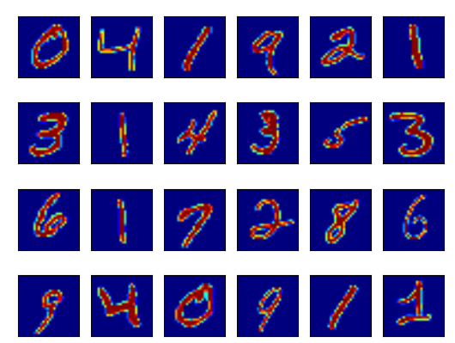

Slide 2
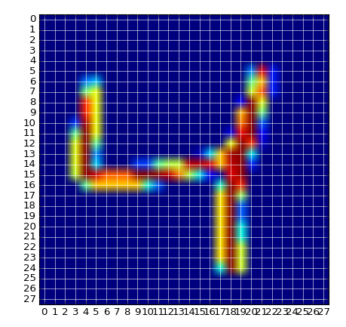
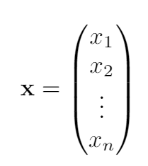
28x28 pixels
n = 28x28=784

Slide 3
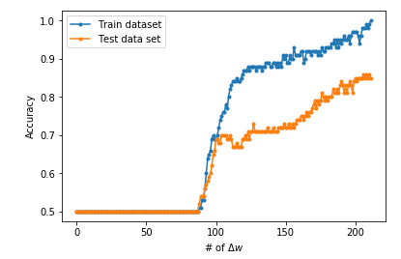
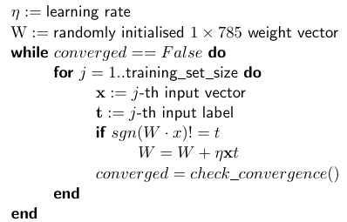
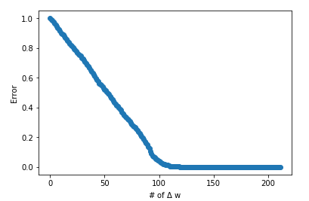
Perceptron hebbian learning update

Slide 4
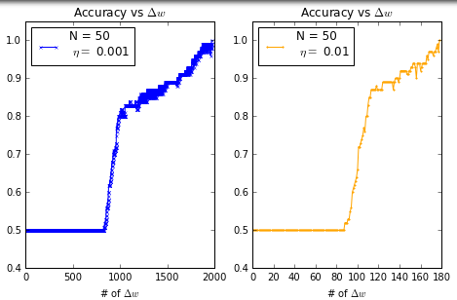
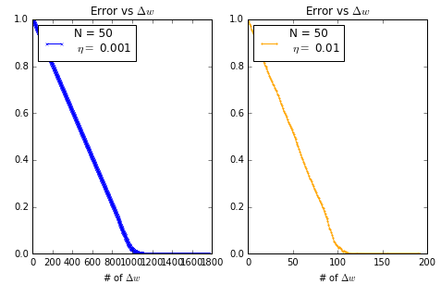
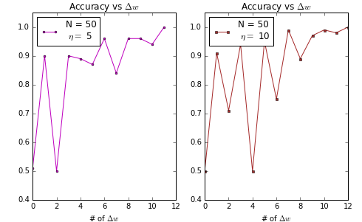
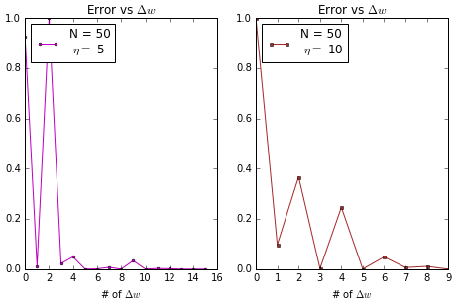

Slide 5


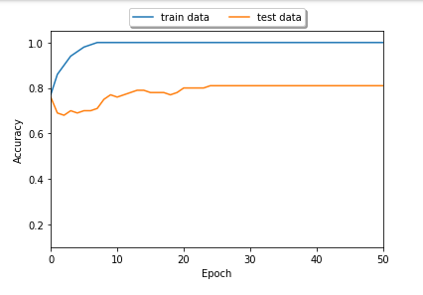
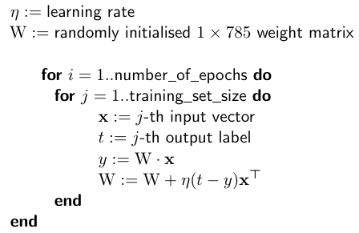
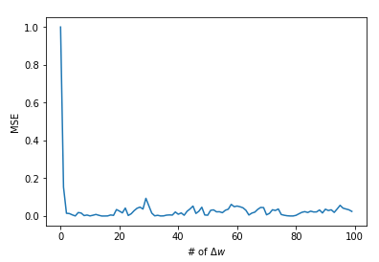
Gradient descent; Squared energy
# of Patterns = 2

Slide 6
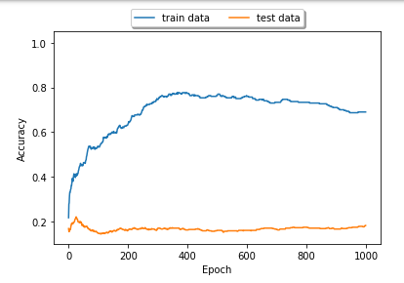
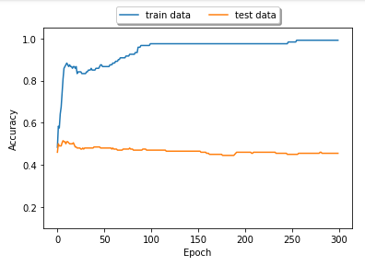









Gradient descent; Squared energy
# of Patterns = 4
# of Patterns = 10

Slide 7
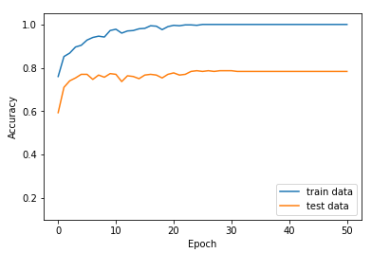
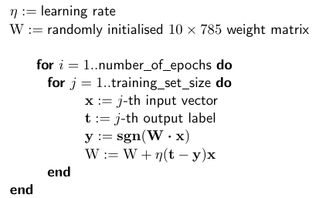
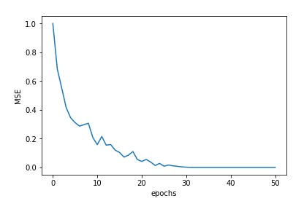
Gradient descent 10 Binary classifiers
# of Patterns = 10

Slide 8
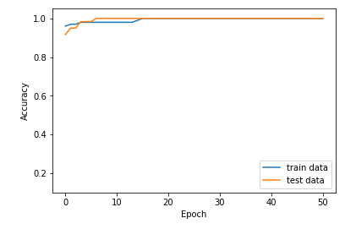
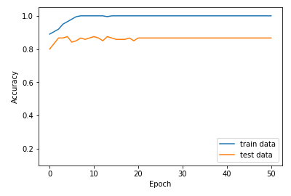
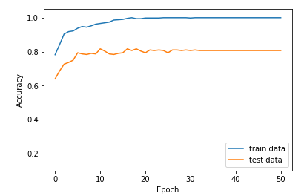
Gradient descent 10 Binary classifiers
# of Patterns = 2
# of Patterns = 4
# of Patterns = 10

Slide 9
Conclusion
Hebbian learning, 1 weight vector, reaches 90% accuracy on test data
Gradient descent; linear activation function. Same performance as Hebbian learning for binary dataset. Terrible for more more than 2 patterns.
Gradient descent N binary classifiers for N datasets: Better results for N=2 than linear activation and Hebbian learning, and decent results for N=10

