Slide 1
Brand Detection using Deep Learning
By:
Ahmad Nadeem Saigol

Slide 2
Problem Statement:
Brand Recognition of given Advertisement
Given Brand can be one of the training dataset
or can be unknown (i.e single video with label provided at test time)

Slide 3
Model
Inspiration: FaceNet [1]
a face recognition system developed in 2015 by researchers at Google
One shot learning
Siamese Network
Triplet Loss function

Slide 4
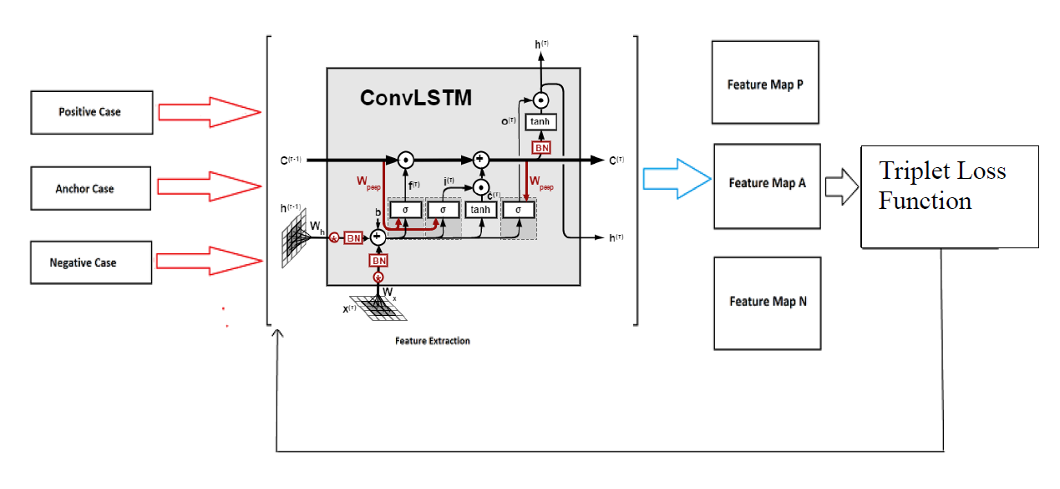
Model
ConvLSTM [2]
2 Dense layer
Triplet loss function

Slide 5
ConvLSTM
It is a Recurrent layer, just like the LSTM, but internal matrix multiplications are exchanged with convolution operations.
Number of Filters: 16
Weight Initialization: Xavier
Kernel_size: 3 x 3
Stride: 1
Activation: tangent hyperbolic
Recurrent Activation: sigmoid
Input shape: (batch, seq, width, height, channel)

Slide 6
Dense layers
Dense Layer 1
Neurons: 1024
Weight Initialization: Xavier
Activation: ReLU
Dropout
P =0.5
Dense Layer 2 (Embeddings)
Neurons: 256
Weight Initialization

Slide 7
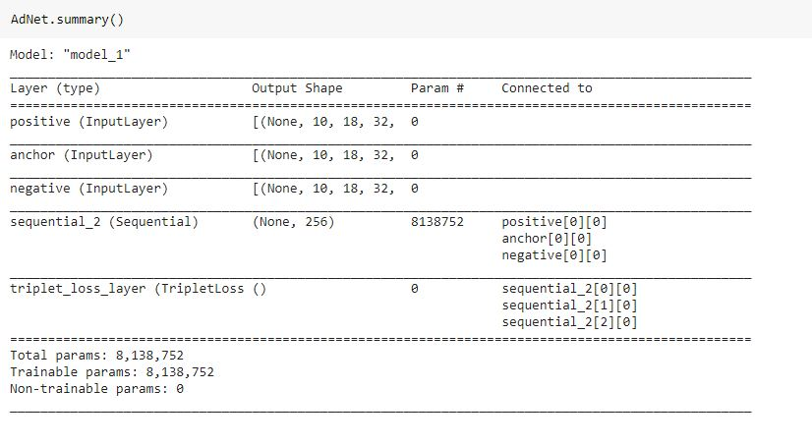
Model

Slide 8
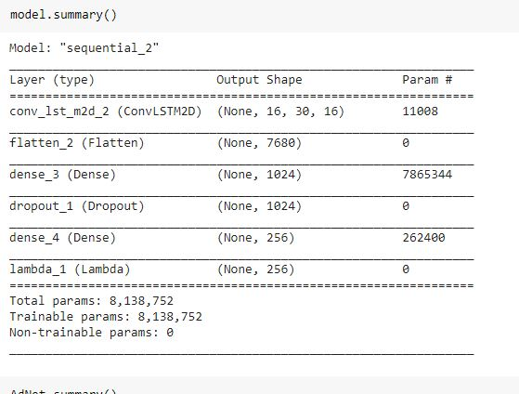
Model

Slide 9
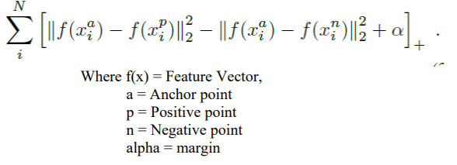
Triplet Loss Function
Alpha = 0.2
Maximizes the difference between Anchor point and Negative Point while Minimizing the difference between Anchor Point and Positive Point ,similar to an SVM.

Slide 10
Dataset: Choice of Triplets
directly affect our model performance
Choices [3]:
Make all possible triplets
Offline / Online Mining
Semi Hard / Hard Mining
Approach Chosen: Offline Mining with random video from a single class for positive and anchor (not same for both, videos not repeated in any triplet) and random video from remaining classes.

Slide 11
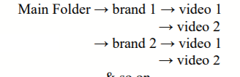
Dataset: Preprocessing
Restructured the dataset as follows:
Python Generator:
Output: [Positive, anchor, video] (each with shape (batch, sequence length, height, width, 3)
Extracting specific number of frames (sequence frames =10)
Resizing =18 x 32
Mapping to [0, 1]

Slide 12
Training
Splitting: (60,20,20)
Optimizer: Adam
Learning Rate = 0.001
Beta 1 = 0.9
Beta 2 = 0.999
Batch Size: 10

Slide 13






Results
Training Loss:

Slide 14
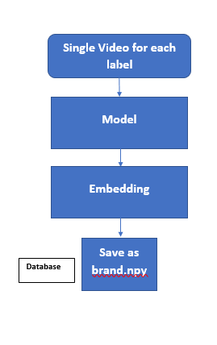
Database
Created database of embedding for each brand

Slide 15
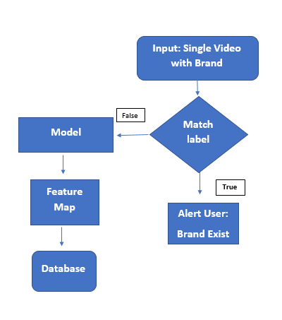
Inference

Slide 16
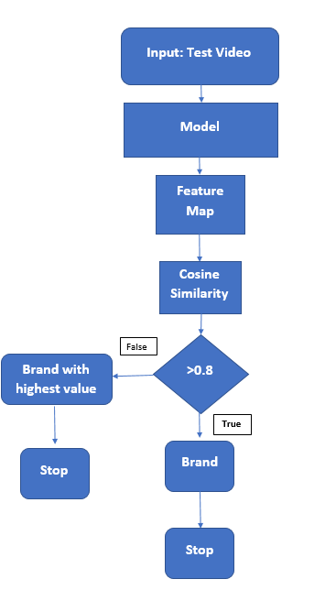
Inference
Cosine Similarity [4] :
Feature Map from Database

Slide 17
Future Work
Better Choice of Triplets (based on some criteria)
Sequence Length
Improve inference time

Slide 18
References
[1] Schroff, F., Kalenichenko, D., & Philbin, J. (2015). Facenet: A unified embedding for face recognition and clustering. In Proceedings of the IEEE conference on computer vision and pattern recognition (pp. 815–823)
[2] Xavier, A. (2019, April 22) ‘ An introduction to ConvLSTM ’, Medium. https://medium.com/neuronio/an-introduction-to-convlstm-55c9025563a7.
[3] Moindrot, O. (2018, March 19). Triplet Loss and Online Triplet Mining in TensorFlow. Olivier Moindrot blog. https://omoindrot.github.io/triplet-loss#offline-and-online-triplet-mining.
[4] Prabhakaran, S. (2020, October 11). Cosine Similarity - Understanding the math and how it works? (with python). Learn applied Data Science. https://www.machinelearningplus.com/nlp/cosine-similarity/.

