Slide 1
Lung Diseases Classification using ML and DL
Group 7:
Ahmad Nadeem Saigol
Joel Romero

Slide 2
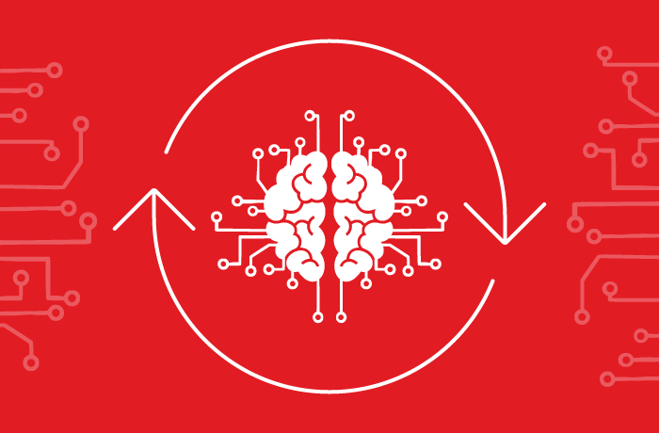
Introduction
Objective
Motivation
Phase 1
Data Preprocessing
Feature Extraction
Classifiers
Phase 2
Data Preprocessing
Models
Evaluation Metrics
Results
Phase 1
Phase 2
Discussion

Slide 3
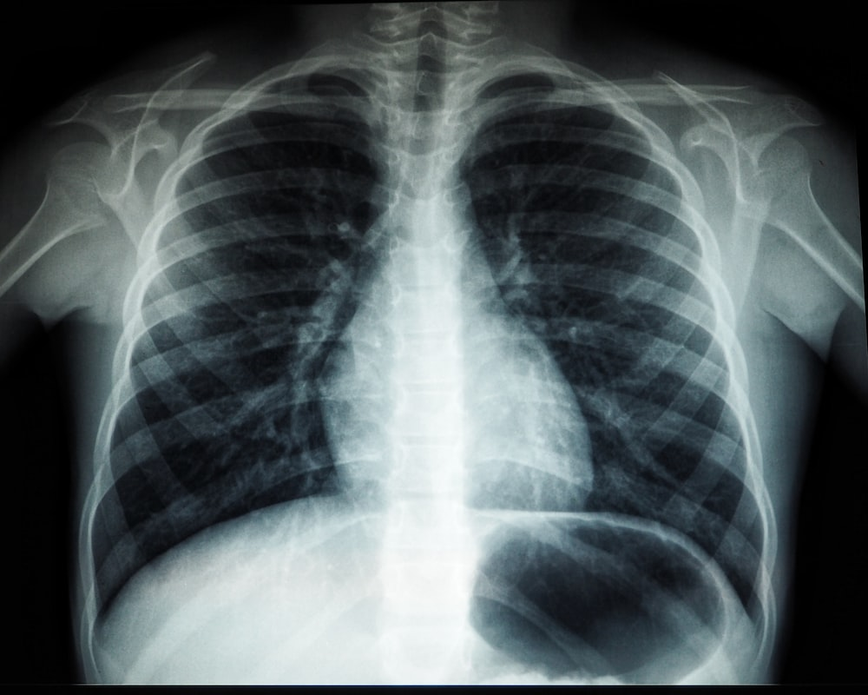
Objective
Classify X Ray Images of patients who may or not be affected by a respiratory disease.
Phase 1: Machine learning
Phase 2: Deep learning

Slide 4
Objective
Binary Classification: COVID, NON-COVID
Multiclass Classification:
Normal
Covid
Pneumonia
Lung Opacity

Slide 5
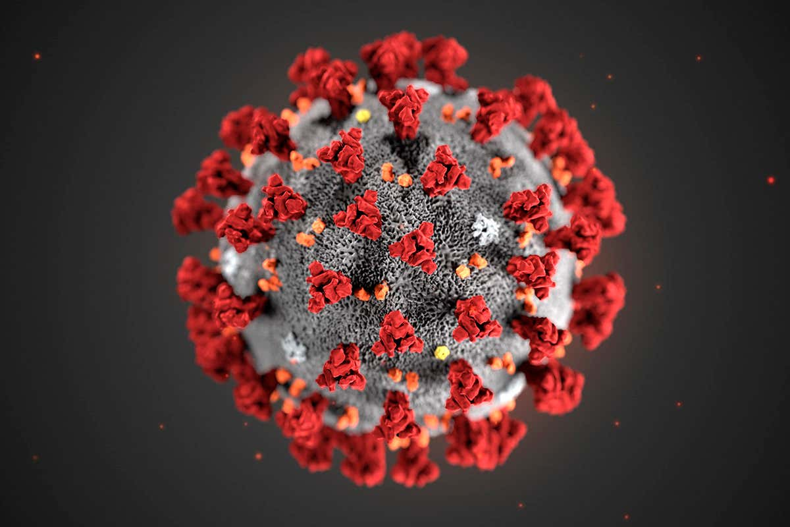
Motivation
Due to recent worldwide COVID-19 outbreak, diagnosis and appropriate treatment methods are required.
First diagnosis and medications are important to prevent the disease from progressing.[1]
[1] COVID-19 detection using X-ray images and statistical measurements, Emre AVUÇLU

Slide 6

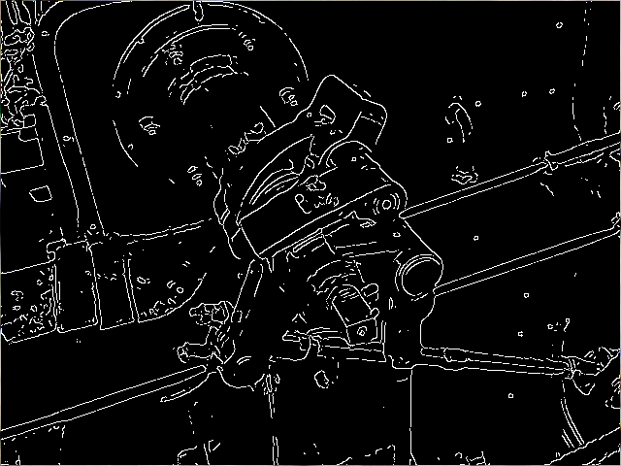
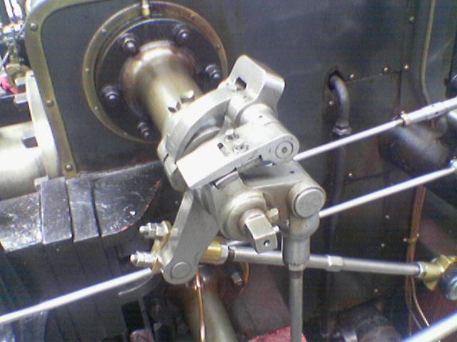
Phase 1: Data Preprocessing
Data Splitting & Batch Processing
Resize
Normalization
Canny Edge Detection

Slide 7



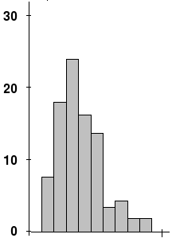
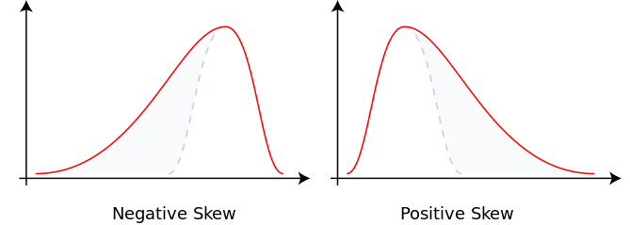
Phase 1: Feature Extraction
Different features tested:
Contrast (Michelson, RMS)
Skewness: Measure of the asymmetry of distribution

Slide 8
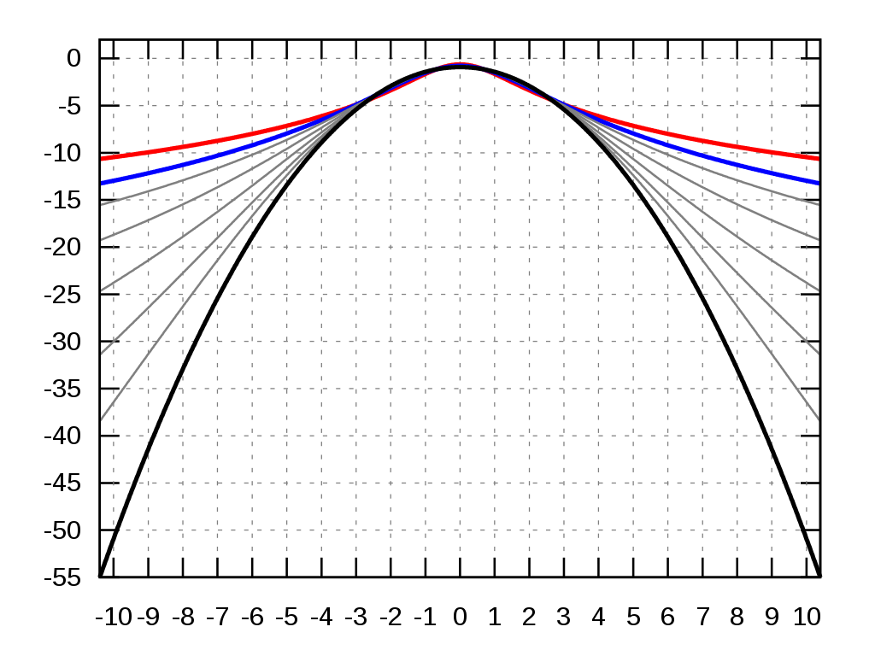
Phase 1: Feature Extraction
Kurtosis: Measure of the “taildness” of a distribution

Slide 9
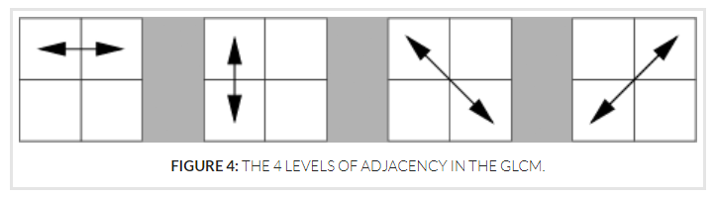
Phase 1: Feature Extraction
Haralick: Used to describe the “texture” of an image
Derived from the Gray Level Co-occurrence Matrix (GLCM), that records how many times two gray-level pixels adjacent to each other appear [2]
[2] Haralick texture. https://cvexplained.wordpress.com/2020/07/22/10-6-haralick-texture/

Slide 10
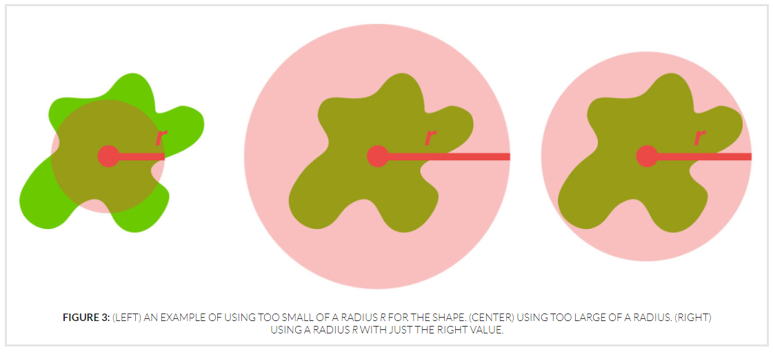
Phase 1: Feature Extraction
Zernike: Zernike Moments characterize and quantify the shape of an object.
To compute we specify radius of the disc and the degree of the polynomial.
[3] Zernike Moments. https://cvexplained.wordpress.com/2020/07/21/10-5-zernike-moments/

Slide 11
Phase 1: Classifiers
single description
formulas
hyperparameters and their formulas
add image

Slide 12
Phase 1: Classifiers
SVM: single description
formulas
hyperparameters and their formulas
add image

Slide 13
Phase 1: Classifiers
RFT baisc idea
hyperparameters
image

Slide 14
Bossitng
single description
hyperaprameters
imp to mention boosting and RFT were attempts to improve performance ..didnot look too much

Slide 15
Histogram
This feature was an interesting finding for us. While analying we noticed that graphs for each class was enough different which leads us to think that this may giive us good results even just by thresholding.
add images here

Slide 16
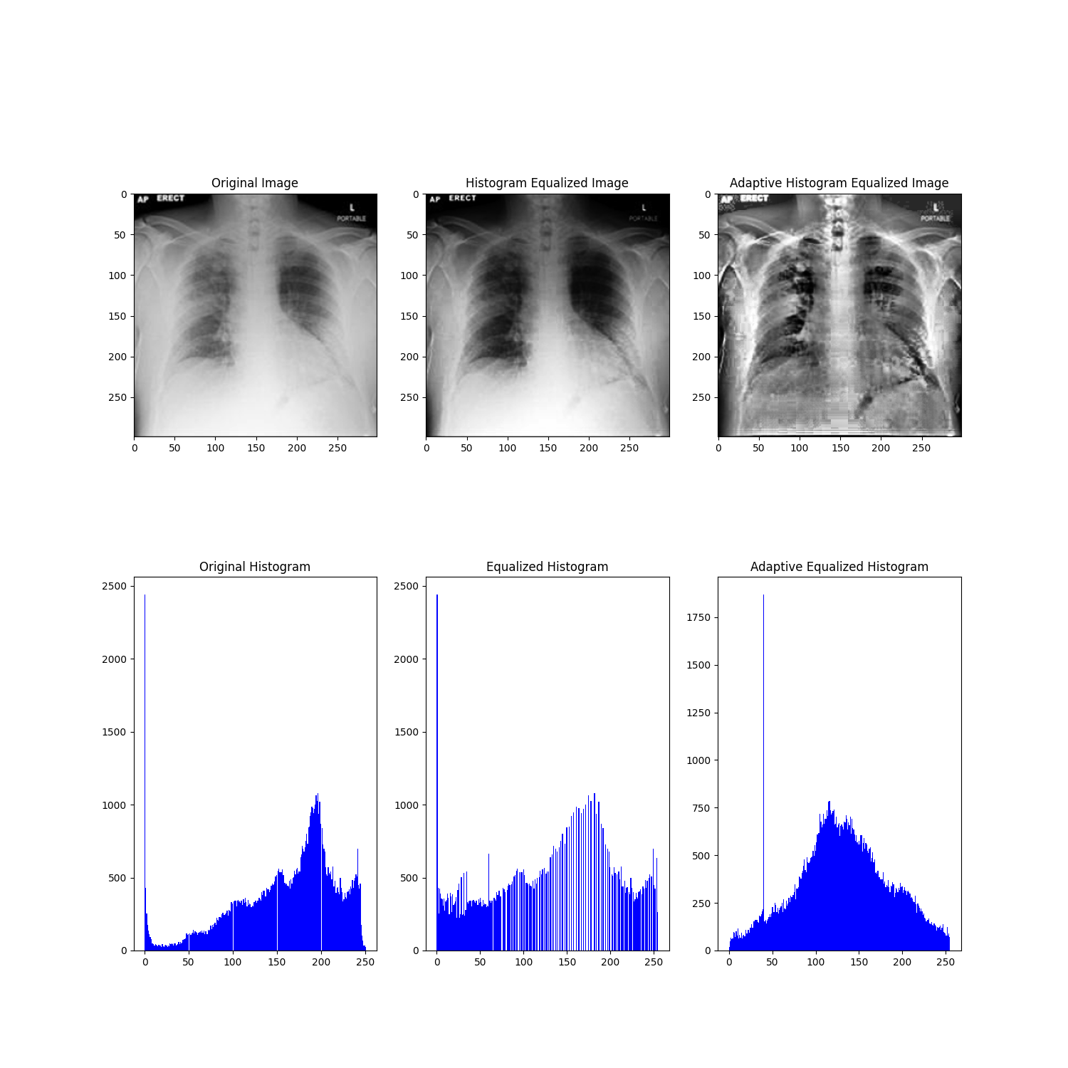
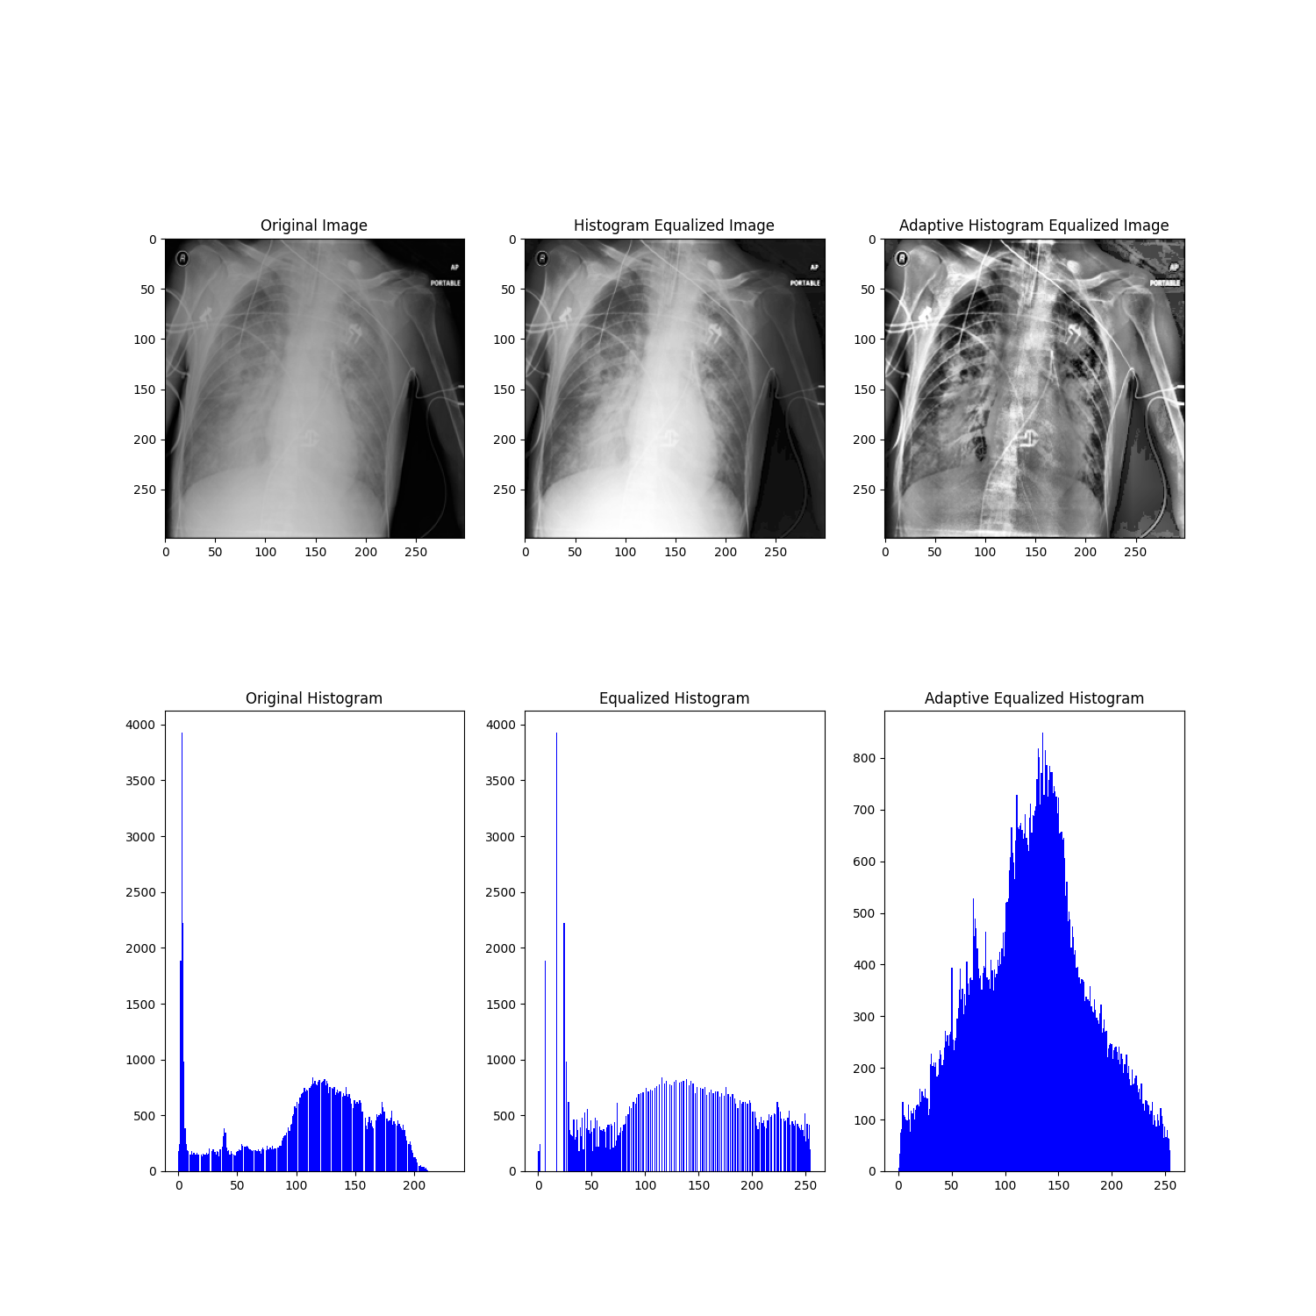
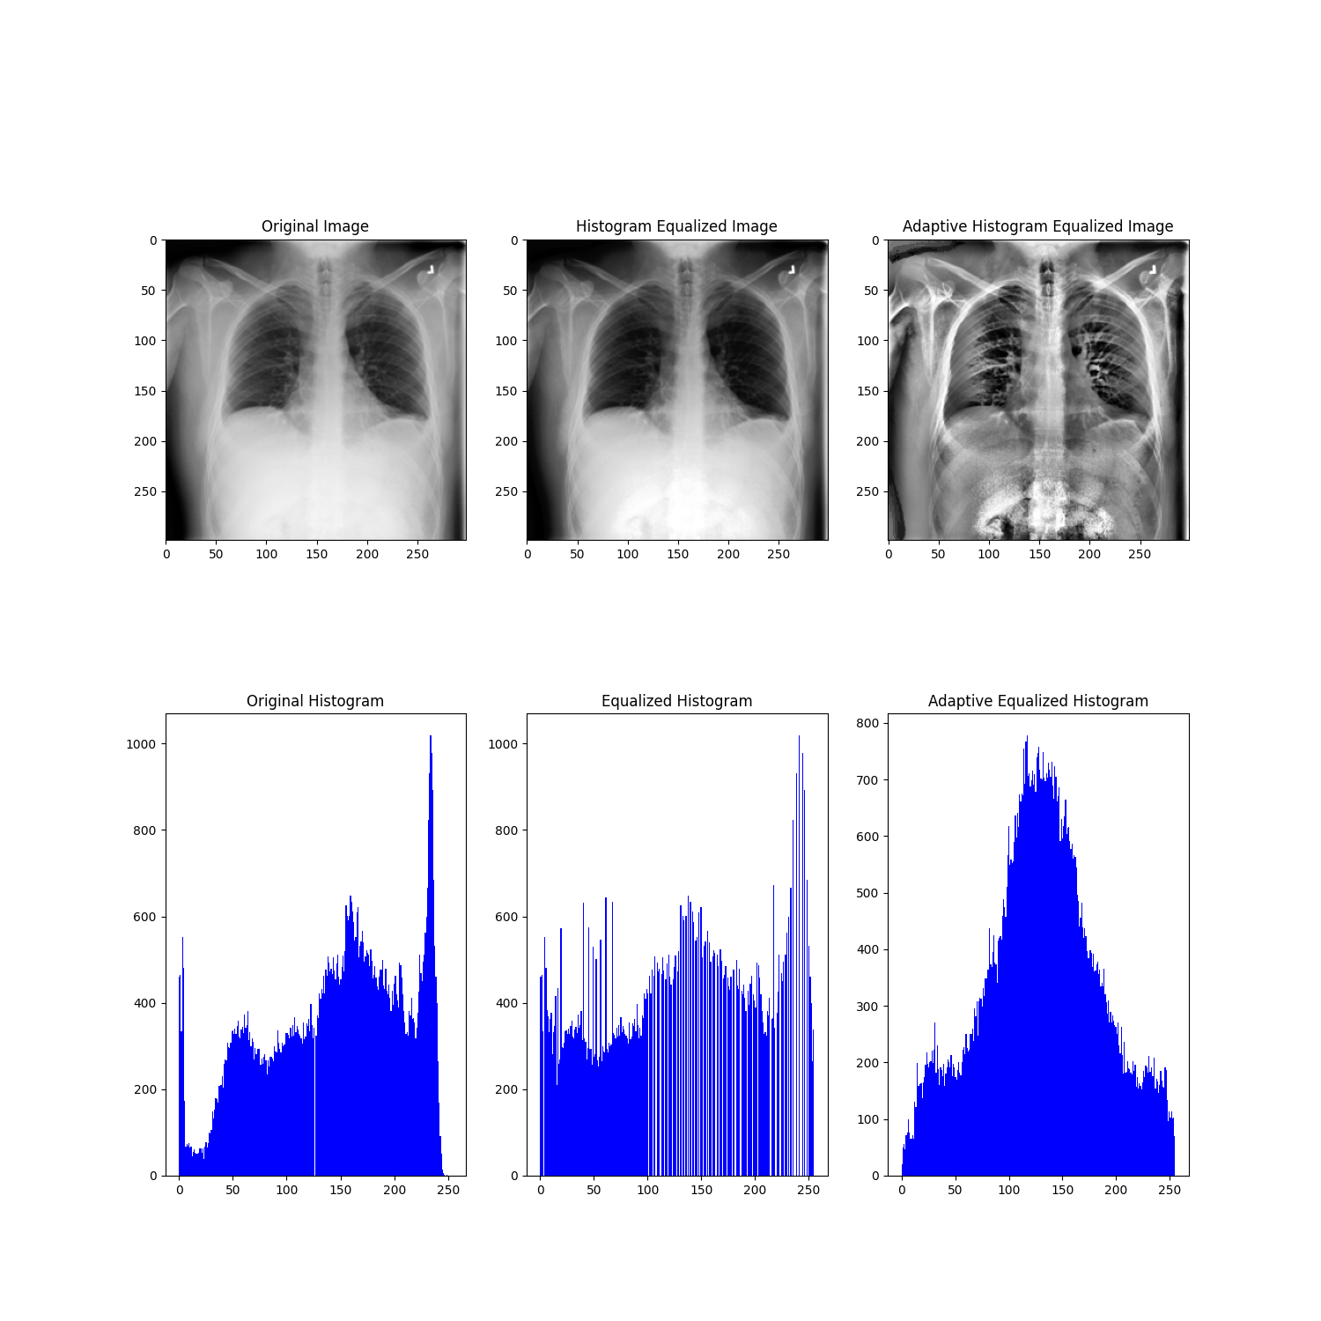
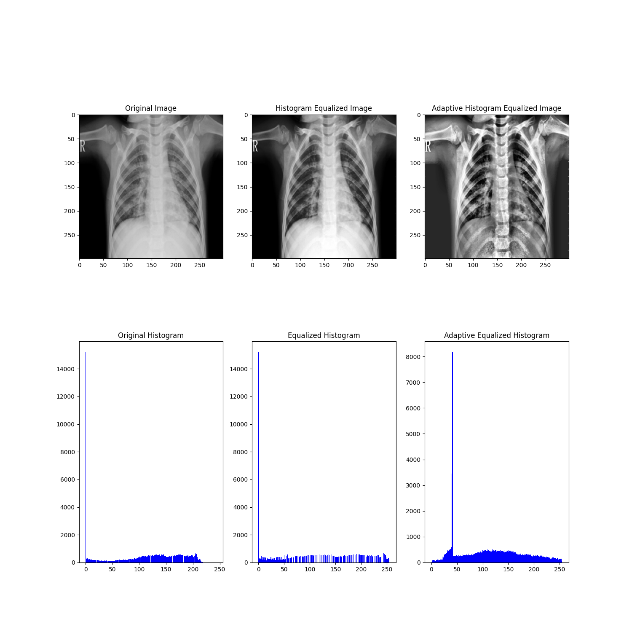
Histogram
COVID
Lung Opacity
Normal
Pneumonia

Slide 17
Haralick features
With some success from histogram, we started thinking using intensity values could possibly lead to good results and whil reasearhing we stumbled upon a paper which had used the same
GCLM ..add figure for explanation (maybe generate them for each class)
haralikc moments (maybe add formulas)
some explanation on them
adding images could be maybe distrac them from formulas(:P)
add refferences
hyperparameters

Slide 18
Zernike Moments
Add reference
ad picture for explanation
add formulas just for reference
hyperparameters

Slide 19
. . .
Bilateral Filtering
last two features are sensitive to noise so we added bilateral in attempt to remove the noise.
add image
some description
Normalization
normalize the features before using with classifier (Standard Scaler)

Slide 20
Phase 2
We mainly worked on three different models/architecture in attempt to see which would be best fit the problem.
All these models were then adapted so that they can handle noisy dataset. Details to follow:

Slide 21
Using Features from Phase 1
we made use of haralick and zerlck features from phase 1 and on top of that, we add a neural network. (blur=yes, distance=1, blur=yes, radius=180, degree=8)
add image here
we tried diffnerent number of laye,rs (1,2,3) ,with different number of neurons (8,16,32,64)
we found this setting produced the best results and stick wth it
Features(38) - Dense(32) - output

Slide 22
CNN
Explanation
Our idea was to train simple CNN that cßuld be used as benchmark
but turned out it was giving good results
weights initializaton
hyperparameter settings
Model:
- Conv1 (kernels=32 size=7, stride=1)-LReLU(0.01)-MaxPool(stride=2, size=2)
- Conv2 (kernels=64 size=5, stride=1)-LReLU(0.01)-MaxPool(stride=2, size=2)
- Conv3 (kernels=128 size=3, stride=1)-LReLU(0.01)-MaxPool(stride=2, size=3)
- Dense(256)-LReLU(0.01)
- Dense(128)-LReLU(0.01)
- Output Layer
trainable parameters= 25850242

Slide 23
Transfer Learning: MobileNet
last layer of the model trained
add description of model
maybe picture
model was initially trained on which dataset, for what reason..details lie that
reference papaer
total parameters: 2228996
trainable: 5124

Slide 24
Transfer learning: ResNet18
trained last layer of the mode
model description
add image
reference papaer
"total_trainable_parameters": 2052,
"total_parameters": 11178564

Slide 25
Transfer Learnig: Resnet50
details of the model
total parameters: 23516228
trainable: 8196

Slide 26
Loss and Optimizer
made use of weighted crossentropy function:
add forumual
weights for each class were calculated as follows:
1- num_of_images/total_num_of_images
Optimzer:
adam (betas = 0.9,0.999, lr =0.001)
Hpyerparameters

Slide 27
Noisy dataset
To handle the noise in dataset, we applied two types of data augmentation:
- online: apply transformation with a probability p while the image is being loaded during trianing.
- offline: generate images using the images given, apply transformation and save them. This increased the size of our dataset (by 50%).
- Original Distribution of classes was not altered during the process
- Images were selected randomly
- transformation were applied in two ways:
- single
- multiple (random number of transformation in random order bur in sequential order)

Slide 28
Data Transfomrations
Included:
Affine
rotated by 90 / -90
horizontal flip
vertical flip
resized crop
add images

Slide 29
Evaluation

Slide 30
methods
Since the dataset had imbalnced classes, we made use of stratified simple split to generate training and validation dataset.
Ratio of classes
binary:
No-COVID:82.9213
COVID:17.0787
multi
COVID: 17:0821
Lung Opacity: 28.4052
Normal: 48.1571
Pneumona: 6.3556
Since we did not have labels for noisy dataset, we generate it using images from training dataset which had size of one fourth of original dataset and were generated separately. they were used for evaluation
Furthermore, although we used number of metrics in pur pipeline but here we will only be showing balanced accuray (or maybe somewhere confusion matrix)

Slide 31
Phase 1 Results and Conclusion
Table1: Col= Features, row: valid score
Table2: Col: different classifiers, row: valid score (effect of different classifiers)
Table 3: Col: different hyperparameters, row:valid score (effect of hyperparameters)
For both binary and multi clasifciaiton
Result got even better when used the complete dataset
Confusion matrix?

Slide 32
best results
 | Basic Extractors |  | Histogram |  | Haralick |  | Zernik |  | Haralick and Zernik features* |  | All
 | Binary | Multi | Binary | Multi | Binary | Multi | Binary | Multi | Binary | Multi | Binary | Mulit
Valid Balanaced accuray | 0.6303 | 0.4242 | 0.8361 | 0.7306 | 0.8170 | 0.685 | 0.721 | 0.741 | 0.8803 | 0.8201 | 0.8438 | 0.734
*These results got further improved when we used complete dataset to train the model

Slide 33
Hyperparameters and their balanced accuracy (NEED TO FIND PATTERNS AND KEEP ONLY THPSE VALEUES
No. | Input shape | Haralick |  | Zernike |  |  | validation balanced accuracy
 |  | blur | distance | blur | radius | degree | binary | multi
1 | same as original | no | 10 | no | 140 | 8 | 0.8599 | 0.809
2 | 250,250 | yes | 10 | yes | 140 | 8 | 0.8601 | 0.8151
3 | same as original | yes | 10 | yes | 140 | 8 | 0.8508 | 0.7950
4 | same as original | yes | 10 | yes | 140 | 10 | 0.8532 | 0.7864
5 | same as original | yes | 10 | yes | 140 | 20 | 0.745 | 0.7746
3 | 250,250 | yes | 1 | yes | 140 | 8 | 0.8724 | 0.8201
4 | same as original | yes | 1 | yes | 140 | 4 | 0.8426 | 0.7996
5 | same as original | yes | 1 | yes | 180 | 8 | 0.8803 | 0.8144
6 | same as original | yes | 5 | yes | 180 | 7 | 0.8508 | 0.8289
7 | same as original | yes | 10 | yes | 180 | 4 | 0.8122 | 0.7993
8 | same as original | yes | 50 | yes | 180 | 8 | 0.8416 | 0.8015
9 | 100,100 | yes | 10 | yes | 140 | 8 | 0.7945 | 0.7824
10 | 100,100 | yes | 10 | yes | 50 | 8 | 0.8326 | 0.7874
11 | 200,200 | yes | 10 | yes | 140 | 8 | 0.846 | 0.8092
12 | 200,200 | yes | 10 | yes | 80 | 8 | 0.8280 | 0.7868

Slide 34
With Haralik (blur and distance=1) and zernike (blur, radius=180 and degree =8), input shape same as original image, the balanced accuracy comparison between classifers
 |  | Binary | Multi
SVM | C_SVC, RBF, hyperparameters were found using kfolds | 0.8803 | 0.8144
RFT | MaxDepth=20 | 0.7517 | 0.7491
Boosting | Number of weak classifiers = 10, MaxDepth=20 | 0.7114 | 0.704

Slide 35
Phase 2 Results nad Conclusion
Table: col:simple, valid and noisy test
rows: models score
for binary and multi

Slide 36
Validation
 | Without Augmentation |  | Online Augmentation |  | Offline Augmentation
 | Binary | Multi | Binary | Multi | Binary | Multi
NN | 0.9084 | 0.8253 | 0.84 | 0.78 | 0.87 | 0.811
CNN | 0.9275 | 0.8708 | 0.7944 | 0.4506 | 0.8787 | 0.8536
MobileNet | 0.9292 | 0.8892 | 0.8294 | 0.7782 | 0.9067 | 0.8759
ResNet18 | 0.891 | 0.8534 | 0.79 | 0.76 | 0.8587 | 0.8321
ResNet50 | 0.9184 | 0.8794 | 0.8521 | 0.8195 | 0.9022 | 0.8653
Noisy dataset
 | Binary | Multi
NN | 0.8110 | 0.7880
CNN | 0.8439 | 0.7482
ResNet50 | 0.8107 | 0.7618

Slide 37
Maybe learning curves and confusion matrix and images confusion matrix
For online augmentation, we believe, we needed large number of epochs since transformation were random.

Slide 39
Discusiion

Slide 40
Technical aspects (maybe)
maybe talk about how model was finding it hard to differentiate between normal and lung opacity in phase 1
maybe talk about models could be trained for large epochs (especially for online data augmentation)
train even more number of layers
not so goid results for noisy dataset..

Slide 41
organizational aspects (amybe)
2 members left in the middle of the project
too much workload.
Only one member with prior experience in programming and ML.
some other thing?
WOW: I LEFT OUT SO MUCH YET THERE ARE STILL 34 INCOMPLETE SLIDES. JUST COMPLETEING THESE SLIDES MAY PUSH OVER 40-45 AND POSSIBLY LEADING TO 40 MINS PRESENTATIION YAY! KILL ME!

