Slide 1
Lung Diseases Classification using ML and DL
Group 7:
Ahmad Nadeem Saigol
Joel Romero

Slide 2

Introduction
Objective
Motivation
Phase 1
Data Preprocessing
Feature Extraction
Classifiers
Phase 2
Data Preprocessing
Arquitecture
Evaluation Metrics
Results
Phase 1
Phase 2
Insights & Discussion

Slide 3
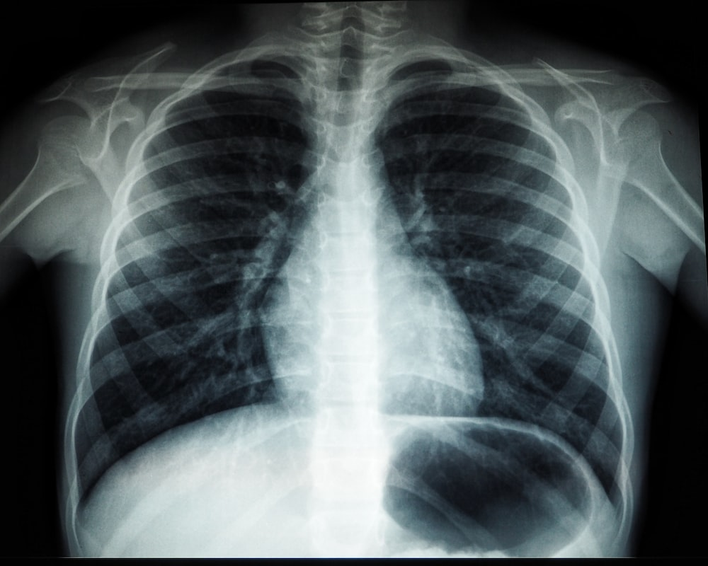
Objective
Classify X Ray Images of patients who may or not be affected by a respiratory disease.
Phase 1: Machine learning
Phase 2: Deep learning

Slide 4
Objective
Binary Classification: COVID, NON-COVID
Multiclass Classification:
Normal
Covid
Pneumonia
Lung Opacity

Slide 5
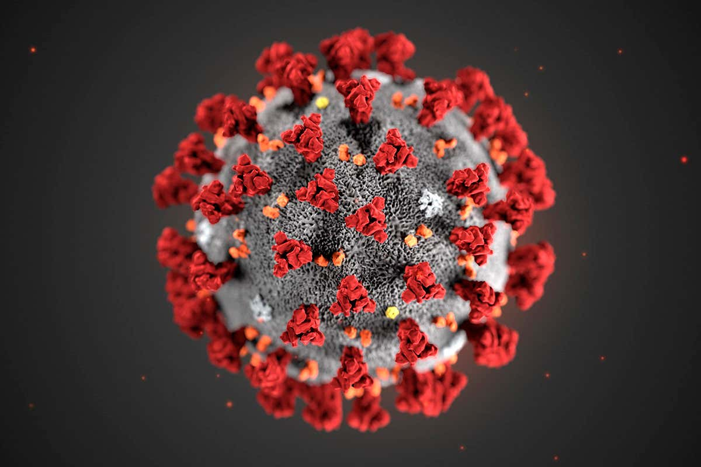
Motivation
Due to recent worldwide COVID-19 outbreak, diagnosis and appropriate treatment methods are required.
First diagnosis and medications are important to prevent the disease from progressing.[1]
[1] COVID-19 detection using X-ray images and statistical measurements, Emre AVUÇLU

Slide 6


Phase 1: Data Preprocessing
Data Splitting (Stratified)
Resize
Normalization
Bilateral Filter: Weighted average of intensity values from nearby pixels. [2]
[2] Bilateral Filter. https://en.wikipedia.org/wiki/Bilateral_filter

Slide 7
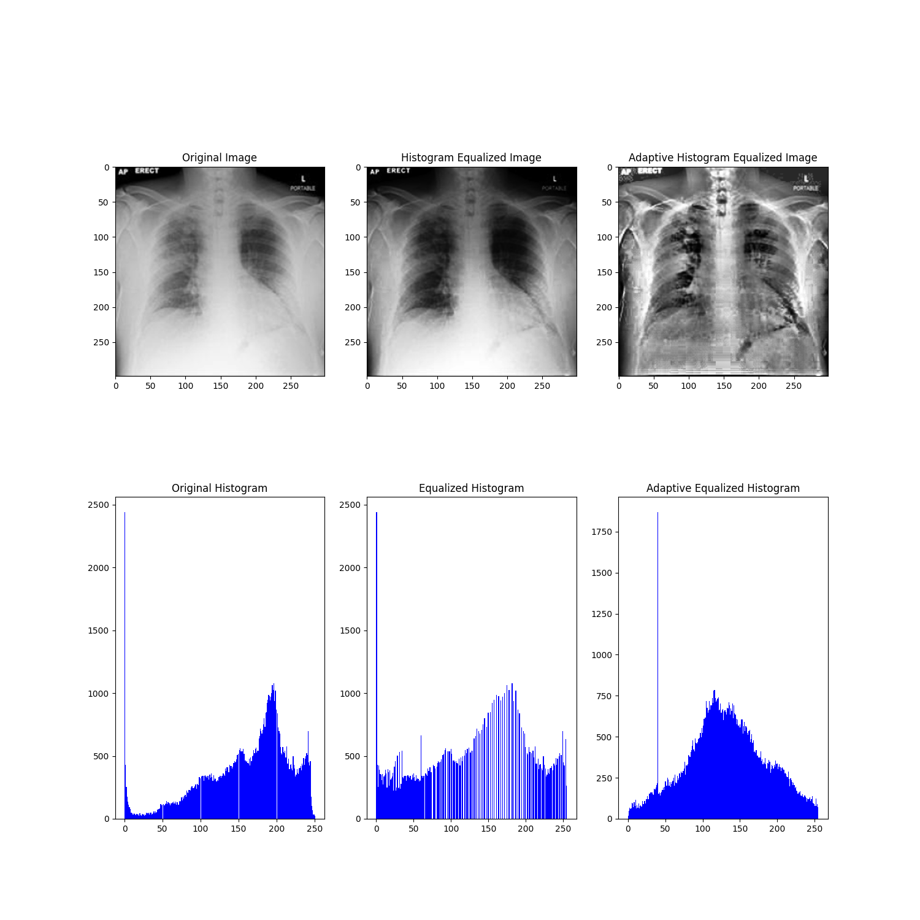
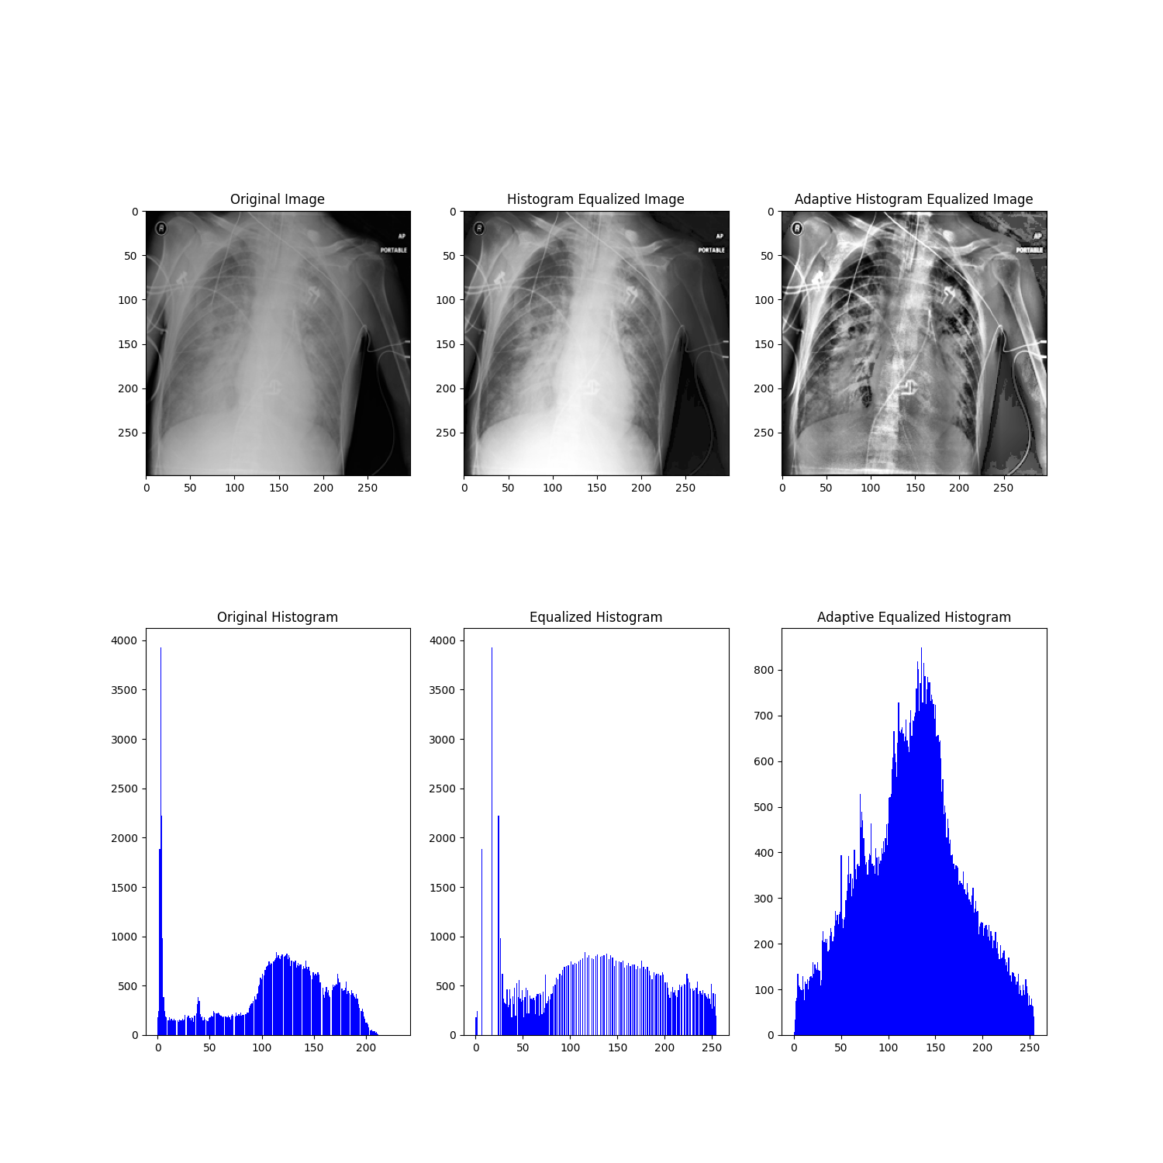
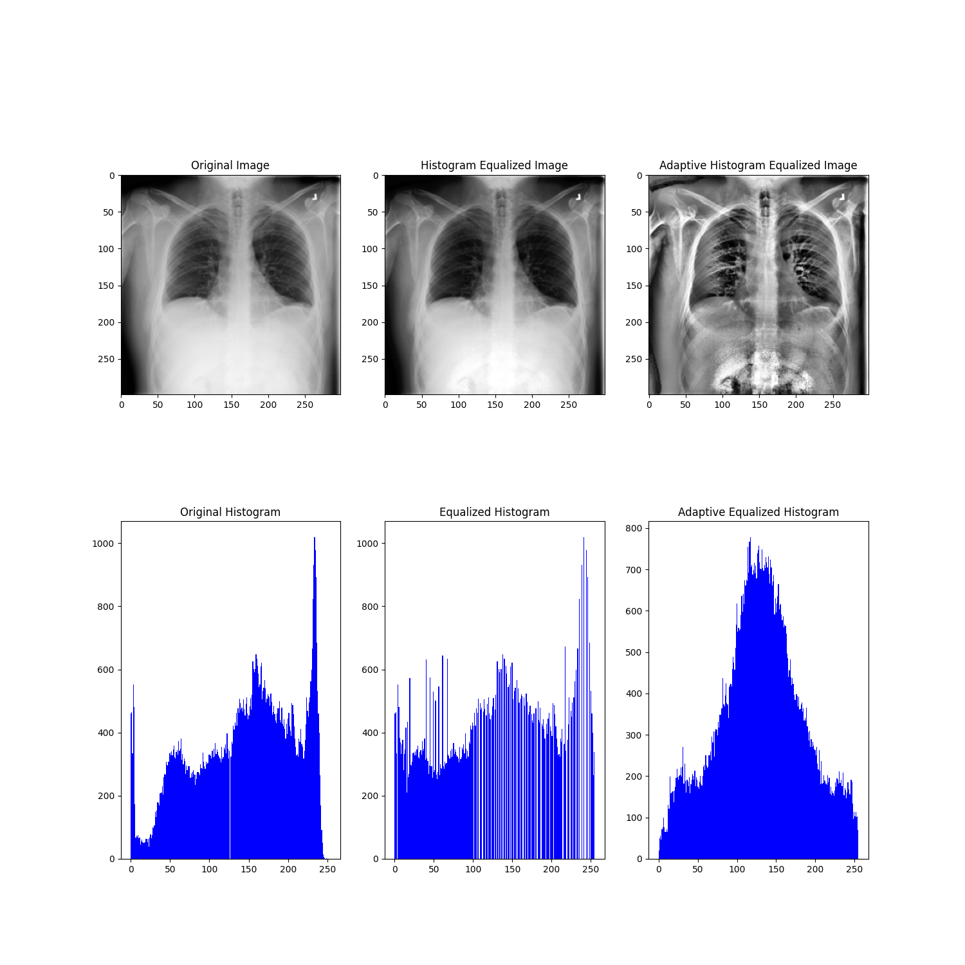
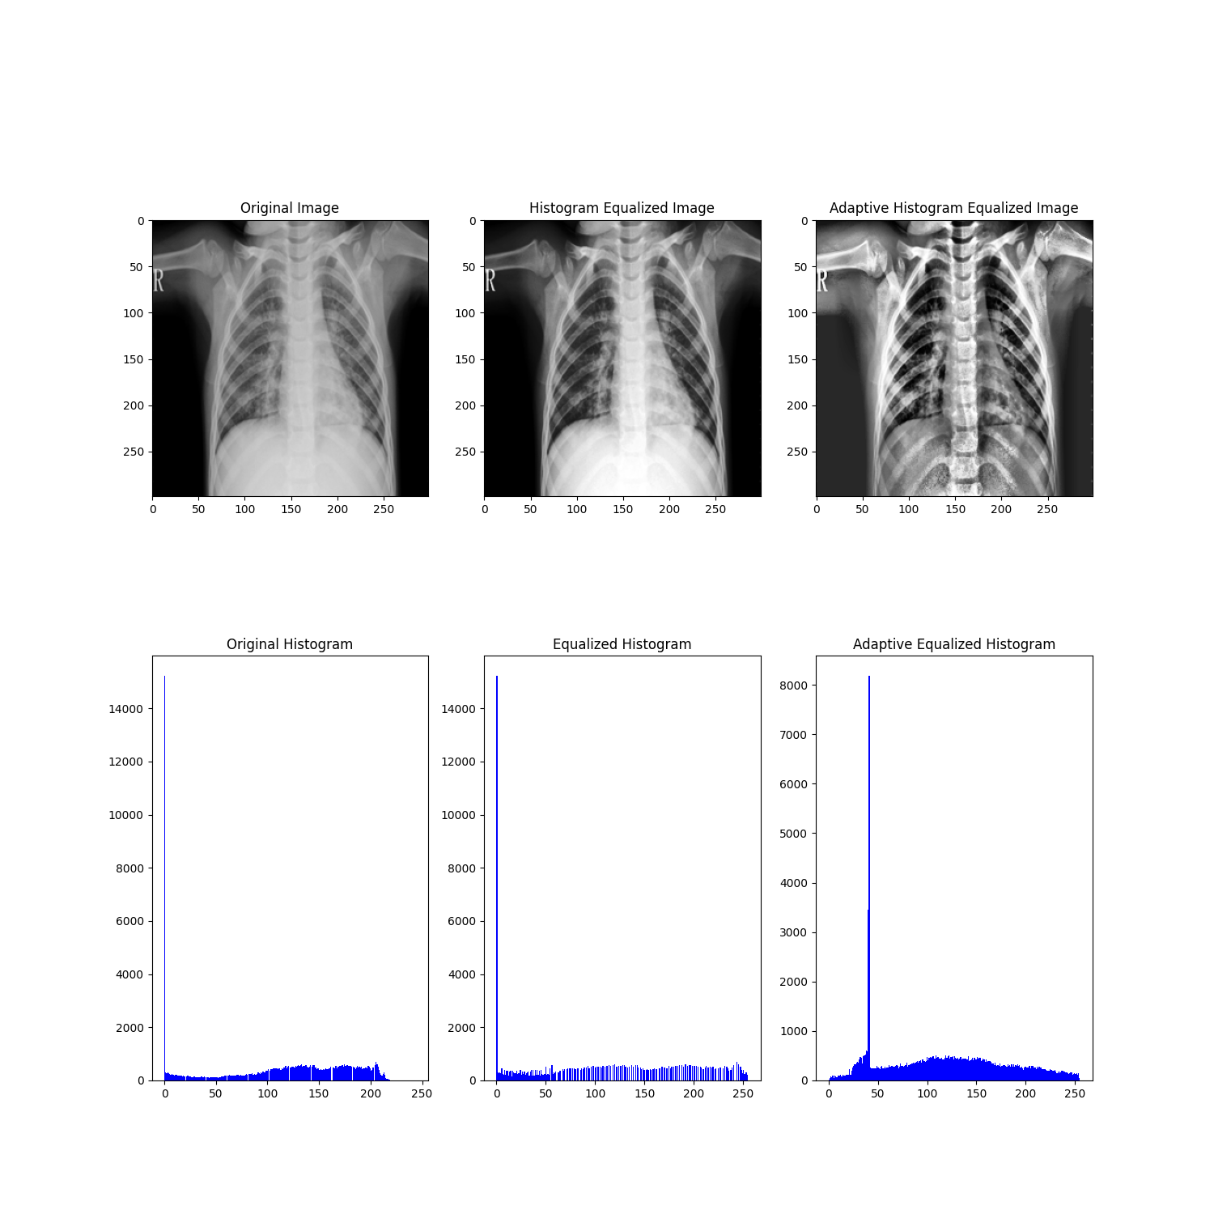
Phase 1: Feature Extraction
Different features tested:
Histogram
COVID
Lung Opacity
Normal
Pneumonia

Slide 8



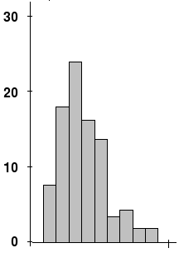
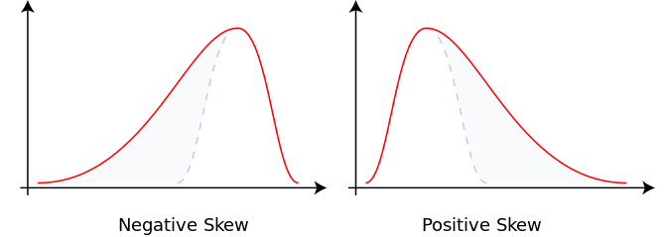
Phase 1: Feature Extraction
Contrast (Michelson, RMS)
Skewness: Measure of the asymmetry of distribution

Slide 9
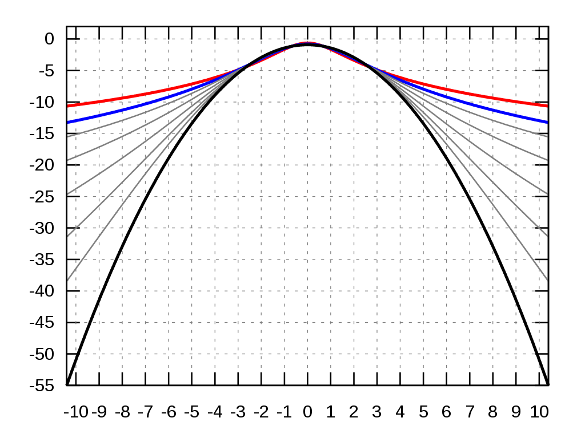
Phase 1: Feature Extraction
Kurtosis: Measure of the “taildness” of a distribution

Slide 10
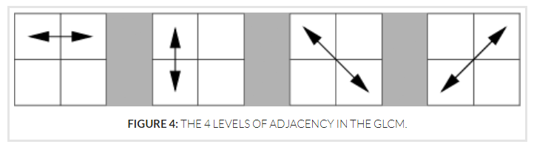
Phase 1: Feature Extraction
Haralick: Used to describe the “texture” of an image
Derived from the Gray Level Co-occurrence Matrix (GLCM), that records how many times two gray-level pixels adjacent to each other appear [2]
[2] Haralick texture. https://cvexplained.wordpress.com/2020/07/22/10-6-haralick-texture/

Slide 11
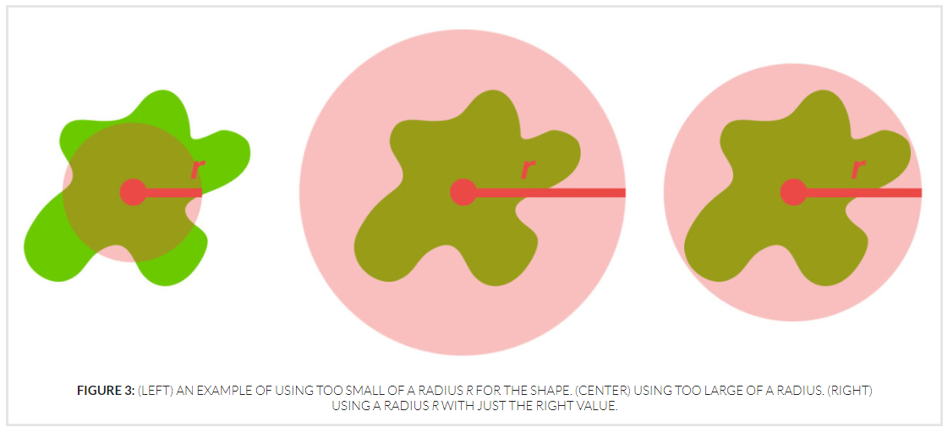
Phase 1: Feature Extraction
Zernike: Zernike Moments characterize and quantify the shape of an object.
To compute we specify radius of the disc and the degree of the polynomial.
[3] Zernike Moments. https://cvexplained.wordpress.com/2020/07/21/10-5-zernike-moments/

Slide 12
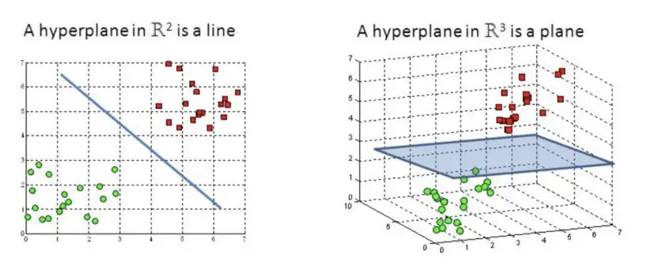
Phase 1: Classifiers
SVM: Support Vector Machine
Find a hyperplane in an N-dimensional space(N — the number of features) that distinctly classifies data points [4]
[4] SVM https://towardsdatascience.com/support-vector-machine-introduction-to-machine-learning-algorithms-934a444fca47

Slide 13
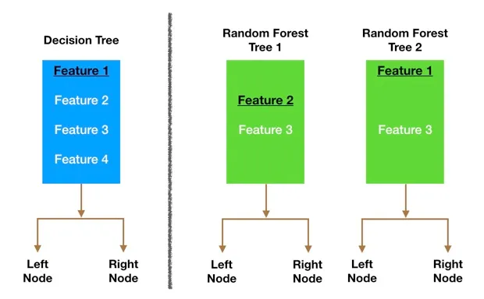
Phase 1: Classifiers
RFT: Random Forest Trees
Large number of individual decision trees that operate as an ensemble [5]
[5] RFT https://towardsdatascience.com/understanding-random-forest-58381e0602d2

Slide 14
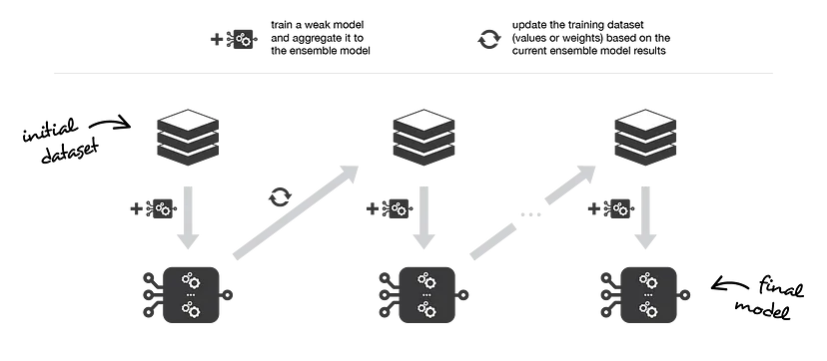
Phase 1: Classifiers
Ensemble learning: multiple models (often called “weak learners”) trained to solve same problem
Boosting, combines them to achieve smaller bias [6]
[6] Ensemble learning. https://towardsdatascience.com/ensemble-methods-bagging-boosting-and-stacking-c9214a10a205

Slide 15
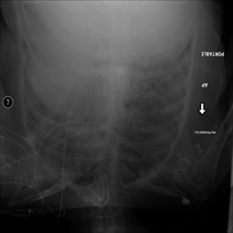
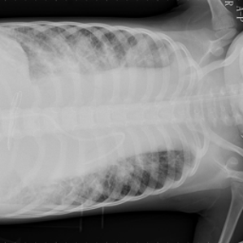
Phase 2: Data Proprocessing
Noisy data set analysis
Augmentation - Minor alterations to dataset: contrast, sharpness, crops, rotations
Two approaches: On the run and Offline Augmentation

Slide 16
Phase 2: Architecture
Tested approaches:
Neuronal Network as a Classifier for Phase 1 extracted features.
Simple CNN as feature extractor and classifier.
CNN - Transfer Learning:
MobileNet_V2
Resnet50

Slide 17
Phase 2: Evaluation metrics
Simply Accuracy
Balanced Accuracy
Precision
Sensitivity
F1 score
MCC - Matthews Correlation Coefficient

Slide 18
Loss and Optimizer
weighted cross entropy loss:
weights for each class were calculated as follows:
1- num_of_images/total_num_of_images
Optimizer:
adam (betas = 0.9,0.999, lr =0.001)

Slide 19
Phase 1 Results

Slide 20
Comparison between different features
Features | Settings |  | Validation Balanced Accuracy
Basic Extractors |  | Binary | 0.6303
 |  | Multi | 0.4242
Histogram | 256 bins | Binary | 0.8361
 |  | Multi | 0.7306
Haralick | blur, distance=10 | Binary | 0.8170
 |  | Multi | 0.685
Zernike | blur, radius=180, degree=8 | Binary | 0.721
 |  | Multi | 0.741
Haralick and Zerike* | blur, distance=1, radius=180, degree=8 | Binary | 0.8803
 | blur, distance=1, radius=140, degree=8 | Multi | 0.8201
All |  | Binary | 0.8438
 |  | Multi | 0.734
*These results got further improved when we used complete dataset to train the model

Slide 21
Hyperparameters Study
Effect of blur:
Setup:
Input Shape: same as original
Haralick: distance = 10
Zernike: radius=140
degree = 8
Effect of distance:
Setup:
Input Shape: same as original
blur: yes
Zernike: radius=180
degree = 8
Blur | binary | multi
yes | 0.8601 | 0.8151
no | 0.8599 | 0.809
Distance | binary | multi
1 | 0.8803 | 0.8144
5 | 0.8508 | 0.82
10 | 0.8122 | 0.7993
Effect of degree:
Setup:
Input Shape: same as original
blur: yes
Haralick: distance=10
Zernike: radius=140
degree | binary | multi
8 | 0.8508 | 0.7950
10 | 0.8532 | 0.7864
20 | 0.745 | 0.7746

Slide 22
Comparison between Classifiers
Setup:
Input shape same as original image
blur: yes
Haralik:
distance=1
Zernike:
radius=180
degree =8,
Classifiers | Settings | Binary | Multi
SVM | C_SVC, RBF, hyperparameters were found using kfolds | 0.8803 | 0.8144
RFT | MaxDepth=20 | 0.7517 | 0.7491
Boosting | Number of weak classifiers = 10, MaxDepth=20 | 0.7114 | 0.704

Slide 23
Few remarks
It may be good idea to see which images are being mislabelled and try to optimize the model further.

Slide 24
Phase 2 Results

Slide 25
Validation
Models | Without Augmentation |  | Online Augmentation |  | Offline Augmentation
 | Binary | Multi | Binary | Multi | Binary | Multi
NN | 0.9084 | 0.8253 | 0.84 | 0.78 | 0.87 | 0.811
CNN | 0.9275 | 0.8708 | 0.7944 | 0.4506 | 0.8787 | 0.8536
MobileNet | 0.9292 | 0.8892 | 0.8294 | 0.7782 | 0.9067 | 0.8759
ResNet18 | 0.891 | 0.8534 | 0.79 | 0.76 | 0.8587 | 0.8321
ResNet50 | 0.9184 | 0.8794 | 0.8521 | 0.8195 | 0.9022 | 0.8653
Noisy dataset
Models | Binary | Multi
NN | 0.8110 | 0.7880
CNN | 0.8439 | 0.7482
ResNet50 | 0.8107 | 0.7618

Slide 26
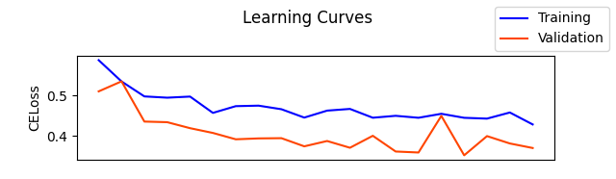
Few remarks
With online data augmentation → large number of epochs
e.g. for ResNet50
train more layers for pretrained models.
especially for handling noise in dataset

Slide 27
Discussion

