Slide 1
Lung Diseases Classification using ML and DL
Group 7:
Ahmad Nadeem Saigol
Joel Romero

Slide 2

Introduction
Objective
Motivation
Phase 1
Data Preprocessing
Feature Extraction
Classifiers
Phase 2
Data Preprocessing
Arquitecture
Evaluation Metrics
Results
Phase 1
Phase 2
Insights & Discussion

Slide 3
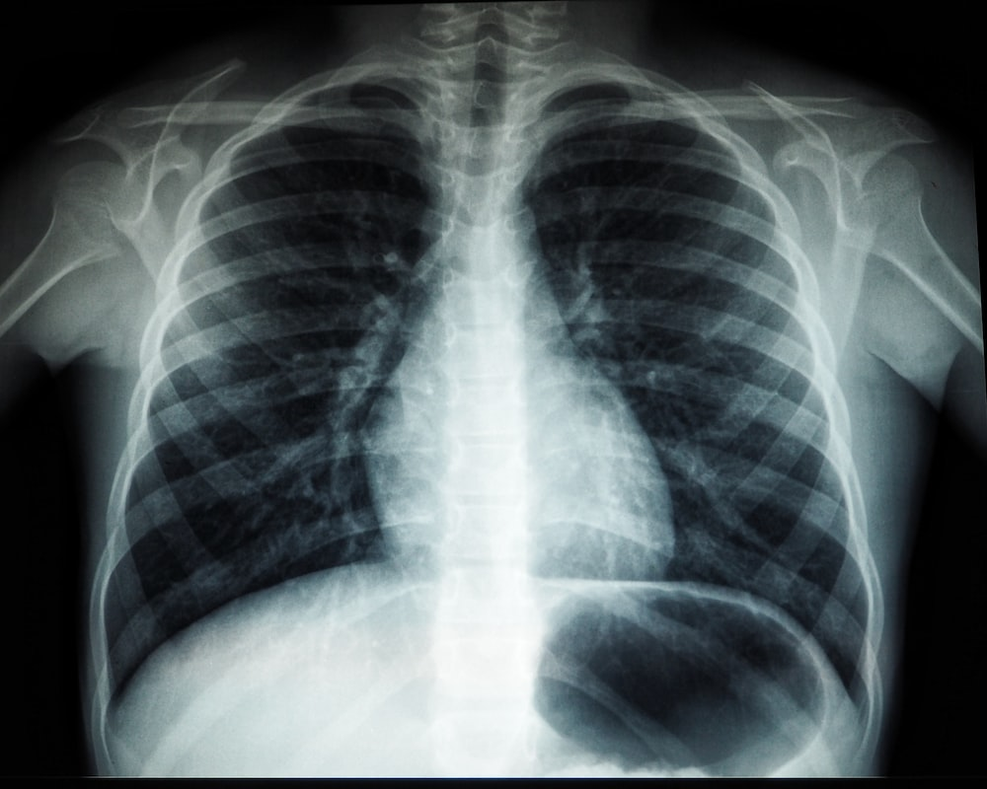
Objective
Classify X Ray Images of patients who may or not be affected by a respiratory disease.
Phase 1: Machine learning
Phase 2: Deep learning

Slide 4
Objective
Binary Classification: COVID, NON-COVID
Multiclass Classification:
Normal
Covid
Pneumonia
Lung Opacity

Slide 5
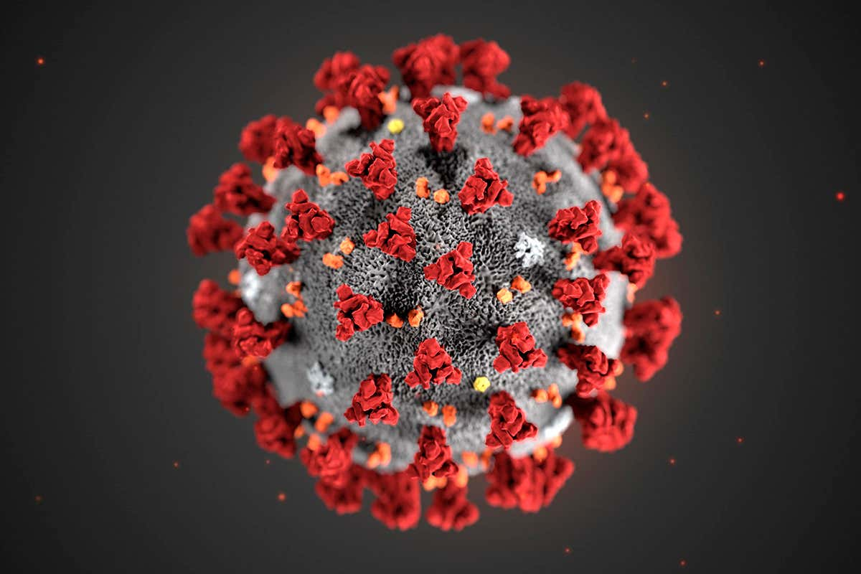
Motivation
Due to recent worldwide COVID-19 outbreak, diagnosis and appropriate treatment methods are required.
First diagnosis and medications are important to prevent the disease from progressing.[1]
[1] COVID-19 detection using X-ray images and statistical measurements, Emre AVUÇLU

Slide 6


Phase 1: Data Preprocessing
Data Splitting (Stratified)
Resize
Normalization
Bilateral Filter: Weighted average of intensity values from nearby pixels. [2]
[2] Bilateral Filter. https://en.wikipedia.org/wiki/Bilateral_filter

Slide 7
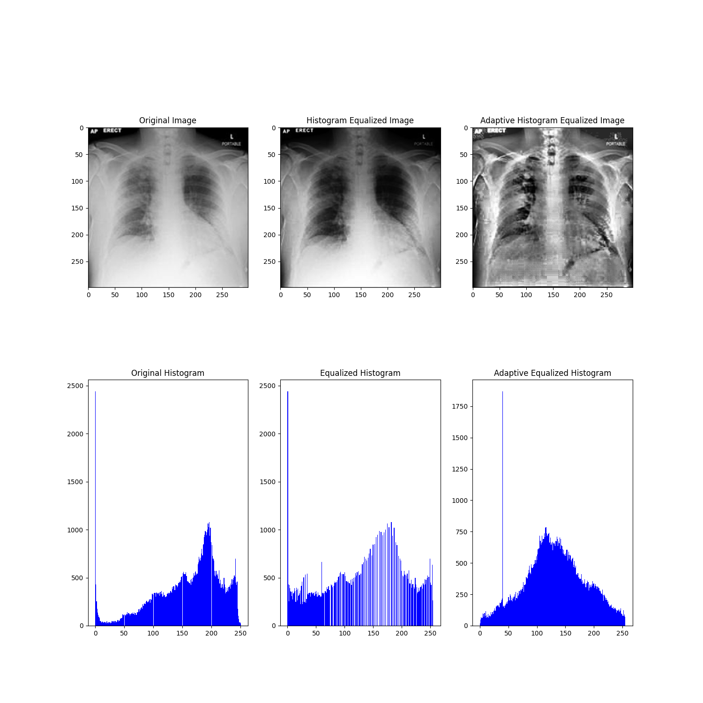
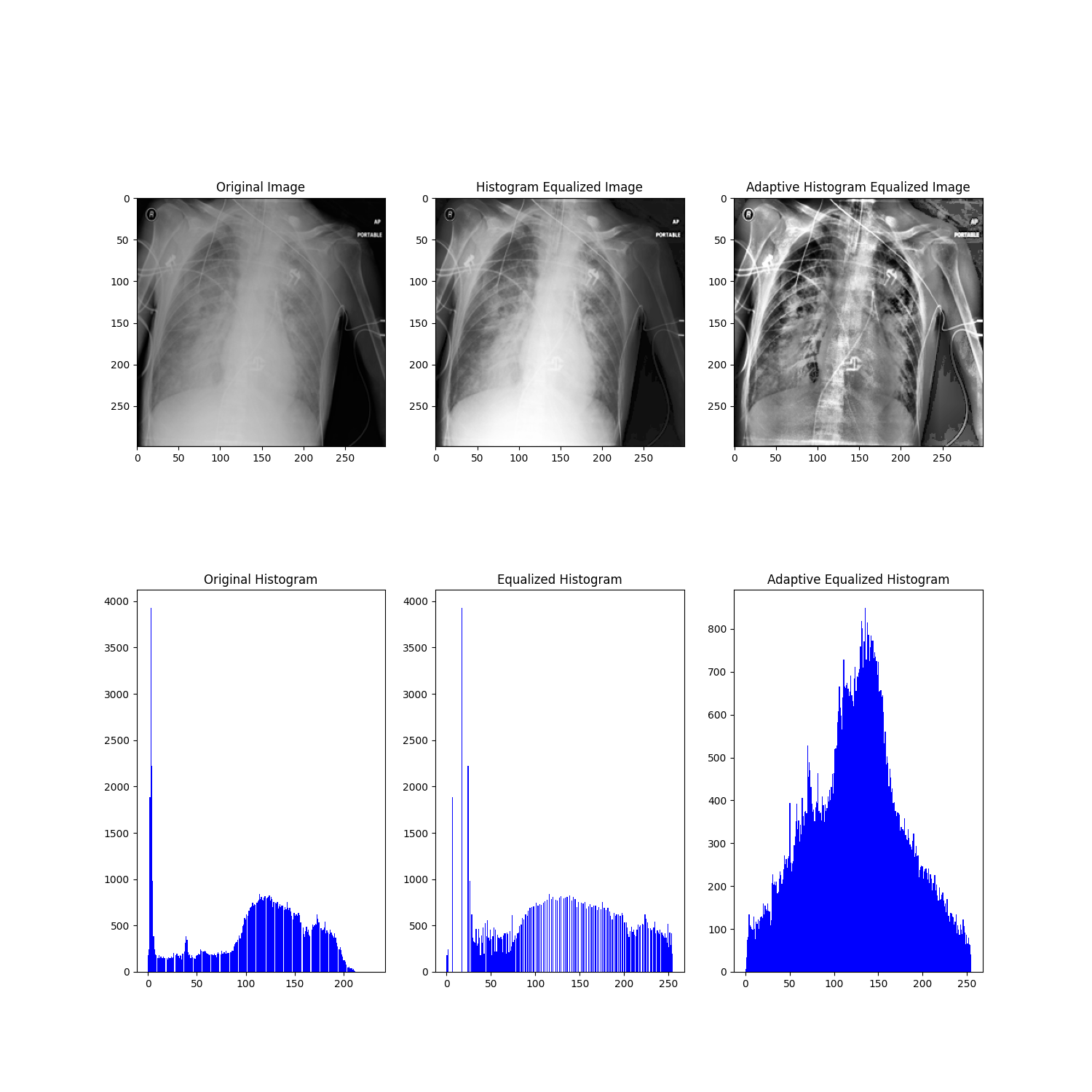
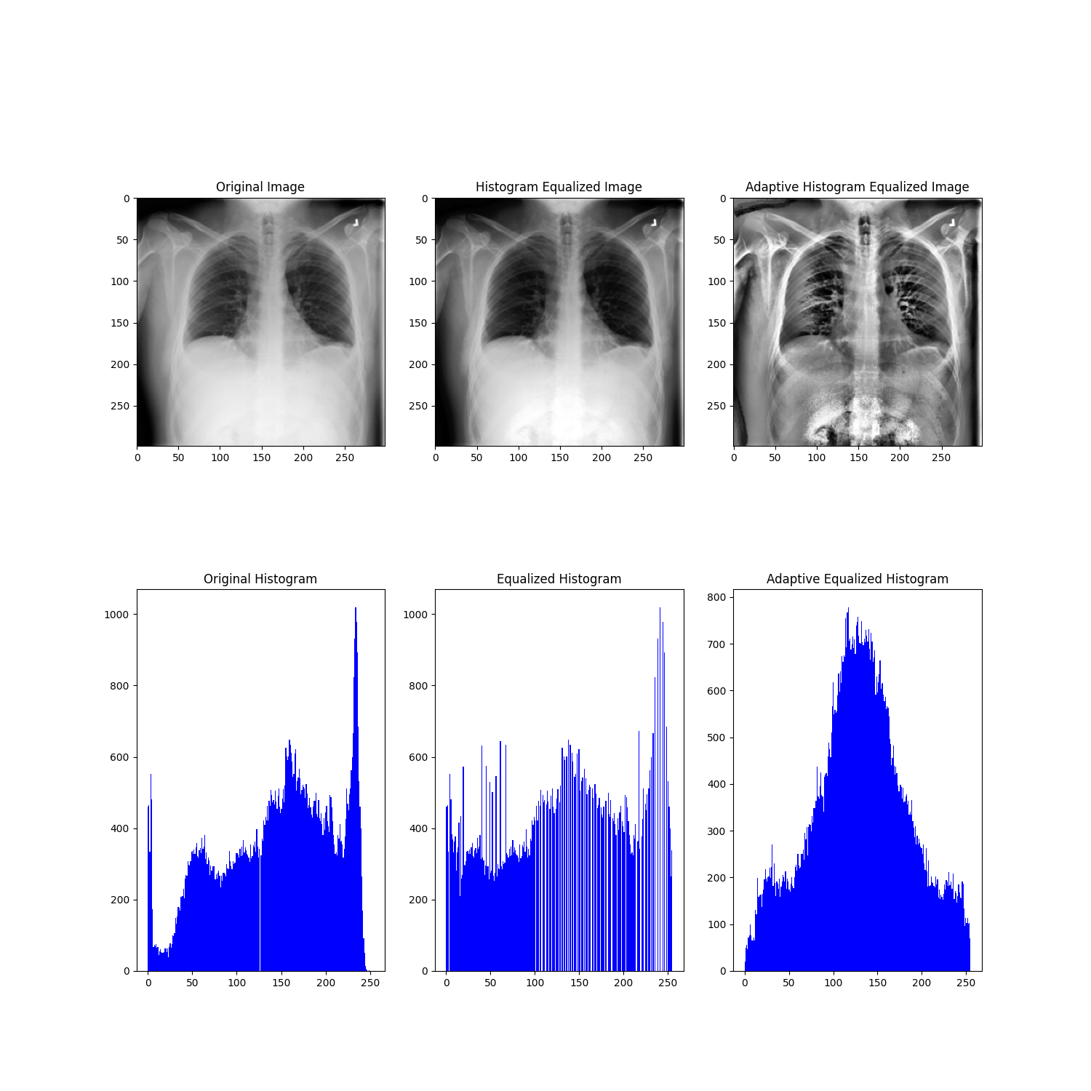
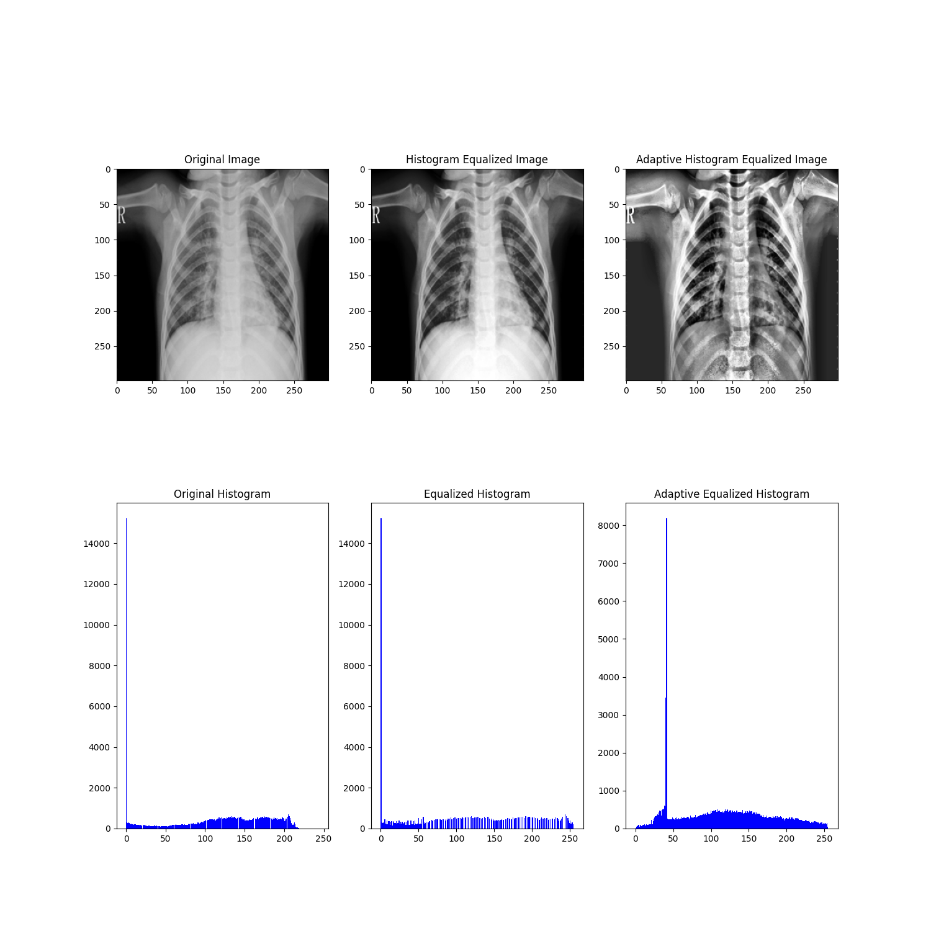
Phase 1: Feature Extraction
Different features tested:
Histogram
COVID
Lung Opacity
Normal
Pneumonia

Slide 8



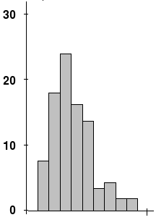
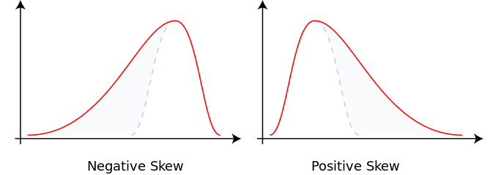
Phase 1: Feature Extraction
Contrast (Michelson, RMS)
Skewness: Measure of the asymmetry of distribution

Slide 9
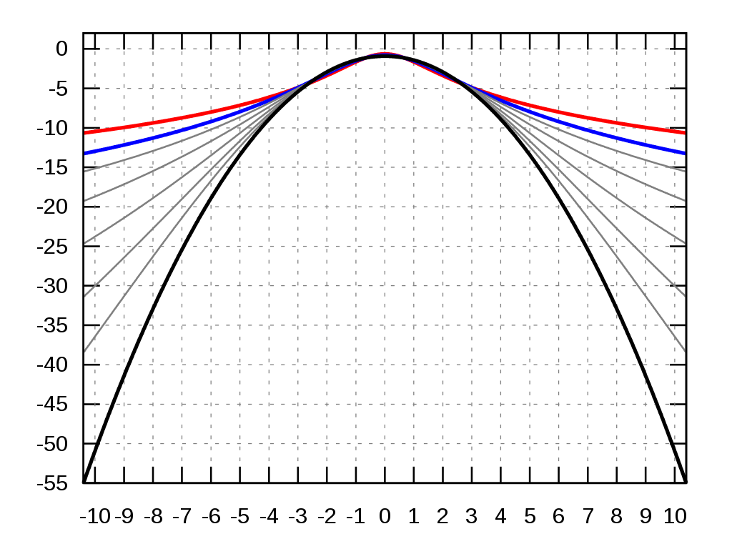
Phase 1: Feature Extraction
Kurtosis: Measure of the “taildness” of a distribution

Slide 10
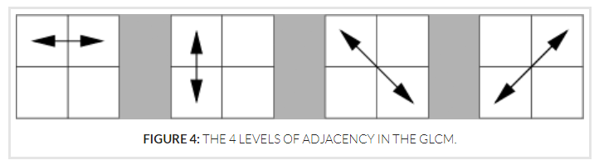
Phase 1: Feature Extraction
Haralick: Used to describe the “texture” of an image
Derived from the Gray Level Co-occurrence Matrix (GLCM), that records how many times two gray-level pixels adjacent to each other appear [2]
[2] Haralick texture. https://cvexplained.wordpress.com/2020/07/22/10-6-haralick-texture/

Slide 11
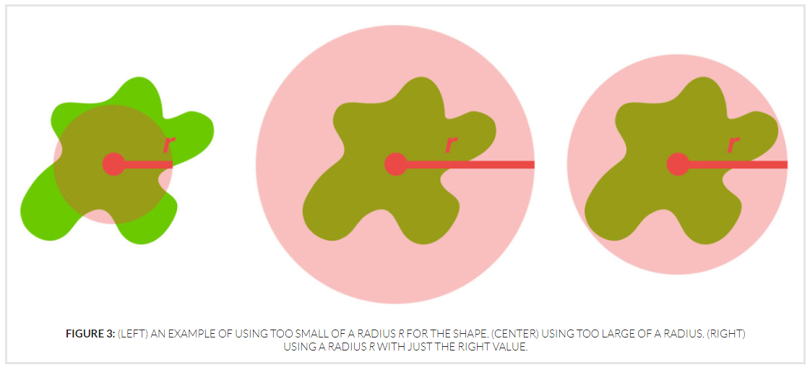
Phase 1: Feature Extraction
Zernike: Zernike Moments characterize and quantify the shape of an object.
To compute we specify radius of the disc and the degree of the polynomial.
[3] Zernike Moments. https://cvexplained.wordpress.com/2020/07/21/10-5-zernike-moments/

Slide 12
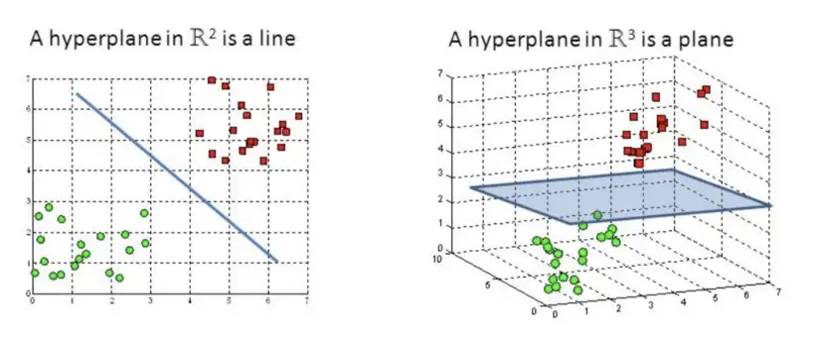
Phase 1: Classifiers
SVM: Support Vector Machine
Find a hyperplane in an N-dimensional space(N — the number of features) that distinctly classifies data points [4]
[4] SVM https://towardsdatascience.com/support-vector-machine-introduction-to-machine-learning-algorithms-934a444fca47

Slide 13
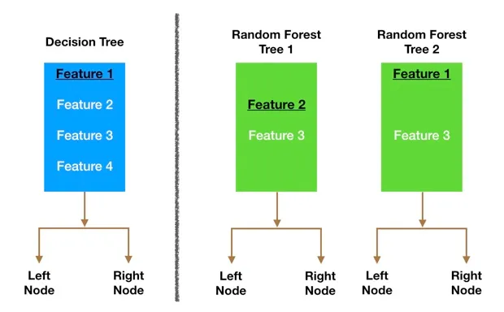
Phase 1: Classifiers
RFT: Random Forest Trees
Large number of individual decision trees that operate as an ensemble [5]
[5] RFT https://towardsdatascience.com/understanding-random-forest-58381e0602d2

Slide 14
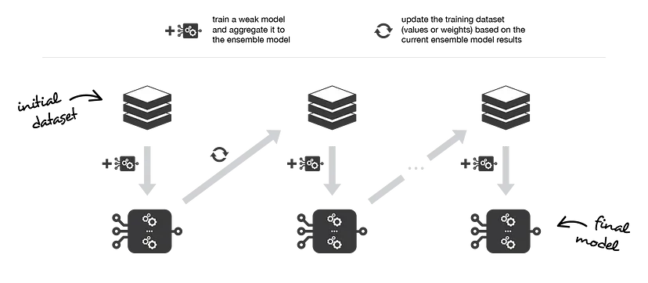
Phase 1: Classifiers
Ensemble learning: multiple models (often called “weak learners”) trained to solve same problem
Boosting, combines them to achieve smaller bias [6]
[6] Ensemble learning. https://towardsdatascience.com/ensemble-methods-bagging-boosting-and-stacking-c9214a10a205

Slide 15
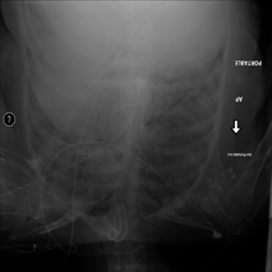
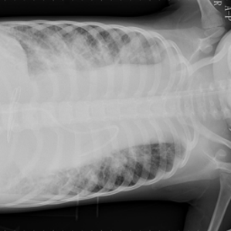
Phase 2: Data Proprocessing
Noisy data set analysis
Augmentation - Minor alterations to dataset: contrast, sharpness, crops, rotations
Two approaches: On the run and Offline Augmentation

Slide 16
Phase 2: Architecture
Tested approaches:
Neuronal Network as a Classifier for Phase 1 extracted features.
Simple CNN as feature extractor and classifier.
CNN - Transfer Learning:
MobileNet_V2
Resnet50

Slide 17
Phase 2: Evaluation metrics
Simply Accuracy
Balanced Accuracy
Precision
Sensitivity
F1 score
MCC - Matthews Correlation Coefficient

Slide 18
CNN
Explanation
Our idea was to train simple CNN that cßuld be used as benchmark
but turned out it was giving good results
weights initializaton
hyperparameter settings
Model:
- Conv1 (kernels=32 size=7, stride=1)-LReLU(0.01)-MaxPool(stride=2, size=2)
- Conv2 (kernels=64 size=5, stride=1)-LReLU(0.01)-MaxPool(stride=2, size=2)
- Conv3 (kernels=128 size=3, stride=1)-LReLU(0.01)-MaxPool(stride=2, size=3)
- Dense(256)-LReLU(0.01)
- Dense(128)-LReLU(0.01)
- Output Layer
trainable parameters= 25850242

Slide 19
Transfer Learning: MobileNet
last layer of the model trained
add description of model
maybe picture
model was initially trained on which dataset, for what reason..details lie that
reference papaer
total parameters: 2228996
trainable: 5124

Slide 20
Transfer learning: ResNet18
trained last layer of the mode
model description
add image
reference papaer
"total_trainable_parameters": 2052,
"total_parameters": 11178564

Slide 21
Transfer Learnig: Resnet50
details of the model
total parameters: 23516228
trainable: 8196

Slide 22
Loss and Optimizer
made use of weighted crossentropy function:
add forumual
weights for each class were calculated as follows:
1- num_of_images/total_num_of_images
Optimzer:
adam (betas = 0.9,0.999, lr =0.001)
Hpyerparameters

Slide 23
Noisy dataset
To handle the noise in dataset, we applied two types of data augmentation:
online: apply transformation with a probability p while the image is being loaded during training.
offline: generate images using the images given, apply transformation and save them. This increased the size of our dataset (by 50%).
Original Distribution of classes was not altered during the process
Images were selected randomly
transformation were applied in two ways:
- single
- multiple (random number of transformation in random order bur in sequential order)

Slide 24
Evaluation

Slide 25
Approach
Stratified Simple Split (70-30)
Distribution of classes
Furthermore, although we used number of metrics (f1 score, precision, confusion matrix etc) in our pipeline but here we will mainly working with balanced accuracy
COVID | No-COVID
82.92% | 17.07%
COVID | Normal | Lung Opacity | Pneumonia
17.07% | 28.40% | 48.18% | 6.34%

Slide 26
Phase 1 Results

Slide 27
Comparison between different features
Features | Settings |  | Validation Balanced Accuracy
Basic Extractors |  | Binary | 0.6303
 |  | Multi | 0.4242
Histogram | 256 bins | Binary | 0.8361
 |  | Multi | 0.7306
Haralick | blur, distance=10 | Binary | 0.8170
 |  | Multi | 0.685
Zernike | blur, radius=180, degree=8 | Binary | 0.721
 |  | Multi | 0.741
Haralick and Zerike* | blur, distance=1, radius=180, degree=8 | Binary | 0.8803
 | blur, distance=1, radius=140, degree=8 | Multi | 0.8201
All |  | Binary | 0.8438
 |  | Multi | 0.734
*These results got further improved when we used complete dataset to train the model

Slide 28
Hyperparameters Study
Effect of blur:
Setup:
Input Shape: same as original
Haralick: distance = 10
Zernike: radius=140
degree = 8
Effect of distance:
Setup:
Input Shape: same as original
blur: yes
Zernike: radius=180
degree = 8
Blur | binary | multi
yes | 0.8601 | 0.8151
no | 0.8599 | 0.809
Distance | binary | multi
1 | 0.8803 | 0.8144
5 | 0.8508 | 0.82
10 | 0.8122 | 0.7993
Effect of degree:
Setup:
Input Shape: same as original
blur: yes
Haralick: distance=10
Zernike: radius=140
degree | binary | multi
8 | 0.8508 | 0.7950
10 | 0.8532 | 0.7864
20 | 0.745 | 0.7746

Slide 29
Comparison between Classifiers
Setup:
Input shape same as original image
blur: yes
Haralik:
distance=1
Zernike:
radius=180
degree =8,
Classifiers | Settings | Binary | Multi
SVM | C_SVC, RBF, hyperparameters were found using kfolds | 0.8803 | 0.8144
RFT | MaxDepth=20 | 0.7517 | 0.7491
Boosting | Number of weak classifiers = 10, MaxDepth=20 | 0.7114 | 0.704

Slide 30
Few remarks
It may be good idea to see which images are being mislabelled and try to optimize the model further.

Slide 31
Phase 2 Results

Slide 32
Validation
Models | Without Augmentation |  | Online Augmentation |  | Offline Augmentation
 | Binary | Multi | Binary | Multi | Binary | Multi
NN | 0.9084 | 0.8253 | 0.84 | 0.78 | 0.87 | 0.811
CNN | 0.9275 | 0.8708 | 0.7944 | 0.4506 | 0.8787 | 0.8536
MobileNet | 0.9292 | 0.8892 | 0.8294 | 0.7782 | 0.9067 | 0.8759
ResNet18 | 0.891 | 0.8534 | 0.79 | 0.76 | 0.8587 | 0.8321
ResNet50 | 0.9184 | 0.8794 | 0.8521 | 0.8195 | 0.9022 | 0.8653
Noisy dataset
Models | Binary | Multi
NN | 0.8110 | 0.7880
CNN | 0.8439 | 0.7482
ResNet50 | 0.8107 | 0.7618

Slide 33
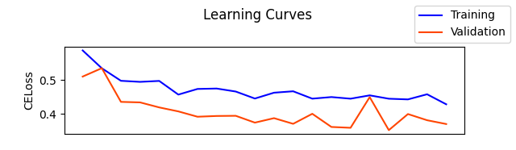
Few remarks
With online data augmentation → large number of epochs
e.g. for ResNet50
train more layers for pretrained models.
especially for handling noise in dataset

Slide 34
Discussion

Slide 35
Organizational Aspects (Going to remove this slide eventually
2 members left in the middle of the project
too much workload.
some other thing?
Go through contrib files

