Slide 1
إسناد Isnad
A replaced SIM should start a check,
not end a customer relationship.
An agentic trust engine on GSMA Open Gateway CAMARA APIs and the Nokia Network-as-Code platform.
Ahmad Shadeed · Yousef Al Masri Princess Sumaya University for Technology, Amman, Jordan
MENA IGNITE HACKATHON 2026 · THEME 4 — SECURE FINTECH, PAYMENTS & ANTI-FRAUD · PROTOTYPE PHASE
Notes:
Isnad, Theme 4. Two-person team from PSUT in Amman. One line: a replaced SIM should start a check, not end a customer relationship.

Slide 2
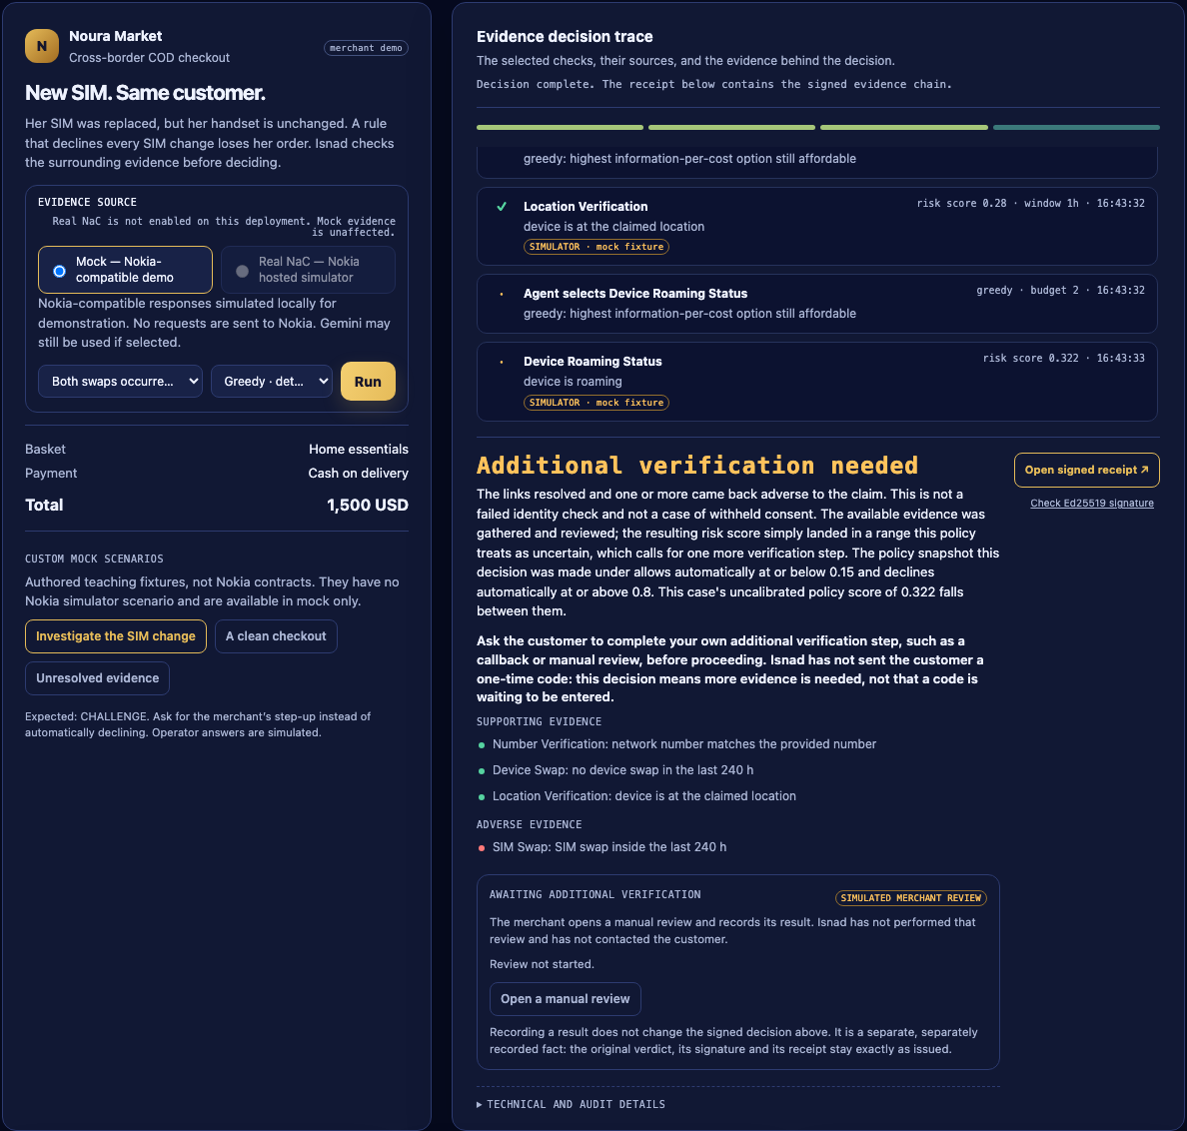
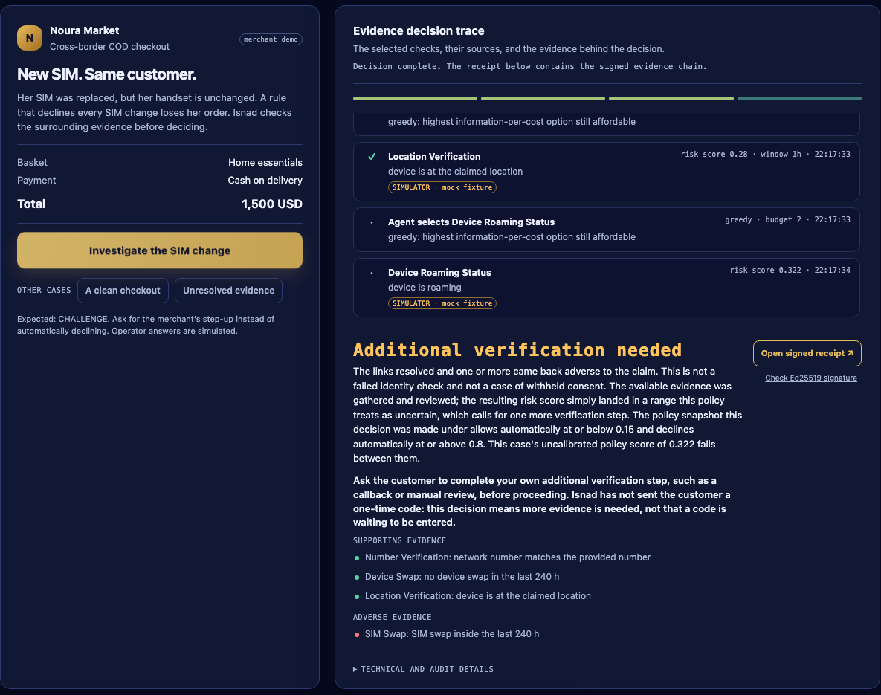
THE PRODUCT, NOT A MOCK-UP
One SIM change, investigated in public.
The evidence source is declared before anything runs. Mock is the default and states that no requests are sent to Nokia.
The adverse fact stays in the chain. SIM Swap is listed under ADVERSE EVIDENCE, not averaged away.
Three links corroborate her, so the engine steps up instead of declining — CHALLENGE, at an uncalibrated policy score of 0.322.
Every row states its own source. SIMULATOR · mock fixture is on the face of the evidence, not in a footnote.
The merchant's own review is a separate, separately recorded fact. It does not change the signed decision above it.
The decision is stored as an Ed25519-signed receipt anyone can check after the sale.
Screenshot: /judge on this repository at 1440 px, English, greedy planner, mock provider, 9 September 2026 build. Cropped to the two decision cards; nothing else is altered.
Notes:
This is the running page, captured by the browser test suite (tests/browser/test_surfaces.py writes docs/ui/release/judge-en-replacement-1440.png on every run), cropped to the two decision cards. Re-cropped on 10 September against the current build, so the Evidence source panel, the Custom mock scenarios grouping and the merchant review panel that shipped on 9 September are all visible here. Operator answers are simulated and each row says so; the signature proves what Isnad issued, never that an operator told the truth.

Slide 3
THE DEFENCE THAT COSTS MORE THAN THE FRAUD
“SIM changed recently → decline.”
Cash on delivery leaves no verified commitment at checkout
A fake order costs a real van, a real driver, a real tank of fuel
A wrongly declined one costs the same — plus the customer
A takeover and a replaced lost phone produce the same signal
The signal is real.
The verdict is the mistake.
A recent SIM change is exactly what an account takeover looks like. It is also exactly what losing your phone looks like. A rule cannot tell them apart, because it never asks a second question.
ISNAD · THEME 4 · THE PROBLEM
Notes:
The rule is cheap and wrong. A SIM change on its own cannot tell a takeover from a customer who lost a phone, so declining on it alone pays for both mistakes: the fraud it misses elsewhere, and the customers it turns away. No market-share figure is claimed on this slide; we have no dated primary source for one.

Slide 4
WHY NOW
Soft proofs of identity are getting easier to imitate.
Deepfakes
Voice clones
OTPs
pass liveness and face checks
defeat call-centre verification
are phishable, and add friction for honest customers
What a model still cannot fake
A physical SIM, in radio range of a physical cell tower, with years of history behind it. That is a constraint an image or a voice sample does not carry, and CAMARA makes that class of evidence available outside the operator.
ISNAD · THEME 4 · WHY NOW
Notes:
Deliberately narrowed. We do not claim generative AI has broken EVERY soft proof, that physical signals are impossible to fake, or that CAMARA is the first programmable network evidence — none of those has a dated source we can show. The defensible claim is that a network check contributes a different KIND of evidence, and that we can demonstrate it end to end.

Slide 5
ISNAD · إسناد · THE CHAIN OF TRANSMISSION
Judge a report by scrutinising every link that carried it.
Human
SIM
Device
Location
History
→
→
→
→
NUMBER VERIFICATION
SIM SWAP
DEVICE SWAP
LOCATION VERIFY
ROAMING · RECYCLING
The name is literal. Isnad is the classical chain of transmission — the method used for over a thousand years to judge whether a report could be trusted, by examining every link that carried it. Every verdict reproduces that structure: each link a specific CAMARA call, each shown with its own provenance.
“The internet never got its isnad.
Every verdict this engine issues is one.”
ISNAD · THEME 4 · THE SOLUTION
Notes:
The name is not decoration. It describes the data structure the engine actually produces.

Slide 6
THE MANDATORY AI AGENT LAYER — OBSERVED 7 SEPTEMBER, REPRODUCED DEPLOYED 9 SEPTEMBER 2026
The model chooses what to buy. Policy decides what it means.
SIM Swap
“Checking for a recent SIM swap provides the highest relevant information value…”
llm
Device Swap
“corroborate before this signal alone can decline”
policy
STOP
“None of the remaining affordable actions are relevant…”
llm
Number Verification
“cheapest step that could resolve the doubt”
policy
Gemini opened with one adverse signal. Policy would not let one signal carry a decline. The model then said stop — and policy overruled it. The adverse case recorded the same boundary again on 9 September, on the deployed site against real Nokia calls: sim_swap chosen by the model, device_swap required by policy.
RECORDED 2026-09-07-gemini-judge-run.json · DEPLOYED REAL NOKIA 2026-09-09-deployed-judge-smoke.json · GEMINI
Notes:
This is the requirement judges score hardest. The boundary is visible in the product, not just claimed in a README. Two independent recordings show it. The trace on this slide is the 7 September local run. The 9 September deployed smoke recorded it again against real Nokia calls: in the adverse (swapped_subscriber) run, journal_decisions shows sim_swap with planner 'llm' and device_swap with planner 'policy', rationale 'corroborate before this signal alone can decline'. Be precise if asked: in the paired stable_subscriber run the model chose both checks and then stopped, so it is the adverse case that demonstrates the override. A third file, 2026-09-09-judge-gemini-journal.json, shows the same seq-by-seq boundary but was recorded locally on the mock source, so it cost nothing and is not deployed evidence.

Slide 7
OPEN GATEWAY INTEGRATION
Eight CAMARA APIs, chosen at run time.
Not one of them is wired to a button. The agent selects each evidence call from the hypothesis, the evidence so far, and the budget it has left.
CAMARA API
ROLE IN THE EVIDENCE CHAIN
COST
RECORDED AGAINST NOKIA
Number Verification
Proves the number belongs to this device. Replaces the OTP.
1
Sandbox
SIM Swap
The primary account-takeover signal.
2
Hosted simulator
Device Swap
The mule-phone signal, and the corroborator that saves customers.
2
Hosted simulator
Location Verification
Boolean against a claim. Never a coordinate.
3
Sandbox
Device Reachability
Bot-farm and burner patterns.
2
Sandbox
Device Roaming
Impossible travel; stability proxy for thin-file customers.
2
Sandbox
Number Recycling
Was this number reassigned to someone else?
1
Hosted simulator
Congestion Insights
Network information — quarantined from the verdict.
—
Hosted simulator
A ninth, Device Intelligence, has no Nokia adapter: the sandbox capture returned EVIDENCE_UNAVAILABLE, so the engine returns unavailable rather than inventing a reputation verdict.
ISNAD · THEME 4 · CAMARA COVERAGE
Notes:
Eight with a working adapter. Four exercised against Nokia's hosted simulator on 6 September; the rest against the sandbox on 30 August. All recorded, failures included.

Slide 8
TECHNICAL ARCHITECTURE
One request in. A signed evidence chain out.
The investigator forms a hypothesis, then spends its budget only on the checks that hypothesis makes relevant — stopping as soon as policy is satisfied.
Merchant context
Investigator
Planner
Provider adapter
Evidence link
signup · checkout
payout · reset
→
hypothesis, belief
in log-odds
→
Gemini or greedy
selects the check
→
NaC · simulator
mock · fake operator
→
normalized, with
its own provenance
The link returns to the investigator and the loop repeats until policy is satisfied or the budget is spent. Then policy alone maps the belief to ALLOW / CHALLENGE / DECLINE, and the vault signs the exact stored receipt bytes. The model chooses what to buy; policy decides what the answer means, and can require a check the model skipped.
MODULE
RESPONSIBILITY
app/agent/
Investigator, Gemini and greedy planners, hypothesis and belief model, explanations
app/policy/
Evidence weights, thresholds, relevance, budget — policy.yaml is the tunable surface
app/providers/
Nokia NaC, hosted simulator, contract mock and fake-operator adapters, and the normalization between them
app/chain/, app/registry/
Evidence chain construction, subject binding, and the Ed25519 vault
app/api/, app/static/
Routes, auth, rate and body limits; judge, API-key, console, lab and receipt pages in English and Arabic
app/db/, migrations/
Persistence, Alembic revisions, and the run-event journal that makes an interrupted trace recoverable
PYTHON 3.11 · FASTAPI · SQLALCHEMY + ALEMBIC · ED25519 · NOKIA NETWORK-AS-CODE SDK · GEMINI OVER HTTPX · PLAYWRIGHT
Notes:
The loop is the point. A fixed pipeline runs every API; this one asks what the hypothesis makes relevant, buys the cheapest useful answer, and stops when policy is satisfied. Two separations matter and both are in the code: the planner never decides what an answer means, and the provider adapter normalizes Nokia, the hosted simulator and the mock into the same evidence shape so a demo cannot quietly become a different code path. Congestion Insights is deliberately outside the scoring path. The full map is the Repository map table in README.md.

Slide 9
REPRODUCIBLE FROM A CLEAN CLONE
Every number is one command away.
8
28
1,605
CAMARA APIs integrated on Nokia Network-as-Code
Recorded Nokia hosted-simulator attempts — 14 probe, 14 from the application itself, failures included
Checks passed on 11 September 2026 — 1,458 non-browser, 147 browser, English and Arabic
49 vs 78
0.322
Ed25519
Provider operations vs a run-everything pipeline, 13 authored cases — a count of calls, not money
Uncalibrated policy score on the lead case — not a fraud probability
Signature over the exact stored receipt bytes
make setup && make judge → 127.0.0.1:8010/judge
LIVE → ahmadshadeed32-isnad-trust-engine.hf.space/judge
API → …/api-keys mint a merchant key behind the organizer code, then curl /v1/verify
TEN-STEP JUDGE GUIDE AT submission/JUDGE_GUIDE.md · EACH STEP STATES ITS EXPECTED OUTPUT
Notes:
1,605 is 1,458 non-browser plus 147 browser checks, run on 11 September 2026 after the judge API-key page shipped; the 9 September release review was 1,442 plus 135, and docs/RELEASE_VALIDATION_2026-09-09.md lists both. The third command line is the /api-keys page: a judge enters the organizer code, receives a merchant key once, and the page prints the guide's curl request filled in. The key drives the deployment's mock provider only and is refused where the default provider bills. The 28 Nokia attempts are 14 standalone probe calls on 6 September plus 14 made by the application itself on 9 September — ten local and four from the deployed page. A probe proves the credential; only an application run proves the integration. Ten of those 14 have a per-attempt HTTP 200 recorded; for the other four the status was not separately captured, and the file claims only what is provable — each carries a normalized signal sourced nac, which the pipeline produces only from a 2xx whose body parsed. Every one of the runs ended in a signed receipt. 49 vs 78 is an OPERATION COUNT on a 13-case authored synthetic set. It is not money: policy.yaml's costs are normalized budget units the engine uses to rank checks, not Nokia's prices, and nothing in the repository converts one to the other. The structural argument is that a pipeline running every API spends the same on a clean checkout as on a suspicious one, and an agent that stops when the answer is justified does not.

Slide 10
BUSINESS MODEL AND MONETIZATION
Priced per decision. Not yet priced with a merchant.
Who pays
What it costs to serve
What the operator gets
Merchants, PSPs and wallets — per decision requested at a moment of risk: checkout, signup, payout, password reset. One endpoint, one answer, one receipt.
The provider operations the agent chooses to buy. Evidence is the cost of goods, and the agent stops buying when the answer is justified.
A per-call CAMARA revenue line, and a recurring commercial reason for merchants to consume network capability rather than a one-off integration.
Why per-decision pricing can work at all
A pipeline that runs every API spends the same on a clean checkout as on a suspicious one. An agent that stops when the answer is justified does not: 49 provider operations against 78 over the same thirteen authored cases. Thin COD margins are the constraint the architecture is answering.
No price has been set, and none can be derived from this repository
49 vs 78 is a count of calls, not money: policy.yaml's costs are normalized budget units used to rank checks, not Nokia's prices and not convertible to them. Revenue, margin and willingness to pay are unmeasured. Route to market is shadow mode first — Isnad writes a signed chain while the merchant's existing rule still decides the order — and pricing follows the outcome data, not the pitch.
ISNAD · THEME 4 · BUSINESS MODEL
Notes:
Say the limit out loud before a judge asks. The business model is a shape, not a forecast: there is no operator price list in this repository, no merchant contract and no revenue data, so any dollar figure on this slide would be invented. What IS defensible is the structural argument — per-decision pricing only survives thin COD margins if the cost of serving a decision varies with its difficulty, which is exactly what the budgeted agent does. docs/MERCHANT_PILOT_PLAN.md is the protocol for getting the missing numbers, written before the results are known, and it starts in shadow mode so no real customer decision changes first.

Slide 11
SCALE AND COMMERCIAL SHAPE
The intended shape. Not yet measured.
Merchants & couriers
Banks & wallets
Fewer fake and refused COD orders, and fewer vans sent to nobody.
Takeover defence at payout and password reset without OTPs, selfies or documents.
Customers
Financial inclusion
A legitimate SIM replacement gets a step-up, not a decline. A clean signup gets no OTP at all.
Thin-file customers assessed on SIM tenure and location stability. Most fraud tools shrink a market; this one grows one.
Operators
One engine, two themes
A measurable revenue line for CAMARA, and a recurring reason for merchants to consume network capability.
Theme 1 — cross-border identity verification — is the same evidence chain with a different hypothesis.
ISNAD · THEME 4 · IMPACT & SCALE
Notes:
Say this as a hypothesis, because that is what it is. Every row here is the shape of the business we intend, and none of it is measured: there are no merchant outcomes, no operator prices and no revenue data in this repository. docs/MERCHANT_PILOT_PLAN.md is the protocol for getting them, written before the results are known, and it starts in shadow mode so no real customer decision changes first.

Slide 12
TEAM AND ROLES
Two engineers, one system, shared across the stack.
Ahmad Shadeed
Yousef Al Masri
Team lead · Engineering
Engineering · Co-builder
Agent and policy design, the CAMARA and Nokia Network-as-Code integration, the API surface and the evidence vault.
Shares the technical build across the agent, the API, the provider integration and the test suite. Both members work across the stack; the split above describes emphasis, not ownership.
WHAT THE TEAM BUILT
Agent and policy engine
The investigator, its belief model in log-odds, and the evidence-cost surface that decides which CAMARA call is worth making next
CAMARA / NaC integration
The adapter for eight CAMARA APIs, the hosted-simulator and contract-mock paths, and the consent-gated Number Verification flow
API and evidence vault
Idempotent verification with replay, trust sessions with live revocation, and the Ed25519-signed chain anyone can verify offline
Surfaces, tests and docs
Judge, API-key, console, lab and receipt pages in English and Arabic, the 1,605 checks of 11 September, and this submission package
Approved tooling only: Google AI Studio (Gemini) as the single model provider. No second model, and no third-party agent framework.
PRINCESS SUMAYA UNIVERSITY FOR TECHNOLOGY (PSUT), AMMAN, JORDAN · TEAM SIZE 2 · ahmadshadeed4321@gmail.com
Notes:
Two people, both across the stack. If asked who wrote what: the areas above describe emphasis rather than a hard split, and the working history is available to the panel on request. The tooling line matters for the mandatory-requirement check — one approved provider, no agent framework, and the Gemini adapter is plain httpx so a missing vendor SDK cannot silently turn an LLM run into a greedy one.

Slide 13
WHAT WE HAVE NOT PROVEN
Named, because provenance cuts both ways.
No physical handset has completed an operator consent round trip — the flow is contract-tested against a local fake operator, not a real SIM
No Nokia congestion subscription has been created and no callback delivery observed. The deployed callback base is registered and its mock lifecycle passes — that proves configuration, not operator acceptance
The risk score is uncalibrated. No real fraud outcomes exist to calibrate it against, and we will not invent any
No independent reviewer has walked through the deployed build; the 9 September checks were run by this project's own agent
Every demo row is stamped SIMULATOR · mock fixture
A signed mock receipt is still mock, and the receipt page says so. Mock and Nokia share the interface, the sentence vocabulary and the contract tests — the answers are ours, and they are labelled.
What we need next: a supported subscriber for the operator consent flow, a Nokia congestion subscription with an observed callback delivery, then a merchant's outcome data to calibrate against.
ISNAD · THEME 4 · HONEST LIMITS
Notes:
Say this before a judge finds it. An engine whose entire argument is provenance does not get to be vague about its own.

Slide 14
إسناد Isnad
The internet never got its isnad.
Every verdict this engine issues is one.
Try it now, nothing to install
ahmadshadeed32-isnad-trust-engine.hf.space/judge
…/api-keys — mint a merchant key and call /v1/verify yourself
git clone github.com/AhmadShadeed32/isnad · make setup && make judge
Ahmad Shadeed · Yousef Al Masri ahmadshadeed4321@gmail.com Princess Sumaya University for Technology, Amman
MENA IGNITE HACKATHON 2026 · THEME 4 · TEAM ISNAD
Notes:
Close on the name. Then take questions.

