Slide 1
Share n’ Care
Supervisor:
Group Members:
Muhammad Ali Nasir
Sohaib Sarfraz i15-0273
Ahmed Shaheer i15-0071
Atif Noman i15-0494

Slide 2
Problem Statement
You come to a new city , you have no idea about the food and the people and you want to save money, what would you do?
What if you have interest in book reading, novel reading, passed your courses and you have books. you want to share or sell them to others?

Slide 3
Project Overview
Share n’ Care is a platform to share your meals and books with random people and save money.
Connects people by just sending and joining requests.
Can add and search books as well as show the nearest book shops.

Slide 4
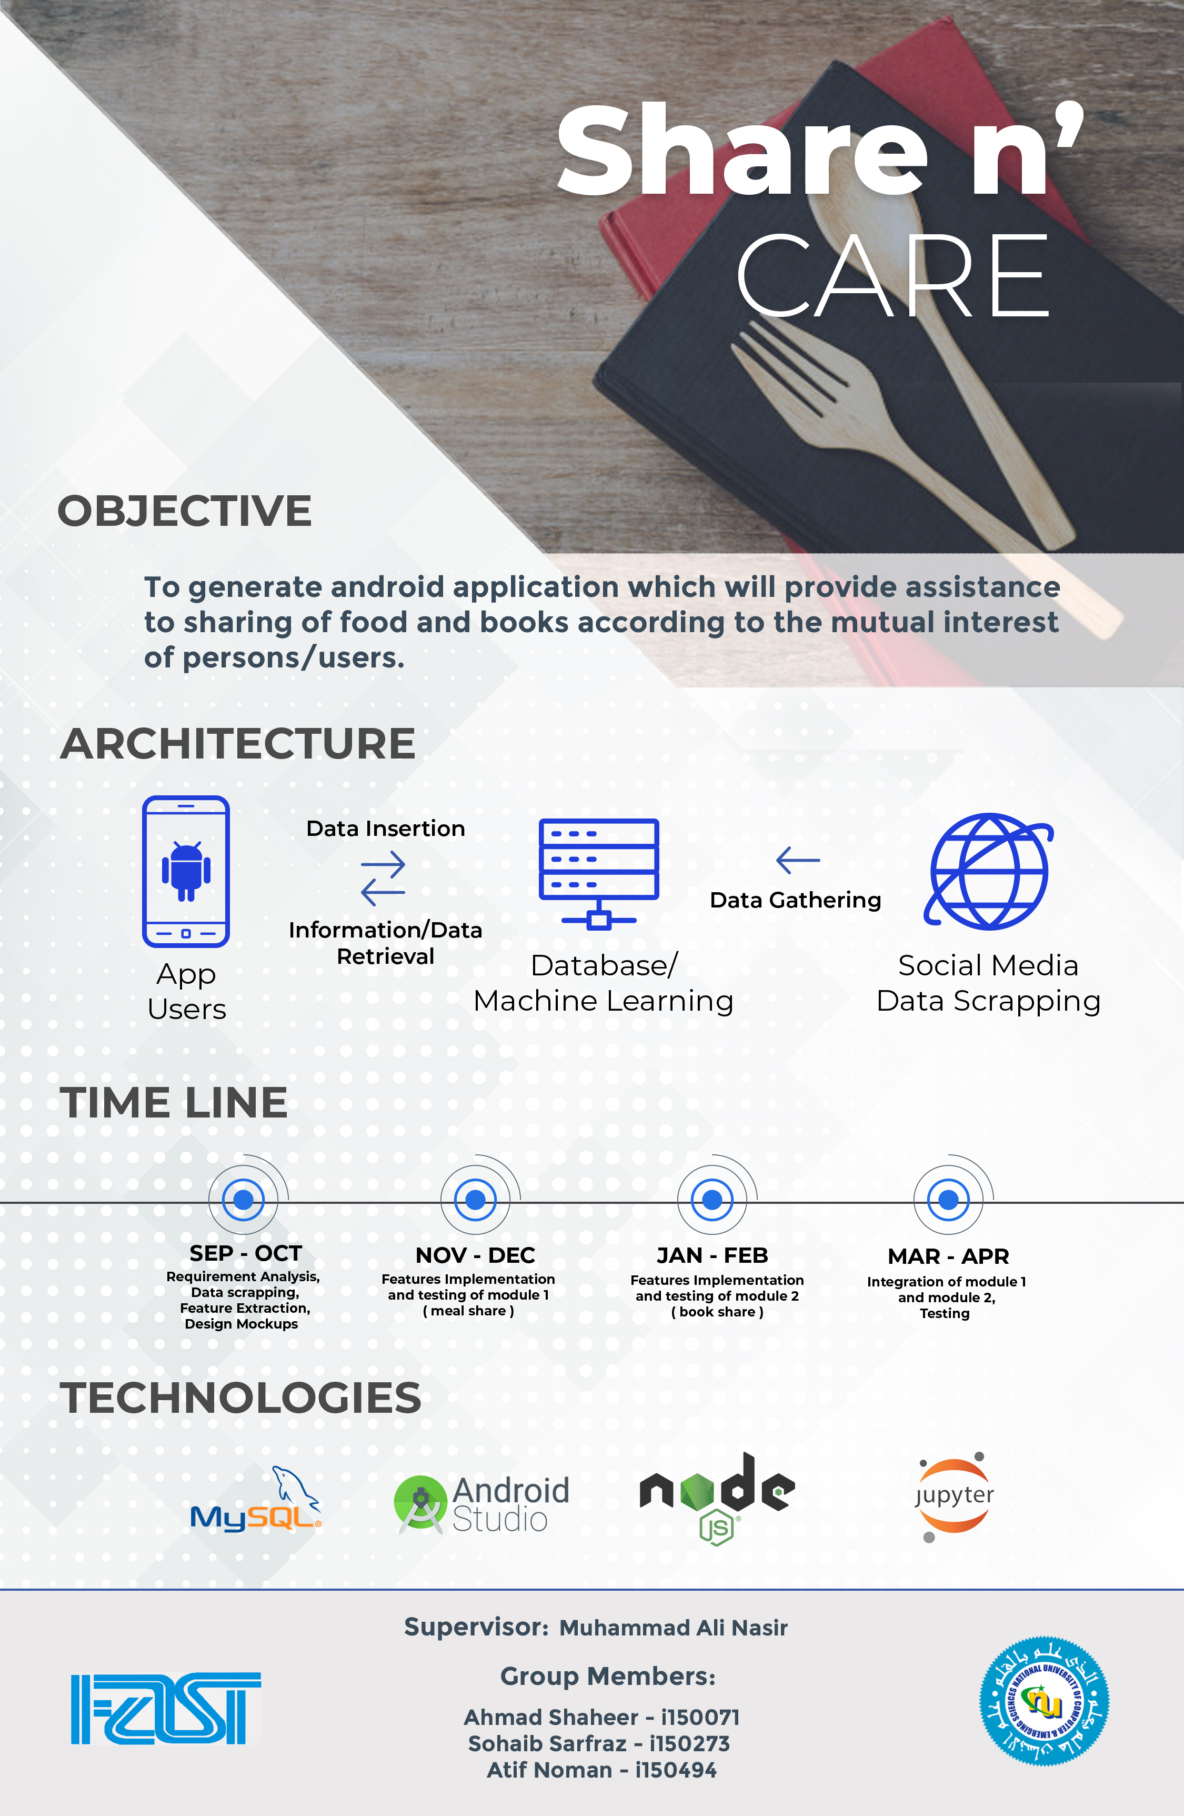
Poster

Slide 5
List of Features
Push the request
Create Request
Accept request
Delete Request
Create messenger
Give recommendation
Dynamic Allocation of resources.
Feedback to user you meet

Slide 6
Functional Requirements
User can login if he is a signed up user.
User can create food or book request.
User can join the created request if he wants.
If user join the request, messenger will create and he will be added into it.
One user can track another user.
Session should be closed and chat should be deleted after eating food or book sharing.
One user can rate another user after session closed.

Slide 7
Non Functional Requirements
Reliability: If back-end server failed, application should use locally stored information for the working of functionality.
Usability: System should be easy to use.
Performance: Average response time of the server should not be too slow.

Slide 8
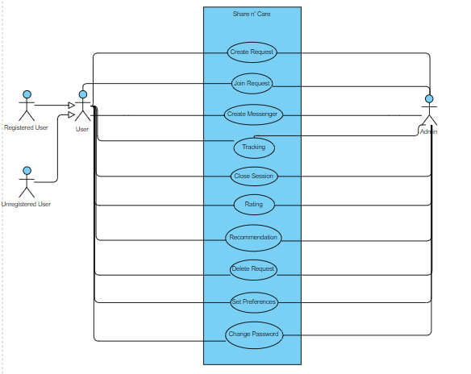
Use Case Diagram

Slide 9
High Level Use cases
Create request
Join Request
Delete Request
Tracking
Recommendations
Close Session

Slide 10
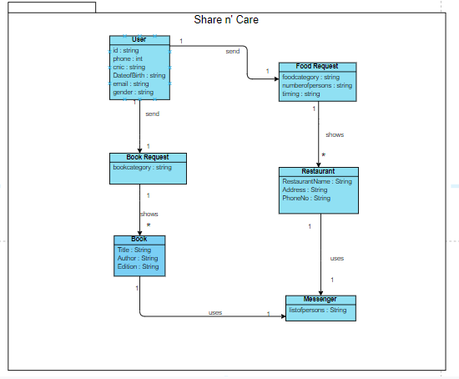
Domain Model

Slide 11
System Sequence Diagrams

Slide 12
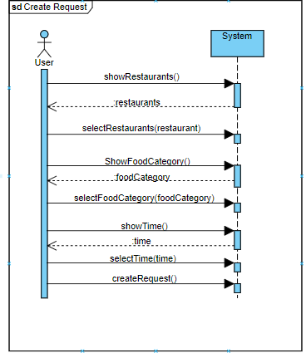
SSD#1

Slide 13
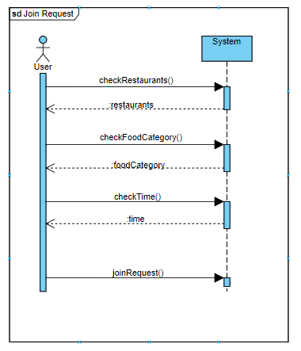
SSD#2

Slide 14
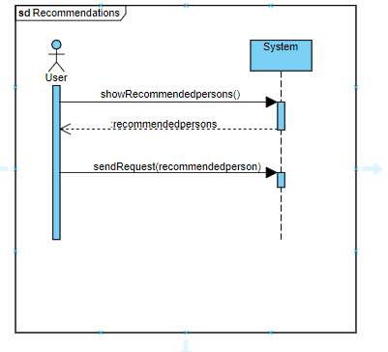
SSD#3

Slide 15
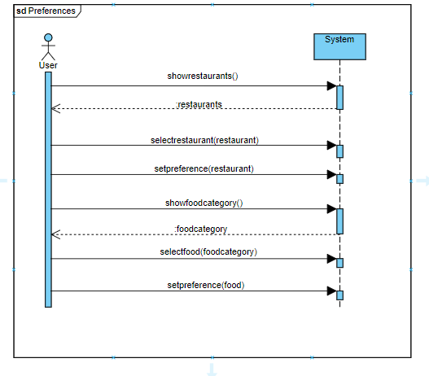
SSD#4

Slide 16
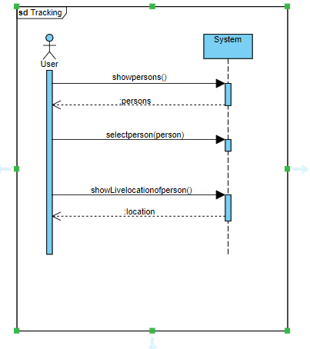
SSD#5

Slide 17
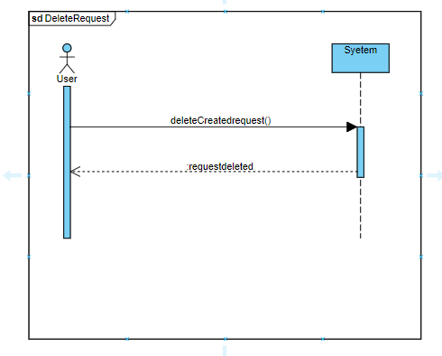
SSD#6

Slide 18
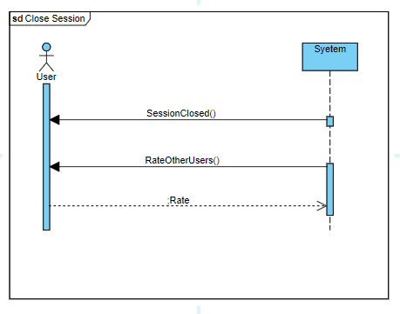
SSD#7

Slide 19
Sequence Diagrams

Slide 20
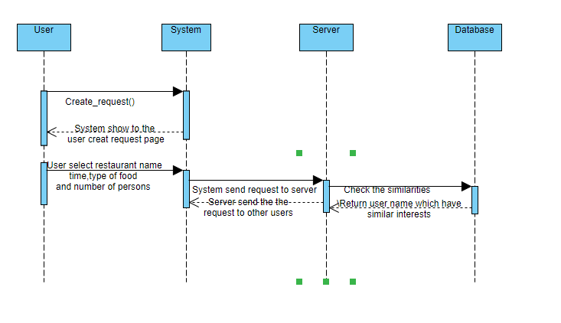
SD#1 Create Request

Slide 21
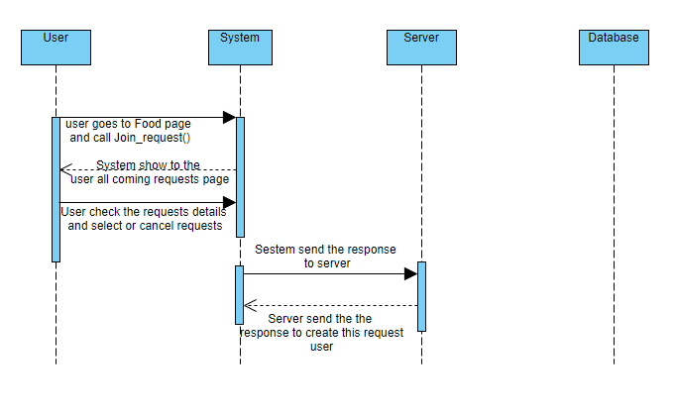
SD#2 Join Request

Slide 22
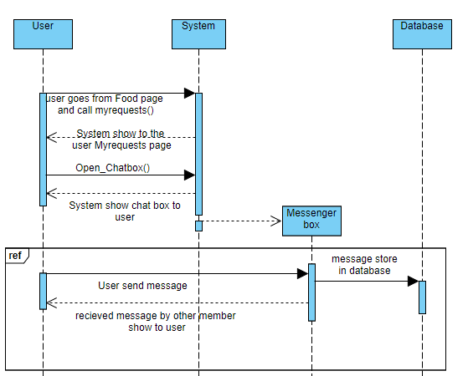
SD#3 Chat Box

Slide 23
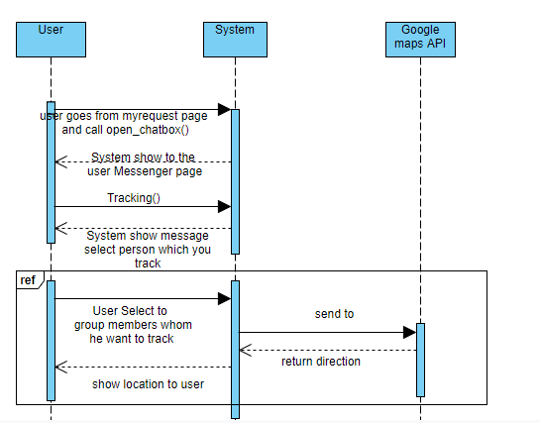
SD#4 Tracking

Slide 24
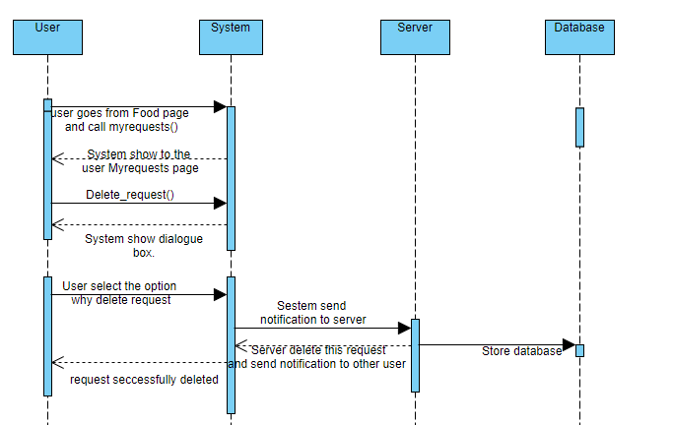
SD#5 Delete Request

Slide 25
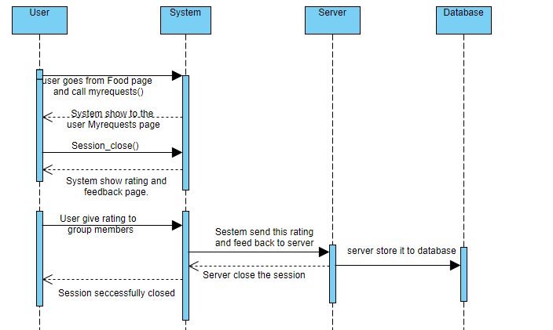
SD#6 Close Session

Slide 26
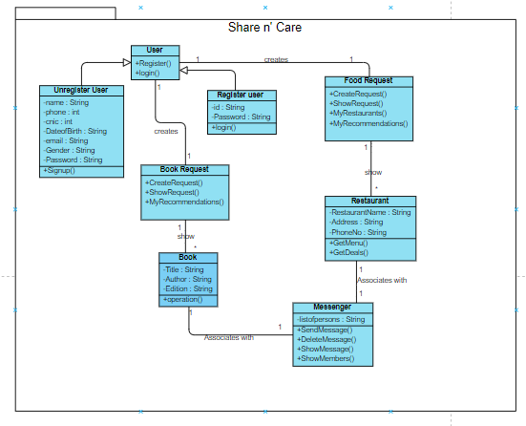
Class Diagram

Slide 27
Mockups

Slide 28
Thank you
Any Questions?

