Slide 1
ANDROID MVVM
Ahmad Shahzad L15-4209
SMF Tehami L15-4046
Usman Majied L15-4033
Saad Zaheer L16-4103

Slide 2
Why Patterns?
Problems while testing and refactoring
Clean architecture and separation is recommended
Redesign (Outdated UI)
Separation of concern
Streamline data process

Slide 3
ANDROID MVVM
M- Model
V- View
VM- ViewModel

Slide 4
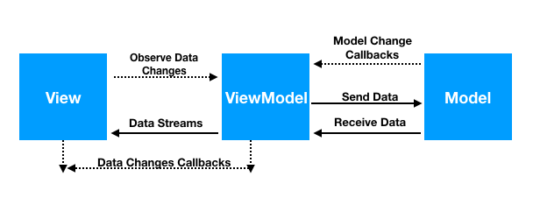
MVVM Pattern

Slide 5
Why MVVM?
How can we notify a class without having reference of it?
Two way data binding
Live data
RxJava

Slide 6
Two Way Data Binding
Binding Objects to XML Layouts
Binding Adapter
Custom attribute defined in XML

Slide 7
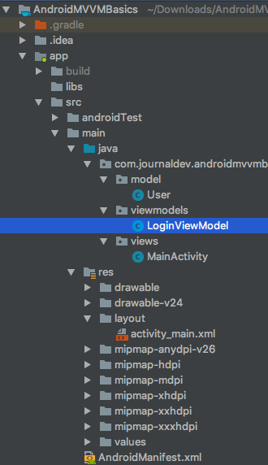
Example Project Structure

Slide 8
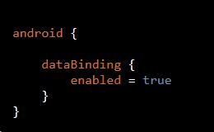

Data Binding Library
Add the following code to your app’s Build.gradle file
Add dependency in your apps build.gradle file

Slide 9
Example Project
Model :
View :
ViewModel :
Main Activity :

Slide 10
Conclusion

