Slide 1
Agenda
Evolution of Analytics
Feature Selection
Feature Scaling

Slide 2
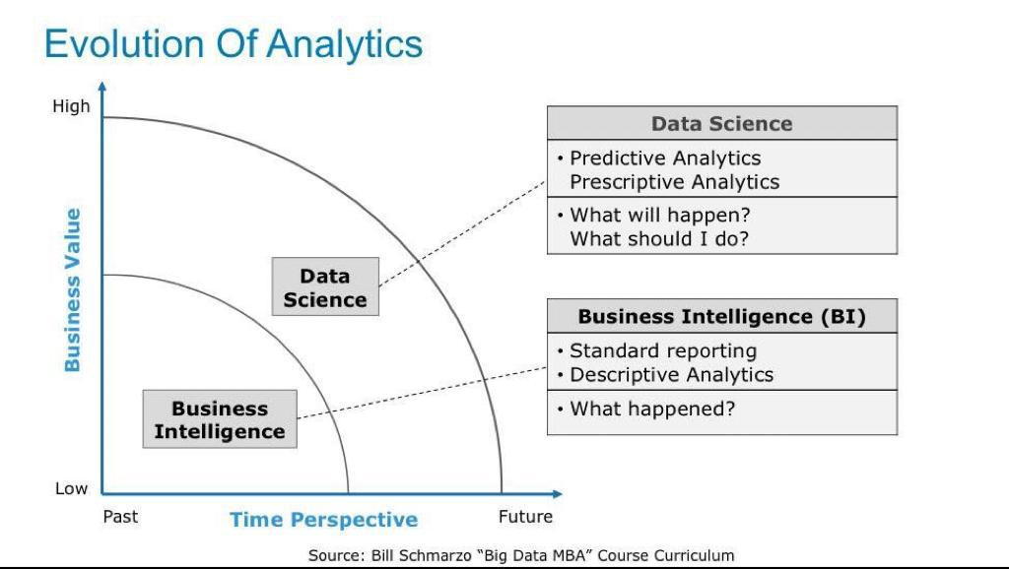
Evolution of Analytics

Slide 3
Feature Selection
In this method, you filter and take only the subset of the relevant features.
The model is built after selecting the features. The filtering here is done using correlation matrix and it is most commonly done using Pearson correlation.
we will first plot the Pearson correlation heatmap and see the correlation of independent variables with the output variable.
We will only select features which has correlation of above 0.5 (taking absolute value) with the output variable.
The correlation coefficient has values between -1 to 1 — A value closer to 0 implies weaker correlation (exact 0 implying no correlation) — A value closer to 1 implies stronger positive correlation — A value closer to -1 implies stronger negative correlation
#Using Pearson Correlation

Slide 4
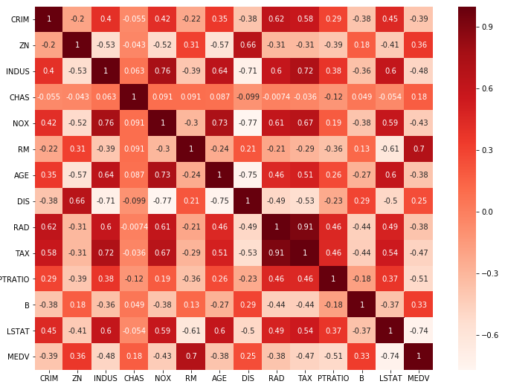
Feature Selection

Slide 5
Filter Method:
#Using Pearson Correlation plt.figure(figsize=(12,10)) cor = df.corr() sns.heatmap(cor, annot=True, cmap=plt.cm.Reds) plt.show()
#Correlation with output variable
cor_target = abs(cor["MEDV"])
#Selecting highly correlated features
relevant_features = cor_target[cor_target>0.5]
relevant_features

Slide 6
Feature Scaling or Standardization ra-class is maximized or minimized
It is a step of Data Pre Processing which is applied to independent variables or features of data. It basically helps to normalise the data within a particular range. Sometimes, it also helps in speeding up the calculations in an algorithm
from sklearn.preprocessing import MinMaxScaler
scaler = MinMaxScaler()
scaler.fit(df[['Income($)']])
df['Income($)'] = scaler.transform(df[['Income($)']])
scaler.fit(df[['Age']])
df['Age'] = scaler.transform(df[['Age']])

Slide 7
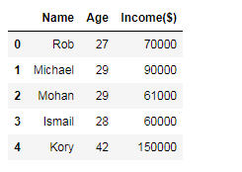
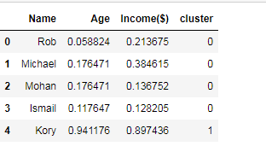
Feature Scaling or Standardization class is maximized or minimized

Slide 8
Clustering ML Algorithm intra-class is maximized or minimized
Clustering is a method to group data into classes with identical characteristics in which the similarity
This method is most widely used procedure for future prediction.
The main objective of this paper is to partition Employees into homogeneous group according to their characteristics and abilities using clustering.
This study makes use of cluster analysis to segment employees into groups according to their performance. The decision tree has been used for making meaningful decisions for the Employee.
Based on the employee’s performance results possible to make a decision whether advanced training, talent enrichment or further qualification required or not.
These applications also help administrative staff to enhance the quality of the organizations.

Slide 9
Clustering ML Algorithm intra-class is maximized or minimized
Data Clustering is an unsupervised and arithmetic data analysis procedure. Cluster analysis is used to segment a large set of data into subsets called clusters.
Each cluster is a collection of data objects that are similar to one another place within the same cluster but are dissimilar to objects place other clusters.
It is used to classify the same data into a homogeneous group.
Data clustering and decision tree algorithm have been used to evaluate employee performance.
Firstly, apply K-means clustering for separating employees' performance into four clusters which is Excellent, Good, Average and Poor according their Performance.
Then apply Decision tree Algorithm for predicting next year Performance.

Slide 10
K-Means Clustering
K-Means Clustering : K-means clustering [5] is a type of unsupervised learning, which is used in unlabelled data (i.e., data without defined categories or groups).
The goal of this algorithm is to find groups in the data, with the number of groups represented by the variable K.
The algorithm works iteratively to assign each data point to one of K groups based on the features that are provided.
Data points are clustered based on feature similarity.
K-Means clustering intends to partition n objects into k clusters in which each object belongs to the cluster with the nearest mean.

