Slide 1


Slide 2
About Us
Established in 2000
Manufacturing HDPE, UPVC & PPRC Pipes
Authorized Agent for Int’l Companies
Stockist for Imported Fittings
Approved by Govt & Public Sector Organizations
Approved by UN Subsidiaries & iNGOs

Slide 3
Our Vision
We believe in focusing on our valued customers and their needs. Our objective is to provide prime quality products at competitive price on committed time to the customer’s entire satisfaction. We would like to be our customers’ First Choice to fulfill their all Pipe related needs.

Slide 4
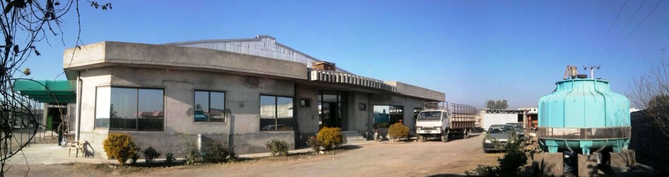
Manufacturing Facility
Located at:
Sarai Kharbooza, off G.T. Road, Islamabad

Slide 5
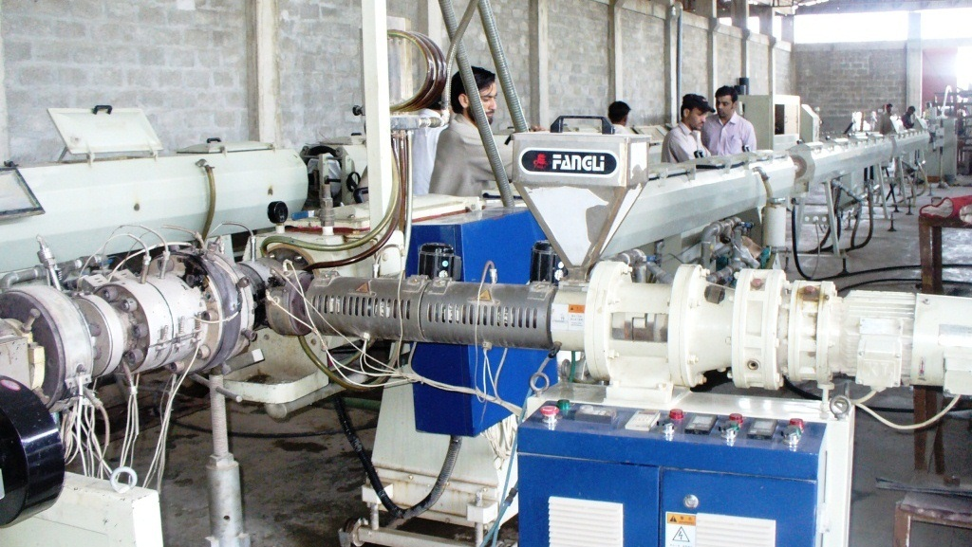
Manufacturing Facility

Slide 6
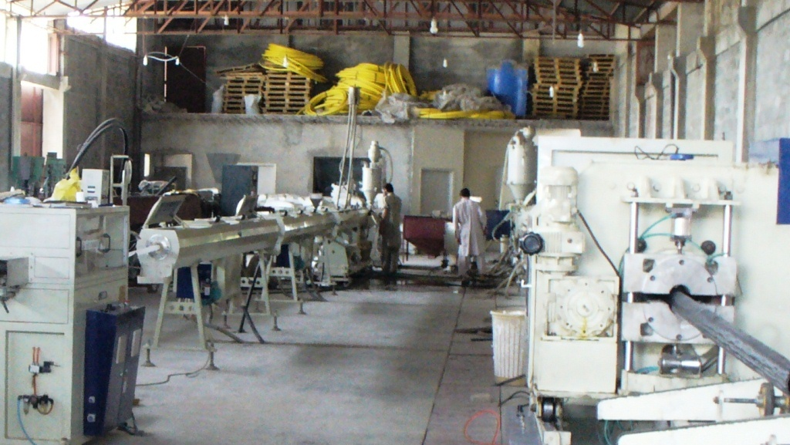
Manufacturing Facility

Slide 7
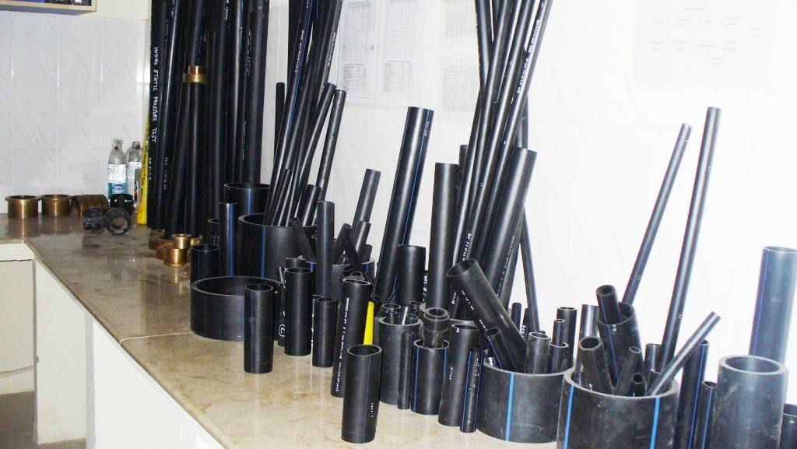
Manufacturing Facility

Slide 8
Quality Standards
Certified by:
ISO 900:2008 Certified
Pakistan Standards & Quality Control Authority
Pakistan Engineering Council
Moreover our,
HDPE Products conform to ISO 4427-2 Standards
UPVC Products conform to BS 3505 Standards
PPRC Products conform to DIN 8077/8078

Slide 9
HDPE Pipe Characteristics
HDPE Stands for High Density Poly Ethylene
Light in Weight
More Flexible than other metal based pipe
Smooth Surface, so Conserve Energy in pumping
Resistant to environmental threats / Crack
Good chemical resistance
Can defy pipeline Corrosion
Can protect form Frost & Rodent

Slide 10
HDPE Applications
Water supply
Telecommunication Industry for Cable Protection
Sewerage & Drainage, Industrial Effluents
Irrigation/farming/Tubewells
Sprinkler & Drip Irrigation Systems
Construction Industry
Gas and oil Transmission
Nuclear Power Plants
Chemical Industries

Slide 11
HDPE Benefits
Hygienically Safe (Food Grade)
Easy to install and handle
Least chance to conduct heat
Abrasion free
Black HDPE is UV Protected
Has Long Life (approx 50 Years)
Can be easily joined by mechanical (Compression Fittings) & butt fusion methods

Slide 12
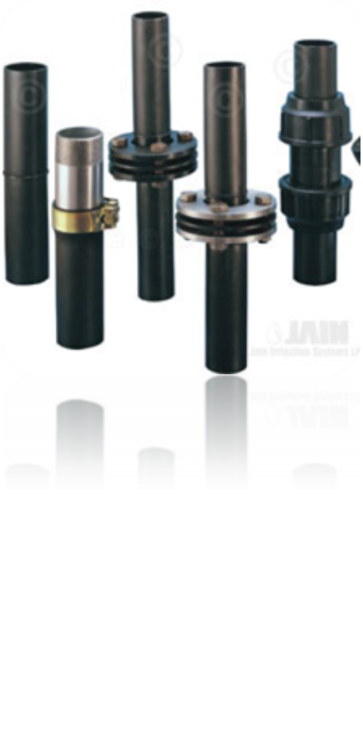
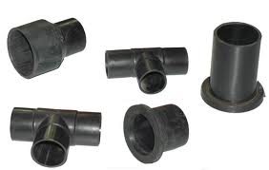
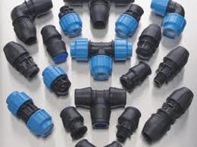
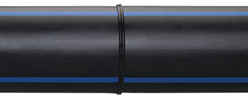
HDPE Jointing

Slide 13
Compression Jointing
HDPE Pipes Compression Jointing Process

Slide 14
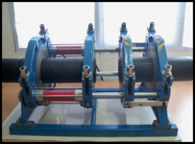
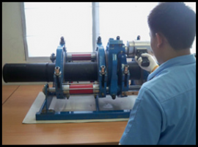
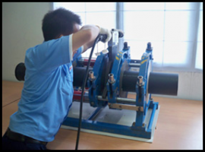
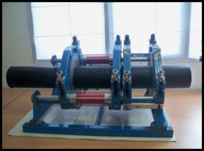
Butt Fusion Jointing

Slide 15
Butt Fusion Jointing
HDPE Pipes
Butt Fusion Jointing Process

Slide 16


