Slide 1


Slide 2
About Us
Established in 2000
Manufacturing HDPE, UPVC & PPRC Pipes
Authorized Agent for Int’l Companies
Stockist for Imported Fittings
Approved by Govt & Public Sector Organizations
Approved by UN Subsidiaries & iNGOs

Slide 3
Our Vision
We believe in focusing on our valued customers and their needs. Our objective is to provide prime quality products at competitive price on committed time to the customer’s entire satisfaction. We would like to be our customers’ First Choice to fulfill their all Pipe related needs.

Slide 4
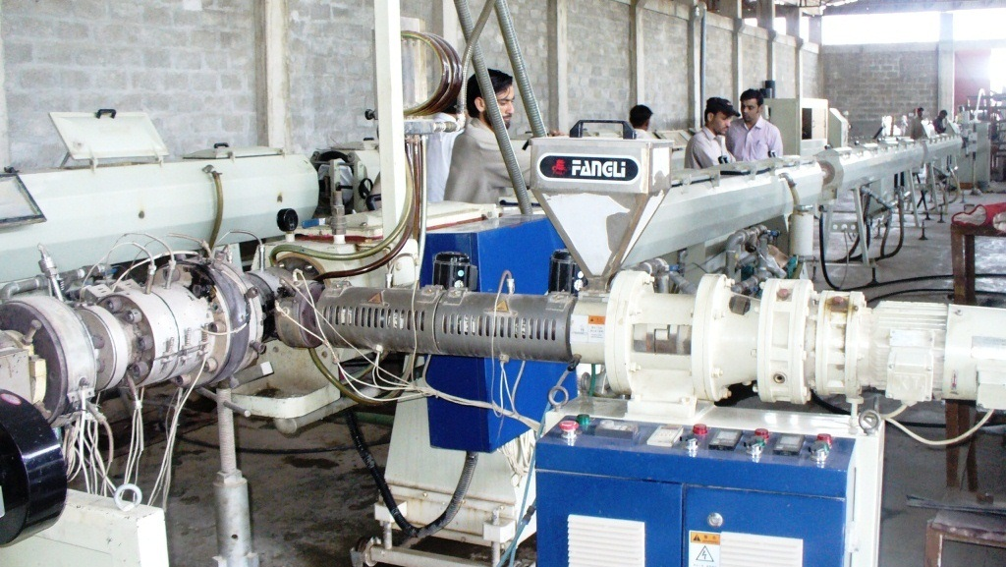
Manufacturing Facility

Slide 5
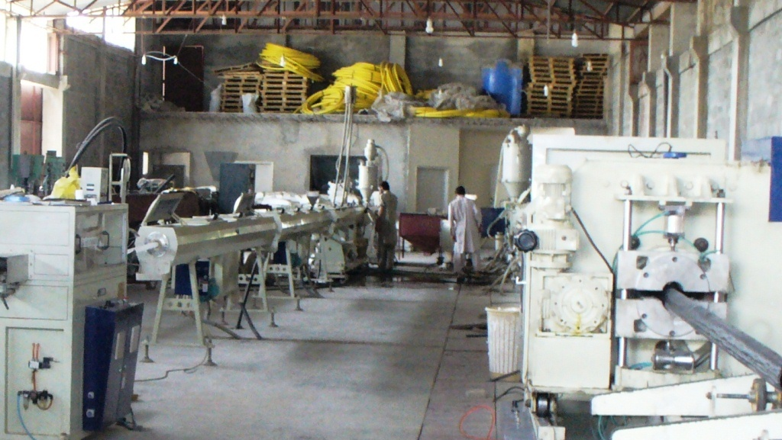
Manufacturing Facility

Slide 6
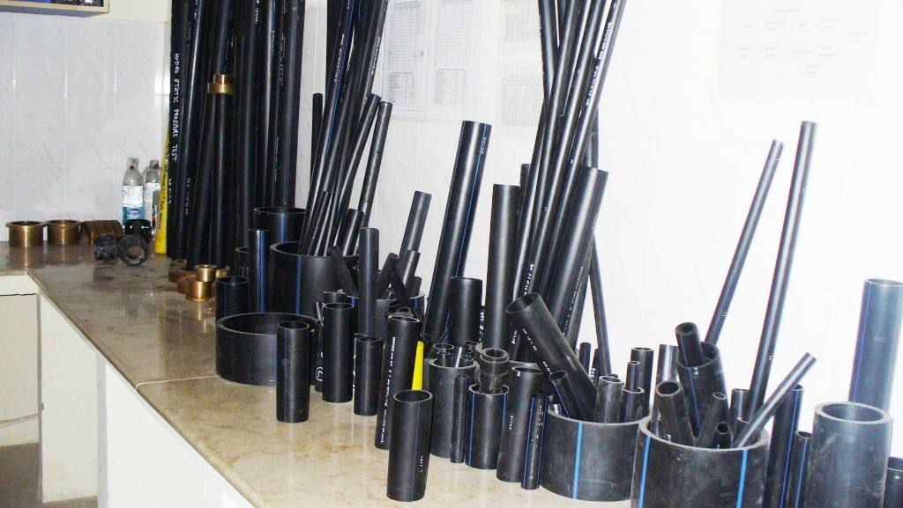
Manufacturing Facility

Slide 7
Quality Standards
Certified by:
ISO 900:2008 Certified
Pakistan Standards & Quality Control Authority
Pakistan Engineering Council
Moreover our,
HDPE Products conform to ISO 4427-2 Standards
UPVC Products conform to BS 3505 Standards
PPRC Products conform to DIN 8077/8078

Slide 8
HDPE Pipe Characteristics
HDPE Stands for High Density Poly Ethylene
Light in Weight
More Flexible than other metal based pipe
Smooth Surface, so Conserve Energy in pumping
Resistant to environmental threats / Crack
Good chemical resistance
Can defy pipeline Corrosion
Can protect form Frost & Rodent

Slide 9
HDPE Applications
Water supply
Telecommunication Industry for Cable Protection
Sewerage & Drainage, Industrial Effluents
Irrigation/farming/Tubewells
Sprinkler & Drip Irrigation Systems
Construction Industry
Gas and oil Transmission
Nuclear Power Plants
Chemical Industries

Slide 10
HDPE Benefits
Hygienically Safe (Food Grade)
Easy to install and handle
Least chance to conduct heat
Abrasion free
Black HDPE is UV Protected
Has Long Life (approx 50 Years)
Can be easily joined by mechanical (Compression Fittings) & butt fusion methods

Slide 11
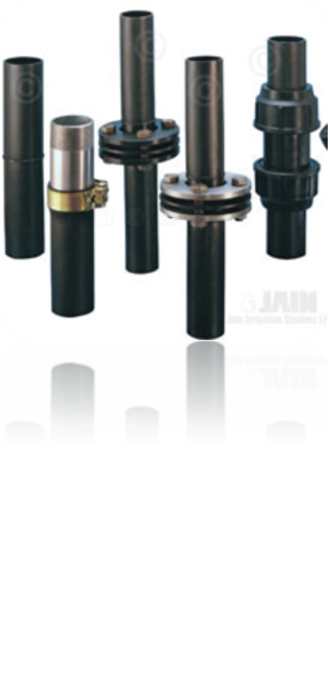
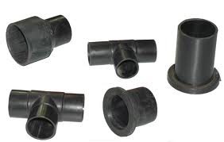
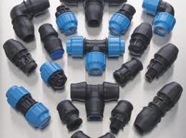
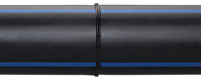
HDPE Jointing

Slide 12
Compression Jointing
HDPE Pipes Compression Jointing Process

Slide 13
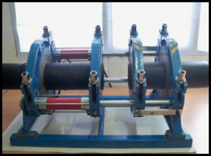
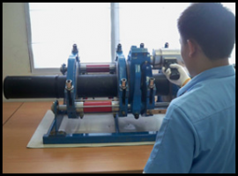
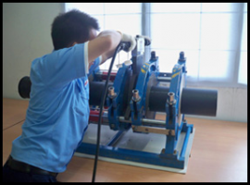
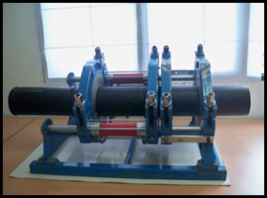
Butt Fusion Jointing

Slide 14
Butt Fusion Jointing
HDPE Pipes
Butt Fusion Jointing Process

Slide 15
UPVC Pipe Characteristics
UPVC stands for Unplasticized Poly Vinyl Chloride
Used in the building industry as a low-maintenance material
Corrosion resistance
Shock resistance
Light weight
Pressure resistance
Low cost and long service life
Insect and mouse proof
Non-Flammable, Non-Toxic

Slide 16
UPVC Pipe Applications
Potable Water Services
Cold Water Plumbing Services
Electrical Conduits
Tubewell Casing and strainer
Telecommunication
Drainage Installations-Domestic & Industrial
Effluent lines
Chemical Plant Installations

Slide 17
UPVC Pipe Applications
Non-Explosive Dry Materials Handlings
Brine lines- Tanning Plant, Ice Rinks
Emergency Repairs to damaged pipe lines
Horticulture and greenhouse Irrigation System
Surface Water Drainage
Ducting for power and communication cables
For irrigation-system and sprinkler system.

Slide 18
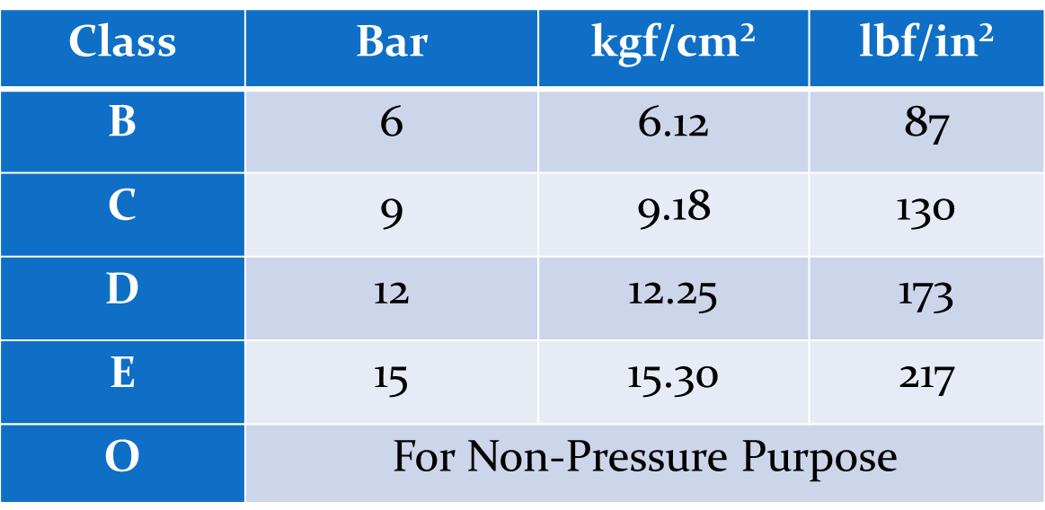
UPVC Pipe Specs
Manufactured as per BS 3505 Standard
Manufactured in Class B, C, D, E and O

Slide 19
PPRC Pipes Characteristics
PPRC stands for Polypropylene Random Copolymer
Environmentally friendly
Chemically Stable
Creeping strength (Hydrostatic test),
High temperature resistance.
Corrosion Resistant.
Higher flow capacities.
Reduces energy losses

Slide 20
PPRC Pipe Applications
Hot / Cold and chilled water piping
Industrial piping for aggressive fluids
Compressed Air
Air Conditioning / Refrigeration
Food and Beverage Processing
Chemical Industries
Suitable for potable water & food processing Industries

Slide 21
PPRC Pipes Benefits
Reduces jointing and labor cost
Low cost of Fittings
Quick & Easy Installation
Lesser number of fittings are used
Easy connectivity over a complex network.
Safe environment with recyclable ability.
Nontoxic and Physiologically harmless material.
Provide Long-life Service

Slide 22
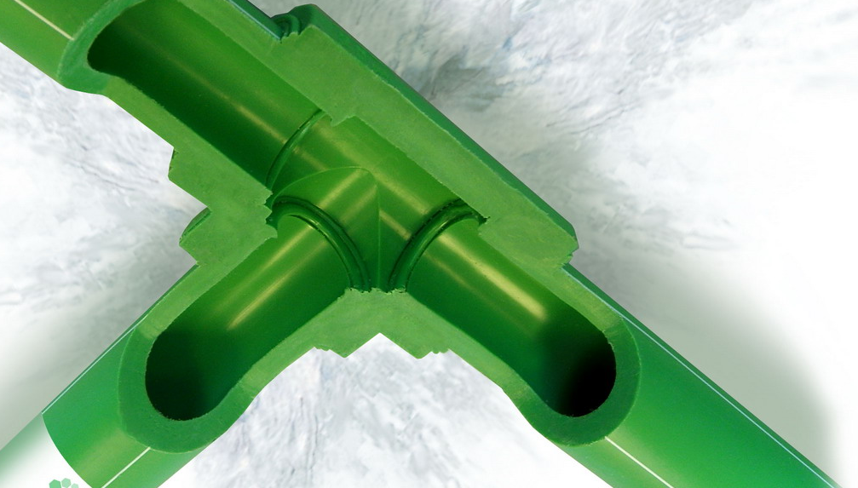
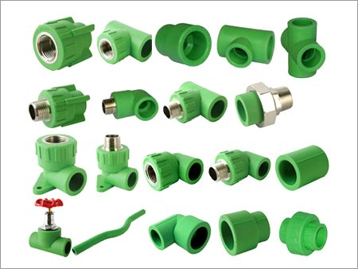
PPRC Pipe & Fittings

Slide 23
PPRC Jointing
PPRC Pipes
Jointing
Process

Slide 24


