Slide 1
CS 35L
Week 4
TA: Tomer Weiss
Jan-26-2016

Slide 2
Change Management
Week 4

Slide 3
What Changes Are We Managing?
Software
Planned software development
team members constantly add new code
(Un)expected problems
bug fixes
Enhancements
Make code more efficient (memory, execution time)
“The only constant in software development is change”

Slide 4
Software development process
Involves making a lot of changes to code
New features added
Bugs fixed
Performance enhancements
Software team has many people working on same/different parts of code
Many versions of software released
Ubuntu 10, Ubuntu 12, etc
Need to be able to fix bugs for Ubuntu 10 even (some customers still use it) though you shipped Ubuntu 12
Notes:
Other example - CAD software

Slide 5
Features Required to Manage Change
Backups
Timestamps
Who made the change?
Where was the change made?
A way to communicate changes with team

Slide 6
How to achieve that
Big project with multiple files
Bug fix required changing multiple files
Bug fix didn’t work
How to find the problem
Figure out which parts changed (diff?)
Communicate changes with team (patch?)
But diff and patch are not that good

Slide 7
Disadvantages of diff & patch
Diff requires keeping a copy of old file before changes
Work with only 2 versions of a file (old & new)
Projects will likely be updated more than once
store versions of the file to see how it evolved over time
index.html index-2009-04-08.html index-2009-06-06.html index-2009-08-10.html index-2009-11-04.html index-2010-01-23.html index-2010-09-21.html
Numbering scheme becomes more complicated if we need to store two versions for the same date

Slide 8
Disadvantages of diff & patch
Two people may edit the same file on the same date
2 patches need to be sent and merged
Changes to one file might affect other files (.h & .c)
Need to make sure those versions are stored together as a group

Slide 9
Source/Version Control
Track changes to code and other files related to software
What new files were added?
What changes made to files?
Which version had what changes?
Which user made the changes?
Revert to previous version
Track entire history of software
Source control software
Git, Subversion (SVN), CVS, and others

Slide 10
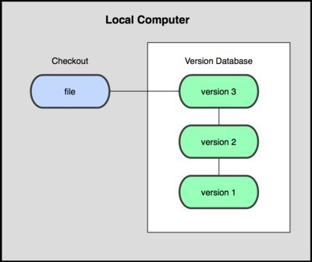
Local SCS
Organize different versions as folders on the local machine
No server involved
Other users copy with disk/network
Image Source: git-scm.com

Slide 11
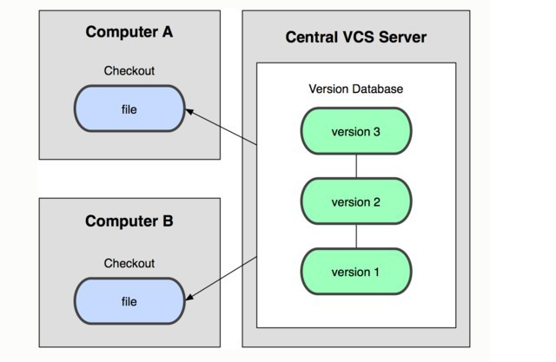
Centralized SCS
Version history sits on a central server
Users will get a working copy of the files
Changes have to be committed to the server
All users can get the changes
Image Source: git-scm.com

Slide 12
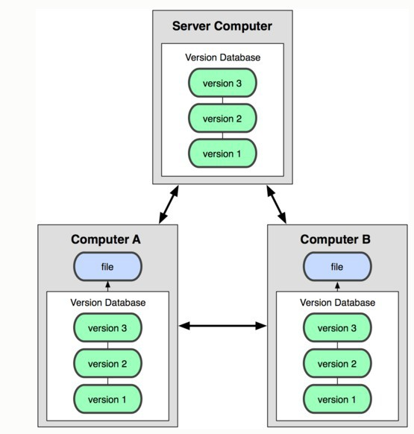
Distributed CCS
Version history is replicated on every user’s machine
Users have version control all the time
Changes can be communicated between users
Git is distributed
Image Source: git-scm.com

Slide 13
Terms used
Repository
Files and folders related to the software code
Full history of the software
Working copy
Copy of software’s files in the repository
Check-out
To create a working copy of the repository
Check-in/Commit
Write the changes made in the working copy to the repository
Commits are recorded by the SCS

Slide 14
Centralized vs. Distributed VCS
Single central copy of the project history on a server
Changes are uploaded to the server
Other programmers can get changes from the server
Examples: SVN, CVS
Each developer gets the full history of a project on their own hard drive
Developers can communicate changes between each other without going through a central server
Examples: Git, Mercurial, Bazaar, Bitkeeper

Slide 15
Centralized: Pros and Cons
“The full project history is only stored in one central place.”
Pros
Everyone can see changes at the same time
Simple to design
Cons
Single point of failure (no backups!)

Slide 16
Distributed: Pros and Cons
“The entire project history is downloaded to the hard drive”
Pros
Commit changes/revert to an old version while offline
Commands run extremely fast because tool accesses the hard drive and not a remote server
Share changes with a few people before showing changes to everyone
Cons
long time to download
A lot of disk space to store all versions

Slide 17
Git source control
Week 4

Slide 18
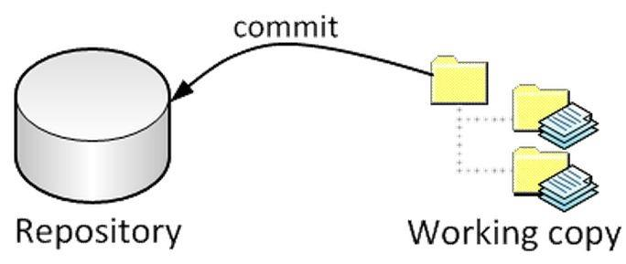
Big Picture
checkout

Slide 19
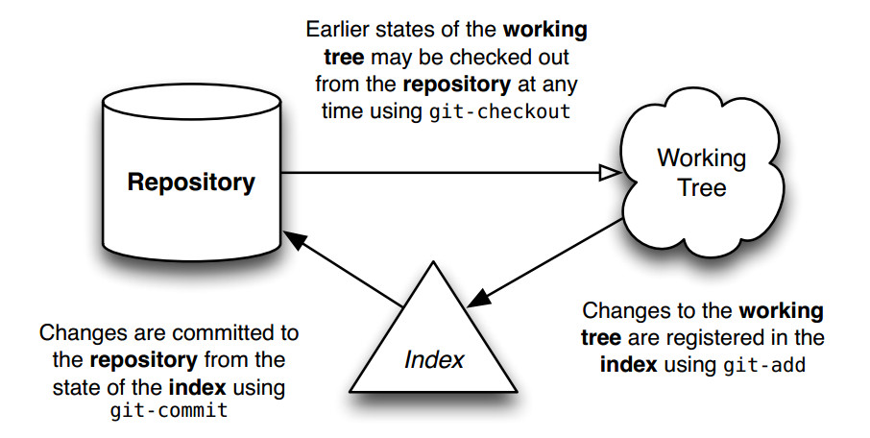
Git Workflow

Slide 20
Git commands
Repository creation
git init (start a new repository)
git clone (create a copy of an existing repository)
Branching
git checkout <tag/commit> -b <new_branch_name> (creates a new branch)
Commits
git add (stage modified files)
git commit (check-in changes to the repository)
Getting info
git status (shows modified files, new files, etc)
git diff (compares working copy with staged files)
git log (shows history of commits)
git show (show a certain object in the repository)
Getting help
git help

Slide 21
Git Repository Objects
Objects used by Git to implement source control
Blobs
Sequence of bytes
Trees
Groups blobs/trees together
Commit
Refers to a particular “git commit”
Contains all information about the commit
Tags
A named commit object for convenience (e.g. versions of software)
Objects uniquely identified with hashes

Slide 22
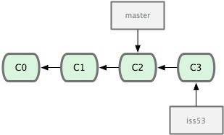
Terms used
Head
Refers to a commit object
There can be many heads in a repository
HEAD
Refers to the currently active head
Detached HEAD
If a commit is not pointed to by a branch
This is okay if you want to just take a look at the code and if you don't commit any new changes
If the new commits have to be preserved then a new branch has to be created
git checkout v3.0 -b BranchVersion3.1
Branch
Refers to a head and its entire set of ancestor commits
Master
Default branch
Image Source: git-scm.com

Slide 23

Git States
Index(cache)
git checkout
git add
git commit
Image Source: git-scm.com

Slide 24
First Git Repository
$ mkdir gitroot
$ cd gitroot
$ git init
creates an empty git repo (.git directory with all necessary subdirectories)
$ echo “Hello World” > hello.txt
$ git add .
Adds content to the index
Must be run prior to a commit
$ git commit –m ‘Check in number one’

Slide 25
Working With Git
$ echo “I love Git” >> hello.txt
$ git status
Shows list of modified files
hello.txt
$ git diff
Shows changes we made compared to index
$ git add hello.txt
$ git diff
No changes shown as diff compares to the index
$ git diff HEAD
Now we can see changes in working version
$git commit –m ‘Second commit’

Slide 26
Undoing What Is Done
git checkout
Used to checkout a specific version/branch of the tree
git rebase master (returns to current working version)
git revert
Reverts a commit
Does not delete the commit object, just applies a patch
Reverts can themselves be reverted!
Git never deletes a commit object
It is very hard to lose data

Slide 27
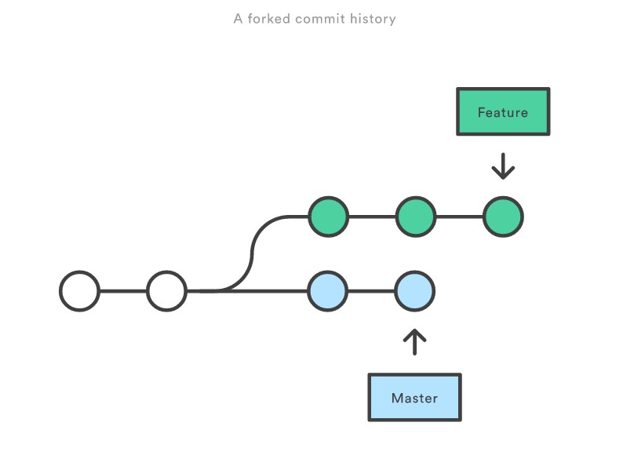
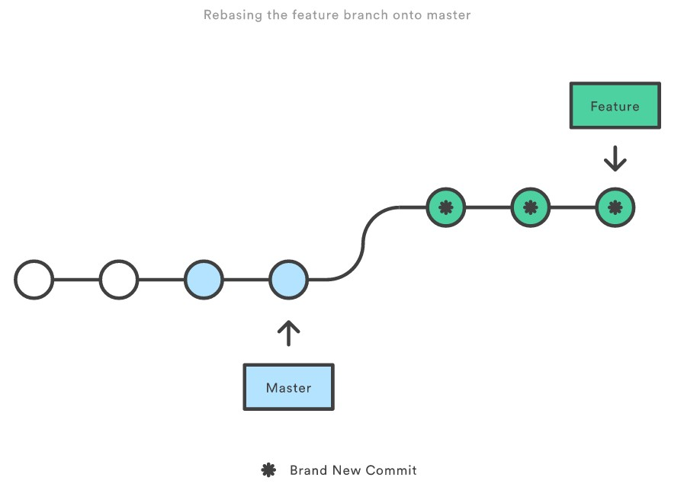
Git Rebase
Rewrites commit history.
Loses context
Never use this on public branches!
How to rebase?
$ git checkout feature
$ git rebase master
Source - https://www.atlassian.com/git/tutorials

Slide 28
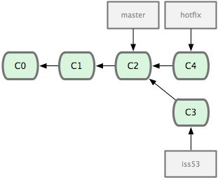
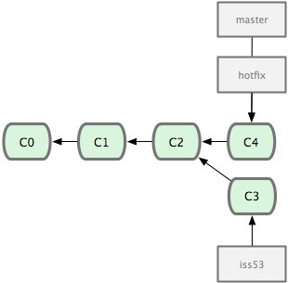
Merging
Merging hotfix branch into master
git checkout master
git merge hotfix
Git tries to merge automatically
Simple if it is a forward merge
Otherwise, you have to manually resolve conflicts
Image Source: git-scm.com

Slide 29
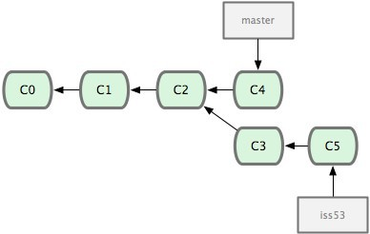
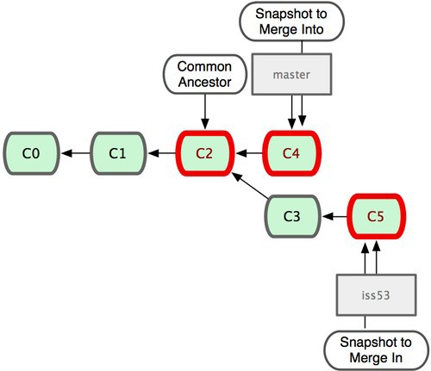
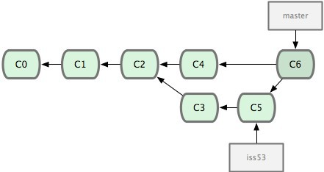
Merging
Image Source: git-scm.com
Merge iss53 into master
Git tries to merge automatically by looking at the changes since the common ancestor commit
Manually merge using 3-way merge or 2-way merge
Merge conflicts - Same part of the file was changed differently

Slide 30
Merging
Image Source: git-scm.com
Refer to multiple parents
git show hash
git show hash^2 (shows second parent)
HEAD^^ == HEAD~2

Slide 31
More Git commands
Reverting
git checkout HEAD main.cpp
Gets the HEAD revision for the working copy
git checkout -- main.cpp
Reverts changes in the working directory
git revert
Reverts commits (this creates new commits)
Cleaning up untracked files
git clean
Tagging
Human readable pointers to specific commits
git tag -a v1.0 -m ‘Version 1.0’
This will name the HEAD commit as v1.0

Slide 32
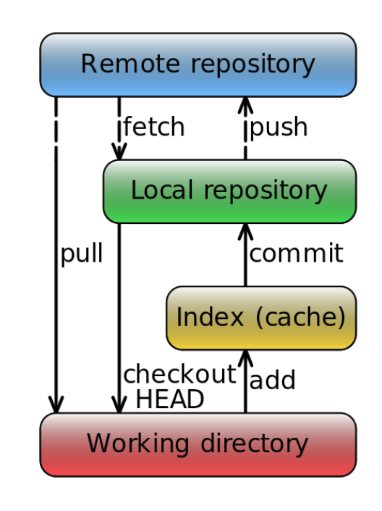
Overview
clone

Slide 33
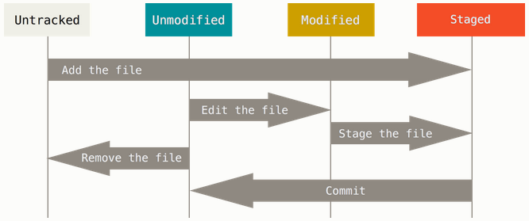
Git File Status Lifecycle
Tracked

Slide 34
Git Example
Project
games: pacman.c, pacman.h, README
Create repository to track new project
$ git init (creates .git dir w/ all necessary repo files)
Is the project tracked?
No, need to add files and do an initial commit
$ git add pacman.c pacman.h README
$ git commit –m “initial commit of my project”

Slide 35
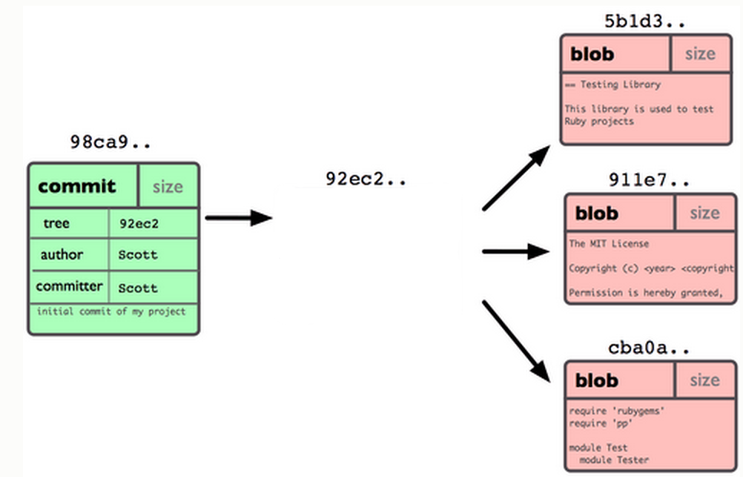
Git Repo Structure
Snapshot
tree |  | size
blob | 5b1d3 | README
blob | 911e7 | pacman.c
blob | cba0a | pacman.h

Slide 36
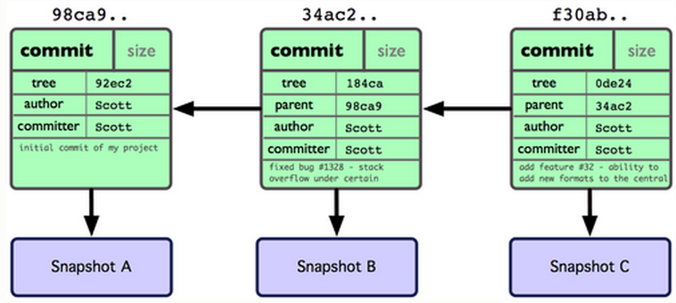
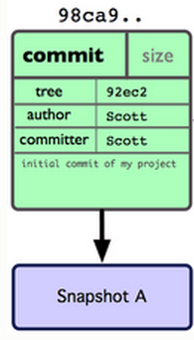
After 2 More Commits…

Slide 37
What Is a Branch?
A pointer to one of the commits in the repo (head) + all ancestor commits
When you first create a repo, are there any branches?
Default branch named ‘master’
The default master branch
points to last commit made
moves forward automatically, every time you commit

Slide 38
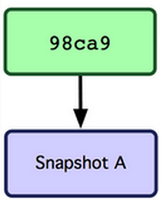
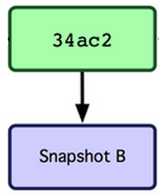
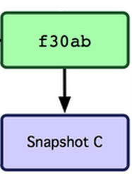
Where Is Master?
master
master

Slide 39
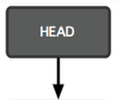
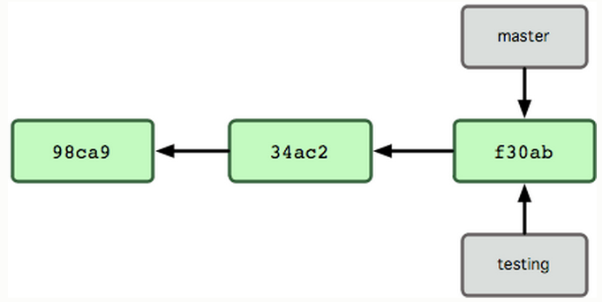
New Branch
Creating a new branch = creating new pointer
$ git branch testing
Where is new branch created?
Current commit
Where is current commit?
HEAD

Slide 40
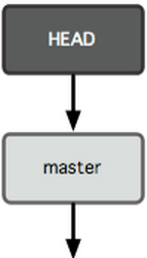
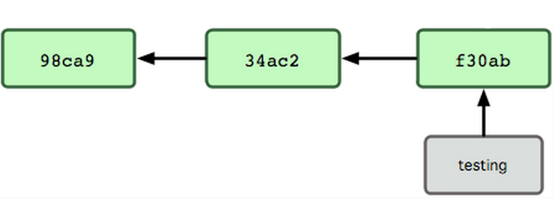
New Commit
What happens if we make another commit?
345f5

Slide 41
Switching to New Branch
Check out new branch
$ git checkout <branch_name>
$ git checkout testing

Slide 42
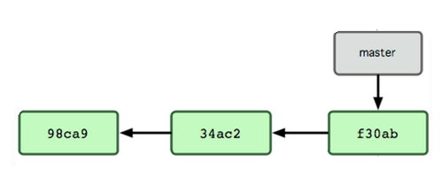

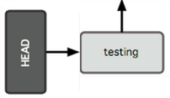
Commit After Switch

Slide 43
Why Branching?
Experiment with code without affecting main branch
Separate projects that once had a common code base
2 versions of the project

Slide 44
Merging I
master
Need to fix a bug
Create a branch
$ git branch bugFix
$ git checkout bugFix
Make some progress
Make a commit
C0
C1
C2
C3
bugFix

Slide 45
Merging II
Not done with bugFix, but need to fix
a simple but urgent bug
Go back to master:
$ git checkout master
=> Create a branch & check it out
$ git checkout –b urgentFix
Make some progress
Make a commit
master
C4
C0
C1
C2
C3
urgentFix
bugFix

Slide 46
Merging III
When confident about fix, we can
merge it back into master
$ git checkout master
$ git merge urgentFix
$ git branch –d urgentFix
urgentFix
master
master
C4
C0
C1
C2
C3
bugFix

Slide 47
Useful Links
Git Tutorial
By topic
Git Beginner’s Tutorial (alternative)
Step by step tutorial + testing terminal
Git Visual Guide
For visualizing what each command does
Git From The Bottom Up
For understanding how Git is structured and the details of how it tracks changes

Slide 48
More Git hints
Git beginner's tutorial (highly recommended):
Click here
Git cheat sheet:
Click here
Putty X11 forwarding (you'll need this for gitk):
Click here
gitk introduction/tutorial:
Click here

Slide 49
Homework 4
Publish patch you made in lab 4
Create a new branch “quote” off of version 3.0
Branch command + checkout command (git branch quote v3.0; git checkout quote)
$ git checkout v3.0 -b quote
Use patch from lab 4 to modify this branch
Patch command
$ patch –pnum < quote-3.0-patch.txt
Modify ChangeLog-2008 file in diffutils directory
Add entry for your changes similar to entries in ChangeLog
Commit changes to the new branch
$ git add . $ git commit –F <Changelog file>
Generate a patch that other people can use to get your changes
$ git format-patch -[num] --stdout > formatted-patch.txt
Test your partner’s patch
Check out version 3.0 into a tmp branch
Apply patch with git am command: $ git am < formatted-patch.txt
Build and test with $ make check
Make sure partner’s name is in HW4.txt for #8

Slide 50
Backporting
Taking a certain software modification (patch) and applying it to an older version of the software than it was initially created for.

Slide 51
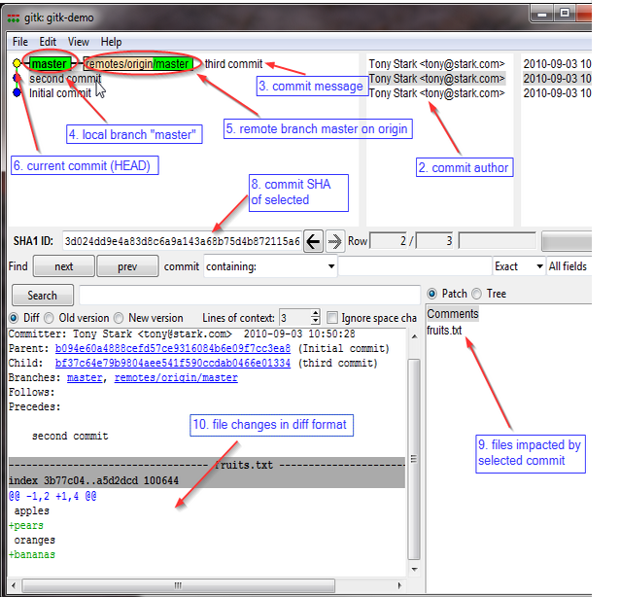
Gitk
A repository browser
Visualizes commit graphs
Used to understand the structure of the repo
Tutorial: http://lostechies.com/joshuaflanagan/2010/09/03/use-gitk-to-understand-git/

Slide 52
Gitk
SSH into the server with X11 enabled
ssh -X for OS with terminal (OS X, Linux)
Select “X11” option if using putty (Windows)
Run gitk in the ~eggert/src/gnu/emacs directory
Need to first update your PATH
$ export PATH=/usr/local/cs/bin:$PATH
Run X locally before running gitk
Xming on Windows

