Slide 1
CS 35L
Week 8
Slides from: TA: Tomer Weiss
Feb-23-2016

Slide 2
Multithreading/Parallel Processing
Week 8

Slide 3
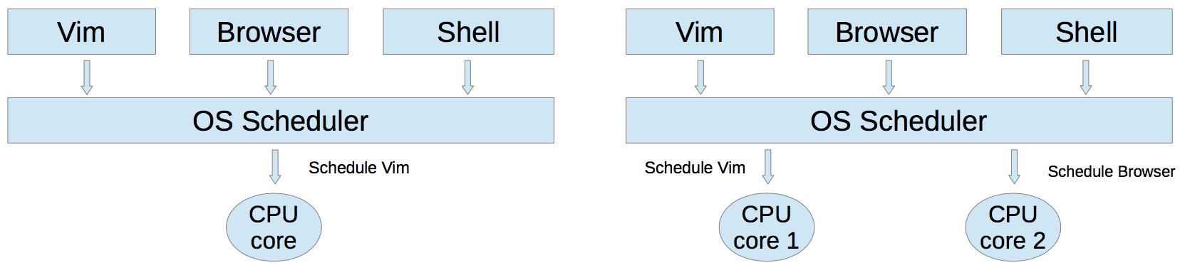
Multitasking
Run multiple processes simultaneously to increase performance
Processes do not share internal structures (stacks,globals,etc)
Communicate via IPC (inter-process communication) methods
Pipes, sockets, signals, message queues
Single core: Illusion of parallelism by switching processes quickly (time-sharing). Why is illusion good?
Multi-core: True parallelism. Multiple processes execute concurrently on different CPU cores

Slide 4
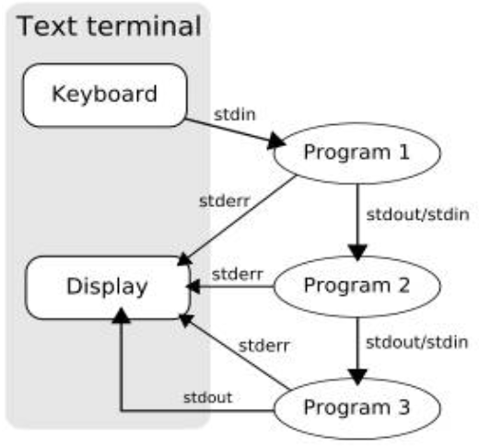
Multitasking
tr -s ‘[:space:]’ ‘\n’ | sort -u | comm -23 - words
Three separate processes spawned simultaneously
P1 - tr
P2 - sort
P3 - comm
Common buffers (pipes) exist between 2 processes for communication
‘tr’ writes its stdout to a buffer that is read by ‘sort’
‘sort’ can execute, as and when data is available in the buffer
Similarly, a buffer is used for communicating between ‘sort’ and ‘comm

Slide 5
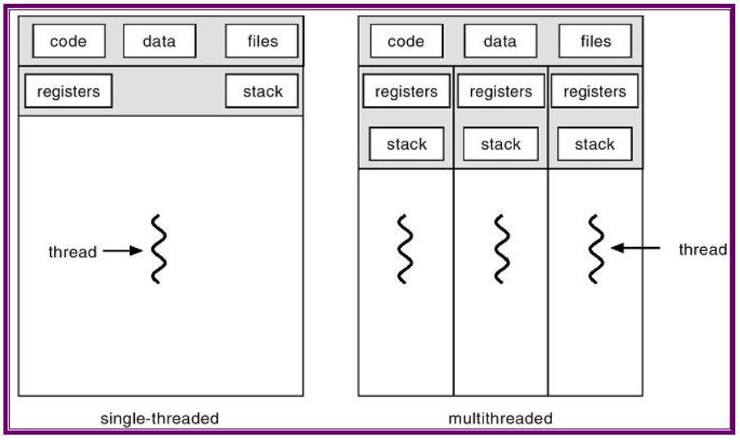
Threads
A process can be
Single-threaded
Multi-threaded
Threads in a process can run in parallel
A thread is a lightweight process
It is a basic unit of CPU utilization
Each thread has its own:
Stack
Registers
Thread ID
Each thread shares the following with other threads belonging to the same process
Code
Global Data
OS resources (files,I/O)

Slide 6
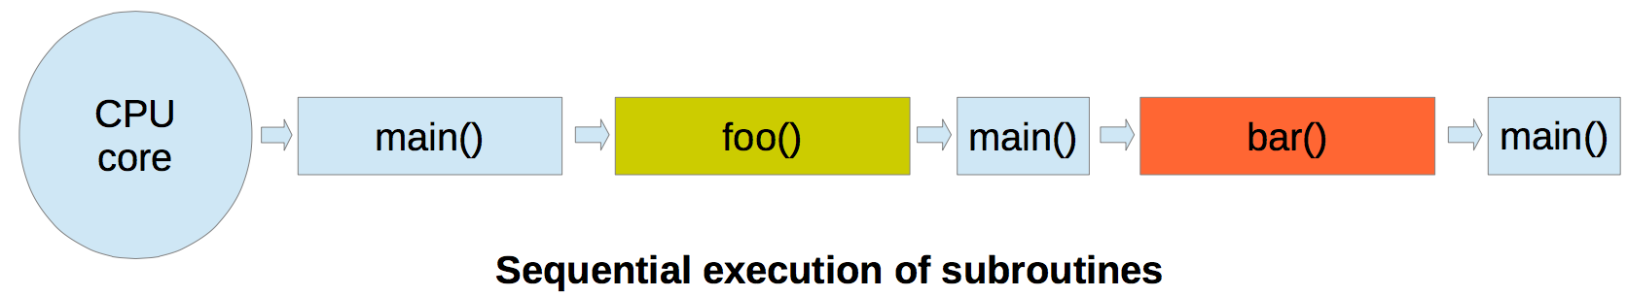
Single threaded execution
int global_counter = 0
int main()
{
…
foo(arg1,arg2);
bar(arg3,arg4,arg5);
…
return 0;
}
void foo(arg1,arg2)
{
//code for foo
}
void bar(arg3,arg4,arg5)
{
//code for bar
}

Slide 7
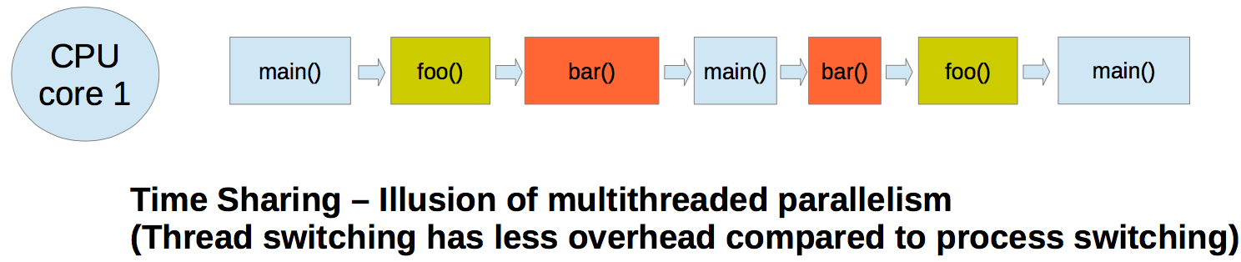
Multi threaded execution (single core)
int global_counter = 0
int main()
{
…
foo(arg1,arg2);
bar(arg3,arg4,arg5);
…
return 0;
}
void foo(arg1,arg2)
{
//code for foo
}
void bar(arg3,arg4,arg5)
{
//code for bar
}

Slide 8
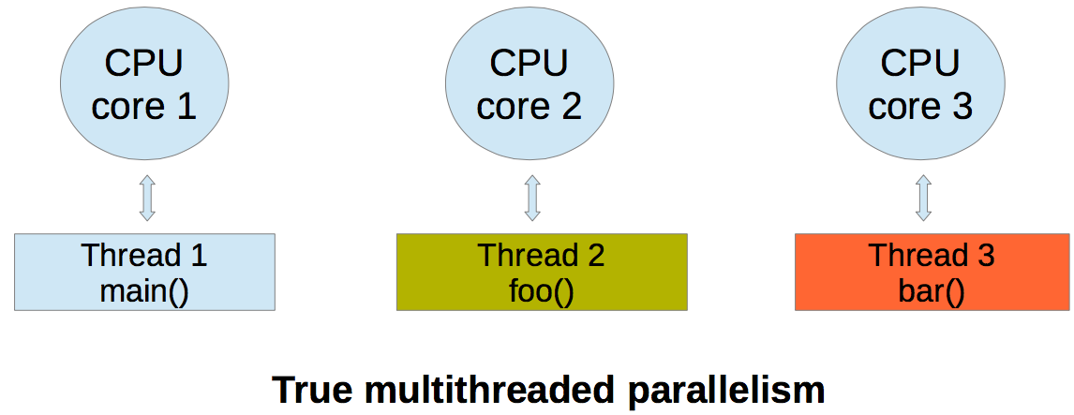
Multi threaded execution (multiple cores)
int global_counter = 0
int main()
{
…
foo(arg1,arg2);
bar(arg3,arg4,arg5);
…
return 0;
}
void foo(arg1,arg2)
{
//code for foo
}
void bar(arg3,arg4,arg5)
{
//code for bar
}

Slide 9
Multithreading properties
Efficient way to parallelize tasks
Thread switches are less expensive compared to process switches (context switching)
Inter-thread communication is easy, via shared global data
Need synchronization among threads accessing same data

Slide 10
Pthread API
#include <pthread.h>
int pthread_create(pthread_t *thread, const pthread_attr_t *attr,void* (*thread_function) (void*), void *arg);
Returns 0 on success, otherwise returns non-zero number
void pthread_exit(void *retval);
int pthread_join(pthread_t thread, void **retval);
Returns 0 on success, otherwise returns non zero error number

Slide 11
Pthread API
#include<pthread.h> //Compile the following code as – gcc main.c -lpthread
#include<stdio.h>
void* ThreadFunction(void *arg) {
long tID = (long)arg;
printf("Inside thread function with ID = %ld\n", tID); pthread_exit(0);}
int main(int argc, char *argv[]) {
const int nthreads = 5; pthread_t threadID[nthreads]; long t;
for(t = 0; t < nthreads; ++t) {
int rs = pthread_create(&threadID[t], 0, ThreadFunction, (void*)t);
if(rs) {
fprintf(stderr, "Error creating thread\n");
return -1; }}
printf("Main thread finished creating threads\n");
for(t = 0; t < nthreads; ++t) {
void *retVal;
int rs = pthread_join(threadID[t], &retVal);
if(rs) {
fprintf(stderr, "Error joining thread\n");
return -1;
}}
printf("Main thread finished execution!\n");
return 0; }

Slide 12
Thread safety/synchronization
Thread safe function - safe to be called by multiple threads at the same time. Function is free of ‘race conditions’ when called by multiple threads simultaneously.
Race condition - the output depends on the order of execution
Shared data changed by 2 threads
int balance = 1000
Thread 1
T1 - read balance
T1 - Deduct 50 from balance
T1 - update balance with new value
Thread 2
T2 - read balance
T2 - add 150 to balance
T2 - update balance with new value

Slide 13
Thread safety/synchronization
Order 1
balance = 1000
T1 - Read balance (1000)
T1 - Deduct 50
950 in temporary result
T2 - read balance (1000)
T1 - update balance
balance is 950 at this point
T2 - add 150 to balance
1150 in temporary result
T2 - update balance
balance is 1150 at this point
The final value of balance is 1150
Order 2
balance = 1000
T1 - read balance (1000)
T2 - read balance (1000)
T2 - add 150 to balance
1150 in temporary result
T1 - Deduct 50
950 in temporary result
T2 - update balance
balance is 1150 at this point
T1 - update balance
balance is 950 at this point
The final value of balance is 950

Slide 14
Thread synchronization
Mutex (mutual exclusion)
Thread 1
Mutex.lock()
Read balance
Deduct 50 from balance
Update balance with new value
Mutex.unlock()
Thread 2
Mutex.lock()
Read balance
Add 150 to balance
Update balance with new value
Mutex.unlock()
balance = 1100
Only one thread will get the mutex. Other thread will block in Mutex.lock()
Other thread can start execution only when the thread that holds the mutex calls Mutex.unlock()

Slide 15
Lab 8
Evaluate the performance of multithreaded ‘sort’ command
od -An -f -N 4000000 < /dev/urandom | tr -s ' ' '\n' > random.txt
Might have to modify the command above
Delete the empty line
time -p sort -g --parallel=2 numbers.txt > /dev/null
Add /usr/local/cs/bin to PATH
$ export PATH=/usr/local/cs/bin:$PATH
Generate a file containing 10M random double-precision floating point numbers, one per line with no white space
/dev/urandom: pseudo-random number generator

Slide 16
Lab 8
od
write the contents of its input files to standard output in a user-specified format
Options
-t f: Double-precision floating point
-N <count>: Format no more than count bytes of input
sed, tr
Remove address, delete spaces, add newlines between each float

Slide 17
Lab 8
use time -p to time the command sort -g on the data you generated
Send output to /dev/null
Run sort with the --parallel option and the
–g option: compare by general numeric value
Use time command to record the real, user and system time when running sort with 1, 2, 4, and 8 threads
$ time –p sort –g file_name > /dev/null (1 thread)
$ time –p sort –g --parallel=[2, 4, or 8] file_name > /dev/null
Record the times and steps in log.txt

Slide 18
Multithreading reminder
Multithreads is an efficient way to parallelize tasks
Thread switches are less expensive compared to process switches (context switching)
Inter-thread communication is easy, via shared global data
Need synchronization among threads accessing same data
e.g. Mutex.lock(), Mutex.unlock()

Slide 19
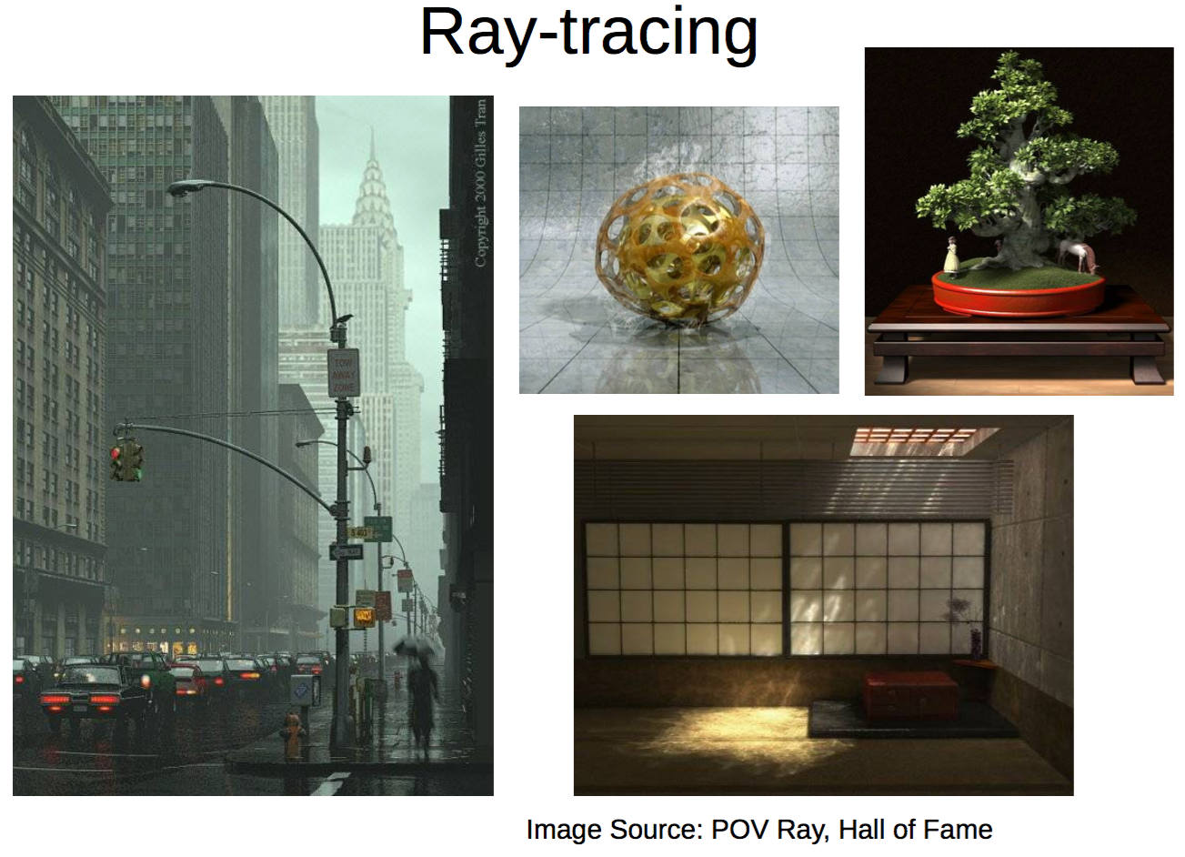
hof.povray.org

Slide 20

Motivation
Siggraph 2015 technical papers
Siggraph Asia 2015 technical papers

Slide 21
Ray-Tracing
Powerful rendering technique in Computer Graphics
Yields high quality rendering
Suited for scenes with complex light interactions
Visually realistic
Trace the path of light in the scene
Computationally expensive
Not suited for real-time rendering (e.g. games)
Suited for rendering high quality pictures (e.g. movies)
Embarrassingly parallel
Good candidate for multi-threading
Threads need not synchronize with each other, because each thread works on a different pixel

Slide 22


Without ray tracing
With ray tracing

Slide 23
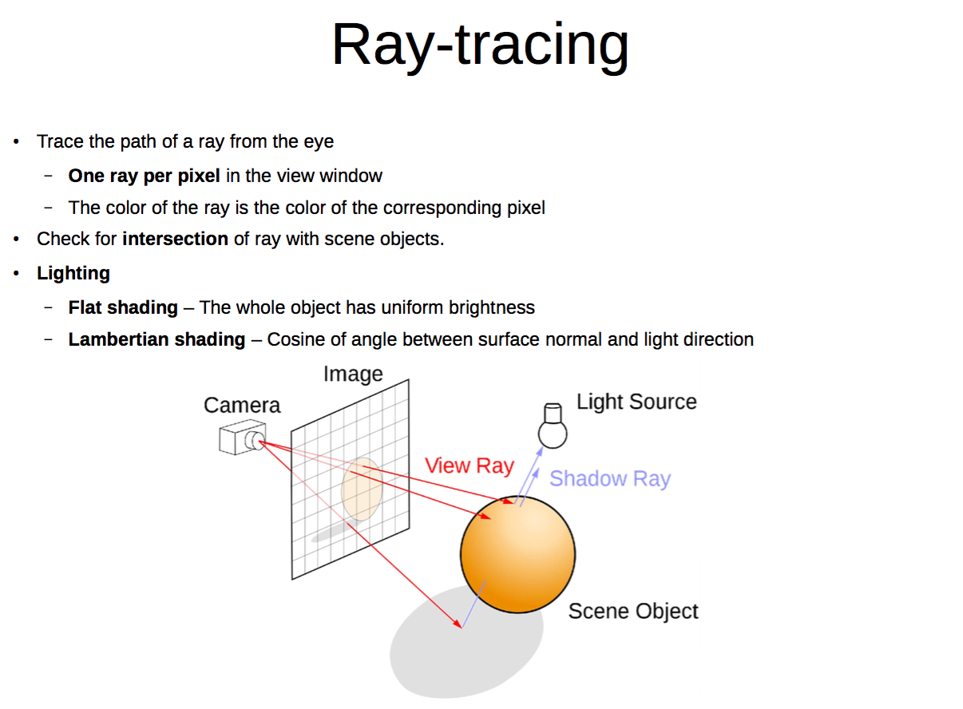

Slide 24
Pthread API
#include <pthread.h>
int pthread_create(pthread_t *thread, const pthread_attr_t *attr,void* (*thread_function) (void*), void *arg);
Returns 0 on success, otherwise returns non-zero number
void pthread_exit(void *retval);
int pthread_join(pthread_t thread, void **retval);
thread: thread ID of thread to wait on
retval: the exit status of the target thread is stored in the location pointed to by *retval
Pass in NULL if no status is needed
Returns 0 on success, otherwise returns non zero error number

Slide 25
Pthread API
#include<pthread.h> //Compile the following code as – gcc main.c -lpthread
#include<stdio.h>
void* ThreadFunction(void *arg) {
long tID = (long)arg;
printf("Inside thread function with ID = %ld\n", tID); pthread_exit(0);}
int main(int argc, char *argv[]) {
const int nthreads = 5; pthread_t threadID[nthreads]; long t;
for(t = 0; t < nthreads; ++t) {
int rs = pthread_create(&threadID[t], 0, ThreadFunction, (void*)t);
if(rs) {
fprintf(stderr, "Error creating thread\n");
return -1; }}
printf("Main thread finished creating threads\n");
for(t = 0; t < nthreads; ++t) {
void *retVal;
int rs = pthread_join(threadID[t], &retVal);
if(rs) {
fprintf(stderr, "Error joining thread\n");
return -1;
}}
printf("Main thread finished execution!\n");
return 0; }

Slide 26
pthread_join Example
#include <pthread.h> …
#define NUM_THREADS 5
void *PrintHello(void *thread_ num) {
printf("\n%d: Hello World!\n", (int) thread_num); }
int main() {
pthread_t threads[NUM_THREADS];
int ret, t;
for(t = 0; t < NUM_THREADS; t++) {
printf("Creating thread %d\n", t);
ret = pthread_create(&threads[t], NULL, PrintHello, (void *) t);
// check return value }
for(t = 0; t < NUM_THREADS; t++) {
ret = pthread_join(threads[t], NULL);
// check return value }
}

Slide 27
Homework 8
Download the single-threaded raytracer implementation
Run it to get output image
Multithread ray tracing
Modify main.c and Makefile
Run the multithreaded version and compare resulting image with single-threaded one

Slide 28
Homework 8
Build a multi-threaded version of Ray tracer
Modify “main.c” & “Makefile”
Include <pthread.h> in “main.c”
Use “pthread_create” & “pthread_join” in “main.c”
Link with –lpthread flag (LDLIBS target)
make clean check
Outputs “1-test.ppm”
Can see “1-test.ppm”
See next slide on how to convert ppm

Slide 29
Viewing ppm file
How to view a ppm file?
ppmtojpeg
ppmtojpeg - is more lightweight than gimp. If you don't already have it, you can download ppmtojpeg as part of the Netpbm package here (windows,linux,mac)
This program comes with many Linux distributions as well as with Cygwin for Windows; it is also installed on the SEAS Unix machines.
ppmtojpeg input-file.ppm > output-file.jpg
Gimp:
sudo apt-get install gimp (Ubuntu)
www.gimp.org - or install on your computer (windows,linux,mac)
scp the file to your local folder to view it
conversion tutorial with gimp
X forwarding (lnxsrv)
gimp 1-test.ppm

Slide 30

1-test.ppm
Figure. 1-test.ppm

Slide 31
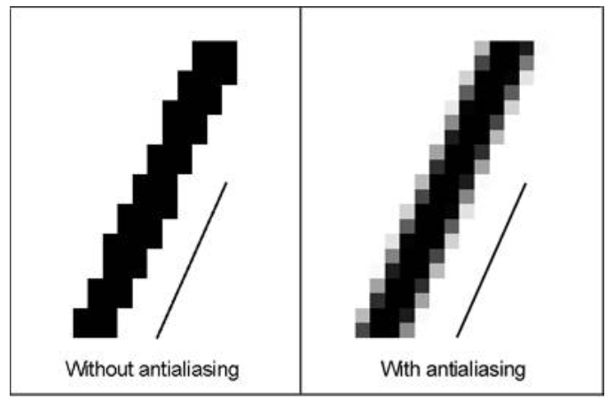
Homework 8 - antialiasing

