Slide 1
CS 35L
Week 6
TA: Tomer Weiss
Feb-09-2016

Slide 2
goo.gl/hTokZ1
Slides

Slide 3
Announcements
Student presentations today:
Google DeepMind's AlphaGo Program defeats European Champion in Go
Robots Learn by Watching “How To” Videos
web.cs.ucla.edu/classes/winter16/cs35L/assign/assign10.html
Next week:
Write your topic here
Not registering you topic beforehand may result in rescheduling of your presentation
For reference on presentation, grading, please refer to this rubric.

Slide 4
SSH - Secure Shell
Week 6

Slide 5
Communication Over the Internet
What type of guarantees do we want?
Confidentiality
Message secrecy
Data integrity
Message consistency
Authentication
Identity confirmation
Authorization
Specifying access rights to resources

Slide 6
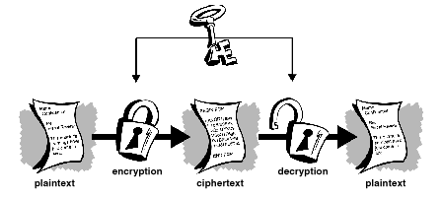
Cryptography
Plaintext - actual message
Ciphertext - encrypted message (unreadable gibberish)
Encryption - converting from plaintext to ciphertext
Decryption - converting from ciphertext to plaintext
Secret key
part of the mathematical function used to encrypt\decrypt
Good key makes it hard to get back plaintext from ciphertext

Slide 7
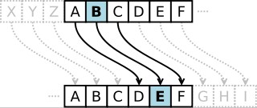
Symmetric-key Encrption
●
Same secret key used for encryption and decryption
●
Example : Data Encryption Standard (DES)
●
Caesar's cipher
–
Map the alphabet to a shifted version
●
ABCDEFGHIJKLMNOPQRSTUVWXYZ DEFGHIJKLMNOPQRSTUVWXYZABC
●
–
Plaintext – SECRET. Ciphertext – VHFUHW Key is 3 (number of shifts of the alphabet)
–
●
Key distribution is a problem
Image Source: wikipedia
–
The secret key has to be delivered in a safe way to the recipient Chance of key being compromised
–
Image Source: gpgtools.org

Slide 8
Public-Key Encryption (Asymmetric)
Uses a pair of keys for encryption
Public Key - published and well known to everyone
Private - Secret key known only to the owner
Encryption
Use public key to encrypt messages
Anyone can encrypt message, but they cannot decrypt the ciphertext
Decryption
Use private key to decrypt messages
In what scheme is this encryption useful?

Slide 9
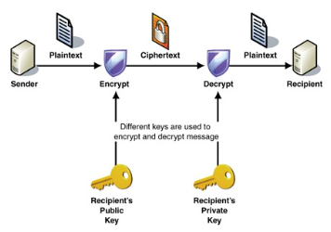
Public-Key Encryption (Asymmetric)
Example: RSA (Rivest, Shamir & Adelman)
Property used: Difficulty of factoring large integers to prime numbers
N= p * q
M is a large integer.
p,q are prime numbers
N is part of the public key
en.wikipedia.org/wiki/RSA_Factoring_Challenge

Slide 10
Encryption Types Comparison
Symmetric Key Encryption
a.k.a shared/secret key
Key used to encrypt is the same as key used to decrypt
Asymmetric Key Encryption: Public/Private
2 different (but related) keys: public and private
Only creator knows the relation. Private key cannot be derived from public key
Data encrypted with public key can only be decrypted by private key and vice versa
Public key can be seen by anyone
Never publish private key!!!

Slide 11
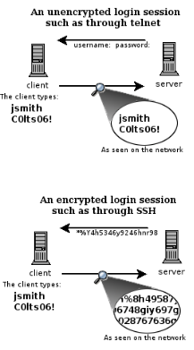
Secure Shell (SSH)
Telnet
Remote access
Not encrypted
Packet sniffers can intercept sensitive information (username/password)
SSH
run processes remotely
encrypted session
Session key (secret key) used for encryption during the session

Slide 12
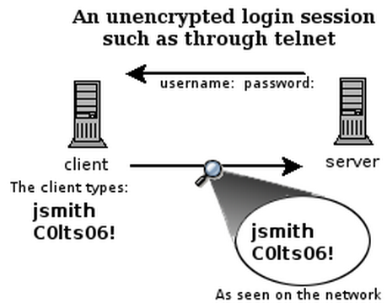
What is SSH?
Secure Shell
Used to remotely access shell
Successor of telnet
Encrypted and better authenticated session
CONFIDENTIAL

Slide 13
Session Encryption
Client and server agree on a symmetric encryption key (session key)
All messages sent between client and server
encrypted at the sender with session key
decrypted at the receiver with session key
anybody who doesn't know the session key (hopefully, no one but client and server) doesn't know any of the contents of those messages

Slide 14
High-Level SSH Protocol
Client ssh’s to remote server
$ ssh username@somehost
If first time talking to server -> host validation
The authenticity of host 'somehost (192.168.1.1)' can't be established. RSA key fingerprint is 90:9c:46:ab:03:1d:30:2c:5c:87:c5:c7:d9:13:5d:75. Are you sure you want to continue connecting (yes/no)? yes Warning: Permanently added 'somehost' (RSA) to the list of known hosts.
ssh doesn't know about this host yet
shows hostname, IP address and fingerprint of the server’s public key, so you can be sure you're talking to the correct computer
After accepting, public key is saved in ~/.ssh/known_hosts

Slide 15
Secure Shell (SSH) - Client Authentication
Password login
ssh username@ugrad.seas.ucla.edu
Passwordless login with keys
Use private/public keys for authentication (server and client authentication)
ssh-keygen
Passphrase (longer version of a password/more secure)
Passphrase for protecting the private key
Passphrase needed whenever the keys are accessed
ssh-copy-id username@ugrad.seas.ucla.edu
Copies the public key to the server (~/.ssh/authorized_keys)
Login without password
ssh username@ugrad.seas.ucla.edu
Run scripts/commands on the remote machine
ssh username@ugrad.seas.ucla.edu ls
But you need to provide a passphrase to use a private key

Slide 16
Secure Shell (SSH) - Client Authentication
Passphrase-less authentication
ssh-agent → authentication agent
Manages private key identities for SSH
To avoid entering the passphrase whenever the key is used
ssh-add
Registers the private key with the agent
Passphrase asked only once
ssh will ask the ssh-agent whenever the private keys are needed

Slide 17
Secure Shell (SSH) - Client Authentication
Session Encryption
Symmetric encryption
Exchange secret key (Example - Diffie-Hellman)
Host/Client Validation
Public-key Encryption
Challenge-Response
Host sends a “challenge” that has to be answered by the client
Similarly, client sends a “challenge” that has to be answered by the host

Slide 18
Account Administration
Install OpenSSH (should be done on both server and client)
sudo apt-get update
sudo apt-get install openssh-server
sudo apt-get install openssh-client
Server
sudo useradd -d /home/<username> -m <UserName>
sudo passwd <username>
cd /home/<username>
sudo mkdir .ssh
sudo chown -R <username> .ssh
sudo chmod 700 .ssh
ifconfig (this will give you the IP address of the server. Give this to your partner).
ps aux | grep ssh
This will give you the
or alternatively pgrep -lf ssh

Slide 19
Account Administration
Client
Password login
ping server_ip_addr (just to check if the server responds)
ssh <username>@server_ip_addr
Password-less login
ssh-keygen
ssh-copy-id -i <username>@server_ip_addr
ssh <username>@server_ip_addr (should not ask for login password)
Passphrase-less login
ssh-add
ssh -X <username>@server_ip_addr (should not ask for key’s passphrase)
X session forwarding - running programs with GUI
ssh -X <UserName>@server_ip_addr
xterm
firefox

Slide 20
X session forwarding
X is the windowing system for GUI apps on linux
X is a network-based system. It is based upon a network protocol such that a program can run on one computer but be displayed on another
i.e. you want to run such apps remotely, but the GUI should show up on the local machine
Windowing system forms the basis for most GUIs on UNIX
ssh -X username@ugrad.seas.ucla.edu
gedit
gimp

Slide 21
Secure copy (scp)
Based on secure shell (ssh)
Used for transferring files between hosts in a secure way (encrypted)
Usage similar to cp
scp [source] [destination]
Transferring to remote host
scp /home/username/doc.txt username@ugrad.seas.ucla.edu:/home/user/docs
Transferring from remote host
scp username@ugrad.seas.ucla.edu:/home/user/docs/foo.txt /home/username

Slide 22
Digital signature
Protect integrity of the documents
Receiver received the document that the sender intended
Digital signature is extra data attached to the document that can be used to check tampering
Message digest
Shorter version of the document
Generated using hashing algorithms
Even a slight change in the original document will change the message digest with high probability

Slide 23
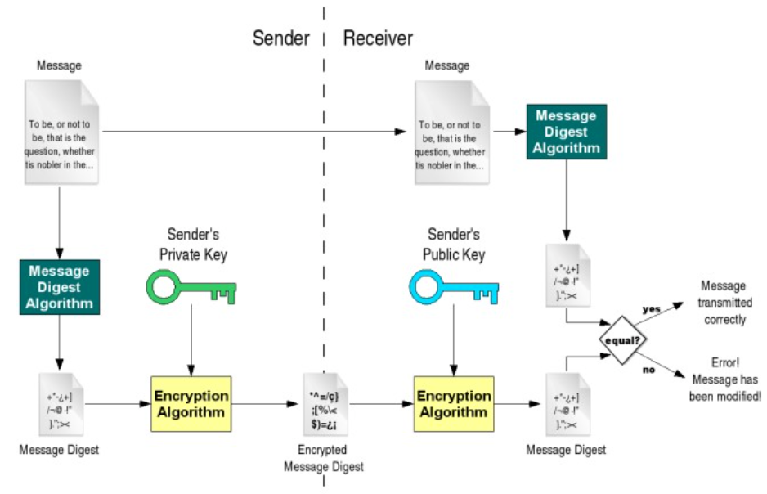
Digital signature
Verifies document integrity, but does it prove origin? and who is the Certificate Authority?

Slide 24
GNU privacy guard
> gpg [option]
--gen key | generating new keys
--armor | ASCII format
--export | exporting public key
--import | import public key
--detach-sign | creates a file with just the signature
--verify | verify signature with a public key
--encrypt | encrypt document
--decrypt | decrypt document
--list-keys | list all keys in the keyring
--send-keys | register key with a public server/-keyserver option
--search-keys | search for someone’s key

Slide 25
Client Authentication
Password-based authentication
Prompt for password on remote server
If username specified exists and remote password for it is correct then the system lets you in
Key-based authentication
Generate a key pair on the client
Copy the public key to the server (~/.ssh/authorized_keys)
Server authenticates client if it can demonstrate that it has the private key
The private key can be protected with a passphrase
Every time you ssh to a host, you will be asked for the passphrase (inconvenient!)

Slide 26
ssh-agent (passphrase-less ssh)
A program used with OpenSSH that provides a secure way of storing the private key
ssh-add prompts user for the passphrase once and adds it to the list maintained by ssh-agent
Once passphrase is added to ssh-agent, the user will not be prompted for it again when using SSH
OpenSSH will talk to the local ssh-agent daemon and retrieve the private key from it automatically

Slide 27
Lab 6
Securely login to each others’ computers
Use ssh (OpenSSH)
Use key-based authentication
Generate key pairs
Make logins convenient
type your passphrase once and be able to use ssh to connect to any other host without typing any passwords or passphrases
Use port forwarding to run a command on a remote host that displays on your host

Slide 28
Lab Environment Setup
Ubuntu
Make sure you have openssh-server and openssh-client installed
$ dpkg --get-selections | grep openssh should output:
openssh-server install
openssh-client install
If not:
$ sudo apt-get install openssh-server
$ sudo apt-get install openssh-client

Slide 29
Server Steps
Generate public and private keys
$ ssh-keygen (by default saved to ~/.ssh/is_rsa and id_rsa.pub) – don’t change the default location
Create an account for the client on the server
$ sudo useradd –d /home/<homedir_name> –m <username>
$ sudo passwd <username>
Create .ssh directory for new user
$ cd /home/<homedir_name>
$ sudo mkdir .ssh
Change ownership and permission on .ssh directory
$ sudo chown –R username .ssh
$ sudo chmod 700 .ssh
Optional: disable password-based authentication
$ emcas /etc/ssh/sshd_config
change PasswordAuthentication option to no

Slide 30
Client Steps
Generate public and private keys
$ ssh-keygen
Copy your public key to the server for key-based authentication (~/.ssh/authorized_keys)
$ ssh-copy-id –i UserName@server_ip_addr
Add private key to authentication agent (ssh-agent)
$ ssh-add
SSH to server
$ ssh UserName@server_ip_addr
$ ssh –X UserName@server_ip_addr (X11 session forwarding)
Run a command on the remote host
$ xterm, $ gedit, $ firefox, etc.

Slide 31
How to Check IP Addresses
$ ifconfig
configure or display the current network interface configuration information (IP address, etc.)
$ ping <ip_addr>(packet internet groper)
Test the reachability of a host on an IP network
measure round-trip time for messages sent from a source to a destination computer
Example: $ ping 192.168.0.1, $ ping google.com

Slide 32
Lab
web.cs.ucla.edu/classes/winter16/cs35L/assign/assign6.html

Slide 33
Homework

Slide 34
Digital signature
An electronic stamp\seal
Digital signature is extra data attached to the document
Can be used to check tampering
Ensures integrity of the documents
Receiver received the document that the sender intended
Message digest
Shorter version of the document
Generated using hashing algorithms
Even a slight change in the original document will change the message digest with high probability

Slide 35
Steps for Generating a Digital Signature
SENDER:
Generate a Message Digest
The message digest is generated using a set of hashing algorithms
A message digest is a 'summary' of the message we are going to transmit
Even the slightest change in the message produces a different digest
Create a Digital Signature
The message digest is encrypted using the sender's private key. The resulting encrypted message digest is the digital signature
Attach digital signature to message and send to receiver

Slide 36
Steps for Generating a Digital Signature
RECEIVER:
Recover the Message Digest
Decrypt the digital signature using the sender’s public key to obtain the message digest generated by the sender
Generate the Message Digest
Use the same message digest algorithm used by the sender to generate a message digest of the received message
Compare digests (the one sent by the sender as a digital signature, and the one generated by the receiver)
If they are not exactly the same => the message has been tampered with by a third party
We can be sure that the digital signature was sent by the sender (and not by a malicious user) because only the sender's public key can decrypt the digital signature and that public key is proven to be the sender’s through the certificate. If decrypting using the public key renders a faulty message digest, this means that either the message or the message digest are not exactly what the sender sent.

Slide 37
Digital signature
Verifies document integrity, but does it prove origin? and who is the Certificate Authority?

Slide 38
GNU privacy guard
> gpg [option]
--gen key | generating new keys
--armor | ASCII format
--export | exporting public key
--import | import public key
--detach-sign | creates a file with just the signature
--verify | verify signature with a public key
--encrypt | encrypt document
--decrypt | decrypt document
--list-keys | list all keys in the keyring
--send-keys | register key with a public server/-keyserver option
--search-keys | search for someone’s key

Slide 39
Homework 6
Answer 2 questions in the file hw.txt
Generate a key pair with the GNU Privacy Guard’s commands
$ gpg --gen-key (choose default options)
Export public key, in ASCII format, into hw-pubkey.asc
$ gpg --armor --output hw-pubkey.asc --export ‘Your Name’
Make a tarball of the above files + log.txt and zip it with gzip to produce hw.tar.gz
$ tar –cf hw.tar <files>
$ gzip hw.tar -> creates hw.tar.gz
Use the private key you created to make a detached clear signature hw.tar.gz.sig for hw.tar.gz
$ gpg --armor --output hw.tar.gz.sig --detach-sign hw.tar.gz
Use given commands to verify signature and file formatting
These can be found at the end of the assignment spec

Slide 40
Lab 6
Securely login to each others’ computers
Use ssh (OpenSSH)
Use key-based authentication
Generate key pairs
Make logins convenient
type your passphrase once and be able to use ssh to connect to any other host without typing any passwords or passphrases
Use port forwarding to run a command on a remote host that displays on your host

Slide 41
Lab Environment Setup
Ubuntu
Make sure you have openssh-server and openssh-client installed
$ dpkg --get-selections | grep openssh should output:
openssh-server install
openssh-client install
If not:
$ sudo apt-get install openssh-server
$ sudo apt-get install openssh-client

Slide 42
Client Authentication
Password-based authentication
Prompt for password on remote server
If username specified exists and remote password for it is correct then the system lets you in
Key-based authentication
Generate a key pair on the client
Copy the public key to the server (~/.ssh/authorized_keys)
Server authenticates client if it can demonstrate that it has the private key
The private key can be protected with a passphrase
Every time you ssh to a host, you will be asked for the passphrase (inconvenient!)

Slide 43
ssh-agent (passphrase-less ssh)
A program used with OpenSSH that provides a secure way of storing the private key
ssh-add prompts user for the passphrase once and adds it to the list maintained by ssh-agent
Once passphrase is added to ssh-agent, the user will not be prompted for it again when using SSH
OpenSSH will talk to the local ssh-agent daemon and retrieve the private key from it automatically

Slide 44
Server Steps
Generate public and private keys
$ ssh-keygen (by default saved to ~/.ssh/is_rsa and id_rsa.pub) – don’t change the default location
Create an account for the client on the server
$ sudo useradd –d /home/<homedir_name> –m <username>
$ sudo passwd <username>
Create .ssh directory for new user
$ cd /home/<homedir_name>
$ sudo mkdir .ssh
Change ownership and permission on .ssh directory
$ sudo chown –R username .ssh
$ sudo chmod 700 .ssh
Optional: disable password-based authentication
$ emcas /etc/ssh/sshd_config
change PasswordAuthentication option to no

Slide 45
Client Steps
Generate public and private keys
$ ssh-keygen
Copy your public key to the server for key-based authentication (~/.ssh/authorized_keys)
$ ssh-copy-id –i UserName@server_ip_addr
Add private key to authentication agent (ssh-agent)
$ ssh-add
SSH to server
$ ssh UserName@server_ip_addr
$ ssh –X UserName@server_ip_addr (X11 session forwarding)
Run a command on the remote host
$ xterm, $ gedit, $ firefox, etc.

Slide 46
How to Check IP Addresses
$ ifconfig
configure or display the current network interface configuration information (IP address, etc.)
$ ping <ip_addr>(packet internet groper)
Test the reachability of a host on an IP network
measure round-trip time for messages sent from a source to a destination computer
Example: $ ping 192.168.0.1, $ ping google.com

Slide 47
Lab
web.cs.ucla.edu/classes/winter16/cs35L/assign/assign6.html

