Slide 1
Crime rate Analysis in Toronto by Neighborhoods
Created by:
Ahmed Abdelrahman
Geon Woo Andy Jeong
Mary Toofani

Slide 2
Background
Team: Data Analytics team in DATAHOLICS Inc. - an emerging startup in Toronto
Client: SafeNet Insurance Corp. - our first client
Goal: Provide an exploratory analysis of historic crime data in the different Neighborhoods of Toronto
Main Deliverable: Qualitative analysis and quantified risk factors for location and other circumstantial categories

Slide 3
Data Sources
Toronto Major Crime Indicators
https://data.torontopolice.on.ca/search?q=crime
This dataset includes all Major Crime Indicators (MCI) occurrences by reported date and related offences from 2014 to June 30, 2022
Maintained by Toronto Police Service
CVS Format via GUI Download
Toronto Open Data
https://open.toronto.ca/dataset/neighbourhood-profiles/
Census data collected and maintained by the City of Toronto
Text format via API Request
Google Maps API
https://developers.google.com/maps
Google maintained location data
JSON format via API request

Slide 4
Data Set Limitations
Toronto Major Crime Indicators
Missing values
Data entry errors
Toronto Open Data
Population Data for 2016 only
Google Maps API
Association of Neighbourhoods and Districts contain missing values

Slide 5
Research Questions and Deliverables
Research Questions
Does criminal activity vary significantly between different Neighborhoods in Toronto?
Is there a historic trend for criminal activity for the City of Toronto and for each Neighborhood?
Is criminal activity affected significantly by the following circumstances:
Premise type?
Time of Day?
Season?
Weekday/Weekend?
Does the type of criminal activity vary significantly?
Deliverables
Provide a location based and category based quantitative risk factor based on the data for statistically significant findings.

Slide 6
Qualitative / Visual Results

Slide 7
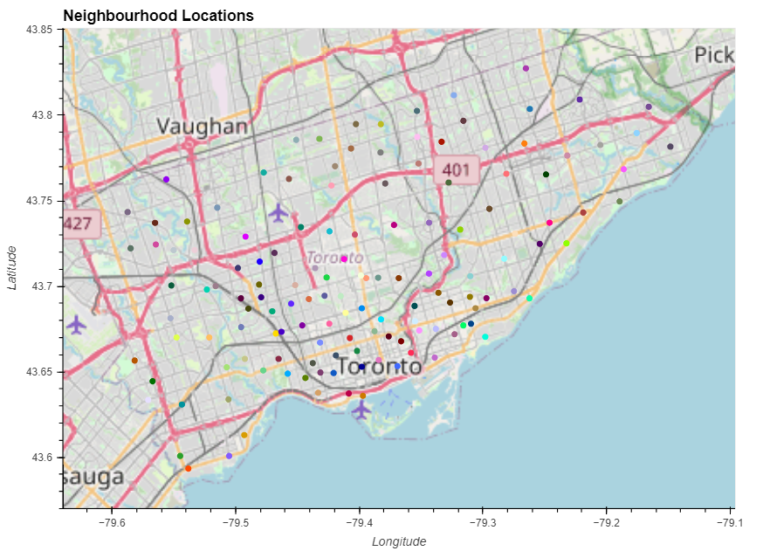
Neighborhood Locations

Slide 8
What are the safest Areas in GTA?

Slide 9
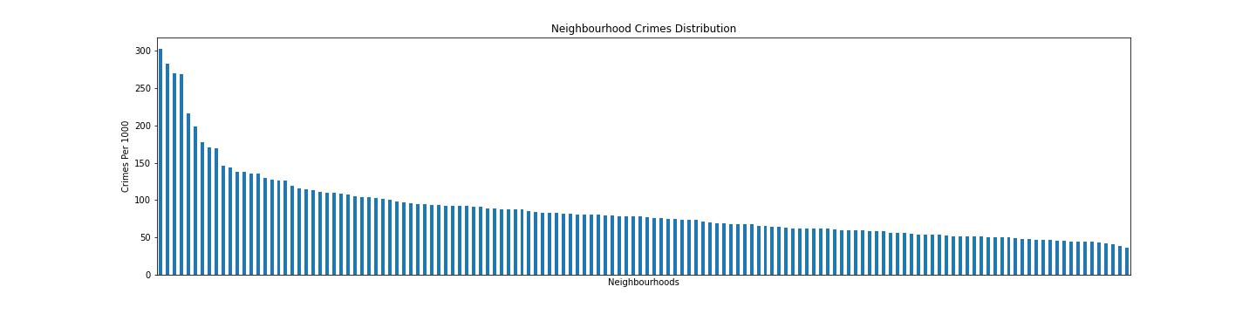
Neighborhood Crimes Distribution

Slide 10
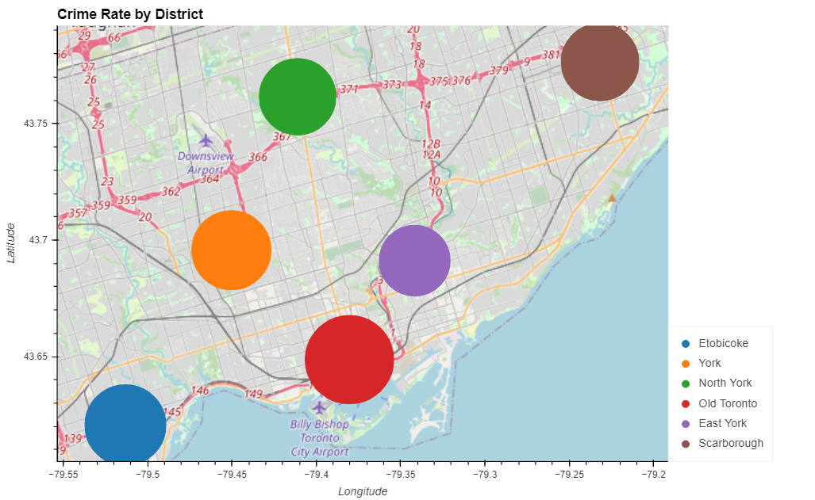
Crime Rate by Districts

Slide 11
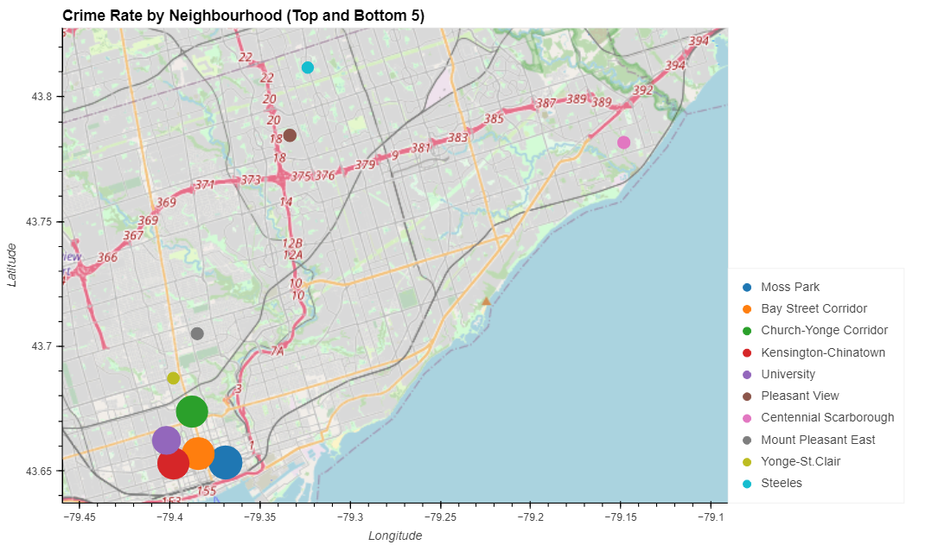
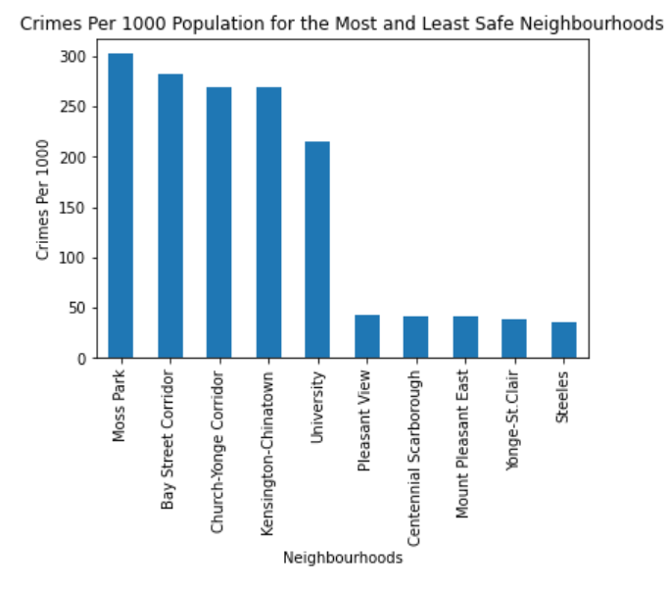
Crime Rate by Neighborhood

Slide 12
Categorical Results

Slide 13
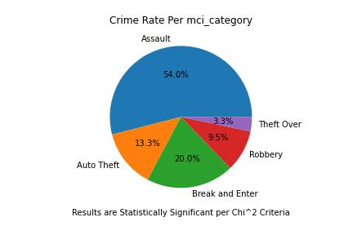
What type of Crimes happen in GTA?

Slide 14
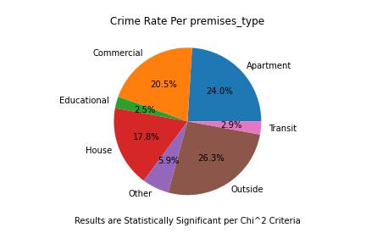
What are crime rates per Premises Type?

Slide 15
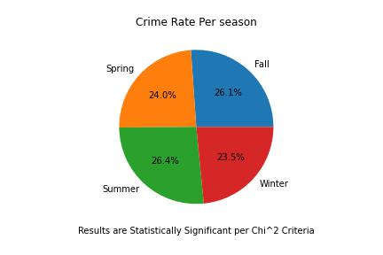
What are crime rates in different seasons?

Slide 16
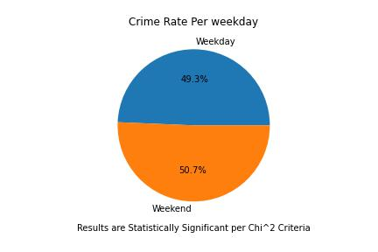
Crime rate is more of less during weekend or weekday?

Slide 17
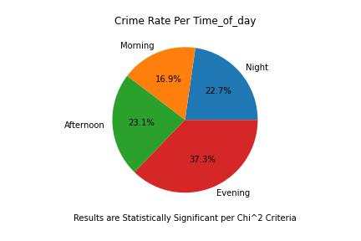
What Time of day the crime rate are more?

Slide 18
Historic Results

Slide 19
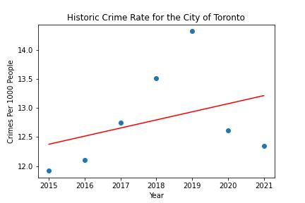
Regression Analysis for the city of Toronto
The r-squared is: 12.6%
Data is not correlated to time
Over -all criminal activity clearly dropped in 2020, this could potentially be related to COVID

Slide 20
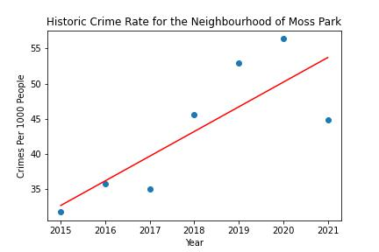
Regression Analysis for 5 least Safe Neighborhoods
The r-squared is: 65%
Data appears to be positively correlated with time
Crime dropped in 2021
2022 data would help establish a trend

Slide 21
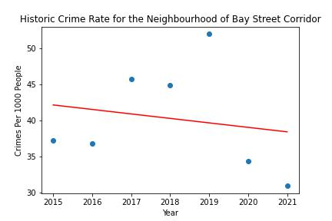
Regression Analysis for 5 least Safe Neighborhoods
The r-squared is: 3.2%
Data is not correlated with time

Slide 22
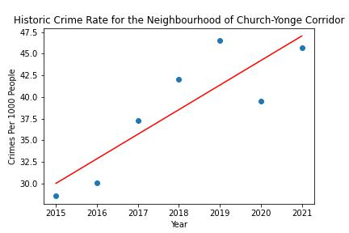
Regression Analysis for 5 Least Safe Neighborhoods
The r-squared is: 75%

Slide 23
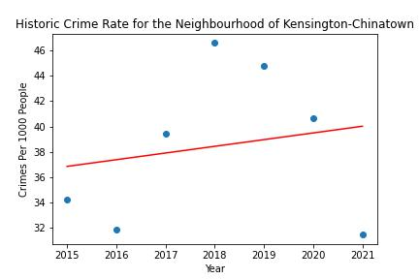
Regression Analysis for 5 Least Safe Neighborhoods
The r-squared is: 3.5%

Slide 24
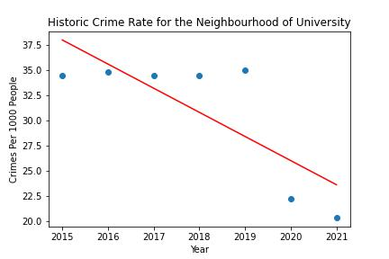
Regression Analysis for 5 Least Safe Neighborhoods
The r-squared is:62%

Slide 25
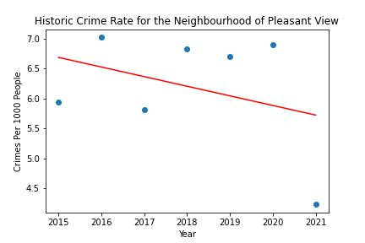
Regression Analysis for 5 Most Safe Neighborhoods
The r-squared is: 12%

Slide 26
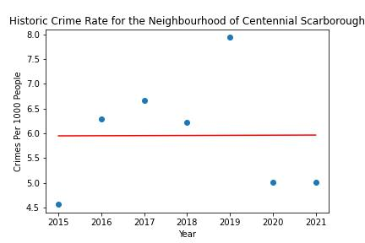
Regression Analysis for 5 Most Safe Neighborhoods
The r-squared is: 0.00%

Slide 27
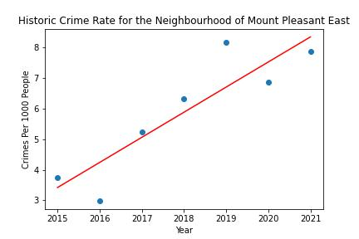
Regression Analysis for 5 Most Safe Neighborhoods
The r-squared is: 80%

Slide 28
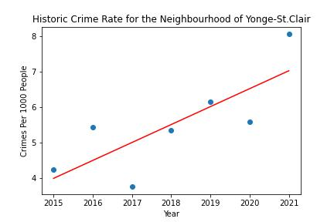
Regression Analysis for 5 Most Safe Neighborhoods
The r-squared is: 62%

Slide 29
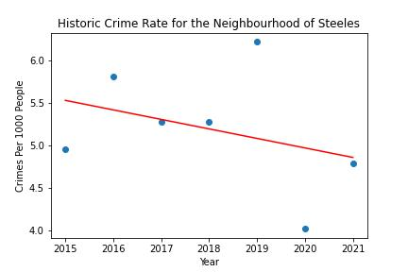
Regression Analysis for 5 Most Safe Neighborhoods
The r-squared is: 11.5%

Slide 30
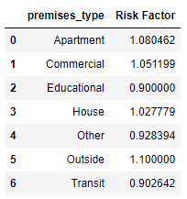
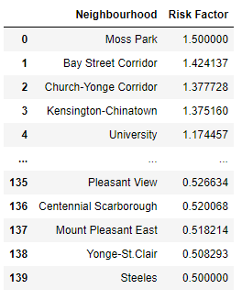
Risk Factor
Premise Type
Neighborhoods
Risk factors were calculated via a predefined formula based on the mean and standard deviation and bounded by user input
Risk factors were calculated for all statistically significant findings which was true for all categories

Slide 31
Statistical Findings
Location:
Criminal Activity Varies Significantly between Toronto’s Neighborhoods
There is no clear correlation for criminal activity for the past 7 years
There are specific neighborhoods that showed an increase in criminal activity correlated to time
Categorical:
All circumstantial categories were statistically significant
More than 50% of criminal activity was attributed to a single category

Slide 32
Conclusions
Crime rates trend in Toronto is not strongly correlated with time.
Correlation with time varies between specific neighborhoods.
The safest areas in GTA are: Pleasant View, Centennial Scarborough, Mount Pleasant East, Yonge St.Clair and Steels.
Five least safe areas are: Moss Park, Bay Street Corridor, Church-Yonge Corridor, Kensington-China Town and University.
Most crimes occur in the evening (6.00pm to 12.00am) and the least crimes occur in the morning (6.00am to 12.00pm)
Different types of crime in GTA are (In order from highest to lowest) Assault, Break and Enter, Auto Theft and Theft Over $5000.
Variation between categories was significant for the Premise type and time of day
Variation was less significant for the seasonal and weekend/weekday parameters

Slide 33
Future Steps
Analyze the historic trend in more detail for each Neighborhood
Establish a bonus risk factor for Neighborhoods with statistically correlated reduction in year-to-year criminal activity and a penalty to neighborhoods with statistically significant increases.

Slide 34
Dateslider!

Slide 35
Q&A

Slide 36
Thanks for your attention

