Slide 1
Crime rate Analysis in Toronto by Neighborhoods
Created by:
Ahmed Abdelrahman
Geon Woo Andy Jeong
Mary Toofani

Slide 2
Who we are ?
We are a team in a data analytics company, and we have recently been asked by an insurance company to find various crime data of different sectors of Toronto to help them find out risk factors for each district.
Premiums are calculated based on the risk factors, so our data is important in setting the right premiums. We have come up with the following questions in order to help the insurance company calculate reasonable premiums so that they can charge their clients appropriately.

Slide 3
Agenda
Resources
What are the safest Areas in GTA?
What are different types of Crime in GTA?
What are most and least safe 5 neighborhoods in GTA?
How crime rate does change during seasons?
How crime rate does change during weekday or weekends?
How crime rate does change during day/night?
How crime rate does change vs premises type?
How crime rate does vary in city of Toronto?
How crime rate vary for most and least safe 5 neighborhoods?
Summary and Results
Q&A

Slide 4
Resources
https://open.toronto.ca/dataset/neighbourhood-profiles/
https://open.toronto.ca/dataset/neighbourhood-crime-rates/
https://developers.google.com/maps

Slide 5
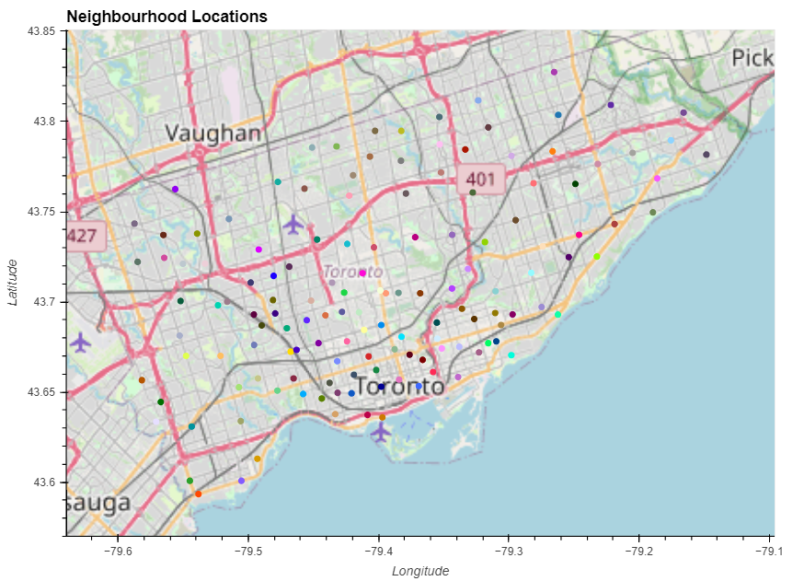
Neighborhood Locations

Slide 6
What are the safest Areas in GTA?

Slide 7
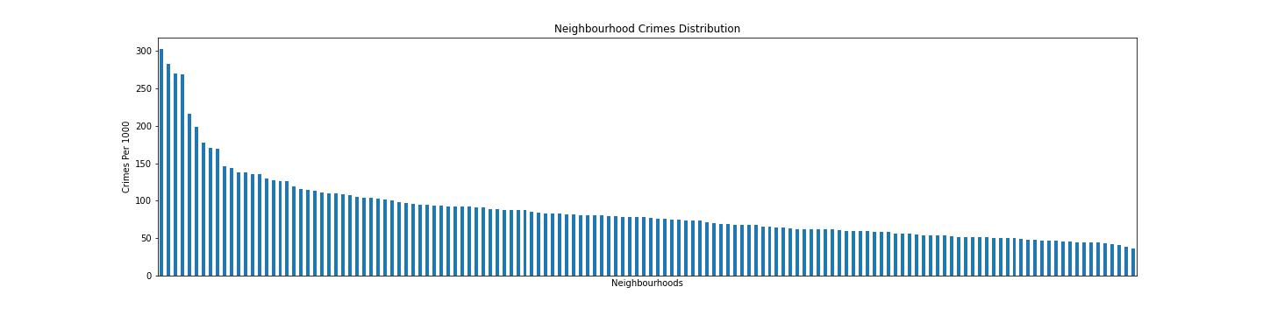
Neighborhood Crimes Distribution

Slide 8
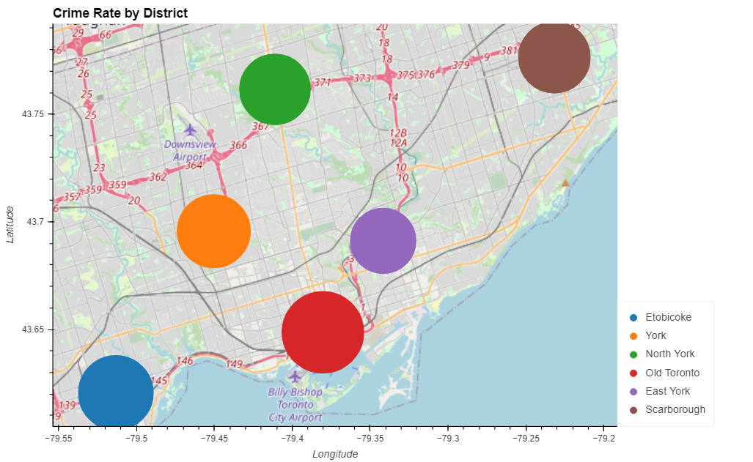
Crime Rate by Districts

Slide 9
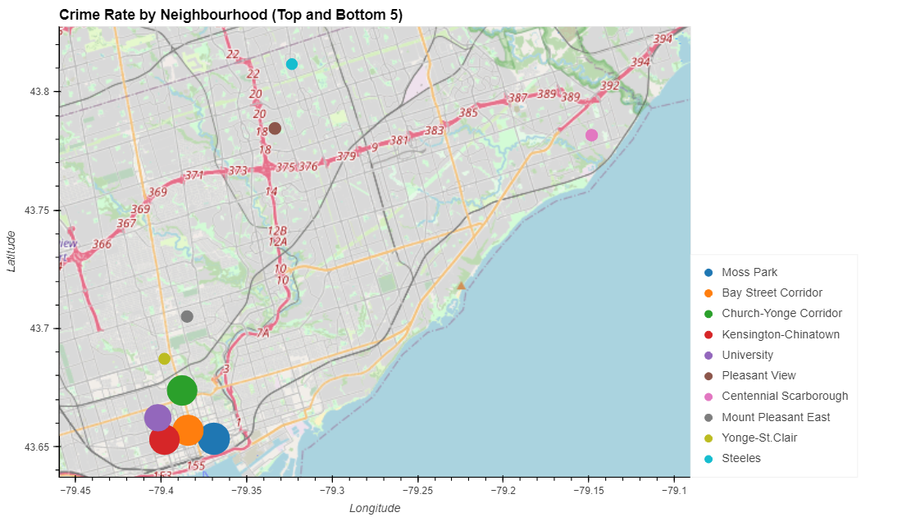
Crime Rate by Neighborhood

Slide 10
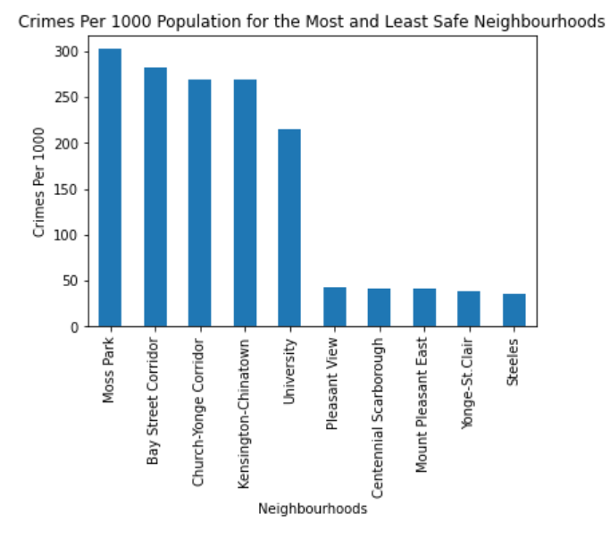
5 Most and Least Safe Neighborhoods

Slide 11
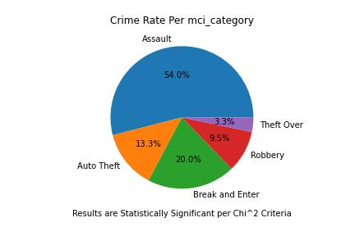
What type of Crimes happen in GTA?

Slide 12
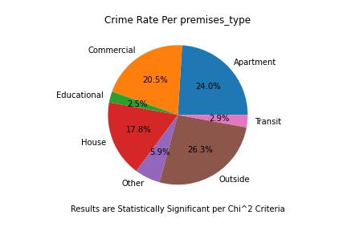
What are crime rates per Premises Type?

Slide 13
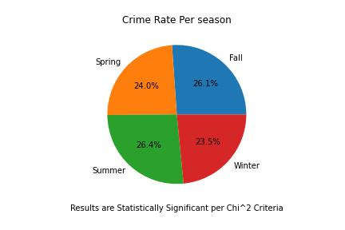
What are crime rates in different seasons?

Slide 14
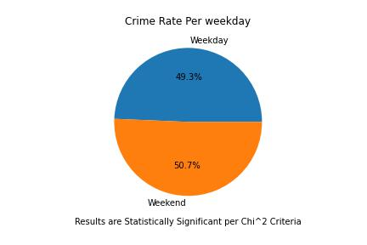
Crime rate is more of less during weekend or weekday?

Slide 15
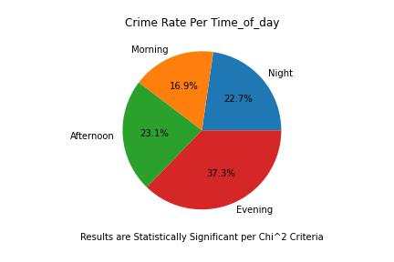
What Time of day the crime rate are more?

Slide 16
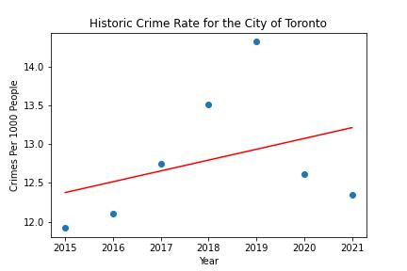
Regression Analysis for the city of Toronto
The r-squared is: 0.1264300099070376

Slide 17
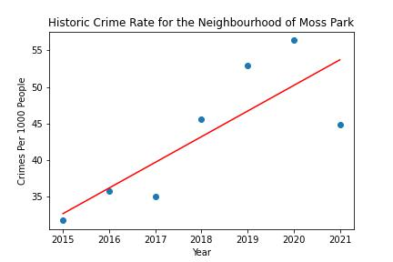
Regression Analysis for 5 least Safe Neighborhoods
The r-squared is: 0.6510760019274734

Slide 18
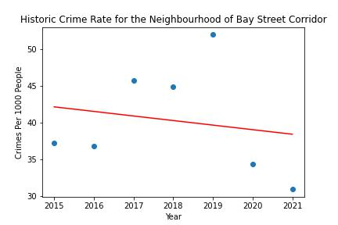
Regression Analysis for 5 least Safe Neighborhoods
The r-squared is: 0.0325154950383764

Slide 19
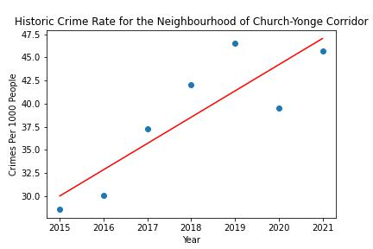
Regression Analysis for 5 Least Safe Neighborhoods
The r-squared is: 0.7506689850717332

Slide 20
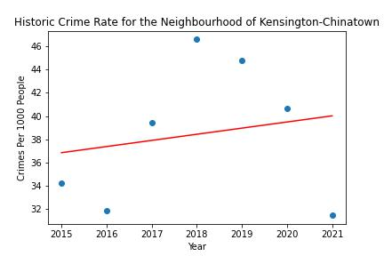
Regression Analysis for 5 Least Safe Neighborhoods
The r-squared is: 0.03504759185987554

Slide 21
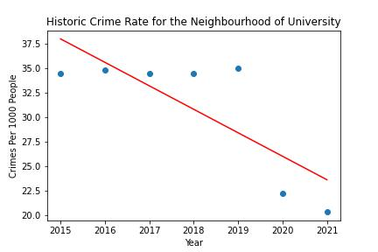
Regression Analysis for 5 Least Safe Neighborhoods
The r-squared is:0.6251230552445661

Slide 22
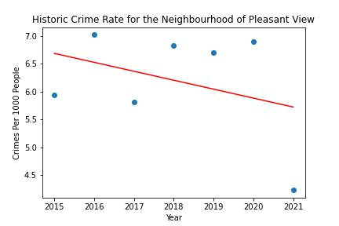
Regression Analysis for 5 Most Safe Neighborhoods
The r-squared is: 0.12273568367744447

Slide 23
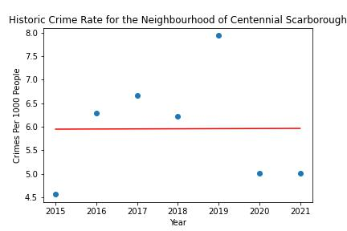
Regression Analysis for 5 Most Safe Neighborhoods
The r-squared is: 2.4135933577914423e-05

Slide 24
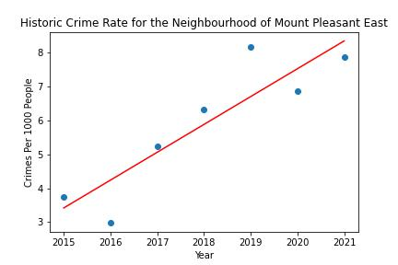
Regression Analysis for 5 Most Safe Neighborhoods
The r-squared is: 0.7995406542457283

Slide 25
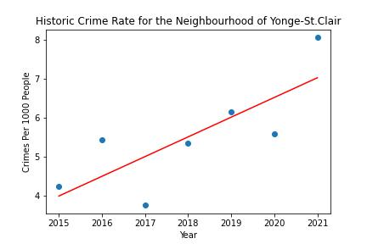
Regression Analysis for 5 Most Safe Neighborhoods
The r-squared is: 0.6169964168873656

Slide 26
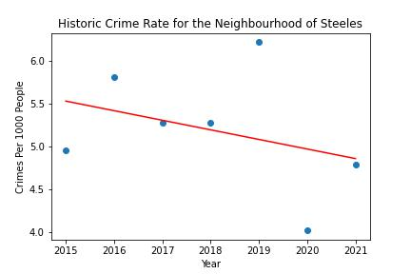
Regression Analysis for 5 Most Safe Neighborhoods
The r-squared is: 0.11540407972594205

Slide 27
Summary and Results
The safest areas in GTA are:
Pleasant View,
Centennial Scarborough,
Mount Pleasant East,
Yonge St.Clair and
Steels.
They are locations with the lowest risk factors, which indicates that customers who are willing to open a business in these areas are charged with the least amount of premiums.
Five least safe areas are:
Moss Park,
Bay Street Corridor,
Church-Yonge Corridor,
Kensington-China Town and
University, indicating high risk factors.
Different types of crime in GTA are (In order from highest to lowest) Assualt, Break and Enter, Auto Theft and Theft Over $5000.

Slide 28
Summary and Results
The pie chart for crime rate vs premises type shows that crime, regardless of type, happens most often outside, then in apartments, and commercial locations, and least happens in education and transit areas. While crimes happening outside is a redundant information, the relatively high percentages of crime occurrences in apartments (24%), commercial buildings (20.5%), and houses (17.8%) important because they are accounted for in calculating the premium.
Crime rate doesn't show any significant changes during seasons. The insurance company does not have to take climate into account when calculating premium.
Crime rate doesn't show any significant changes during weekdays or weekends, which indicates that premiums be equal regardless of whether the insurance company's clients operate on weekdays or weekends.

Slide 29
Summary and Results
Crime rate shows that most crimes happen during the evening and least happen in the morning. Time of day can be accounted for when calculating premium. For example, if a business operates in a relatively high-risk area as well as at night, the insurance company may apply a higher risk factor, which results in a higher premium cost.
The regression model of crime rates in Toronto shows a gradual increase annually, but with an r-squared value of 0.12, which indicates that the relationship between crime rates and time is neither strong in positive nor negative direction.
The regression models of crime rates for 5 most and least safe neighborhood plotted as well. While some have a strong correlation, others show a very marginal r-squared value, so it is difficult to assume that the risk factors would naturally increase over the years.

Slide 30
Q&A

Slide 31
Thanks for your attention

