Slide 1
Crime rate Analysis in Toronto by Neighborhoods
Created by:
Ahmed Abdelrahman
Geon Woo Andy Jeong
Mary Toofani

Slide 2
Agenda
Resources
What are the safest Areas in GTA?
What are different types of Crime in GTA?
What are most and least safe 5 neighborhoods in GTA?
How crime rate does change during seasons?
How crime rate does change during weekday or weekends?
How crime rate does change during day/night?
How crime rate does change vs premises type?
How crime rate does vary in city of Toronto?
How crime rate vary for most and least safe 5 neighborhoods?
Q&A

Slide 3
Resources
Csv dataset from Toronto Police Services
Google map API

Slide 4
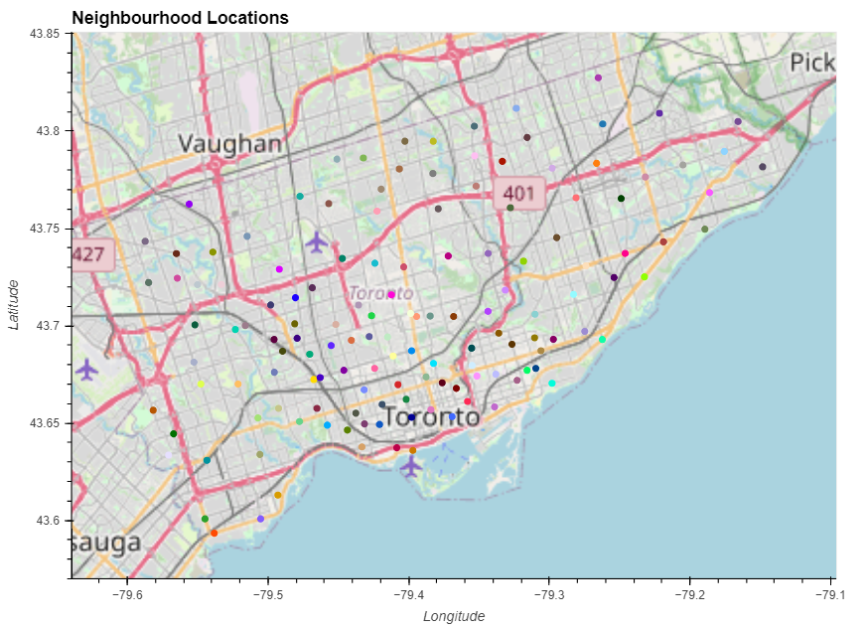
Neighborhood Locations

Slide 5
What are the safest Areas in GTA?

Slide 6
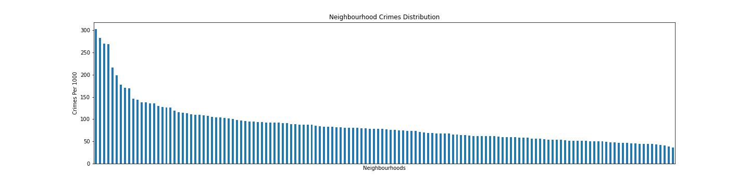
Neighborhood Crimes Distribution

Slide 7
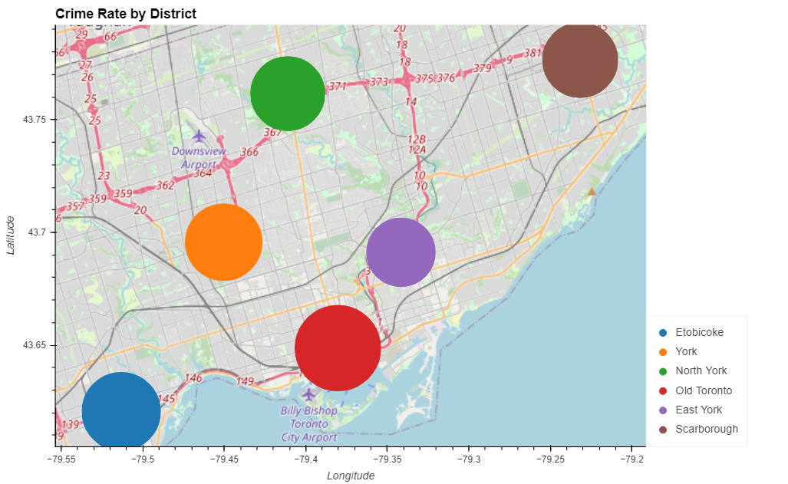
Crime Rate by Districts

Slide 8
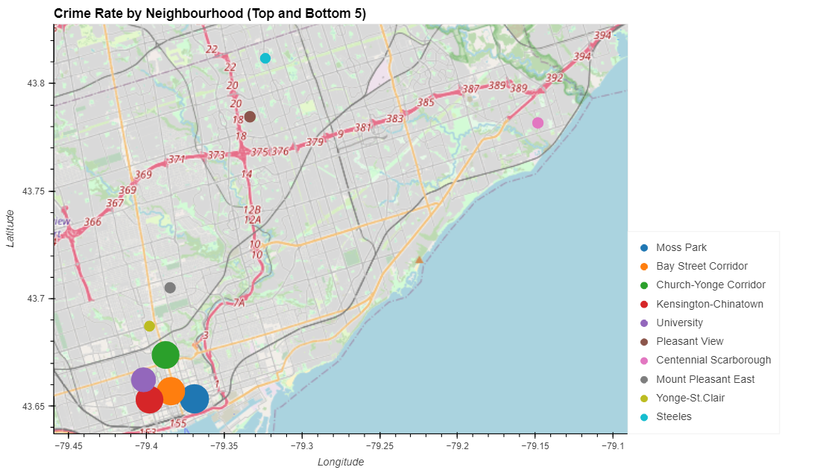
Crime Rate by Neighborhood

Slide 9
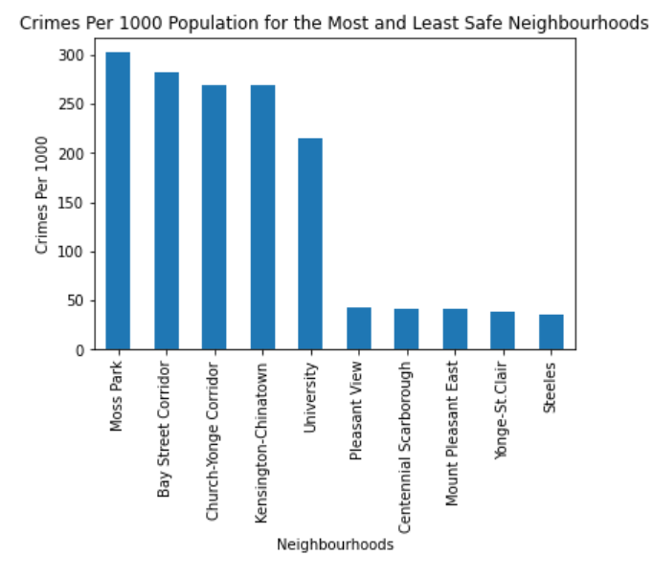
5 Most and Least Safe Neighborhoods

Slide 10
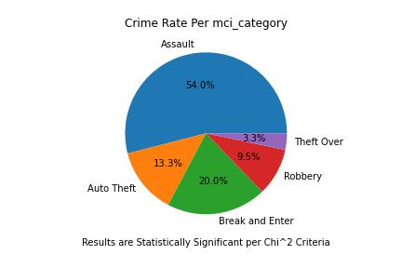
What type of Crimes happen in GTA?

Slide 11
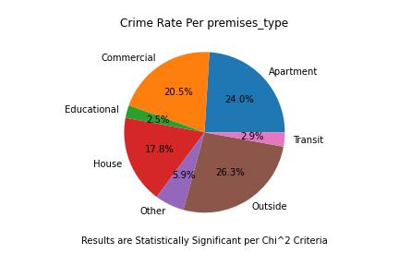
What are crime rates per Premises Type?

Slide 12
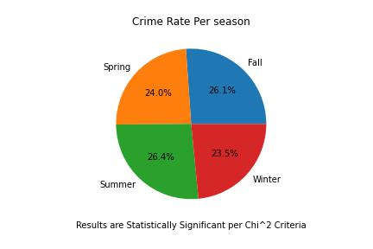
What are crime rates in different seasons?

Slide 13
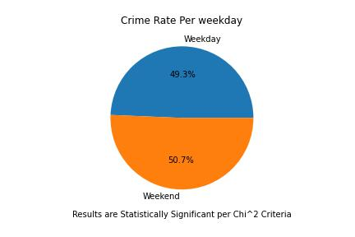
Crime rate is more of less during weekend or weekday?

Slide 14
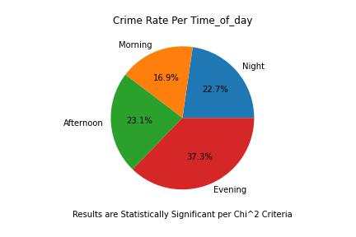
What Time of day the crime rate are more?

Slide 15
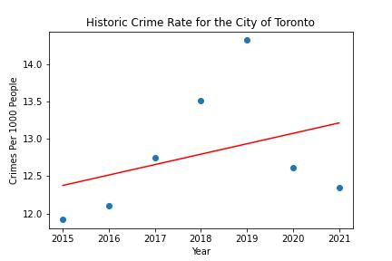
Regression Analysis for the city of Toronto
The r-squared is: 0.1264300099070376

Slide 16
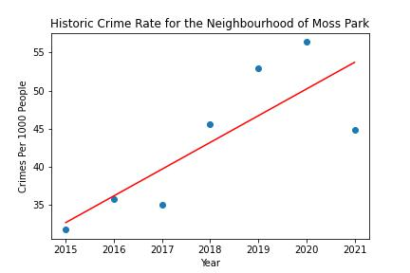
Regression Analysis for 5 least Safe Neighborhoods
The r-squared is: 0.6510760019274734

Slide 17
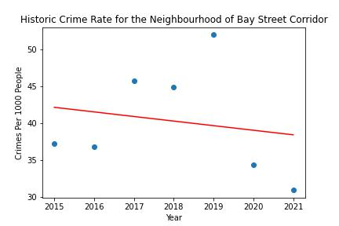
Regression Analysis for 5 least Safe Neighborhoods
The r-squared is: 0.0325154950383764

Slide 18
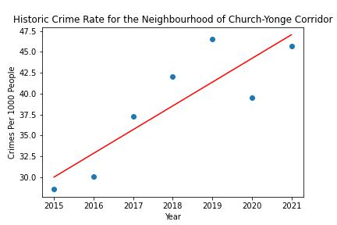
Regression Analysis for 5 Least Safe Neighborhoods
The r-squared is: 0.7506689850717332

Slide 19
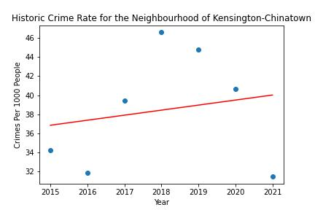
Regression Analysis for 5 Least Safe Neighborhoods
The r-squared is: 0.03504759185987554

Slide 20
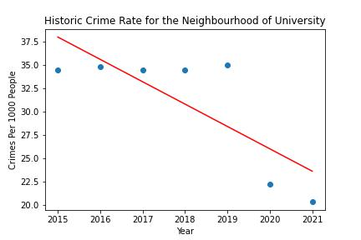
Regression Analysis for 5 Least Safe Neighborhoods
The r-squared is:0.6251230552445661

Slide 21
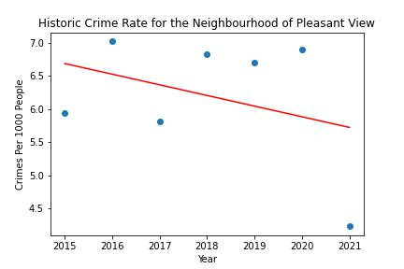
Regression Analysis for 5 Most Safe Neighborhoods
The r-squared is: 0.12273568367744447

Slide 22
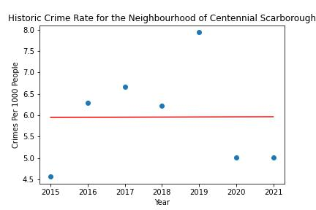
Regression Analysis for 5 Most Safe Neighborhoods
The r-squared is: 2.4135933577914423e-05

Slide 23
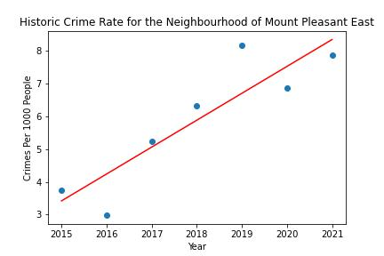
Regression Analysis for 5 Most Safe Neighborhoods
The r-squared is: 0.7995406542457283

Slide 24
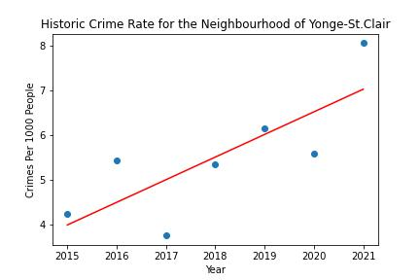
Regression Analysis for 5 Most Safe Neighborhoods
The r-squared is: 0.6169964168873656

Slide 25
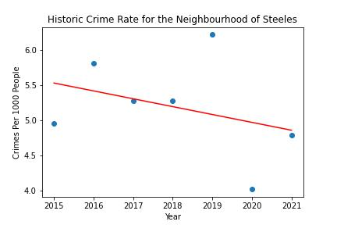
Regression Analysis for 5 Most Safe Neighborhoods
The r-squared is: 0.11540407972594205

Slide 26
Summary
Most Safe Areas in GTA are (Pleasant view, Centennical scarborough ,Mount pleasant East , Younge St.clair and Steals.)
5 least safe areas are (Moss Park, Bey Street Corridor,Church-Younge Corridor,kingston-China Town and University)
Different types of Crime in GTA, are (In order from highest to lowest are) Assualt ,Break and Enter,Auto Theft and Theft Over.
The pie chart for Crime rate vs premises showed that most crime happens in outside areas, apartments ,commercial locations and least happens in Education and transit areas.
crime rate doesn't show any significant changes during seasons.
crime rate doesn't show any significant changes during weekdays or weekends.
crime rate showed that most crimes happen during evening and least happen in the morning.
Regression crime rate analysis for Toronto shows increase year over year with r-squared 0.12, which show the relationship is not very strong.
Regression crime rate analysis for 5 most and least safe neighborhood plotted as well.

Slide 27
Q&A

Slide 28
Thanks for your attention

