Slide 1
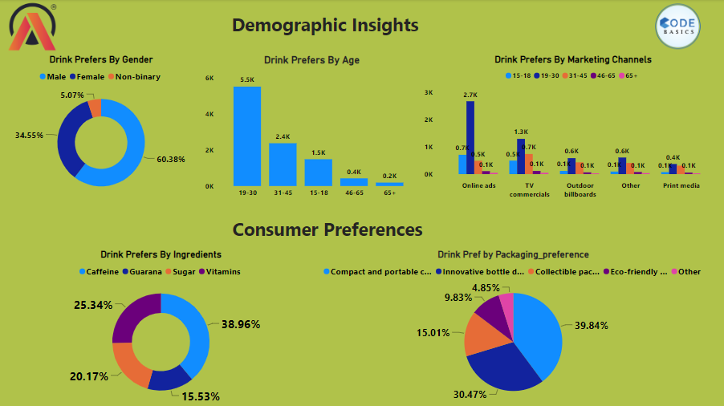

Slide 2
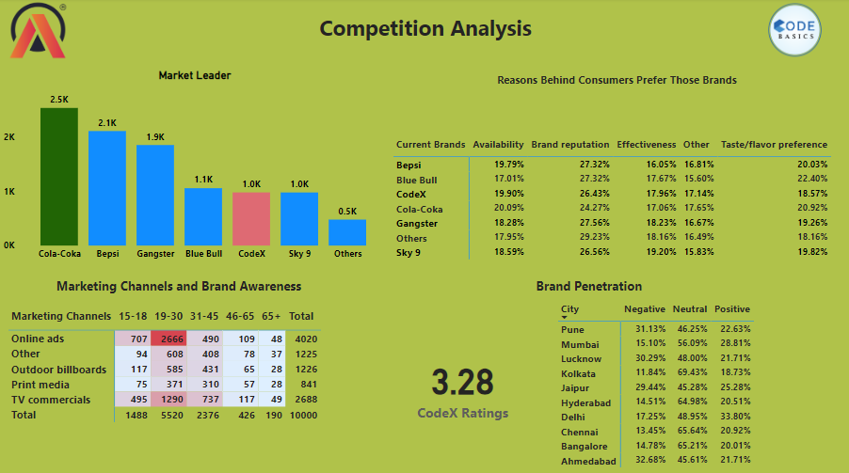

Slide 3
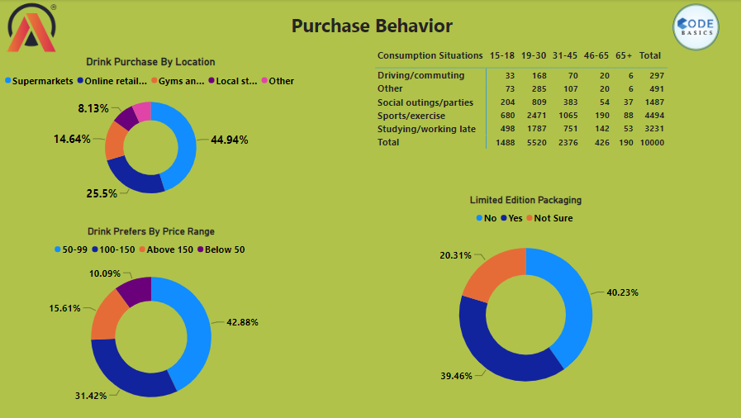

Slide 4
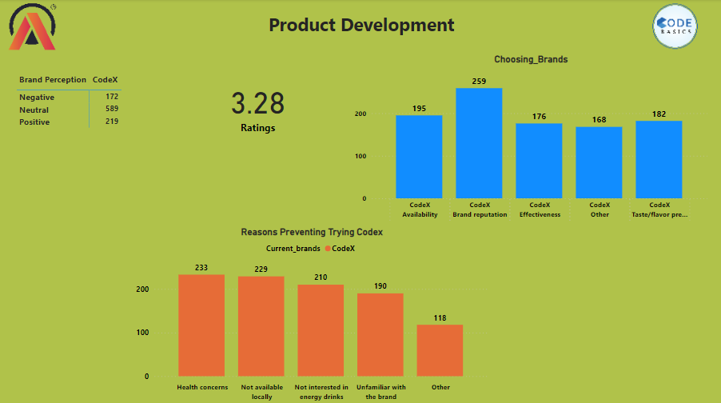

Slide 5


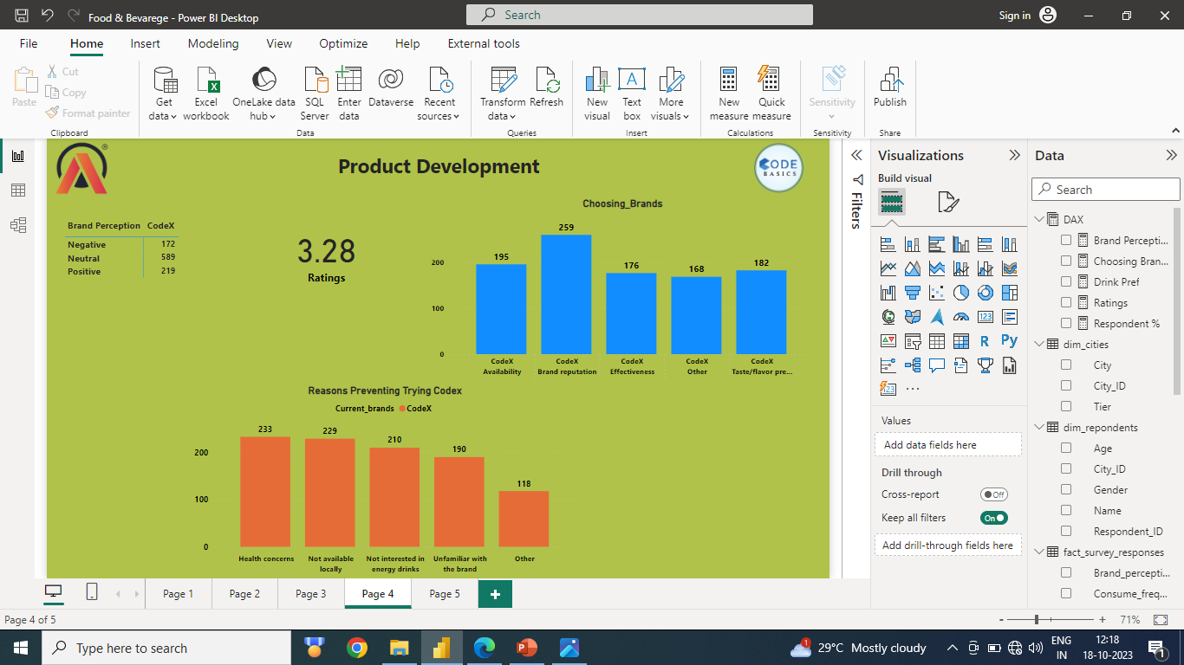
What immediate improvements can we bring to the product
Health Concern: In the survey, we observed that 233 out of 980 respondents are not purchasing our product due to health concerns. Therefore, we should consider adding healthier ingredients to our drink.
Availability: The survey revealed that 229 out of 980 respondents are not buying our product because it is unavailable. We need to ensure the local availability of our product.
Brand Perception: According to the survey, 219 out of 980 respondents have a positive perception of our brand. We should take necessary actions to capitalize on this positive perception.

Slide 6
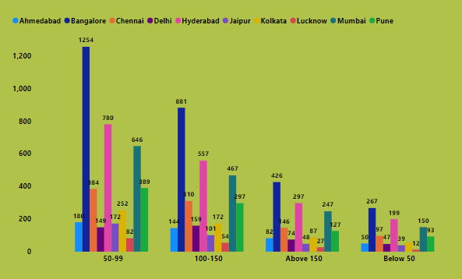
What should be the ideal price of our product
As seen in this visual, most cities prefer to purchase drinks priced between 50 and 99, with the ideal price range falling within this bracket.

Slide 7
What kind of marketing campaigns, offers, and discounts we can run?
Marketing Campaigns
Use social media. Social media is a great way to connect with our target audience and promote our marketing campaigns. Be sure to post engaging content and interact with our followers.
Run contests and giveaways. Contests and giveaways are a great way to generate excitement and buzz around our brand. Be sure to choose prizes that our target audience will be interested in.
Offers and Discounts
Bundle Deals: Offer bundle deals on our soft drinks and other products. This is a great way to encourage customers to buy more products from us.
Limited-Time Offers: Limited-time offers create a sense of urgency and encourage customers to buy now. We could offer a discount on a specific product or size, or a free item with purchase.
Loyalty Programs: Loyalty programs reward customers for buying from you repeatedly. We could offer points that can be redeemed for discounts or free products.

Slide 8
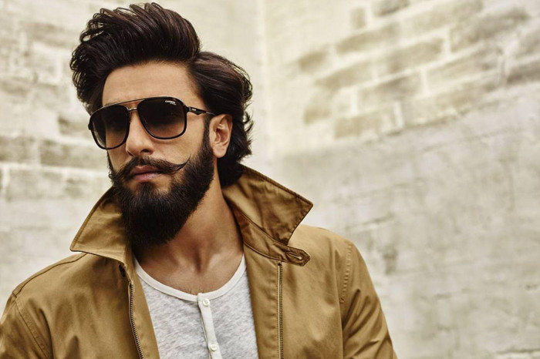
Who can be a brand ambassador, and why?
Ranveer Singh: Ranveer Singh is a popular Bollywood actor who is known for his energetic and flamboyant personality.
He is also a fashion icon and has a large following among young people.

Slide 9
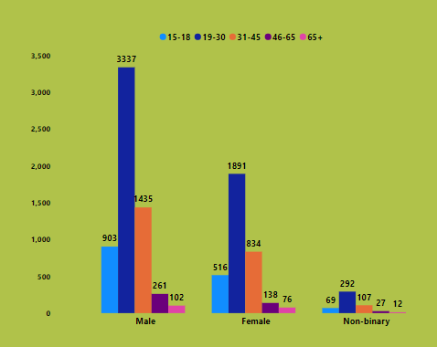
Who should be our target audience, and why?
In this data, it is evident that males between the ages of 19-30 purchase a significant amount of our drink, followed by females in the same age group. This age demographic proves to be ideal for our brand.

