Slide 1

Question Answering Model in Medical Field
By: Amro Qadaha 1200674 Ahmad Hamad 1212621 Razi Atyani 1200028

Slide 2
Electra Transformer
The Electra transformer is a type of neural network architecture specifically designed for efficient pre-training and fine-tuning of language models.
Electra encodes the input to capture the relationships and meanings of words and phrases within the context of the question and passage.
The fine-tuned Electra model identifies the span in the text passage where the answer lies, usually by predicting start and end positions within the passage.
We used AraElectra for Question Answering, fine tuned using the Arabic-SQuADv2 dataset

Slide 3
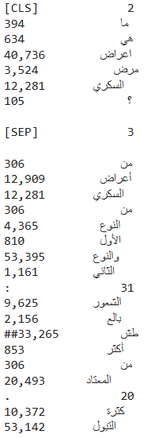
Tokenizer
The Electra model tokenizer is an integral part of the Electra transformer architecture, designed to efficiently prepare text data for the model.
The tokenizer’s main goal is to convert text into a format that the Electra model can process. This involves breaking down raw text into tokens and converting them into numerical representations (token IDs) that the model can understand
In the model, these numerical IDs are transformed into dense vectors (embeddings) that capture semantic information.

Slide 4
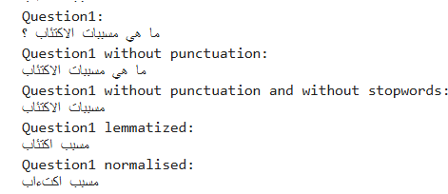
Pre processing of data
Procedure:
Punctuation marks Removal
Stop words Removal
Lemmatization
Normalization
The Procedure is done on both the question prompted by the user
& the questions in the dataset for better matching & retrieval.

Slide 5
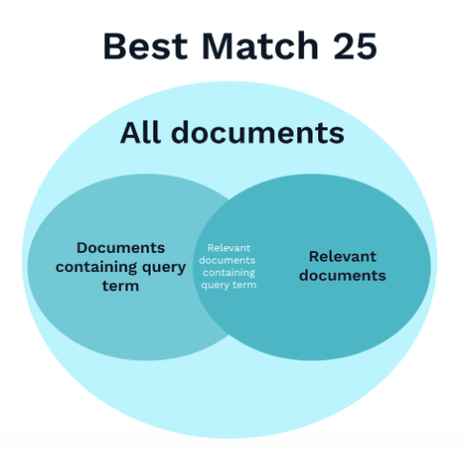
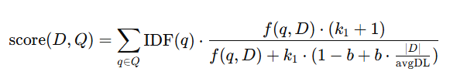
Retrieval System
BM25 Algorithm
Efficiency
The BM25 algorithm is a popular method for ranking documents based on their relevance to a query
Effective for long queries
Dynamic Ranking
Inside BM25 Algorithm
Document Indexing
IDF Calculation
Query Processing
Score Calculation
Score Calculation
Normalization and Saturation

Slide 6
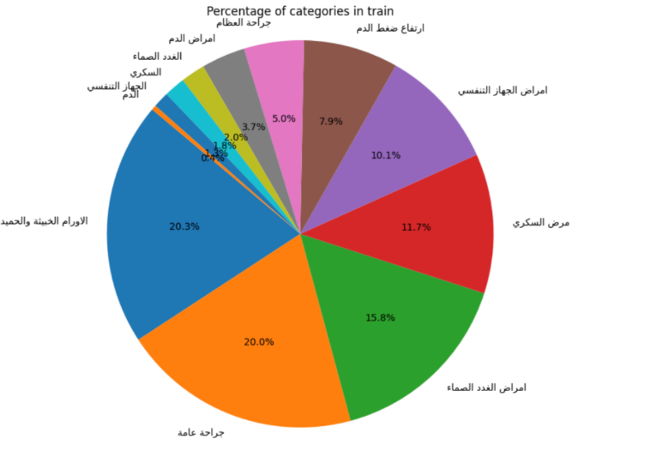
Integration of Electra Model and Retrieval System
Overview
Data from Kaggle
The model is designed to answer questions by extracting relevant information from a given text.
It operates in two modes: with context and without context.
With context:
The user can give a text and answer the model about any information provided in the text and the model will extract the answer
The answer could be a number or word or sentence
Without context:
Generates context from the data through a retrieval process.
Searches the dataset to find relevant information that forms the basis for answering questions.

Slide 7
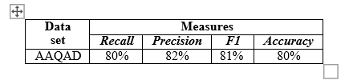
Performance of the Question Answering Model
Based on our evaluation with the Kaggle test data, we found that incorporating contextual information significantly enhanced the model's performance. This improvement highlights the crucial role of context in achieving more accurate and insightful results from our question-answering model.

Slide 8
Conclusion
Summing Up, The Integration between the QA & Retrieval system are very efficient especially in real world problems where context is sometimes provided, and sometimes when its not provided where Retrieval system come in handy.
Thank You

