Slide 1
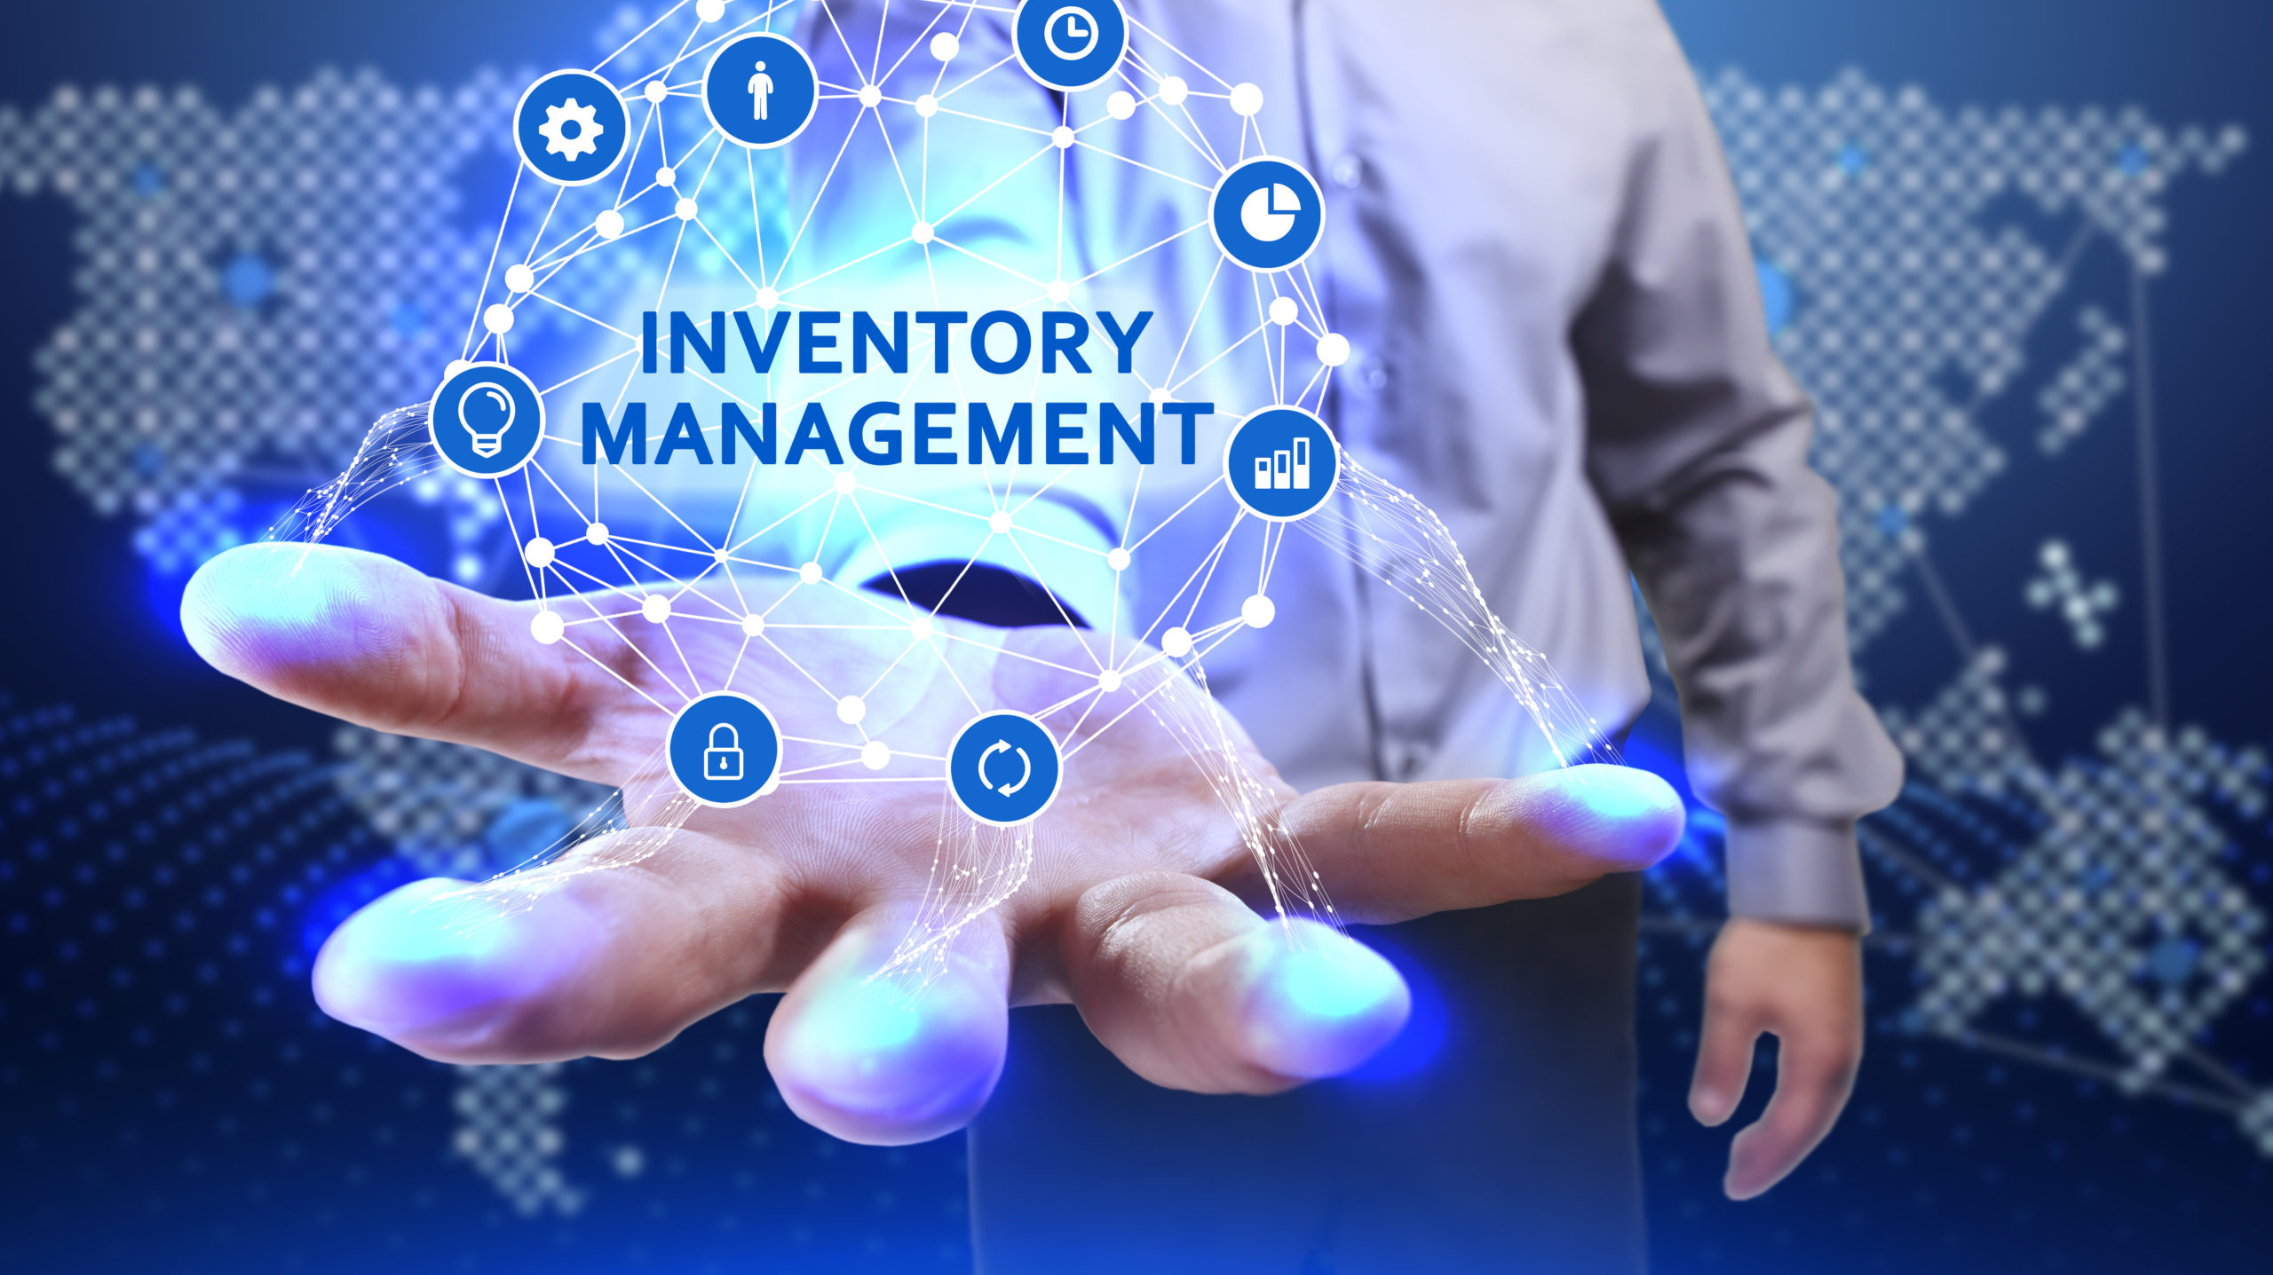
Explanation of the simulation tool
By Ahmadou oury DIALLO
ahmadouourydiallo@gmail.com

Slide 2

ACKNOWLEDGMENTS
I would like to thank Mr. Julien MAHEUT for all his contribution and advice throughout this process.

Slide 3

Summary
Introduction
Inventory Management
Importance
Inventory decisions
Type of inventory
Inventory Model
Fixed order–quantity
Economic order quantity (EOQ)
Production Order quantity (POQ)
Quantity discount
Single period
Diffrence between stochastic and deterministic
Deterministic model
Stochastic model
Continoous review
Policy ( S, Q )
Policy ( s, S )
Periodic review
Policy ( R, S )
Policy ( R, s, S )

Slide 4
Introduction
Inventory is any stored resource that is used to satisfy a current or future need.
In this presentation we will present to you some basic concepts to understand inventory management. Once you have finished this document, you will be able to:
- Explain the importance of inventory management
Explain and use order and fixed quantity models: EOQ, EOP, Quantity discount-
Explain and use deterministic and stochastic models with the different revision policies for stochastic models.

Slide 5
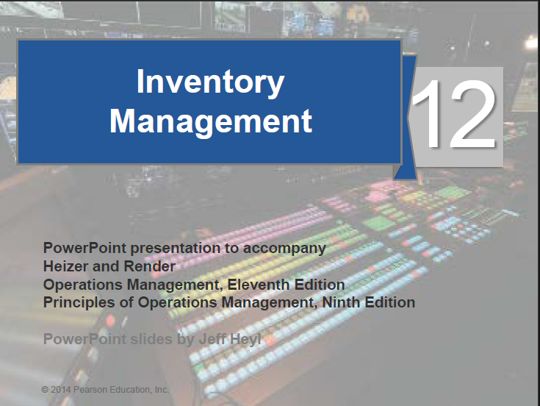
Introduction
All examples and data for calculations comes from this document.

Slide 6
II. Inventory Management
1. Importance
One of the most expensive assets of many companies representing as much as 50% of total invested capital.
Operations managers must balance inventory investment and customer service
Functions of inventory :
To provide a selection of goods for anticipated demand and to separate the firm from fluctuations in demand
To decouple or separate various parts of the production process
To take advantage of quantity discounts
To hedge against inflation

Slide 7
II. Inventory Management
2. Iventory decisions
There are only two fundamental decisions in controlling inventory
How much to order
When to order
The mayo objective is to minimize total inventory costs
Common inventory costs are :
Cost of the items ( purchase or material cost )
Cost of ordering
Cost of carrying, or holding inventory
Cost of stockouts

Slide 8
II. Inventory Management
3. Type of inventory
Raw material Purchased but not processed
- Purchased but not processed
Work-in-process (WIP)Undergone some change but not completed
- Undergone some change but not completed
- A function of cycle time for a product
Maintenance/repair/operating (MRO)Necessary to keep machinery and processes productive
- Necessary to keep machinery and processes productive
Finished goods Completed product awaiting shipment
- Completed product awaiting shipment

Slide 9
III. Inventory model
0. Key informations :
Lead time : time interval between ordering and receiving the order
Holding costs -the costs of holding or “carrying” inventory over time
Ordering costs -the costs of placing an order and receiving goods
Setup costs -cost to prepare a machine or process for manufacturing an order
Independent demand - the demand for item is independent of the demand for any other item in inventory
Dependent demand - the demand for item is dependent upon the demand for some other item in the inventory

Slide 10
III. Inventory model
1.a) Economic order quantity (EOQ)
The economic order quantity model is one of the oldest and most commonly known inventory control techniques. It dates from 1915.
It is esasy to use but has a number of important assumptions :
Known and constant demand
Known and constant leat time
No quantity discounts
No stockouts
Only variable costs are setup (or ordering) and holding

Slide 11



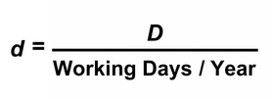

III. Inventory model
1.a) Economic order quantity (EOQ)
Model equations :
Optimal order quantity :
D = demand per year
S = setup(order) cost per order
H = Holding (carrying ) cost
d = dmeand per day
L = lead time in days
Total annual cost = Setup cost + Holding cost = $\frac{D∗S}{Q}+ \frac{Q∗H}{2}$

Slide 12
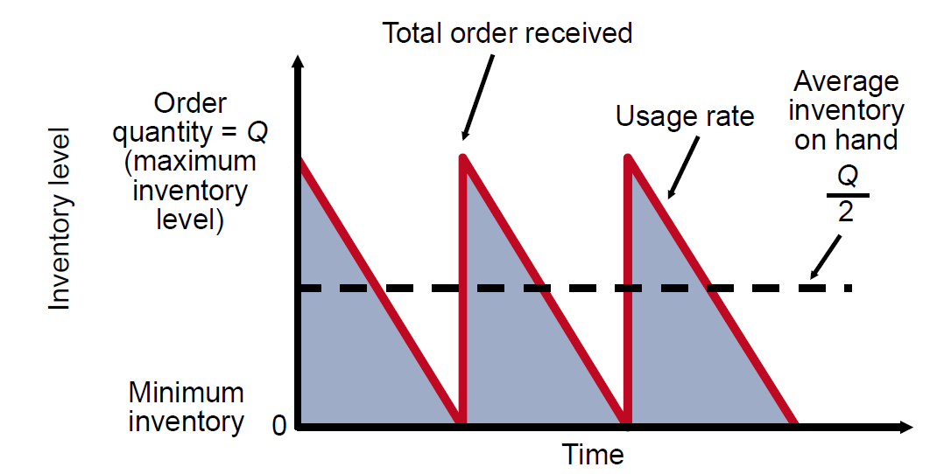
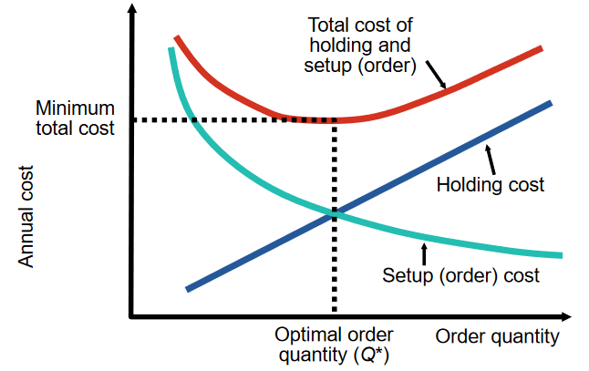


III. Inventory model
1.a) Economic order quantity (EOQ)
Chart for the model :
Inventory usage over time :
Minimizing costs : objective is to minimise total costs
Annual holding cost = $\frac{Q∗H}{2}$
Annual setup cost= $\frac{D∗S}{Q}$
Total annual cost = Setup cost + Holding cost = $\frac{D∗S}{Q}+ \frac{Q∗H}{2}$

Slide 13
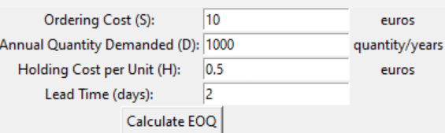
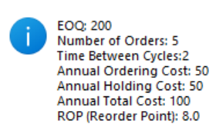
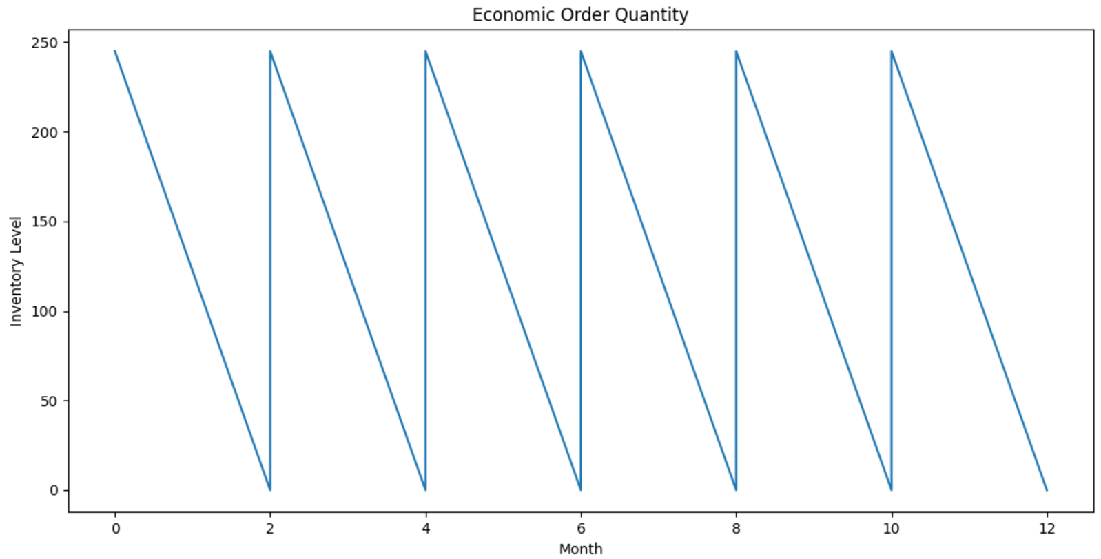
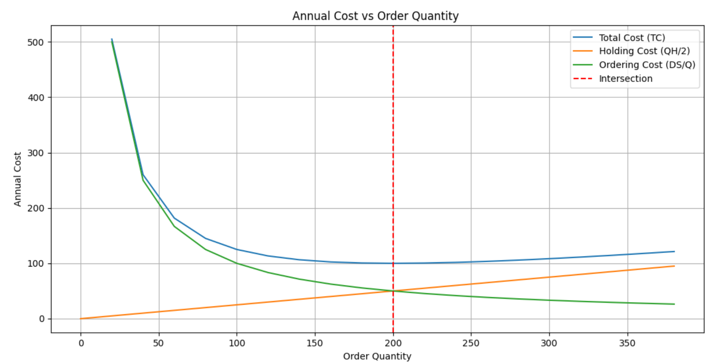

III. Inventory model
1.a) Economic order quantity (EOQ)
Simulation
Input data
Result
Chart
Chart of evolution of EOQ
Chart for annual cost

Slide 14
III. Inventory model
1.b) Production order quantity ( POQ )
Answers how much to order and when to order
Allows partial receipt of material
Other EOQ assumptions apply
Suited for production environment
Material produced, used immediately
Provides production lot size
Lower holding cost than EOQ model
Reasons for variability in production : most variability is caused by waste or by poor management.
Specific causes include :
- employees, machines, and suppliers produce units that do not conform to standards, are late or are not the proper quantity

Slide 15
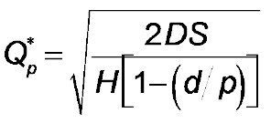

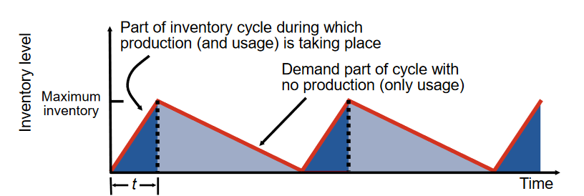
III. Inventory model
1.b) Production order quantity ( POQ )
When subassemblies are manufactured within the firm, use the Production Order Quantity (POQ ) fashion
Model equations :
Q = Number of pieces per order
p = Daily production rate
H = Holding cost per unit per year
d = Daily demand/usage rate
t = Length of the production run in days
Qp = optimal production quantity

Slide 16
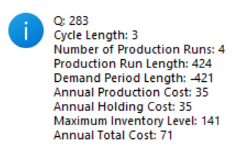
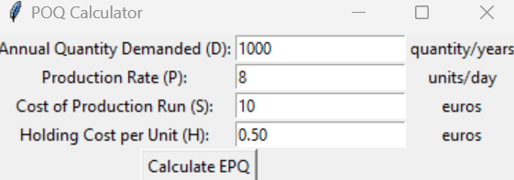
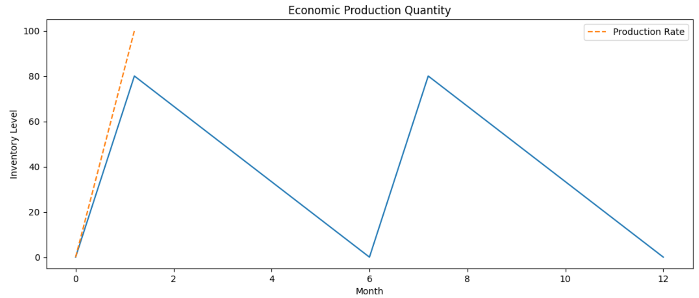
III. Inventory model
1.b) Production order quantity ( POQ )
Simulation
Input data
Result
Chart

Slide 17
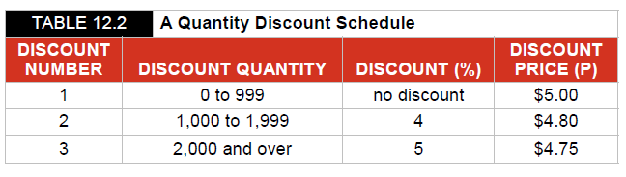
III. Inventory model
1.c) Quantity discount model
The purpose of the quantity discount model is to encourage buyers to purchase a larger amount of goods, which is beneficial to the seller. The buyer benefits from the lower price per unit, while the seller benefits from the increased sales volume
Answers how much to order and when to order
Allows quantity discounts
Reduced price when item is purchased in larger quantities
Other EOQ assuptions apply
Tade-off is between lower price and incresed holding cost
For example :

Slide 18
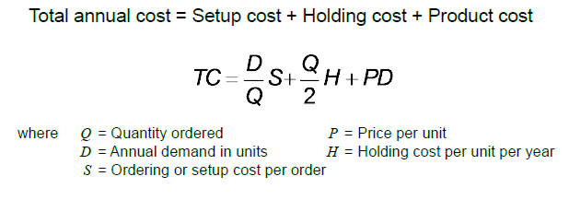
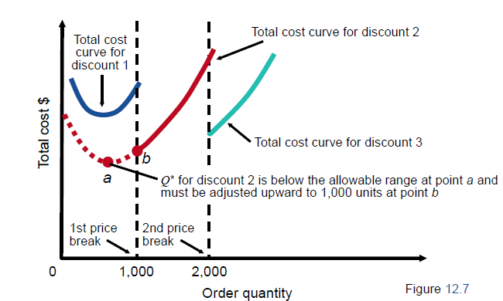
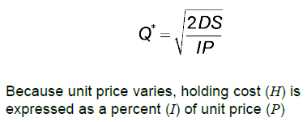
III. Inventory model
1.c) Quantity discount model
Model equation :

Slide 19
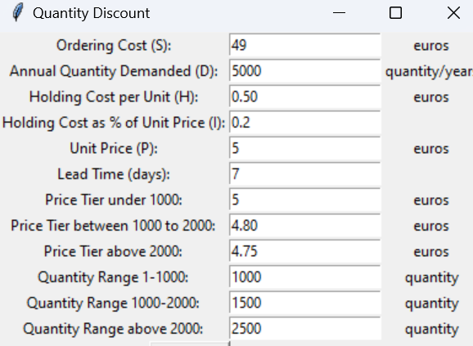
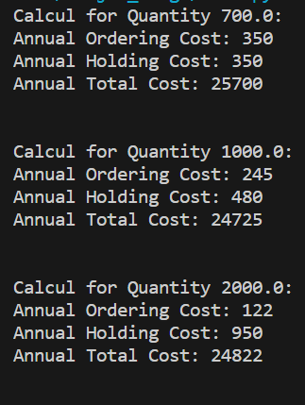
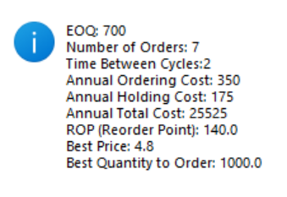
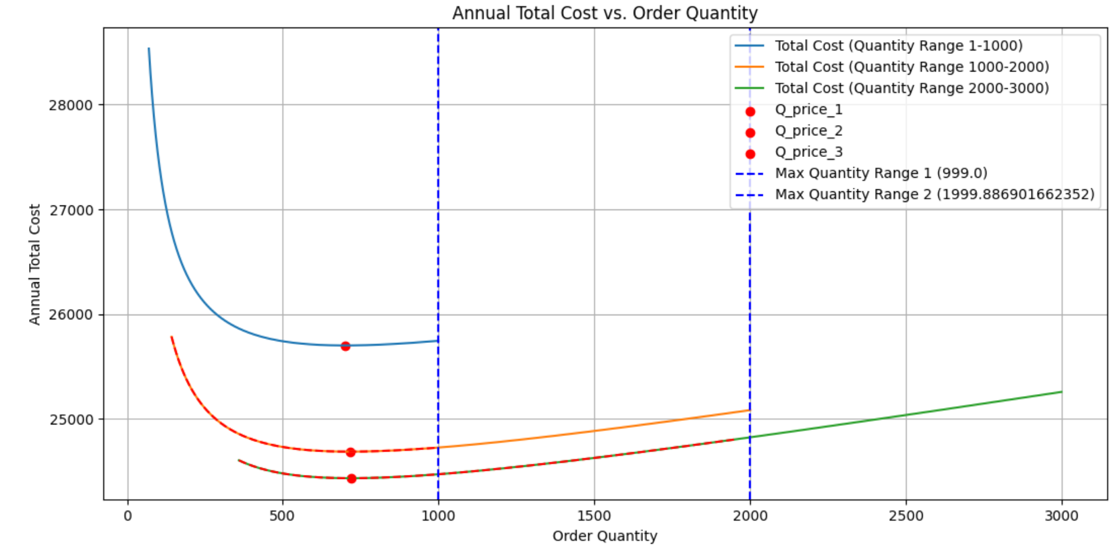
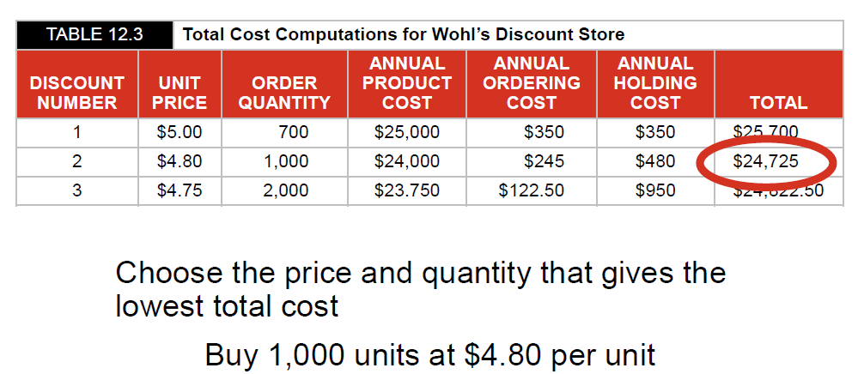
III. Inventory model
1.c) Quantity discount model
Simulation
Input data
Result
Chart

Slide 20
III. Inventory model
2) Single period model
The Single-Period Model, also known as the Newsboy Problem, is a classic inventory management problem that focuses on making a one-time purchase decision for a perishable product. In this model, a retailer must decide how much inventory to order for a single selling season, given uncertain demand and limited shelf life. The goal is to maximize expected profit by finding the optimal order quantity that minimizes the trade-off between overstocking and stockouts.
Key elements of the Single-Period Model include:
Demand: The uncertain customer demand for the product during the selling season. It is typically described by a probability distribution.
Sales Price: The price at which the product is sold to customers.
Cost per Unit: The cost incurred to purchase each unit of the product from the supplier.
Salvage Value: The value obtained for each unsold unit of the product at the end of the selling season. This salvage value could represent, for instance, the price at which the product can be sold or returned to the supplier.
The objective is to determine the optimal order quantity that maximizes expected profit or, equivalently, minimizes expected costs. The decision involves finding a balance between the cost of overordering (stocking excess inventory that might not be sold) and the cost of underordering (stockouts leading to lost sales or unsatisfied customers).

Slide 21
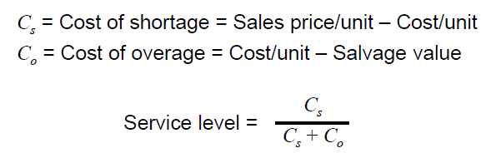
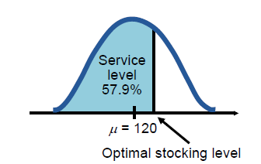
III. Inventory model
2) Single period model
Model Equation :
The Optimal Stocking Level in the Single-Period Model can be calculated as follows:
Optimal Stocking Level = Average Demand + (Z)(Standard Deviation of Demand)
The Stockout Risk is given by: Stockout Risk = 1 - Service Level

Slide 22
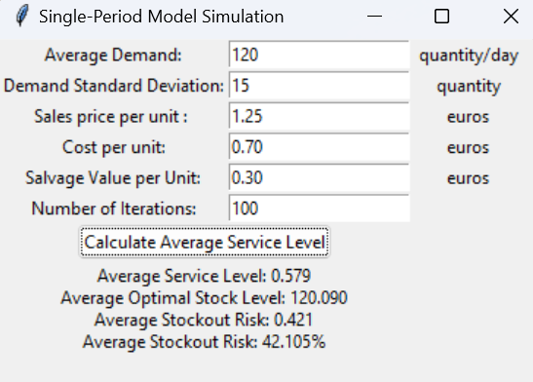
III. Inventory model
2) Single period model
Simulation
Input data and Result

Slide 23
III. Inventory model
3) Difference between deterministic and stochastic
Deterministic
- outcomes are entirely predictable and can be precisely determined based on known inputs and initial conditions.
Every time the same input is provided to the system, it will produce the same output.
There is no randomness or uncertainty involved in the process
Stochastic
Stochastic models are mathematical models that incorporate randomness or uncertainty in some of their parameters or variables. For example, a stochastic model for inventory management might consider the demand for a product as a random variable that follows a certain probability distribution, such as a normal, Poisson, or binomial distribution. Stochastic models can capture the variability and unpredictability of real-world situations and help you evaluate the trade-offs between different inventory policies.

Slide 24
III. Inventory model
3.a) Library used for simulation
Numpy : is a powerful library for numerical computing in Python. It provides support for working with arrays and matrices, along with a wide range of mathematical functions. In my code, NumPy is used for generating random numbers, particularly for modelling demand and lead times.
Simpy: is a discrete-event simulation library in Python. It allows us to model and simulate complex systems using discrete events (e.g., arrivals, departures, etc.). SimPy is often used for simulation of systems that involve entities (like customers, orders, etc.) and resources (like machines, servers, etc.). In your code, SimPy is used to create and run simulations of inventory systems.
Tkinter : is the standard GUI (Graphical User Interface) library for Python. It provides tools for creating windows, dialogs, buttons, labels, and other graphical elements to build interactive applications with graphical interfaces. In my code, Tkinter is used to create a graphical interface for users to input simulation parameters and view simulation results
Matplolib : for graphic

Slide 25
III. Inventory model
4) Deterministic
Deterministic inventory forecasting techniques assume that the future demand for your products is known and fixed or can be estimated with certainty based on historical data or trends. For example, you might use a simple average, a moving average, or a linear regression to project your future sales based on your past performance. Deterministic techniques are easy to apply and understand, but they have some limitations. They do not account for variability, uncertainty, or randomness in the demand, which can be affected by factors such as seasonality, promotions, competitors, or customer preferences
Important point for simulation of deterministic model :
Demand : constant , - lead times : 0 or 0 > 0, but not probabilistic
Products : one product, - Capacity no limits

Slide 26
III. Inventory model
4) Deterministic
simulation context :
Problem statement :
The company starts the period with an initial inventory of 60 units. There is a fixed cost associated with placing an order of $32, Each individual items costs the company $3 to order The company incurs a holding cost of $1 per month for every item in inventory, shortage cost of $3 per month for every item backlogged
MEAN_IAT = 0.1 # average time between customer demands (months)
DEMANDS = [5] # predefined customer demand sizes
START_INVENTORY = 60. # units in inventory at simulation start
COST_ORDER_SETUP = 32. # fixed cost of placing an order
COST_ORDER_PER_ITEM = 3. # variable cost of ordering an item
COST_BACKLOG_PER_ITEM = 5. # monthly cost for each item in backlog
COST_HOLDING_PER_ITEM = 1. # monthly cost for each item in inventory

Slide 27
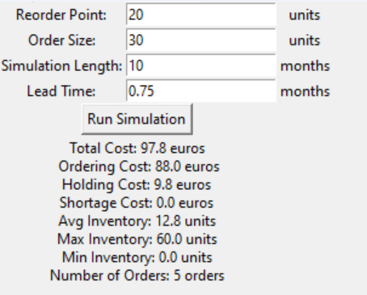
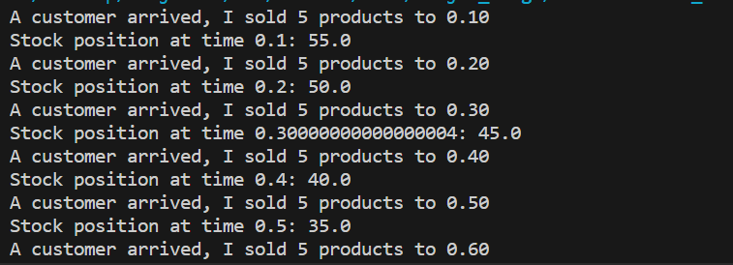
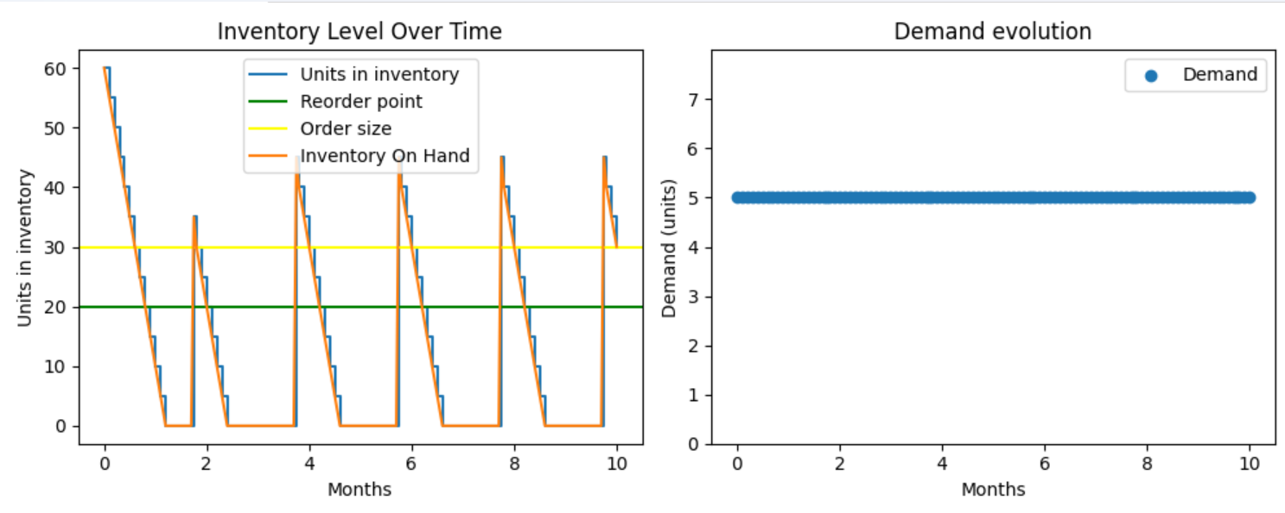
III. Inventory model
4) Deterministic
Simulation
Input data
Result
Chart

Slide 28
III. Inventory model
5) Stochastic
Stochastic models can help you answer essential questions about inventory management, such as how much safety stock to maintain a certain service level, how often to review and place orders, and how large the order quantity should be to minimize total inventory cost
How to use ?
To use stochastic models for inventory management, you need to define your inventory system and identify its components, such as demand, supply, lead time, cost, and service level. Then, you must choose a suitable stochastic model that matches the characteristics of your inventory system. After that, you have to estimate the parameters of your stochastic model. To do this, you need to determine the mean and variance of demand, the lead time distribution, the holding cost, the ordering cost, and the shortage cost. Once these steps are completed, you can solve your stochastic model to find the optimal inventory policy

Slide 29
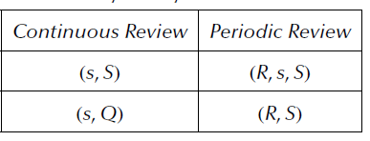
III. Inventory model
5) Stochastic
Which replenishment policy should you choose ?
We will use 4 replenishment policies in our simulation, there are two which are used for a periodic review and 2 others for a continuous review
The advantage of the continuous review system:
Provide real-time updates of inventory counts
Make easier to know when to order
Provide accurate accounting
The disadvantage of the continuous system:
Involves additional cost
The advantage of the periodic review system:
Reduce time for business owner to analyze inventory counts
Allows the business owner having more time to run another aspect of the business
Simple to administer
Save labor cost for counting
The disadvantage of the periodic review system:
It may not provide an accurate inventory count when there is a high volume of sale
It may also make accounting inaccurate

Slide 30
III. Inventory model
5.a) Continuous Review:
Policy ( s , Q )
○ Definition: This policy triggers an order of size Q when the inventory position reaches or falls below the reorder point s.
○ Pros: Allows you to maintain a relatively constant level of inventory. The fixed order size makes it easier to plan and manage inventory.
○ Cons: Determining replenishment level S can be complex and require extensive demand and cost analysis. May result in more complex inventory management due to variation in order size.

Slide 31
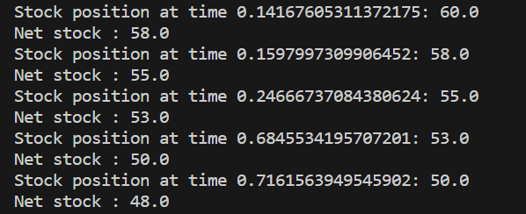
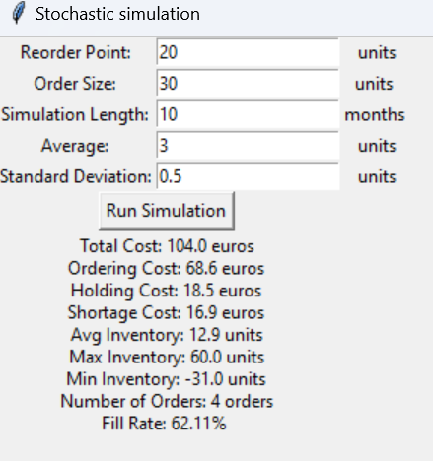
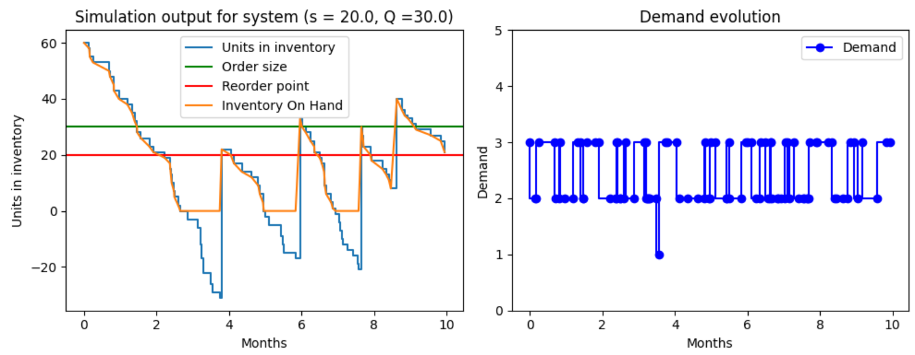
III. Inventory model
5.a) Continuous Review:
Policy ( s , Q )
Result
Simulation
Input data
Chart

Slide 32
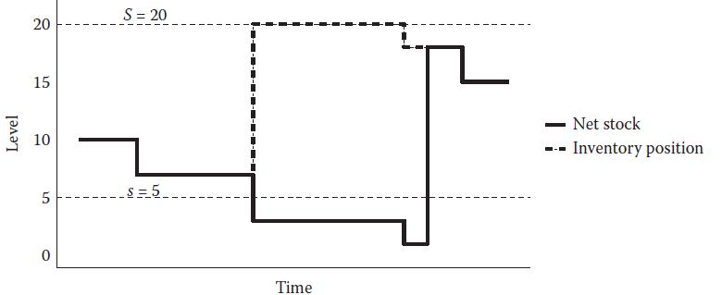
III. Inventory model
5.a) Continuous Review:
Policy ( s , S )
○ Definition: This policy triggers an order whose size is the difference between the reorder level S and the current inventory position when the inventory position reaches or falls below the reorder point s.
○ Pros: Allows better adaptation to actual demand, as the size of the order is adjusted according to the current inventory level. Can help maintain a better balance between inventory levels and demand
○ Cons: Determining replenishment level S can be complex and require extensive demand and cost analysis. May result in more complex inventory management due to variation in order size

Slide 33
III. Inventory model
5.a) Continuous Review:
Policy ( s , Q )
Result
Simulation
Input data
Chart

Slide 34
III. Inventory model
5.a) Periodic Review:
Policy ( R , S )
○ Definition: This policy involves periodic reviews of the inventory position at regular intervals R. During each review, an order is placed to achieve the replenishment level S minus the current inventory position.
○ Advantages: Allows more regular inventory management by carrying out periodic reviews. Ordering is based on the gap between the inventory position and the replenishment level S, which takes into account variations in demand.
○ Disadvantages: May cause delays in ordering and replenishment because the order is placed only at scheduled review points. May require careful planning of exams to avoid stock-outs or overstocks.

Slide 35
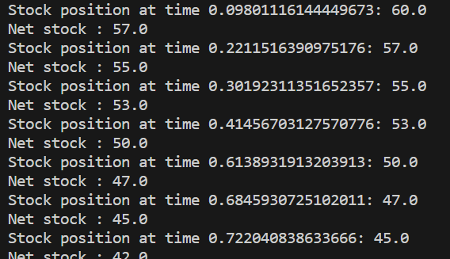
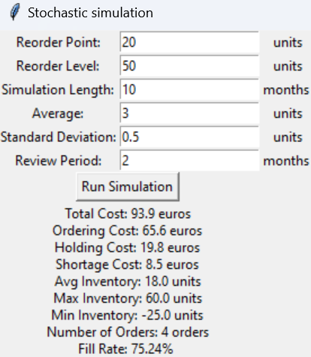
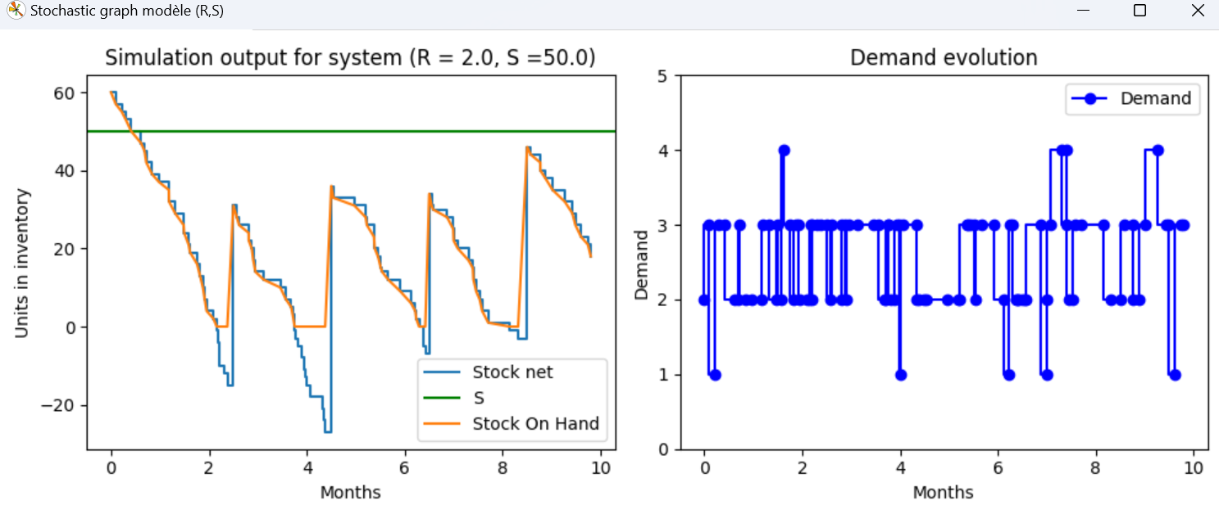
III. Inventory model
5.a) Periodic Review:
Policy ( R , S )
Result
Simulation
Input data
Chart

Slide 36
III. Inventory model
5.a) Periodic Review:
Policy ( R , s , S )
○ Definition: This policy combines aspects of (s, Q) and (R, S) policies. The inventory position is checked at intervals of R. An order is triggered only if the inventory position reaches or falls below the reorder point s. The order size is determined by the difference between the reorder level S and the current inventory position.
○ Benefits: Allows you to combine the benefits of (s, Q) and (R, S) policies by taking into account both actual demand and periodic reviews. Allows more flexible inventory management by adjusting order size based on current inventory situation.
○ Disadvantages: May require careful planning of examinations and continuous monitoring of inventory position. Improper estimation of reorder point s can lead to errors in ordering decisions

Slide 37
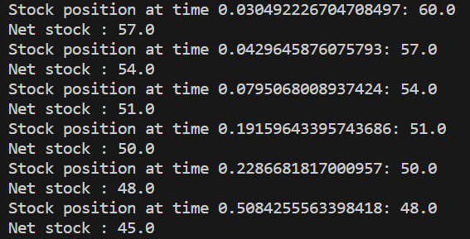
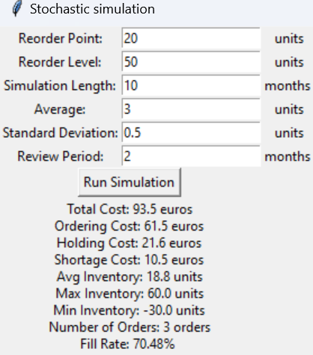
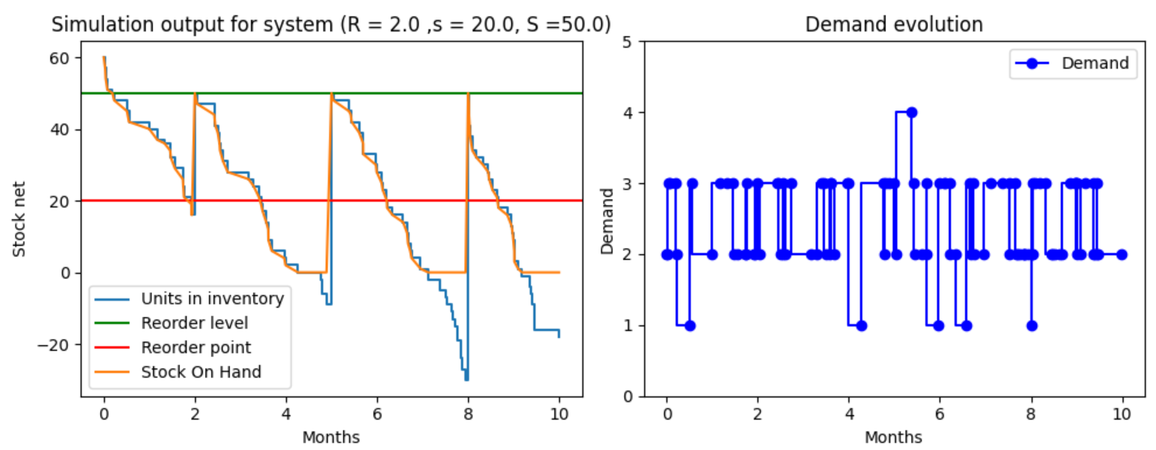
III. Inventory model
5.a) Periodic Review:
Policy ( R , s , S )
Result
Simulation
Input data
Chart

Slide 38

Bibliography
https://blog.scallog.com/reapprovisionnement-logistique
https://towardsdatascience.com/inventory-management-for-retail-deterministic-demand-311682c02518
https://asadali047.medium.com/inventory-simulation-for-beginners-7ea55eb6c4f8
https://victorjacobsen.com/?p=1740

