Slide 1
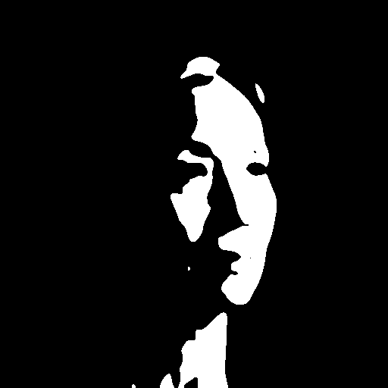
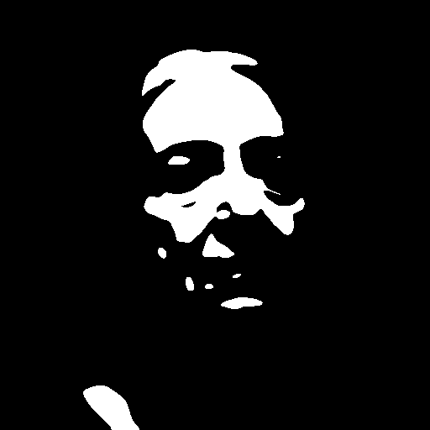
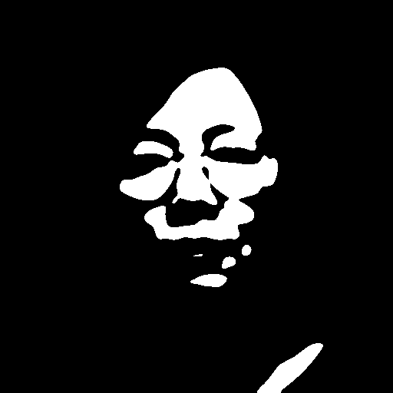
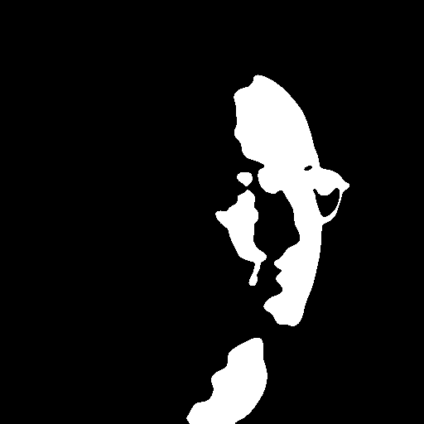
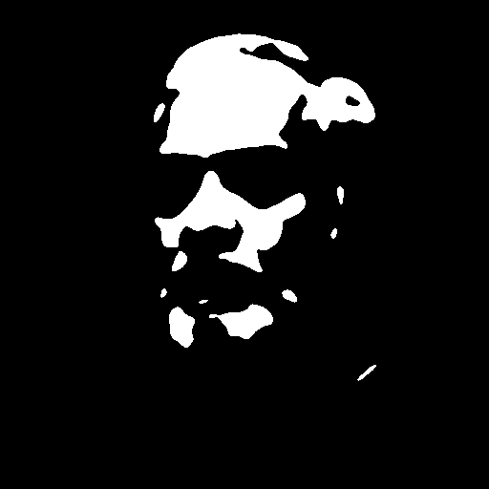
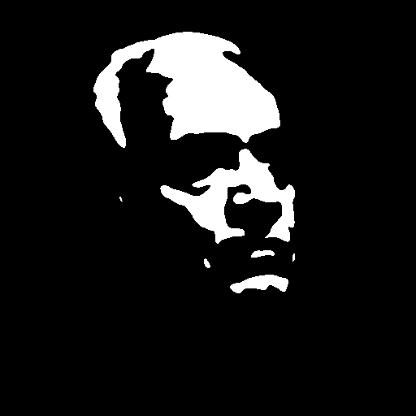
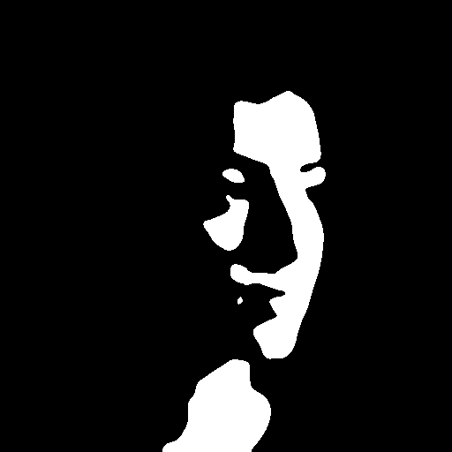
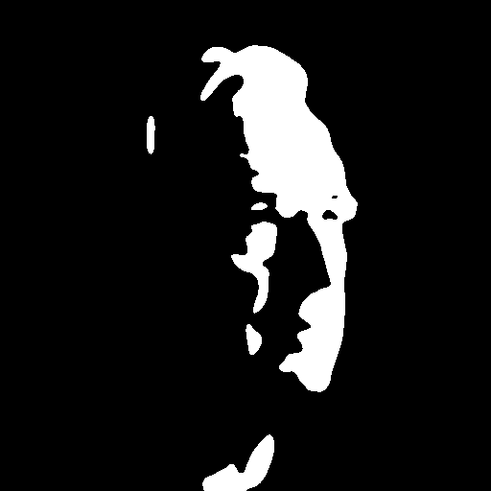
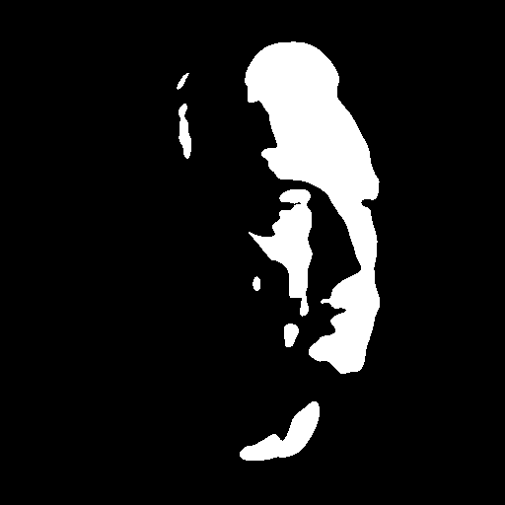
COMPUTATIONAL VISUAL PERCEPTION · PROJECT PART 1
Do Modern Vision Systems Perceive Faces in Mooney Images?
Four state-of-the-art vision systems tested on 100 photorealistic portraits under extreme single-source lighting and on their two-tone Mooney versions
Ahmadreza Nourozi
M.Sc. Artificial Intelligence · Student no. 23726011
FAU Erlangen-Nürnberg · November 2026
Team: Ahmadreza Nourozi (single-person team)

Slide 2
Approach: extreme lighting, one Mooney tool, four vision systems
APPROACH AND IDEAS
1
Stimuli
2
Mooney tool
3
Evaluation
100 photorealistic synthetic portraits (Z-Image-Turbo): no real persons
One hard light from the left, right, above or below (25 each), black background
Balanced: 50 female / 50 male, 3 age groups, 6 ethnic backgrounds, frontal and 3/4 views
Quality control on 204 candidates: one clear face, light direction verified twice (shading gradient + facial key-point regions)
Ground truth from the design: light direction, gender, age (+ measured head yaw)
Grayscale → Gaussian blur → threshold at the luminance percentile that leaves w % of the pixels white (closed form of the threshold search in Egger et al.)
Same parameters for all images: σ = 0.7 % of the image side, 10 % white (global sweep + visual check)
Face-centred crops (1.7× face box, 512 px) normalise head size
Revised after lecturer feedback: σ 1.5 %, 15 % white lost age, beard and glasses, so both were reduced
GUI (live sliders, batch, top-10 picker) + CLI (batch 100+ images, CSV log); 3D-mesh input
All originals and Mooneys through 4 systems with an identical protocol
Depth: agreement with the original's depth; 'bright = near' shortcut
VLM: face, gender, age, head orientation and light direction vs. ground truth
Face DCNN: detection and ArcFace identification (Paper 1 used VGG-Face)
Inverse rendering: normals; are black regions explained as shadow or as albedo?
Hypotheses. H1: humans see a 3D face in a good Mooney image (Paper 1: inverse rendering of shape + extreme light); feed-forward vision models do not. H2 (light-from-above prior; Ramachandran 1988, Johnston et al. 1992): bottom-lit Mooneys are hard by design (not 'good' Mooneys) and test the inverse-rendering account: humans should fail on them; do vision models show the same bias?

Slide 3
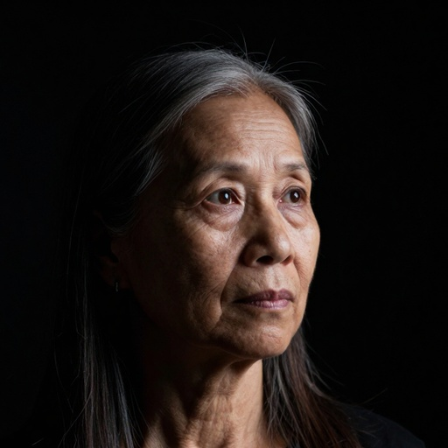
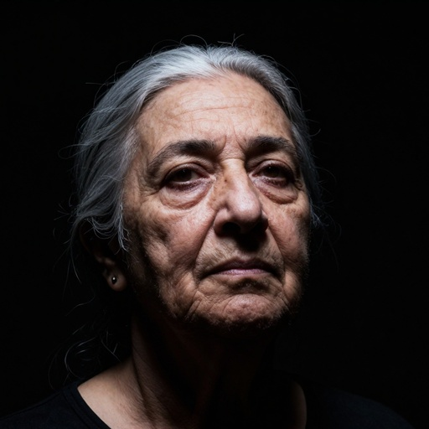



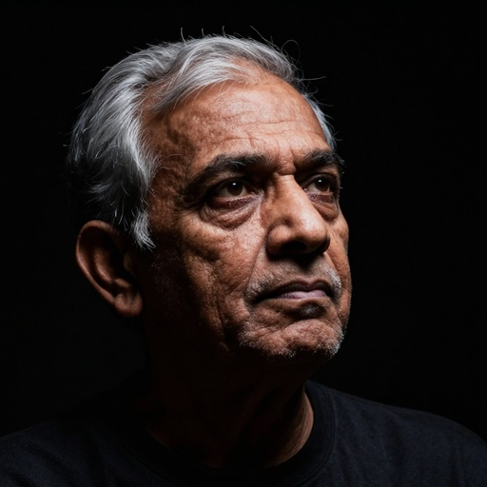
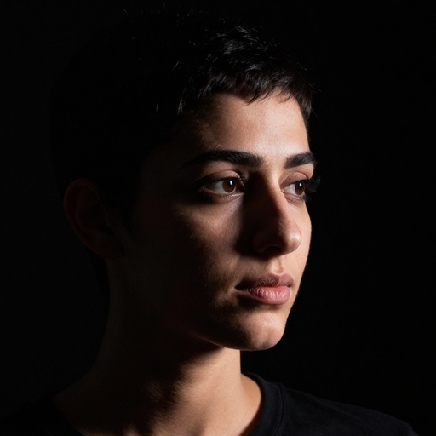
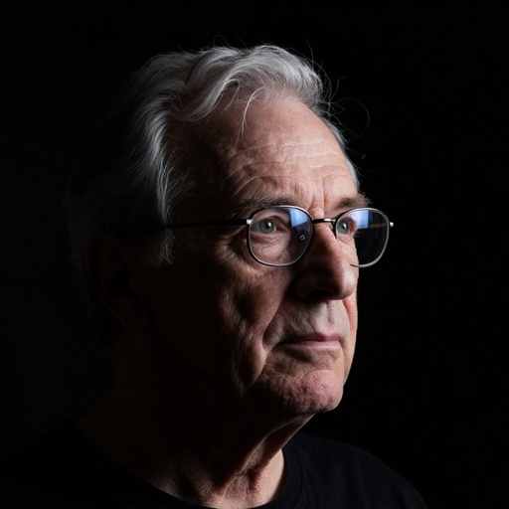
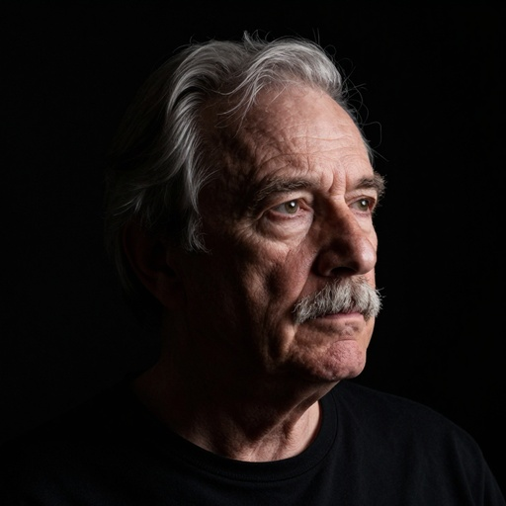
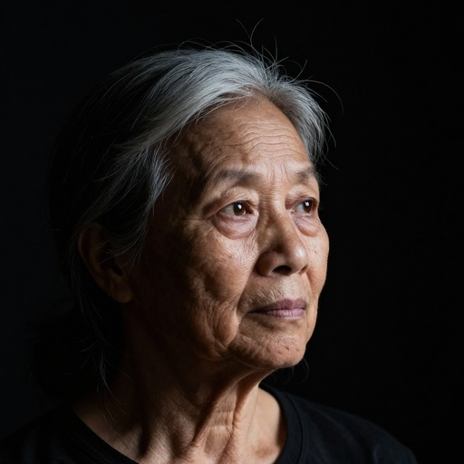
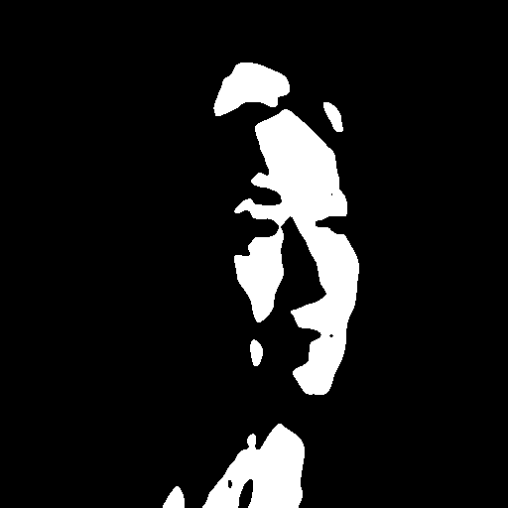
10 selected originals and their Mooney images
SUBSET: MANUALLY SELECTED TOP 10
Original
Mooney
#022 · right
#033 · top
#055 · top
#056 · right
#077 · top
#004 · top
#001 · right
#043 · right
#039 · right
#062 · right
Picked by the author from all 100 Mooneys after the blind 1–5 face rating (done before the originals were shown); 8 of the 10 were rated 4 or 5. 6 right-lit, 4 top-lit.
Readable, not trivial
Large coherent blobs
Lost contours
A face appears for a human observer, but no single blob is a face part on its own.
Shadows form a few big regions: no speckle from skin texture, hair strands or clothing.
Part of the outline merges with the black background, so perceptual closure is needed (Mooney, 1957).

Slide 4
Four vision systems, one input protocol
DECLARATION OF USED VISION SYSTEMS
 | System | Model / checkpoint | Output we analyse | Source · licence
R1 | Monocular depth estimation | Depth Anything V2 Large (depth-anything/Depth-Anything-V2-Large-hf) | Relative depth map; depth rendered as a lit 3D relief | Yang et al. 2024 · Hugging Face · CC-BY-NC-4.0
R2 | Vision-language model | Qwen3-VL-8B-Instruct (fp16, greedy decoding) | Free description + structured answers: face, gender, age, head orientation, light direction, black regions | Qwen Team 2025 · Hugging Face · Apache-2.0
R3 | Face analysis DCNN | InsightFace buffalo_l: SCRFD-10G, 106-pt landmarks, gender/age, ArcFace R50 | Face detection + score, landmarks, attributes, 512-d identity embedding | Guo et al. 2022; Deng et al. 2019 · non-commercial research
R4 | Diffusion inverse rendering | Marigold v1-1: normals + IID-Lighting (albedo, diffuse shading, residual) | Surface normals; albedo vs. shading decomposition | Ke et al. 2024/25 · Hugging Face · OpenRAIL++
All systems are used off-the-shelf (pretrained, no fine-tuning): R1, R2 and R4 on Kaggle (2× NVIDIA T4, 16 GB), R3 on CPU (onnxruntime). Originals (512 px JPEG) and Mooneys (512 px binary PNG, fed as 3-channel RGB) get identical pre-processing. Per-image outputs are in Result1–Result4/{Original, Mooney} of the zip.

Slide 5
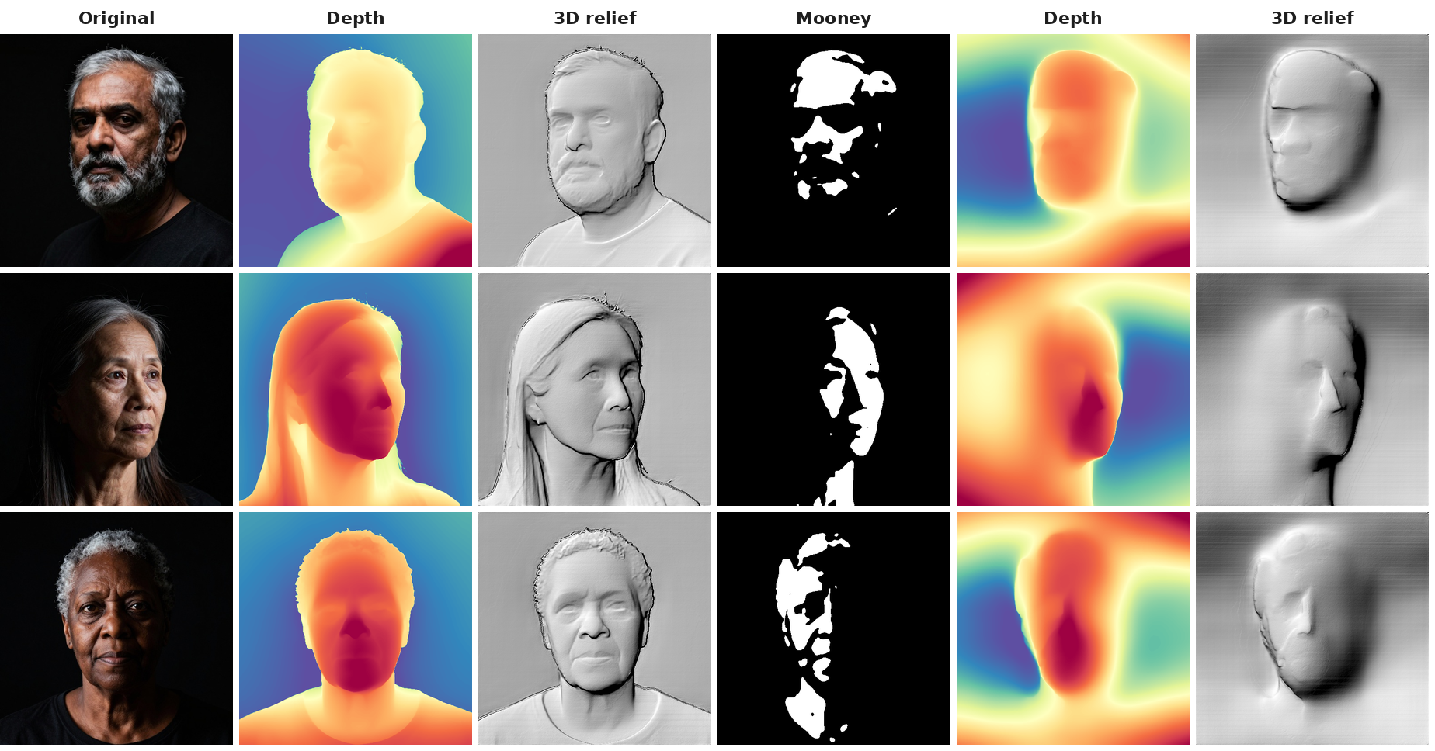
Depth: a coarse head, partly an embossed pattern
RESULTS · SYSTEM 1 · DEPTH ANYTHING V2
r = 0.40
0.40
depth agreement Mooney vs. original (face region)
extra correlation with the white pattern (partial r)
Original → predicted depth → depth rendered as 3D relief; right: the same for its Mooney image.
Inside the face, depth predicted from the Mooney only partly matches the original's depth (mean r = 0.40, normals off by 53°). Part of it follows the paint: white = near (partial r = 0.40 with the white pattern). A coarse head shape survives; the facial relief does not.

Slide 6
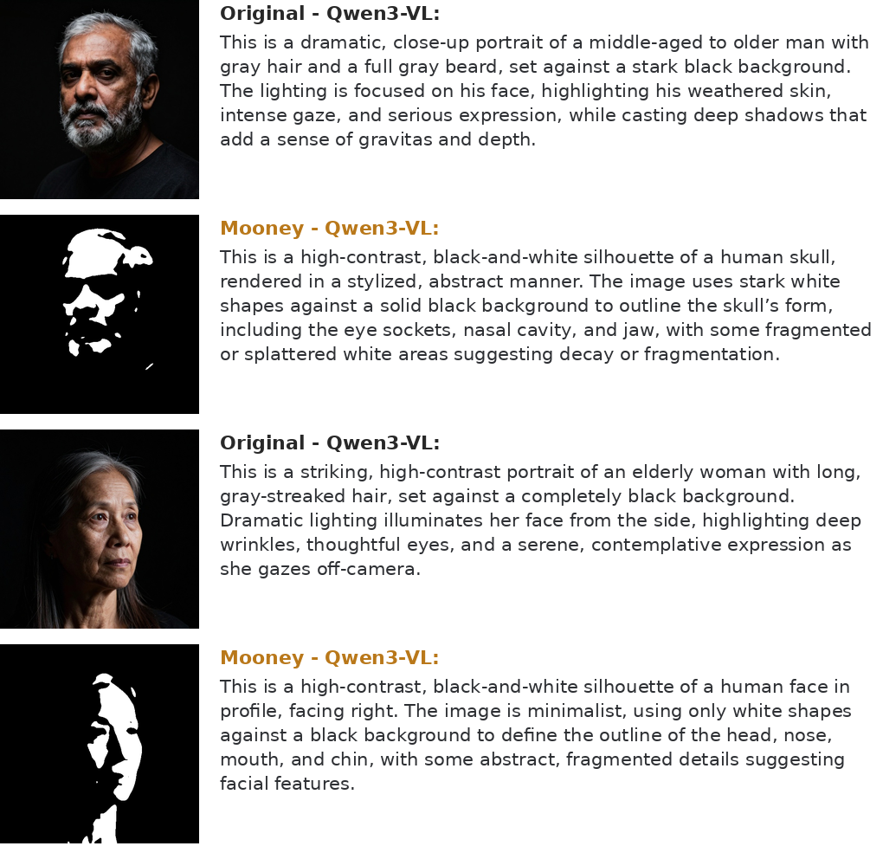
VLM: a flat silhouette instead of a lit face
RESULTS · SYSTEM 2 · QWEN3-VL-8B
100%
78%
'contains a face' for originals
'contains a face' for Mooneys
Unprimed descriptions (first two sentences) of two originals and their Mooney images.
Qwen3-VL calls 78% of the Mooneys a face (originals 100%), but as a flat 'abstract silhouette', sometimes a skull or a mask. Gender and age stay 'unclear' (correct: 8%, 10%) and the black regions are never called shadows (0%; originals 99%). Even for the originals the light direction is weak (26%).

Slide 7
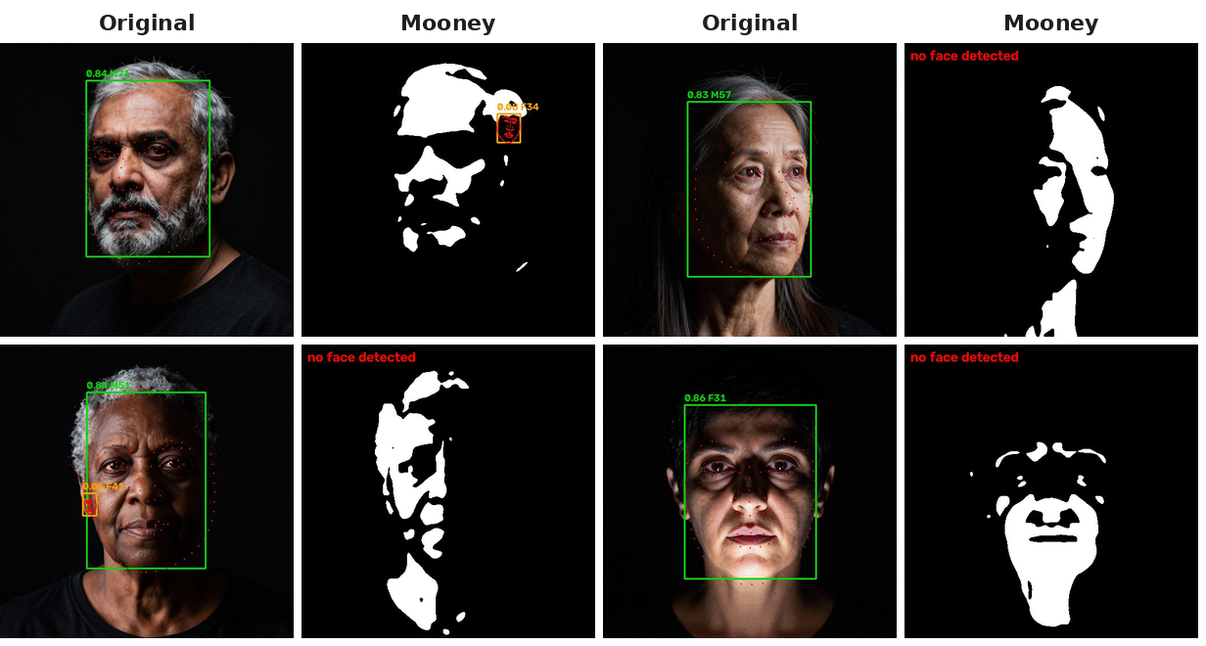
Face DCNN: the detector misses Mooney faces
RESULTS · SYSTEM 3 · INSIGHTFACE
100%
0%
faces detected in originals
faces detected in Mooneys
SCRFD detections (green: score ≥ 0.5) with landmarks, gender and age.
SCRFD finds 0% of the Mooney faces (originals 100%). When the Mooney is aligned with the original's key points, ArcFace picks the right person out of 100 in 29% of the cases (chance 1%; top-10: 66% vs. 10%): some identity information survives, but the system cannot use it without first finding the face.

Slide 8
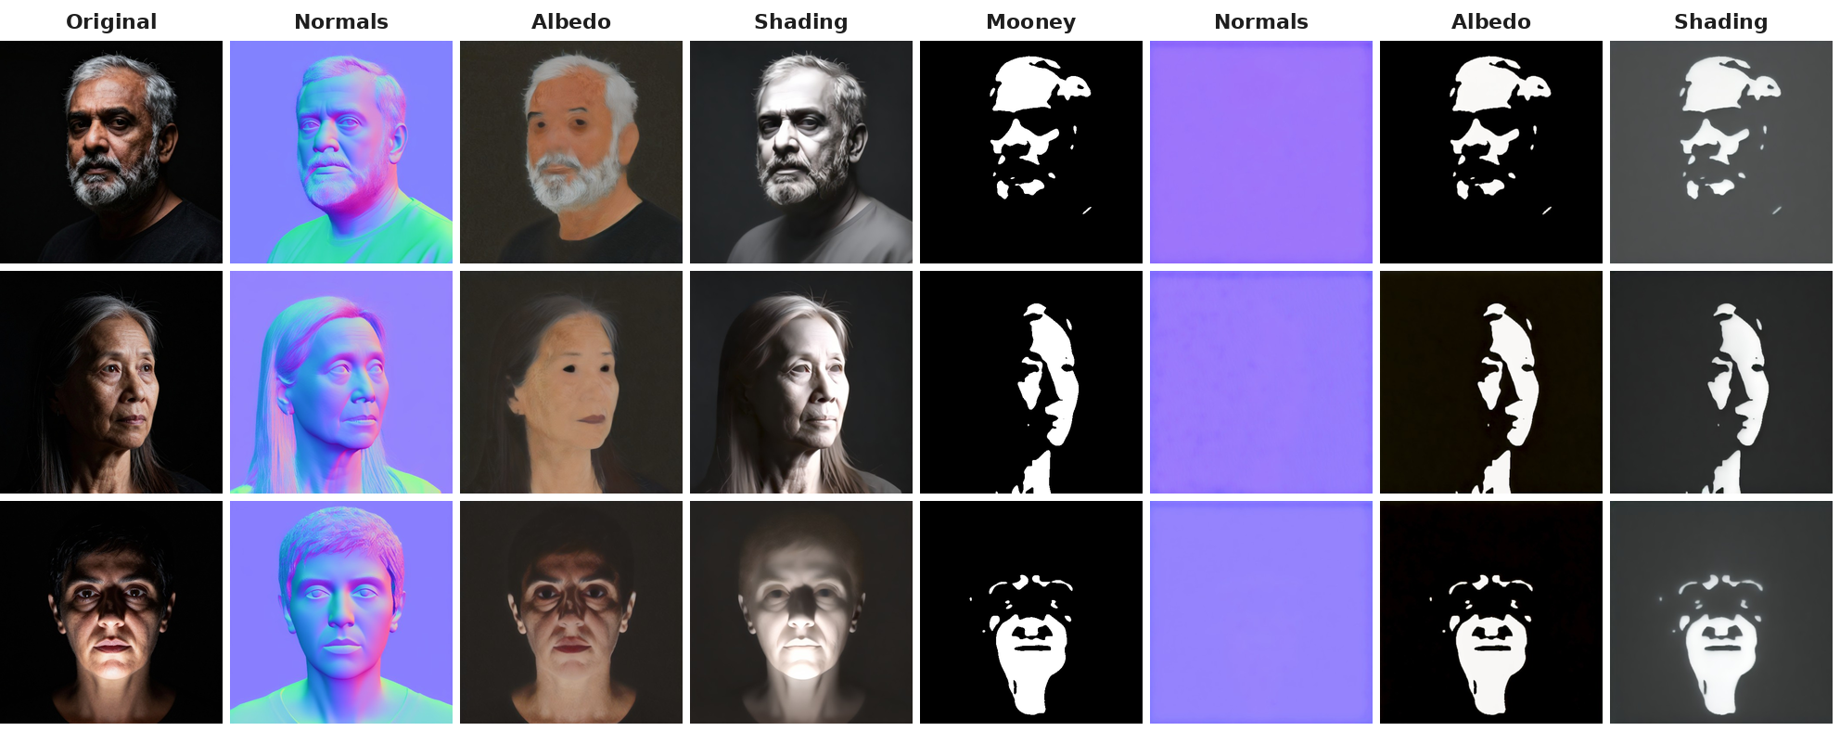
Inverse rendering: black regions become paint, not shadow
RESULTS · SYSTEM 4 · MARIGOLD
0.84
0.32
shadow index, originals (1 = all contrast is shading)
shadow index, Mooneys
Marigold normals, albedo and diffuse shading: originals (left) and their Mooney images (right); bottom row lit from below.
For originals 0.84 of the white/black contrast is explained as shading, for Mooneys only 0.32: the black regions are mostly read as dark paint (albedo), although the normals keep a rough head shape (31° error). Humans read the same black regions as shadows.

Slide 9
Light from below: the hardest case for humans and machines
RESULTS · LIGHT FROM ABOVE VS. BELOW (H2)
Human observer (the author, n = 1, each Mooney rated alone, without its original): a face (rating ≥ 4) in 68%/16% of the right/left-lit, 16% of the top-lit and 0% of the bottom-lit Mooneys.
Machines: bottom light is also the worst case. Qwen3-VL 'contains a face': 60% (bottom) vs. 88% (top); ArcFace rank-1: 8% vs. 56%.
Marigold, even on the ORIGINAL photos, explains bottom-lit contrast less as shading (0.61 vs. 0.90–0.94; also when the hairline is excluded): consistent with a light-from-above prior.
Top light is not the best case for the human here: with 10 % white, top-lit Mooneys keep mainly forehead, nose and cheekbones, while side light keeps a half face with eye, nose and mouth.
H2 partly supported: light from below is the hardest condition for the human observer, the VLM and ArcFace, and the inverse-rendering model behaves as if light came from above.

Slide 10
Summary: machines find a face-like pattern, not a lit 3D face
RESULTS · ALL SYSTEMS
Detection fails (0%), the VLM names a face in 78% but never a shadow, and inverse rendering reads black as paint. Per image, only ArcFace similarity follows the human ratings (ρ = 0.30, 95% CI 0.12–0.49); VLM confidence does not (ρ = 0.13). Consistent with Paper 1: feed-forward models lack the inverse-rendering explanation (shape + extreme light) that humans seem to use.

Slide 11
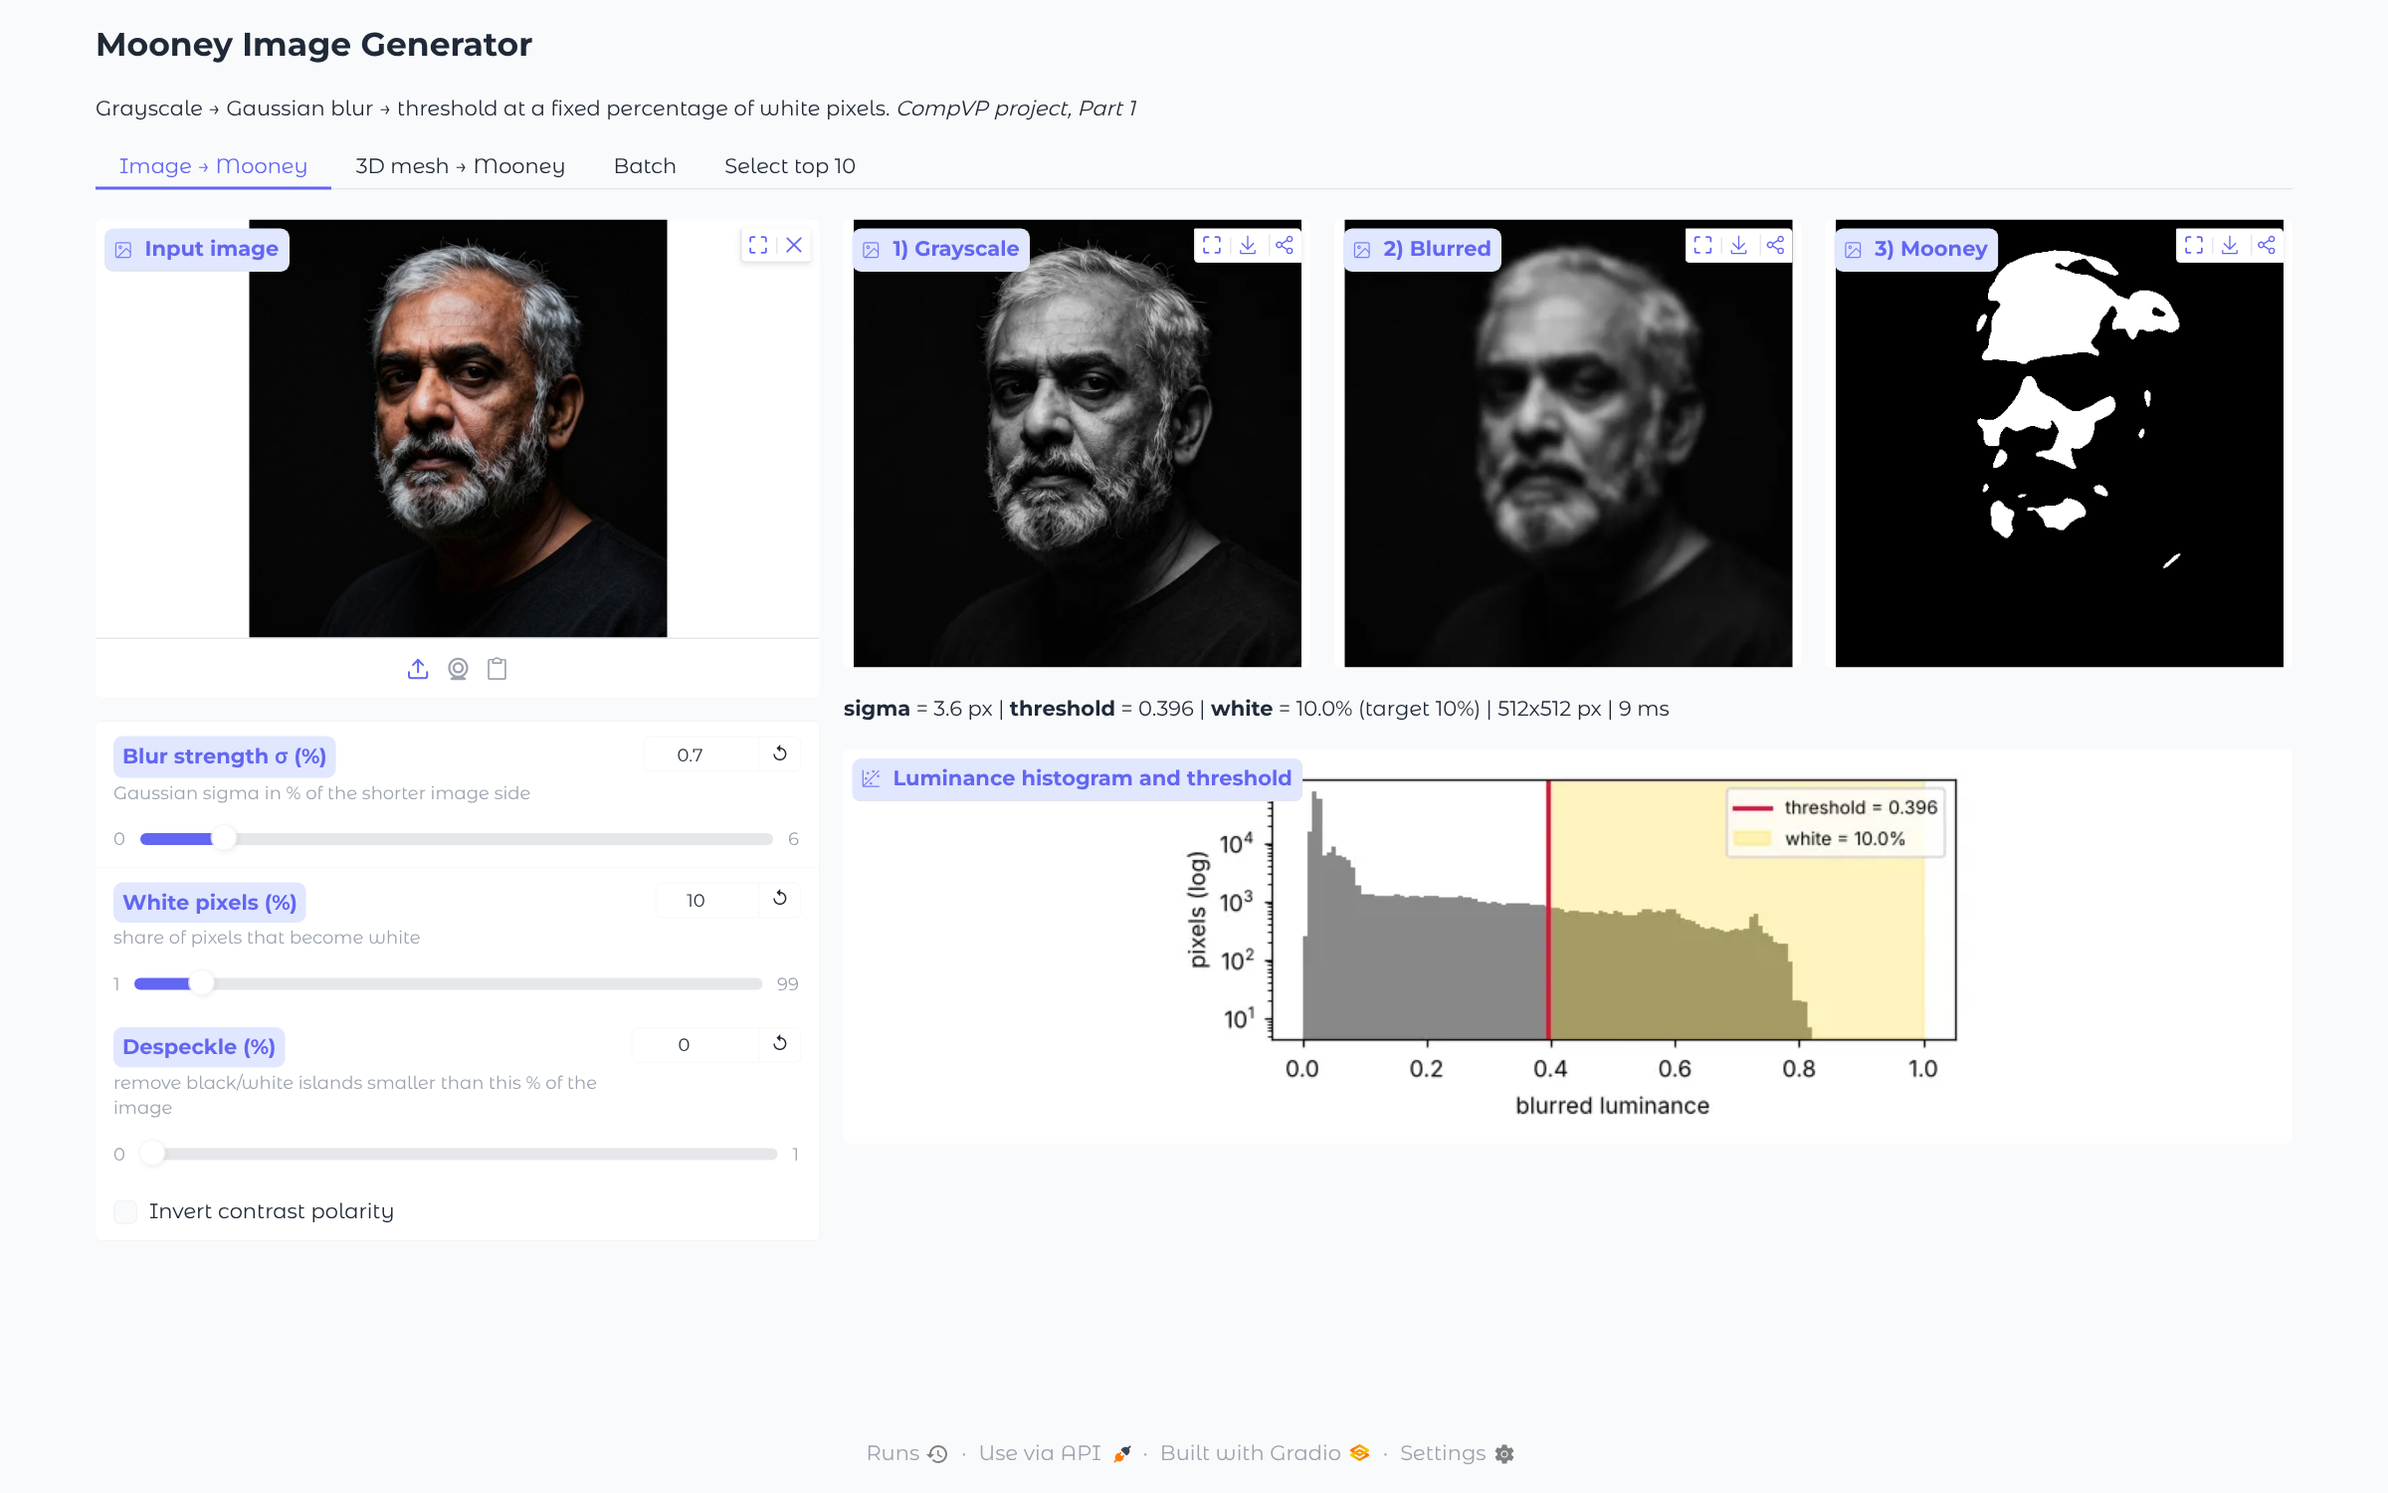
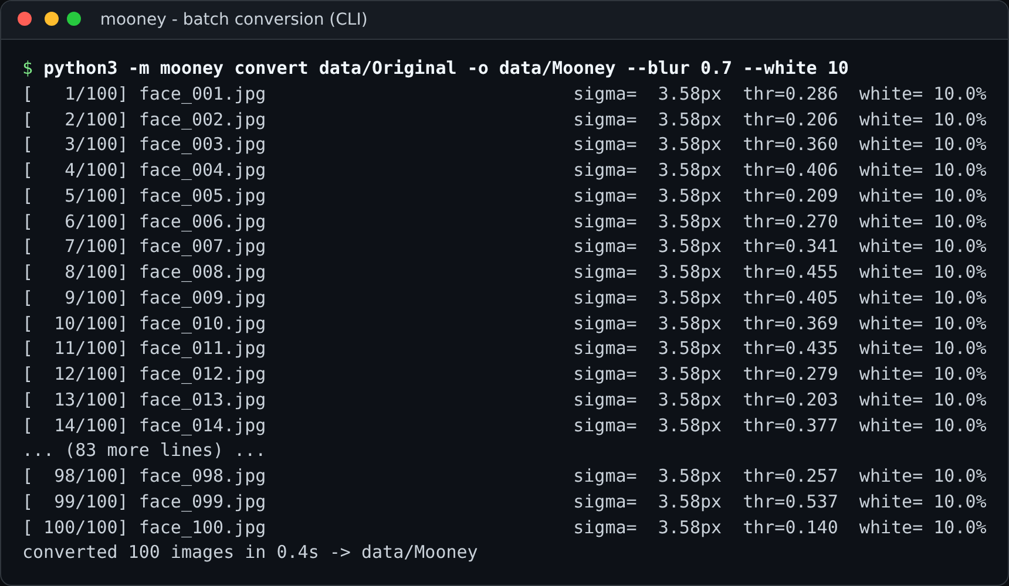
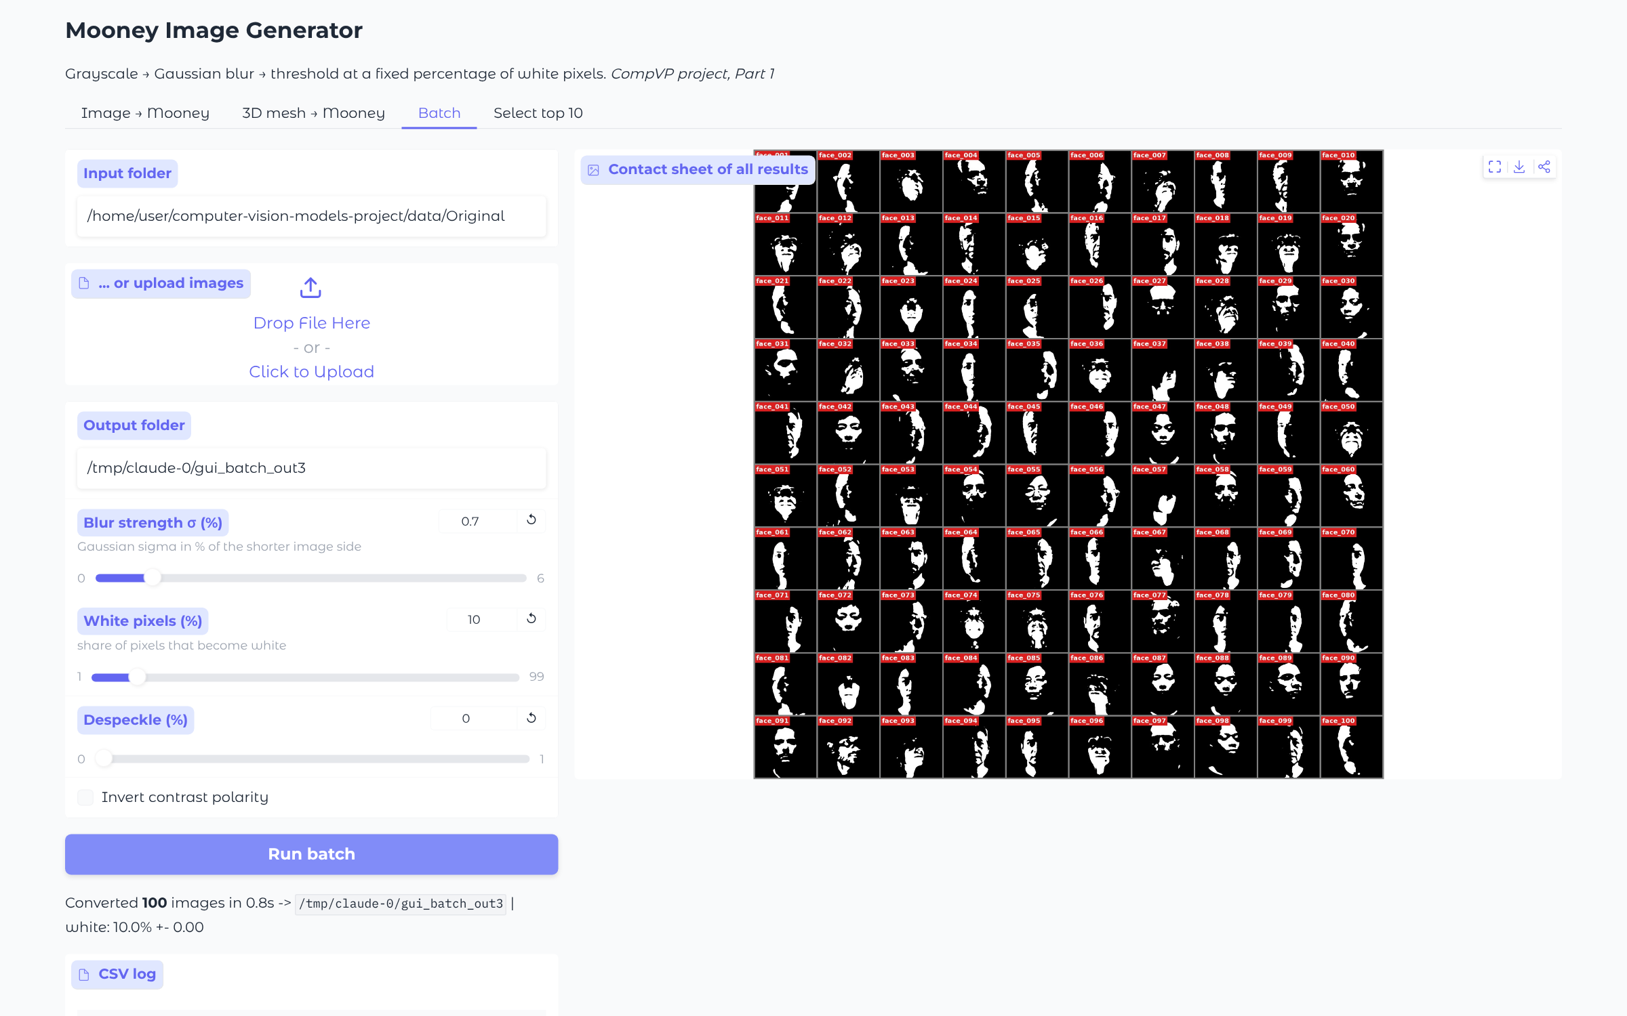
The Mooney tool: GUI with live controls + batch CLI
SCREENSHOT OF THE TOOL
Left: GUI (python -m mooney.gui) with sliders for blur strength and % white, live preview and threshold histogram. Right: the CLI batch run that produced the 100 Mooneys, and the GUI batch tab.

Slide 12
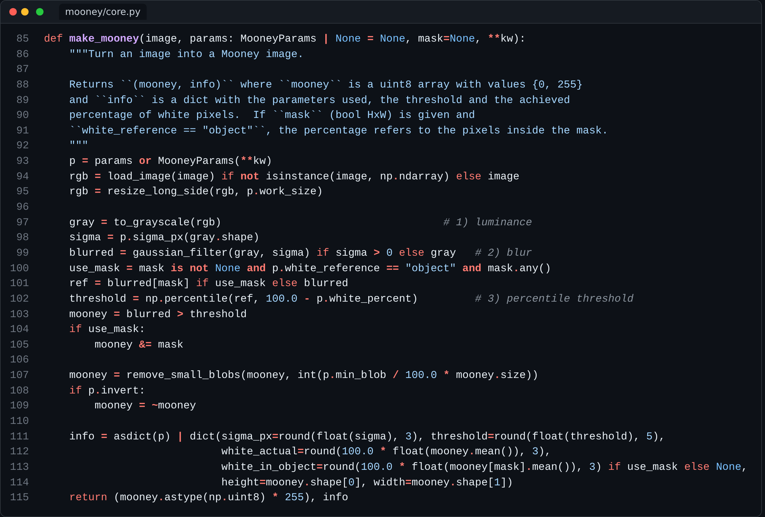
The code that generates the Mooney images
SCREENSHOT OF THE CODE THAT GENERATES MOONEYS
1) Luminance: ITU-R BT.601 grayscale.
2) Blur: Gaussian, σ given in % of the shorter image side, so the result does not depend on resolution.
3) Threshold: the (100 − w)-th percentile of the blurred image, so exactly w % of the pixels become white (Egger et al. search the same threshold by bisection).
Options: despeckling, contrast-polarity inversion, % white inside an object mask (3D meshes).

Slide 13
How generative AI was used in this project
DECLARATION OF AI USAGE
Where AI assistance was used
My own work and decisions
Claude (Anthropic) as coding and research assistant: wrote and debugged most of the Python code (Mooney tool CLI + GUI, image generation and vision-system jobs, analysis) and ran the GPU jobs on Kaggle
Proposed options (stimulus design, models that fit a 16 GB T4 GPU, metrics) and drafted the wording and layout of these slides
Chose the idea and the four vision systems from the proposed options and revised the plan with my comments (e.g. focus on light from above, landmark-based light check, 1–5 ratings)
Blind face ratings of all Mooney images (three rounds) and the manual top-10 selection
Reviewed the results and the slides; I am responsible for this submission
The 100 original images are AI-generated on purpose (Z-Image-Turbo, Apache-2.0) to control the lighting and to avoid showing real persons. All vision systems are pretrained models used without fine-tuning.

Slide 14
References
REFERENCES AND REPRODUCIBILITY
[1] B. Egger, M. Siegel, R. Arora, A. A. Soltani, I. Yildirim, J. Tenenbaum. Inverse rendering best explains face perception under extreme illuminations. CogSci 2020.
[2] C. M. Mooney. Age in the development of closure ability in children. Canadian Journal of Psychology, 1957.
[3] J. K. Lappalainen et al. Connectome-constrained networks predict neural activity across the fly visual system. Nature 634, 2024.
[4] L. Yang et al. Depth Anything V2. NeurIPS 2024.
[5] Qwen Team. Qwen3-VL (Qwen3-VL-8B-Instruct), 2025.
[6] J. Guo et al. Sample and computation redistribution for efficient face detection (SCRFD). ICLR 2022. J. Deng et al. ArcFace. CVPR 2019. InsightFace buffalo_l model pack.
[7] B. Ke et al. Repurposing diffusion-based image generators for monocular depth estimation (Marigold). CVPR 2024; Marigold v1-1 normals and intrinsic image decomposition models, 2025.
[8] Tongyi-MAI. Z-Image: an efficient image generation foundation model with single-stream diffusion transformer, 2025.
[9] O. M. Parkhi, A. Vedaldi, A. Zisserman. Deep face recognition (VGG-Face). BMVC 2015.
[10] V. S. Ramachandran. Perception of shape from shading. Nature 331, 163–166, 1988.
[11] A. Johnston, H. Hill, N. Carman. Recognising faces: effects of lighting direction, inversion, and brightness reversal. Perception 21, 365–375, 1992.
Code: github.com/Ahmadrezanourozii/computer-vision-models-project

