Slide 1

Patented
Service Robot

Slide 2
01
02
TABLE OF CONTENTS
03
04
ABSTRACT
BACKGROUND
EXPLANATION OF PICTURES
DETAILED DESCRIPTION

Slide 3
05
TABLE OF CONTENTS
06
PROTECTION ITEMS
PICTUTRES

Slide 4
Background
Robot is the installations of automated execution work, it can not only receive mankind commander, but also can run advance volume The program of row, can also be according to the principle guiding principle action formulated with artificial intelligence technology, its task is assistance or the substitution mankind, such as production industry, construction industry, or dangerous work. Our invention is a robot that serves food in restaurants or events. - Similar: CN204819533U on 2015-12-02: Waiter intelligent robot of built -in utensil cartoon image of dinner plate. JP2002352138A on 2002-12-06: Server, retrieval system, system and terminal and method for providing information, method for retrieving information and method for displaying information. JP5667993B2 on 2015-02-12: Standby order management system, management apparatus, standby order management method, and standby order management program. WO2002057931A2 on 2002-07-25: System for making restaurant order system available online.

Slide 5
Explanation of Pictures
Picture 1- general view of the invention in operation.
Picture 2- general view of the invention from the side.
Picture 3- general view of the invention from the back

Slide 6
Detailed Description
In the current invention, it is a robot that delivers food by placing the tray in its place, then choosing the correct table number, then the robot goes to the designated table. The operating system is Android. Based on Linux, the robot turns at an angle of 360 at a speed of 0,10,7m/s. It is a robot that is 1.5 m long, 0.56 m wide and weighs 62 kg. The robot has a smart screen with a smiley face (1) a length of 7.5 inches attached to its neck (2) and its neck attached to the body. The body contains the rest of the parts (3), (4), (5), (6), (7), (8), (9), Touch screen (3) to help customers put their suggestions and complaints or also to deliver notes to the supervisor and also to write the table number to deliver food to the right table. Emergency button (4) if there is any combustion in the engine or generator, Touch sensor (5) to know if the customer has taken the order or not, and when the order is finished, it will return. It is charged with electricity through (9) charging time less than 10 hours in charge mode AC 100240V Manually, the obstacle avoidance sensor system (7) can laser sense a distance of 16 m.

Slide 7
Protection Items
1. an intelligent robot waiter with a built-in plate. This intelligent robot waiter comprises: (head) smiley face (1), neck (2), emergency button (4), touch sensor (5) and an obstacle avoidance sensor system(7).

Slide 8
Protection Items
2. The head is provided with a reception of wireless signals transmitter and relates to the body by the neck. The plate is used for transferring food and both of its sides are equipped with arms that have a touch sensor (5). Finally, in the chassis we have an obstacle avoidance sensor system (7) which has a stable and movable chassis (8) under it and at the very bottom we find the charging port and pile (9).

Slide 9
Protection Items
3. The intelligent robot waiter with built-in plate according to claim (1) is characterized in that: the described arm comprises the upper arm and the underarm; the upper arm is connected with the underarm by a screw.

Slide 10
Protection Items
4. The intelligent robot waiter with a built-in plate according to claim (1) is provided with loud speakers on both sides of the body and an 8-inch touch screen on the body.

Slide 11
Protection Items
5. The intelligent robot waiter with a built-in plate according to claim (1) is provided with a double tray that can hold up to 10kg of holdings.

Slide 12
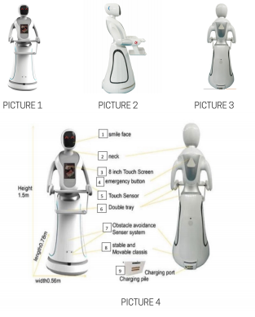
Pictures

Slide 13
Thanks!
@Smart_Methods

