Slide 1



SMART INDIA HACKATHON 2026
TITLE PAGE
• Problem Statement ID – SIH26028
• Problem Statement Title- AI-Driven Dynamic Section Controller & Track Maintenance Block Scheduling System for Indian Railways
• PS Category- Software
• Theme- Transportation & Logistics / Smart Railways
• Team ID- SIH-26028-TEAM
• Team Name (Registered on portal) : RailTrack Pioneers

Slide 2
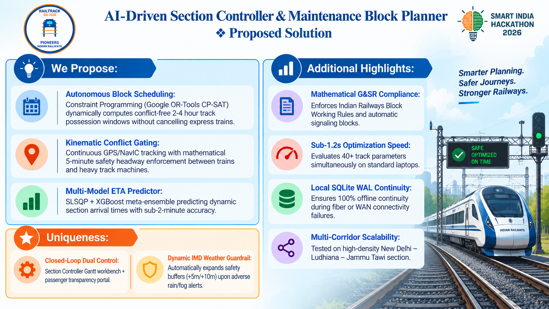
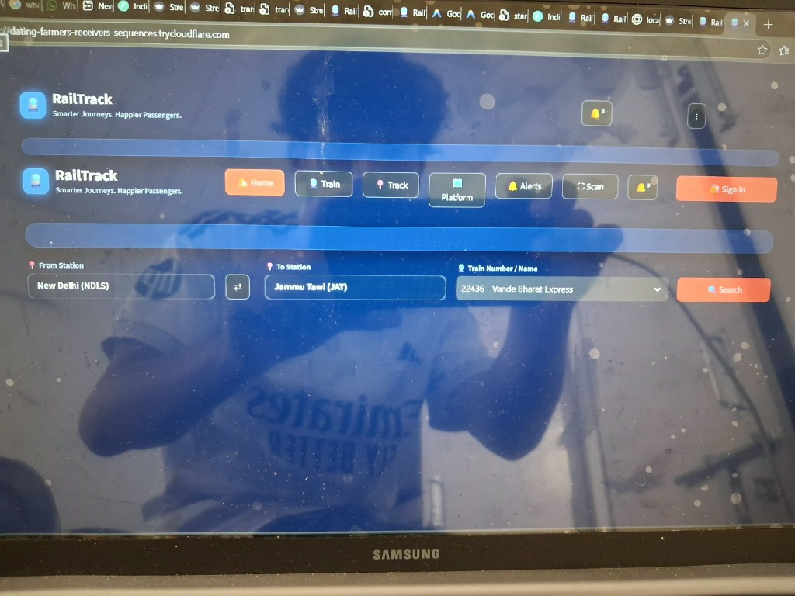
AI-Driven Section Controller & Maintenance Block Planner
❖ Proposed Solution
We Propose:
• Autonomous Block Scheduling: Constraint Programming (Google OR-Tools CP-SAT) dynamically computes conflict-free 2-4 hour track possession windows without cancelling express trains.
• Kinematic Conflict Gating: Continuous GPS/NavIC tracking with mathematical 5-minute safety headway enforcement between trains and heavy track machines.
• Multi-Model ETA Predictor: SLSQP + XGBoost meta-ensemble predicting dynamic section arrival times with sub-2-minute accuracy.
• Mathematical G&SR Compliance:
Enforces Indian Railways Block Working Rules and automatic signaling blocks.
• Sub-1.2s Optimization Speed:
Evaluates 40+ track parameters simultaneously on standard laptops.
• Local SQLite WAL Continuity:
Ensures 100% offline continuity during fiber or WAN connectivity failures.
• Multi-Corridor Scalability:
Tested on high-density New Delhi – Ludhiana – Jammu Tawi section.
Uniqueness:
• Closed-Loop Dual Control: Section Controller Gantt workbench + passenger transparency portal.
• Dynamic IMD Weather Guardrail: Automatically expands safety buffers (+5m/+10m) upon adverse rain/fog alerts.
@SIH Idea submission- Template
2

Slide 3
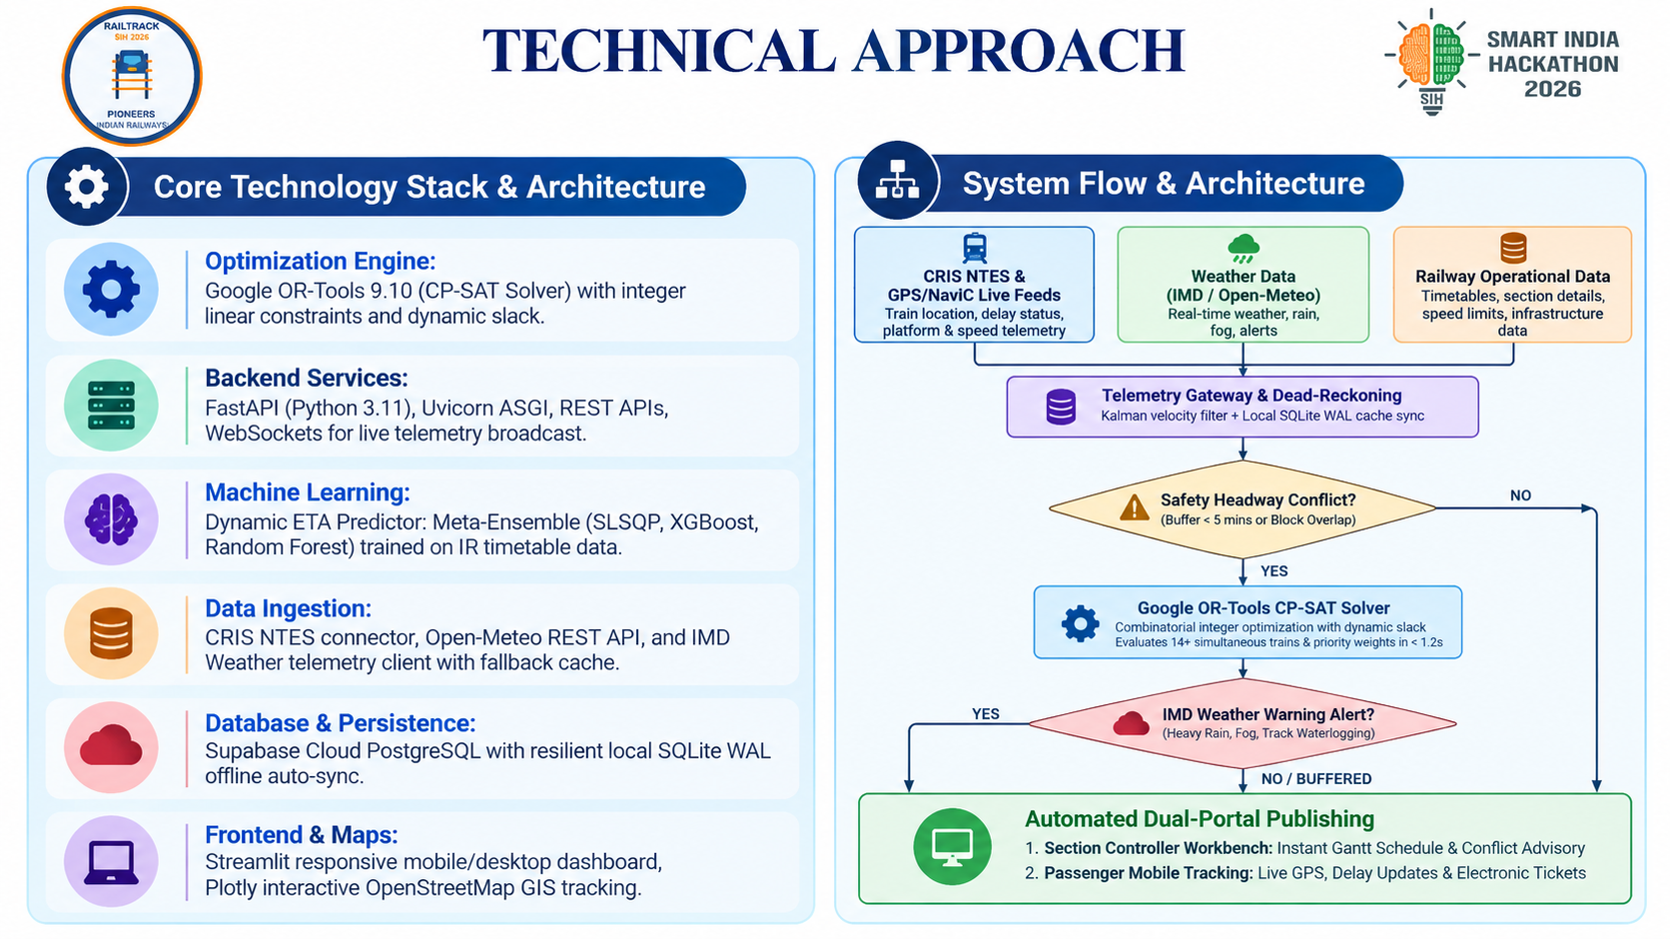
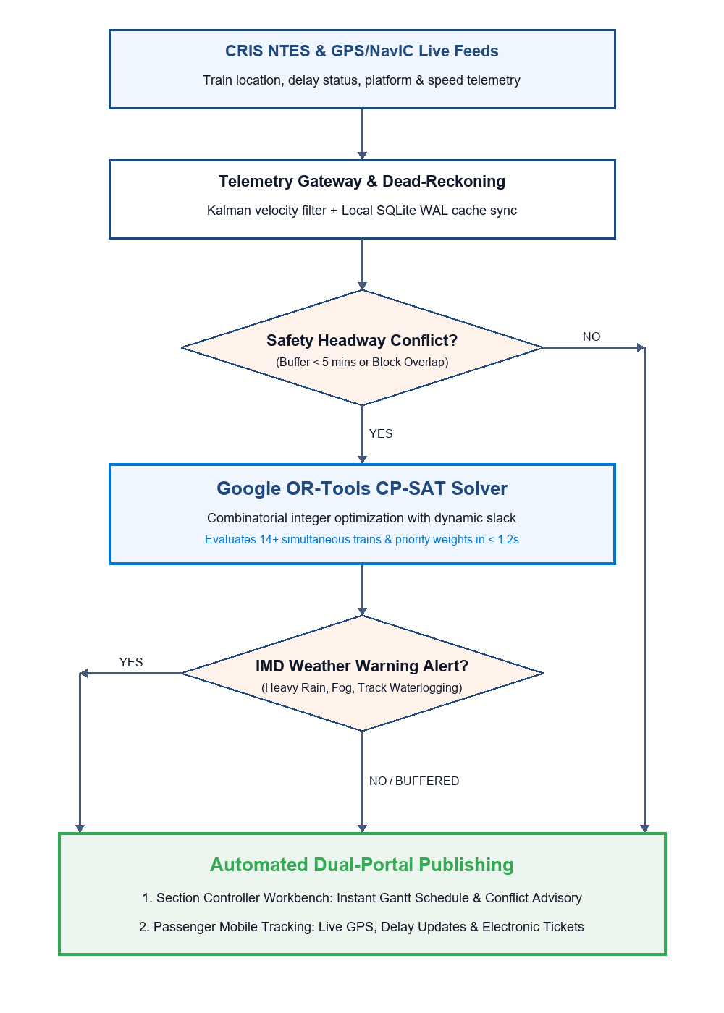
TECHNICAL APPROACH
Core Technology Stack & Architecture
• Optimization Engine: Google OR-Tools 9.10 (CP-SAT Solver) with integer linear constraints and dynamic slack.
• Backend Services: FastAPI (Python 3.11), Uvicorn ASGI, REST APIs, WebSockets for live telemetry broadcast.
• Machine Learning: Dynamic ETA Predictor: Meta-Ensemble (SLSQP, XGBoost, Random Forest) trained on IR timetable data.
• Data Ingestion: CRIS NTES connector, Open-Meteo REST API, and IMD Weather Telemetry client with fallback cache.
• Database & Persistence: Supabase Cloud PostgreSQL with resilient local SQLite WAL offline auto-sync.
• Frontend & Maps: Streamlit responsive mobile/desktop dashboard, Plotly interactive OpenStreetMap GIS tracking.
@SIH Idea submission- Template
3

Slide 4
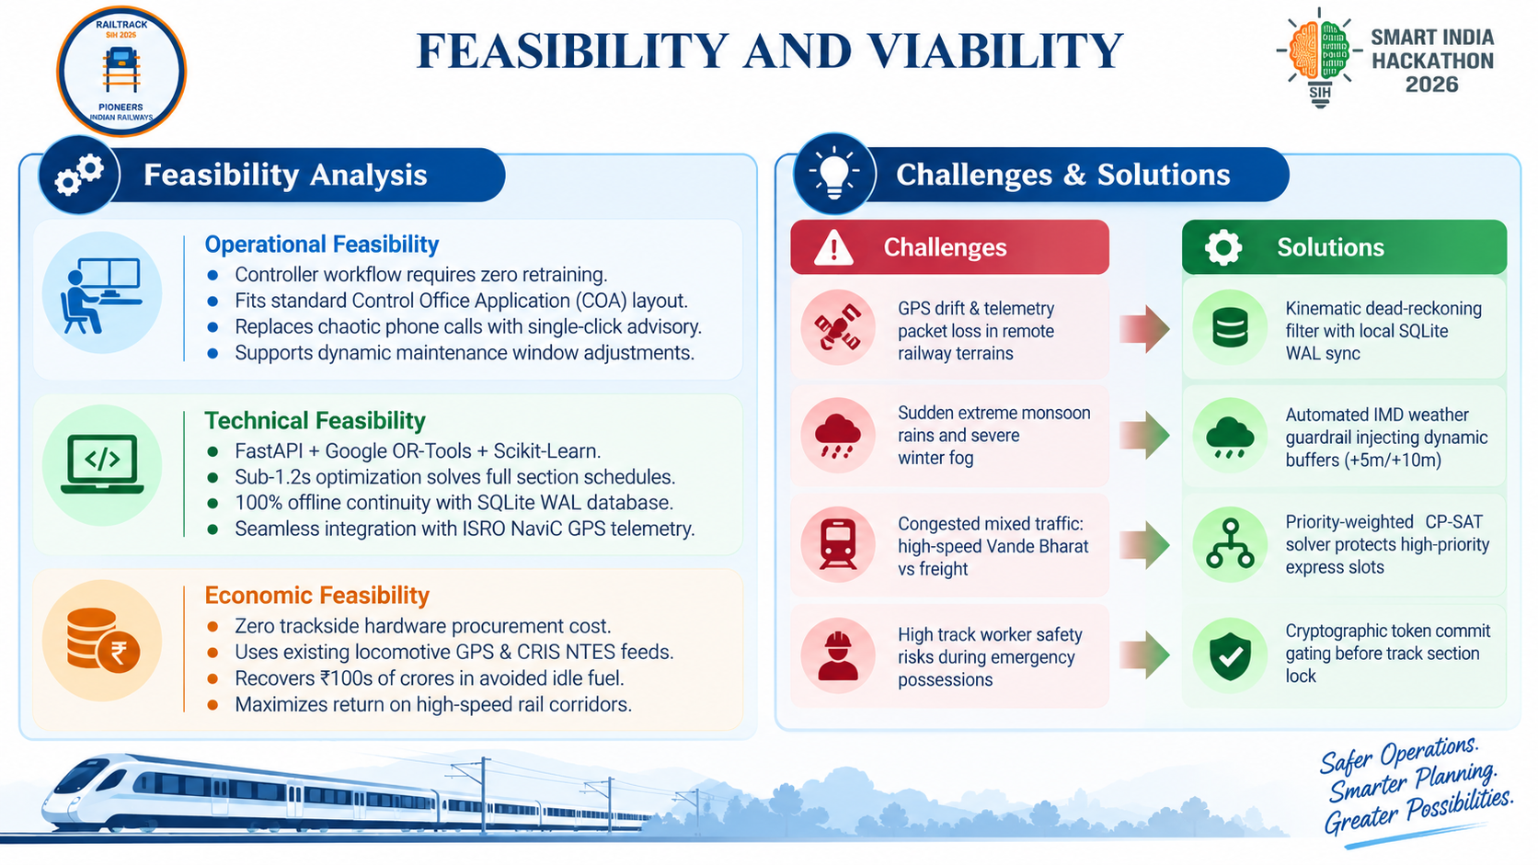
FEASIBILITY AND VIABILITY
Challenges & Solutions
Operational Feasibility: Controller workflow requires zero retraining.
Fits standard Control Office Application (COA) layout.
Replaces chaotic phone calls with single-click advisory.
Supports dynamic maintenance window adjustments.
Technical Feasibility: FastAPI + Google OR-Tools + Scikit-Learn.
Sub-1.2s optimization solves full section schedules.
100% offline continuity with SQLite WAL database.
Seamless integration with ISRO NavIC GPS telemetry.
Economic Feasibility: Zero trackside hardware procurement cost.
Uses existing locomotive GPS & CRIS NTES feeds.
Recovers ₹100s of crores in avoided idle fuel.
Maximizes return on high-speed rail corridors.
• GPS drift & telemetry packet loss in remote railway terrains
• Sudden extreme monsoon rains and severe winter fog
• Congested mixed traffic: high-speed Vande Bharat vs freight
• High track worker safety risks during emergency possessions
• Kinematic dead-reckoning filter with local SQLite WAL sync
• Automated IMD weather guardrail injecting dynamic buffers (+5m/+10m)
• Priority-weighted CP-SAT solver protects high-priority express slots
• Cryptographic token commit gating before track section lock
@SIH Idea submission- Template
4

Slide 5
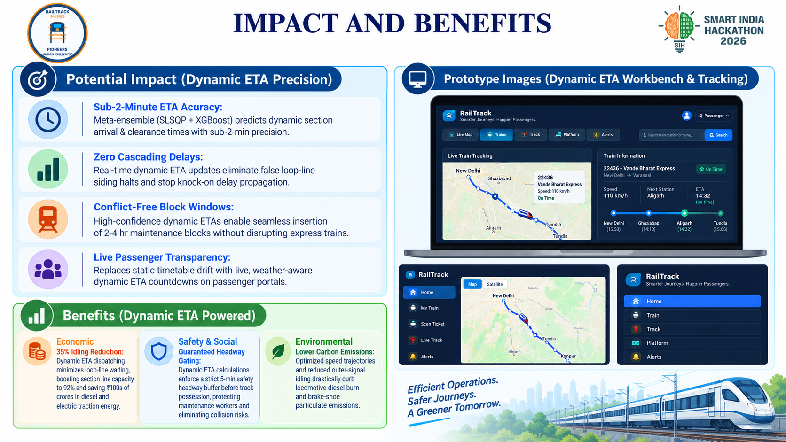
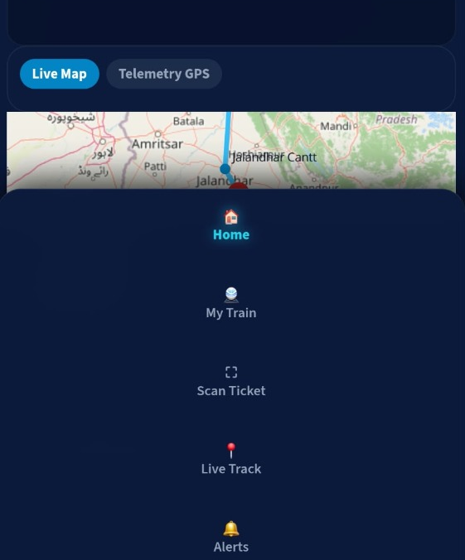
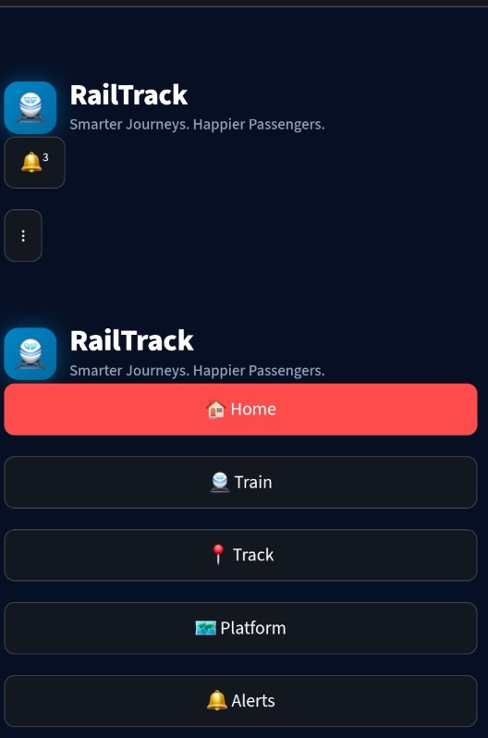
IMPACT AND BENEFITS
Potential Impact (Dynamic ETA Precision):
• Sub-2-Minute ETA Accuracy: Meta-ensemble (SLSQP + XGBoost) predicts dynamic section arrival & clearance times with sub-2-min precision.
• Zero Cascading Delays: Real-time dynamic ETA updates eliminate false loop-line siding halts and stop knock-on delay propagation.
• Conflict-Free Block Windows: High-confidence dynamic ETAs enable seamless insertion of 2-4 hr maintenance blocks without disrupting express trains.
• Live Passenger Transparency: Replaces static timetable drift with live, weather-aware dynamic ETA countdowns on passenger portals.
PROTOTYPE IMAGES (DYNAMIC ETA WORKBENCH & TRACKING)
Benefits (Dynamic ETA Powered):
Economic: 35% Idling Reduction: Dynamic ETA dispatching minimizes loop-line waiting, boosting section line capacity to 92% and saving ₹100s of crores in diesel and electric traction energy.
Safety & Social: Guaranteed Headway Gating: Dynamic ETA calculations enforce a strict 5-min safety headway buffer before track possession, protecting maintenance workers and eliminating collision risks.
Environmental: Lower Carbon Emissions: Optimized speed trajectories and reduced outer-signal idling drastically curb locomotive diesel burn and brake-shoe particulate emissions.
@SIH Idea submission- Template
5

Slide 6
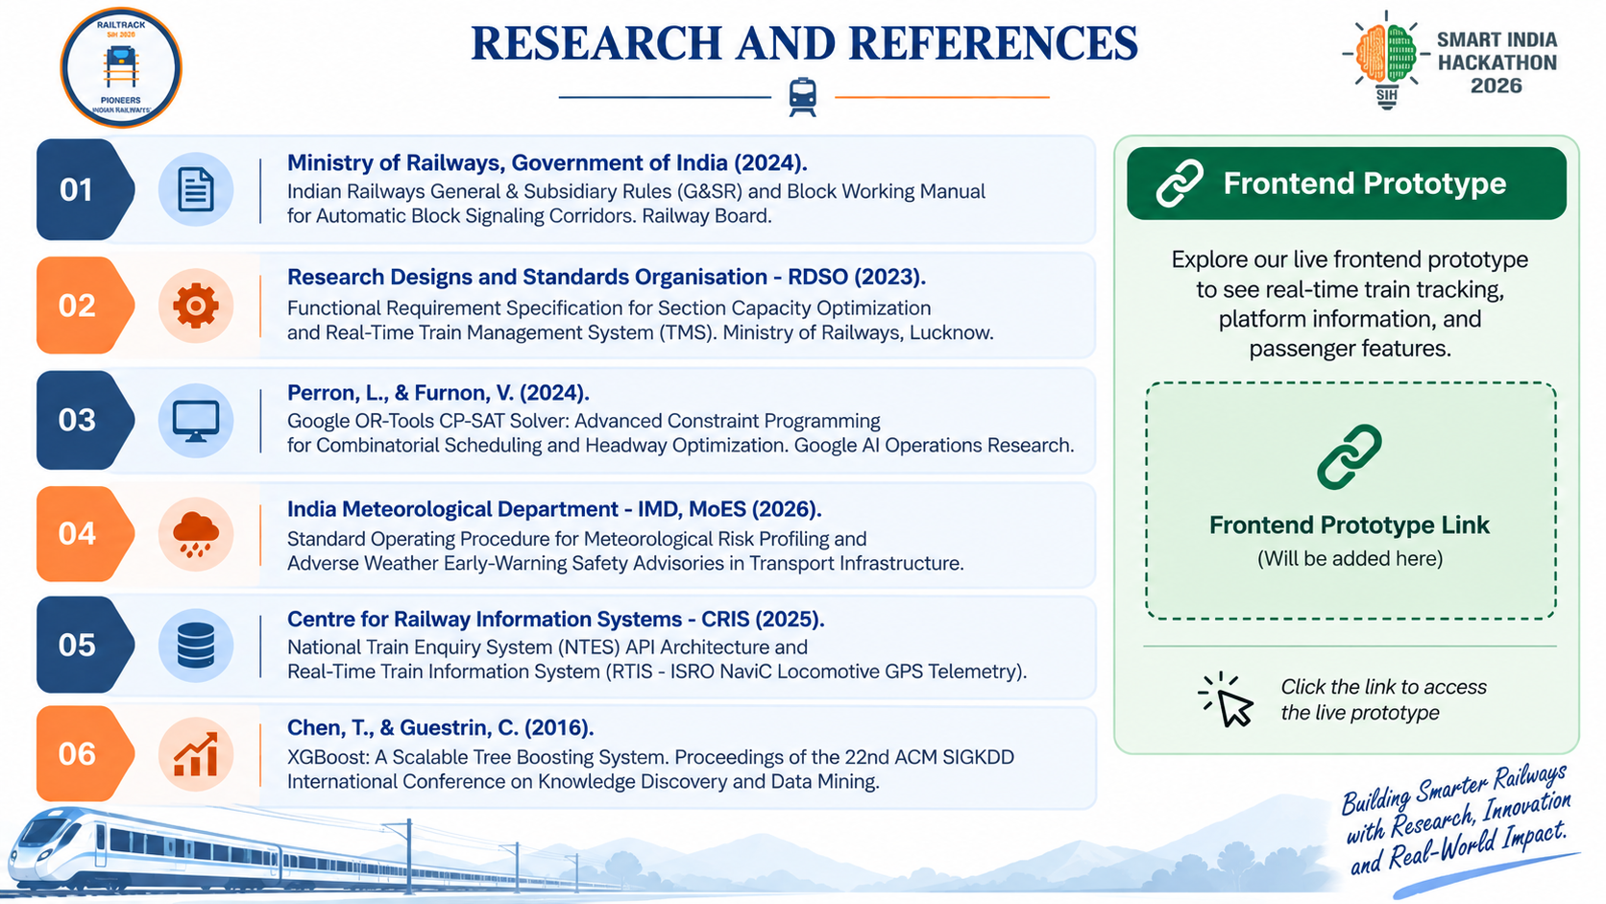
RESEARCH AND REFERENCES
• Ministry of Railways, Government of India (2024). Indian Railways General & Subsidiary Rules (G&SR) and Block Working Manual for Automatic Block Signaling Corridors. Railway Board.
• Research Designs and Standards Organisation - RDSO (2023). Functional Requirement Specification for Section Capacity Optimization and Real-Time Train Management System (TMS). Ministry of Railways, Lucknow.
• Perron, L., & Furnon, V. (2024). Google OR-Tools CP-SAT Solver: Advanced Constraint Programming for Combinatorial Scheduling and Headway Optimization. Google AI Operations Research.
• India Meteorological Department - IMD, MoES (2026). Standard Operating Procedure for Meteorological Risk Profiling and Adverse Weather Early-Warning Safety Advisories in Transport Infrastructure.
• Centre for Railway Information Systems - CRIS (2025). National Train Enquiry System (NTES) API Architecture and Real-Time Train Information System (RTIS - ISRO NavIC Locomotive GPS Telemetry).
• Chen, T., & Guestrin, C. (2016). XGBoost: A Scalable Tree Boosting System. Proceedings of the 22nd ACM SIGKDD International Conference on Knowledge Discovery and Data Mining.
LINK
@SIH Idea submission- Template
6

