Slide 1
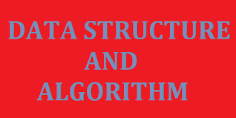

Slide 2
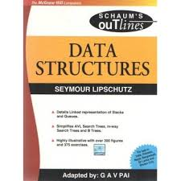
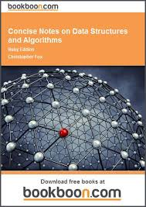
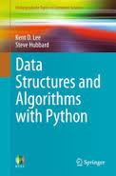
Related books

Slide 3
Introduction
Data- values or set values
Data item- sigle unit of value
Group items- data items that can be divided into subitems. E.g Name
Elementary items- data items that cannot be divided into subitems. E.g Phone number
Information-

Slide 4
Cont…
Entity- something that has certain attributes/properties which my be assignned values
Entity set- collection of entities with similar attributes
Attributes | Name | Age | Sex | Reg. Number
Values | Musa Isa | 18 | M | CST/14/00123

Slide 5
Cont…
Field- a single elementary unit of information representing an attribute of an entity
Record- collection of field values of a given entity
File- collection of records of the entities in a given entity set

Slide 6
Cont…
Primary key- a field that uniquely determines a record in a file
example
Level coordination
Keeps students’ files
Each file contains student’s record
Each record is made up of fields, e.g name,
Records are sorted according to a key

Slide 7
Cont…
Fixed-length record: Same data items with same amount of space assigned to each data item
Variable-length record: different data and length
example
Students’ course registration
Fresh and returning

Slide 8
Data structures?
Logical and mathematical model of a particular organization of data
Data Structure is a way of collecting and organising data in such a way that we can perform operations on these data in an effective way

Slide 9
Classification of Data structures
Primitive data structures- Basic data types such as integer, real, character, and boolean
Non-primitive data structures: Complex data structures used to store large and connected data. Examples include Linked list, stacks, queues, trees and graphs.

Slide 10
Linear and Non-linear data structure
Linear – elements form a sequence/ linear list
example- arrays, linked-list, stacks and queues
non-linear: data/elements not arranged in sequence
example- Trees and graphs

Slide 11
Cont…
Node
Edge
Degree

Slide 12
Data structures operations
Traversing
Searching
Inserting
Deleting
Sorting
merging

Slide 13
Abstract Data Types (ADT)
Refers to set of data values and associated operations that are specified accurately, independent of any particular implementation
With an ADT, we know what a specific data type can do, but how it actually does it is hidden

Slide 14
Algorithms
A well defined list of steps for solving a particular problem
Complexity- function which gives the running time and/or space in terms of the input size
Efficiency- measured in terms of time and space

Slide 15
Searching algorithms
Linear search
complexity: C(n)=n/2
Binary search
complexity: C(n)=log₂n

Slide 16
Cont…
Time-Space Tradeoff

Slide 17
Mathematical Notations and Functions
Floor and Ceiling functions
Remainder function; Modulor Arithmetic
Interger and absolute value functions
Summation
Factorial function
Permutation
Exponents and logarithms

