Slide 1

Mutual Fund Analytics Platform Capstone Project I
Submitted By: Ahmar Kalam · Technology Stack: Python | SQLite | Power BI | Financial Analytics

Slide 2


Problem Statement
Investors require a robust, data-driven platform to evaluate mutual funds across performance, risk, and behavior. This capstone constructs an end-to-end analytics solution to support fund selection, monitoring, and recommendation based on historical performance and market trends.
Goal: Turn disparate mutual fund data into actionable, auditable insights for portfolio decisions.

Slide 3


System Architecture
End-to-end pipeline that ingests raw mutual fund sources, transforms data, stores it for analytics, and surfaces insights via dashboards and models.
1
2
3
Raw Mutual Fund Data
Python ETL Pipeline
SQLite Database
Price histories, transactions, holdings, and benchmarks
Extraction, normalization, validation, and enrichment
Normalized schema for NAV, transactions, and metadata
4
5
Analytics Engine
Power BI Dashboard
SQL queries, financial computations, cohort analytics
Interactive visualizations, slicers, and KPI reports
Flow summary: Raw Mutual Fund Data ↓ Python ETL Pipeline ↓ SQLite Database ↓ Analytics Engine ↓ Power BI Dashboard

Slide 4
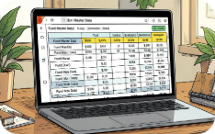
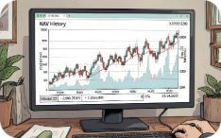


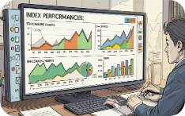
Dataset Overview
Primary datasets ingested and integrated:
Fund Master Data
NAV History
Investor Transactions
Scheme Performance & AUM
Daily NAV series used for returns and volatility calculations
Identifiers, fund house, category, inception date, expense ratios
Systematic and lump-sum flows for cohort and SIP analysis
Assets under management, category inflows, and allocation snapshots
Benchmark Indices
Reference series for alpha/beta and benchmark-relative analytics

Slide 5

Data Engineering Pipeline
Implemented in Python (Pandas) with modular ETL jobs and transactionally-consistent SQLite loads.
Key Operations
Date parsing & timezone normalization
Missing NAV handling: forward-fill + business-day interpolation
Duplicate removal & referential integrity checks
Automated data validation and exception reporting
Batch loads into SQLite with indexed tables for analytics
Processing cadence: nightly incremental loads + weekly full reconciliation

Slide 6
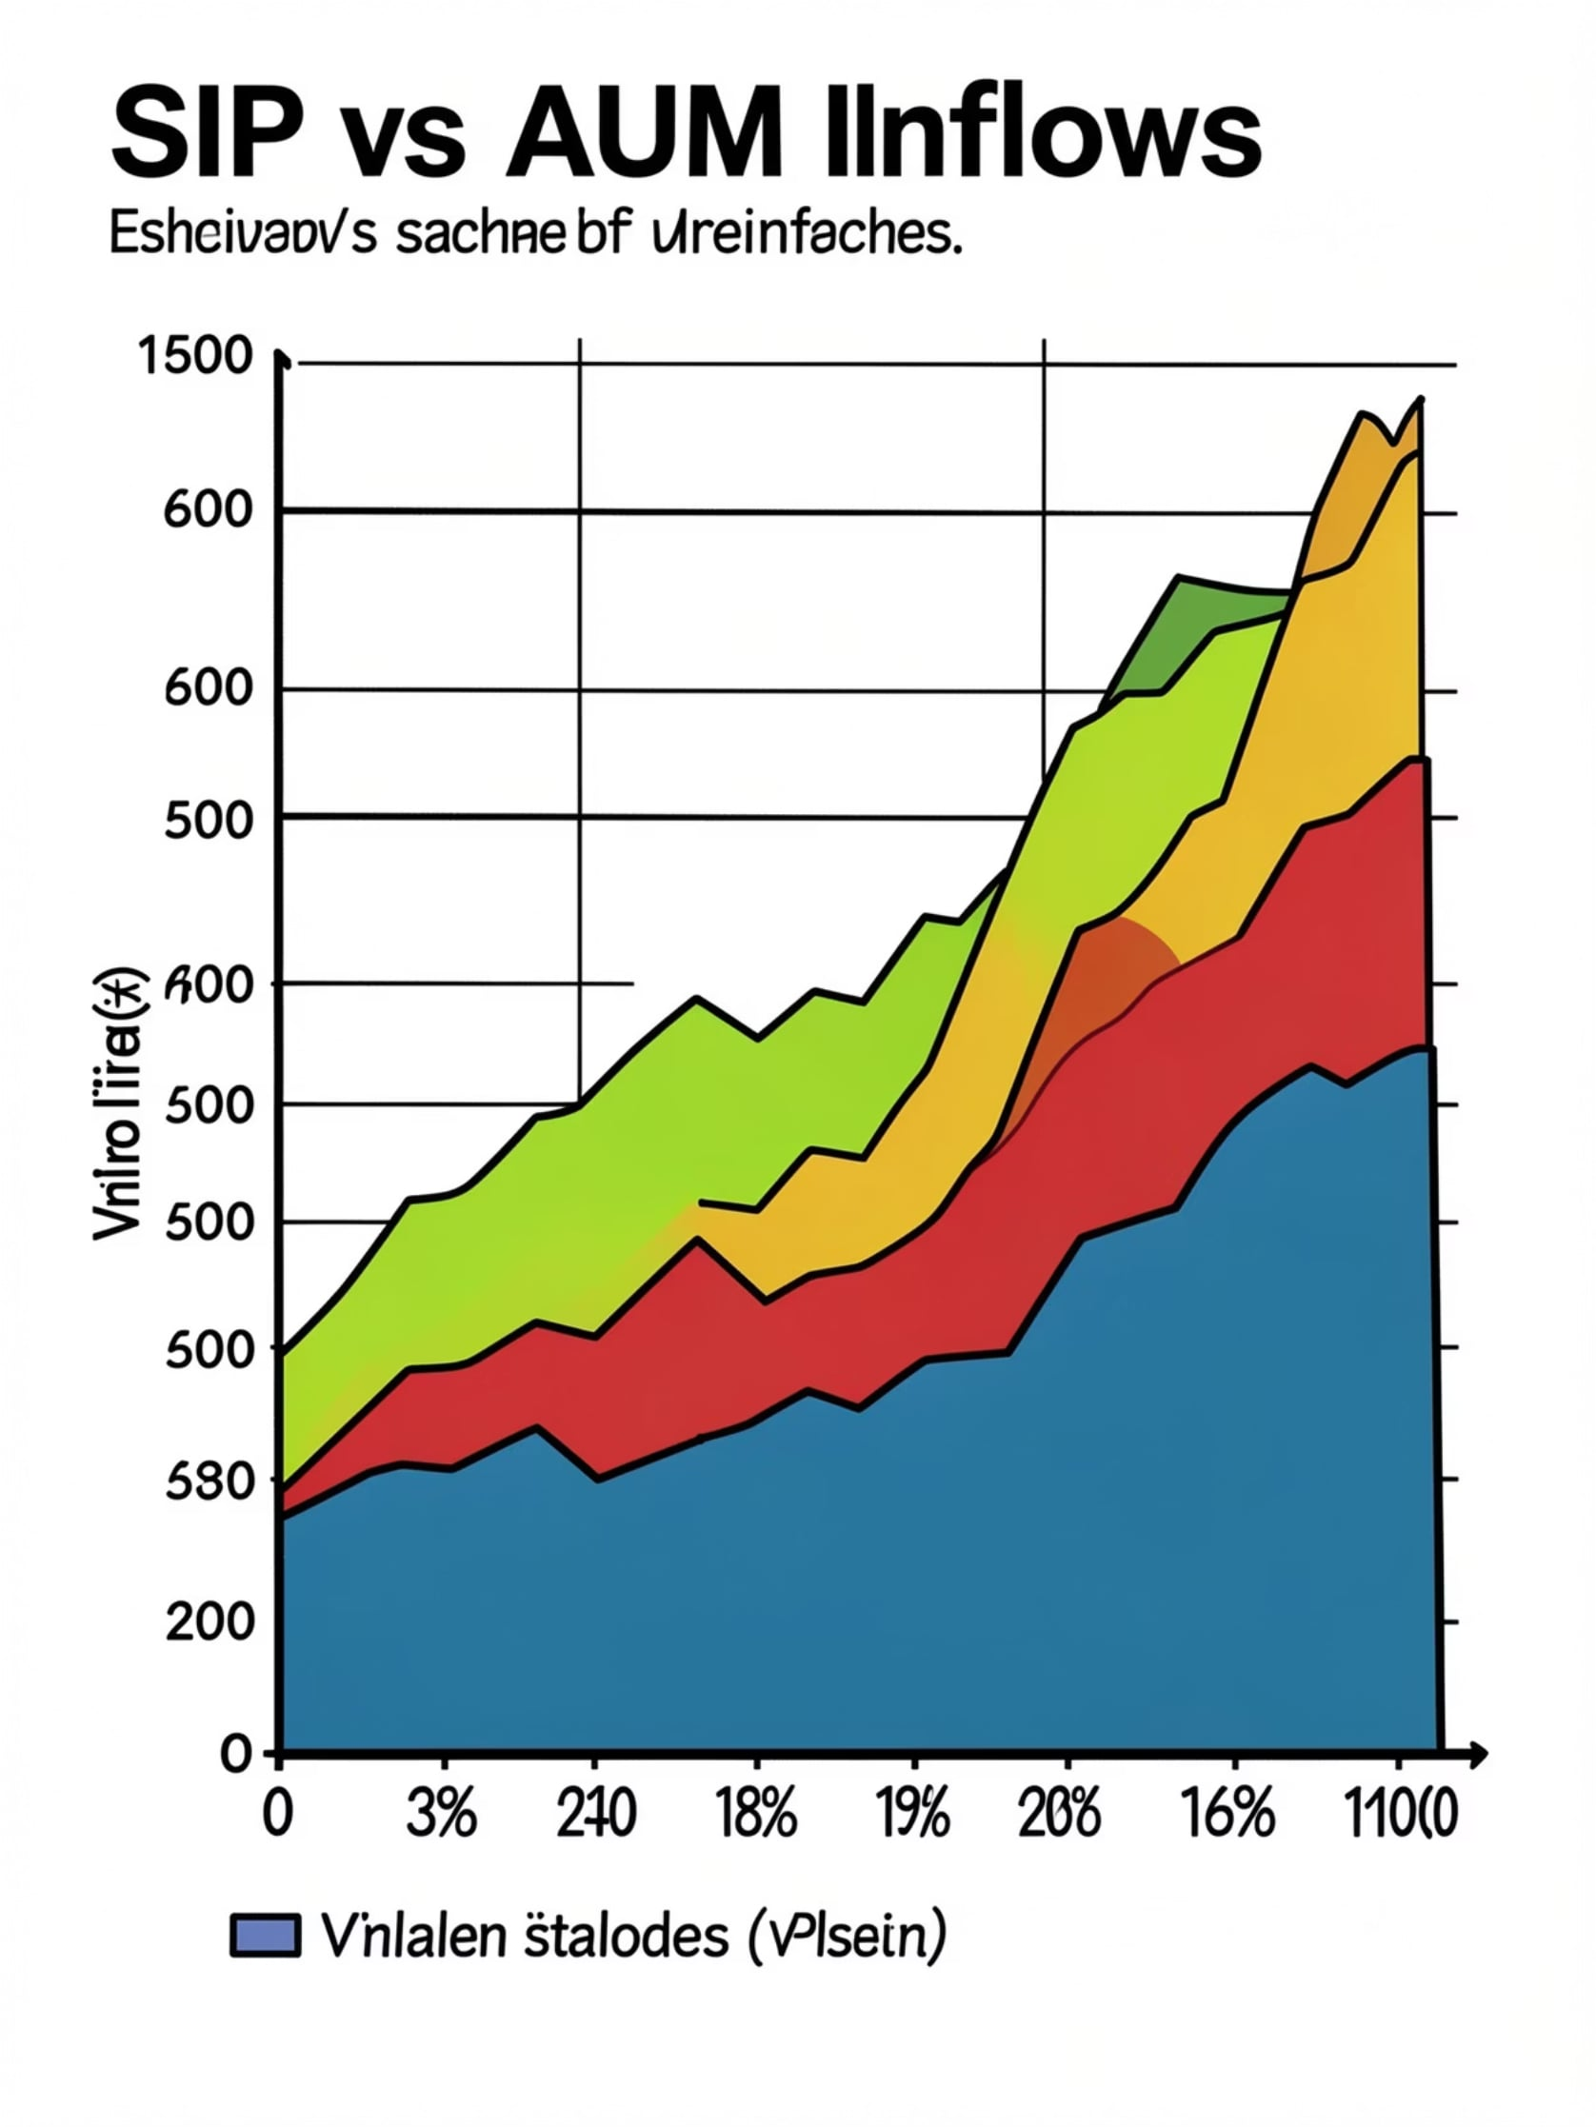
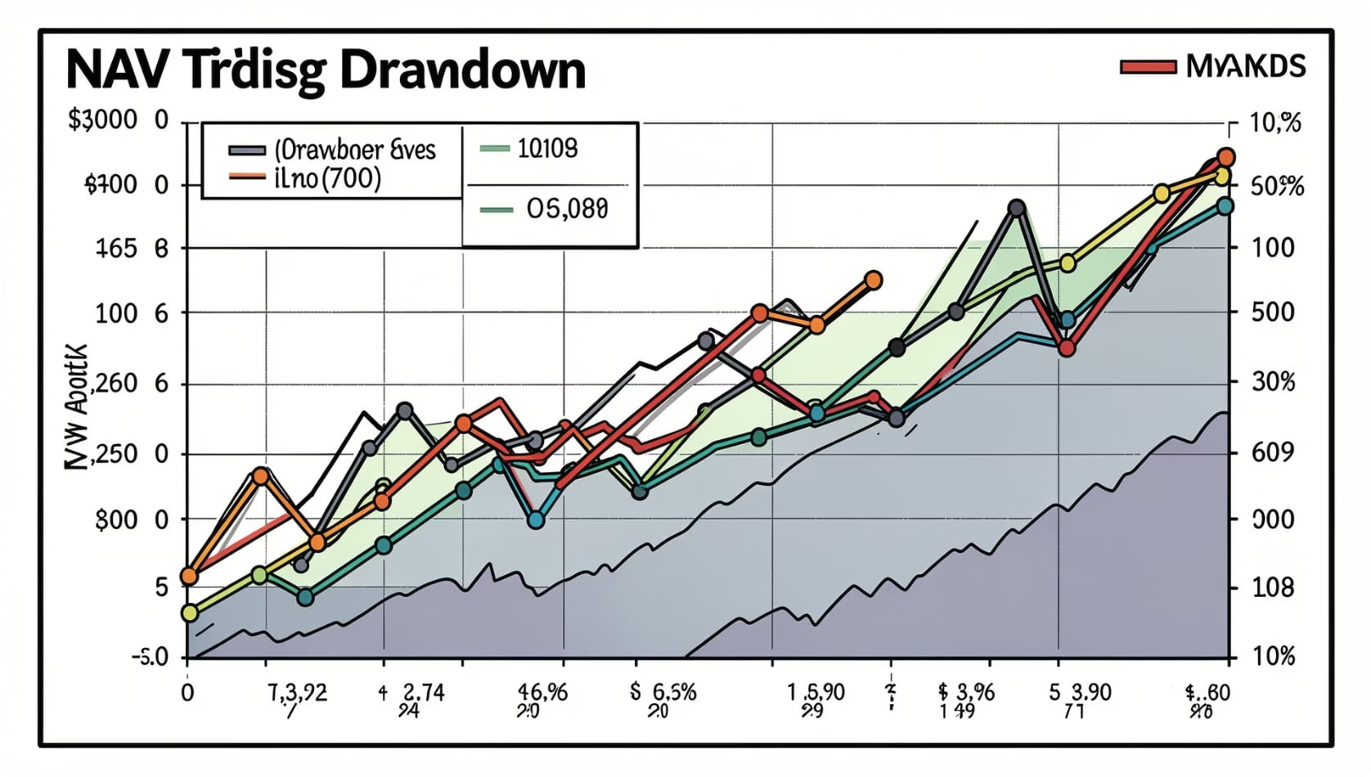
Exploratory Data Analysis (EDA)
Visual and statistical exploration to surface patterns, seasonality, and anomalies.
Key Insights
SIP inflows exhibited steady, month-on-month growth across equity funds
AUM rose materially for top AMCs after market rebounds
Equity categories attracted disproportionate inflows vs debt during the period

Slide 7
Fund Performance Metrics
Implemented a standard suite of performance measures for comparable evaluation and scoring.
CAGR
Sharpe & Sortino Ratios
Alpha & Beta
Max Drawdown
Annualized return over multiple horizons
Benchmark-relative performance and systematic risk exposure
Peak-to-trough loss used for stress assessment
Risk-adjusted returns using volatility and downside deviation
Fund Scorecard
Composite ranking combining performance, risk, and flow metrics
Visualization: benchmark comparison chart included in dashboard to contextualize metrics (screenshot captured).

Slide 8





Risk Analytics & Recommendation System
Advanced models and cohort analysis power risk signals and personalized recommendations.
Historical VaR (95%)
CVaR
Rolling Sharpe
Empirical distribution-based tail risk estimates per fund
Expected shortfall for stress scenario planning
Time-varying risk-adjusted performance to detect regime shifts
Investor Cohort Analysis
Recommendation Engine
Behavioral segmentation by SIP behavior, tenure, and realized returns
Rule + score-based suggestions: risk match, diversification, and momentum

Slide 9
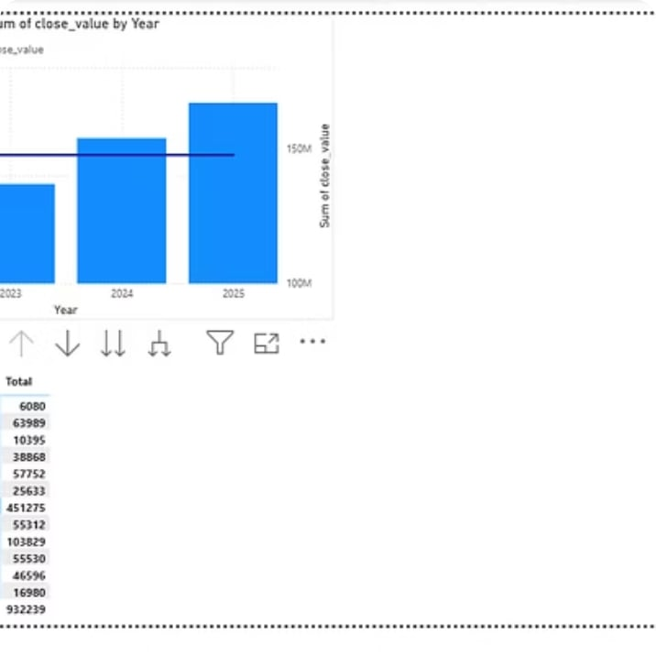
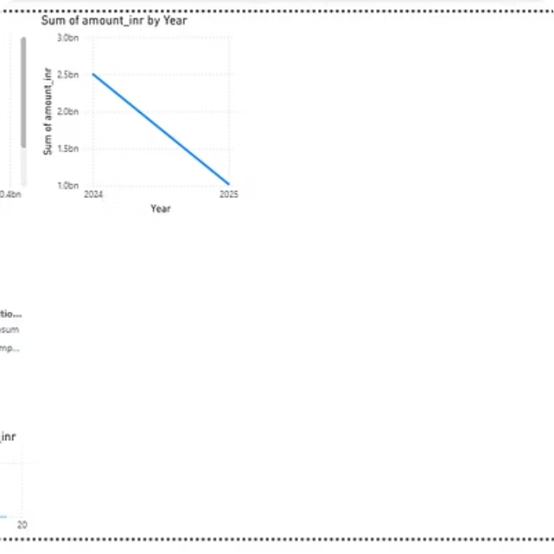
Interactive Dashboard (Power BI)
Deliverables: high-impact, interactive reports for analysts and stakeholders with drill-through and filters.
Features: slicers, KPI tiles, time-series analysis, and exportable scorecards for evidence-based decisions.

Slide 10

Conclusion
The project delivered an operational mutual fund analytics platform combining: Data Engineering, SQL Analytics, Financial Modeling, Risk Analysis, and a Power BI dashboard to support investment decisions.
Impact
Deliverables
Recommended Next Steps
Enables rigorous fund comparison, risk-aware recommendations, and operational reporting.
ETL codebase, SQLite schema, analytics notebooks, and Power BI reports.
Productionize ETL, add automated backtests, integrate live market feeds, and deploy model monitoring.

