Slide 1
MINISTRY OF COMMUNICATIONS AND INFORMATION TECHNOLOGY (MCIT)
TuT AI: Sovereign Local AI Platform
Strategic Pitch Deck — 100% Offline National Intelligence, Deep Summarization, Autonomous Presentations & Vector Infographics
Principal Architect & Project Lead: Ahmed Gamal Sophi Arfa | Under the Supervision of MCIT Leadership

Slide 2
CHALLENGE & OPPORTUNITY
The Strategic Imperative: Why Sovereign Local AI Matters
VULNERABILITY
1. Severe Data Security Risks
• Relying on foreign commercial clouds (OpenAI, Claude) means confidential state data leaves Egypt.
• Strict government data laws forbid storing ministerial decrees and citizen archives abroad.
• Risk of third-party model retraining on sensitive Egyptian intellectual property.
• Cloud services remain vulnerable to international outages, embargoes, and rate limits.
OPERATIONAL FRICTION
2. The Document Bottleneck
• Ministries process thousands of 100+ page technical specs, legal decrees, and briefs daily.
• Human summarization takes hours or days, causing executive bottlenecks in decision-making.
• Building slide presentations and executive infographics requires multiple manual designers.
• High recurring SaaS subscription fees for disparate design and AI editing platforms.
SOVEREIGN SOLUTION
3. The TuT AI Breakthrough
• 100% On-Premise, Air-Gapped execution on local Egyptian infrastructure.
• Zero cloud transmission — works completely offline without internet connectivity.
• Unifies deep research, document drafting, slides, and spreadsheet audit in one single sign-on.
• Maximizes local hardware via dedicated NVIDIA GPU acceleration.

Slide 3
PLATFORM CAPABILITIES
TuT AI Core Engine: Three Deliverable Powerhouses
RESEARCH ENGINE
📑 Deep Summarization
• Ingests 100+ page PDFs, Word docs, decrees, and raw spreadsheets into local notebooks.
• Hierarchical multi-tier synthesis: Executive Brief, Chapter Breakdown, and Key Deliverables.
• Grounded passage citations: Every bullet point is bound to exact numbered passage references.
• Guaranteed Zero-Hallucination via local vector and full-text hybrid RAG retrieval.
DECKCRAFT STUDIO
📊 Autonomous Presentations
• Prompts in natural language directly generate complete 12+ slide PowerPoint decks (.pptx).
• DeckCraft local engine with strict MCIT branding, Nohemi typography, and royal gold accents.
• 5-pass automated layout audit loop fixes text overflow, card alignment, and visual balance.
• Direct download in chat & instant editing via integrated ONLYOFFICE Document Server.
VECTORCRAFT STUDIO
🎨 Vector Infographics
• Translates complex metrics, policy timelines, and architectures into visual sketchnotes.
• VectorCraft engine integrates Open Doodles, structured flowchart arrows, and metric badges.
• High-resolution exports in PNG, scalable SVG, and print-ready vector PDF.
• Instantly embeds into official ministerial publications and social media briefs.

Slide 4
CORE FEATURE DEEP-DIVE
Pillar 1: Intelligent Deep Summarization Engine
ARCHITECTURE
Multi-Source Knowledge Digestion
• Omni-Channel Ingestion: Scanned and text PDFs, Word (.docx), Excel spreadsheets, audio transcripts, and HTML portals.
• Local Chunking & Vectorization: Embeddings generated on-premise using nomic-embed-text via local Ollama bridge.
• SurrealDB Account Isolation: Each ministry department and user operates in a segregated, sandboxed database.
• Lightning Synthesis: Synthesizes complex multi-volume reports into an executive brief in under 20 seconds.
VERIFICATION
Grounded Trust & Zero-Hallucination
• Numbered Citation System: Summary sentences display [1], [2] clickable references pointing back to the exact passage.
• Context-Locked LLM: The model is strictly instructed to answer only from verified retrieved passages.
• Executive Summary Tiers: Switch between a 1-page High-Level Digest, a 5-page Comprehensive Study, or a Table of Deliverables.
• Arabic & English Mastery: Full bilingual comprehension of complex Egyptian administrative and legal phrasing.

Slide 5
CORE FEATURE DEEP-DIVE
Pillar 2: Autonomous PowerPoint Presentation Engine
CONVERSATIONAL FLOW
End-to-End In-Chat Generation
• Natural Language Prompting: Ask TuT Agent: 'Create a 12-slide presentation on Egypt Vision 2030 digital pillars'.
• Local MCP Protocol: Agent invokes the local deck generator tool via Model Context Protocol (MCP) in real-time.
• Production Deck Output: Produces a genuine, fully editable .pptx file (5+ MB) directly in the conversation stream.
• Instant ONLYOFFICE Editing: Click to open in port :8082 without needing Microsoft Office installed on the PC.
DESIGN RIGOR
DeckCraft Design & Audit Pipeline
• Approved MCIT Typography: Automatically embeds Nohemi headings, Libre Franklin body, and Inter covers.
• Royal Obsidian Theme: High-contrast midnight obsidian background with royal Egyptian gold framing (#D4AF37).
• Multi-Slide Typology: Hero cover slides, 3-pillar metric cards, timeline roadmaps, and closing executive summaries.
• Automated Layout Audit: Self-healing loop inspects slide text lengths and refactors cards to ensure zero visual overlap.

Slide 6
CORE FEATURE DEEP-DIVE
Pillar 3: VectorCraft Infographics Studio
VISUAL DESIGN
Visualizing Abstract Governmental Data
• From Numbers to Art: Transforms dry tables and statistical metrics into intuitive visual sketchnotes.
• Process & Flow Mapping: Automatically draws sequential arrows, milestone containers, and dependency diagrams.
• Open Doodles & Custom Vector Icons: Integrates approved human-centric vector doodles for friendly, modern appeal.
• Responsive Layouts: Generates square, portrait, and landscape compositions adapted for print, web, or mobile.
PRODUCTION FORMATS
Multi-Format Sovereign Export
• Vector SVG Export: Infinitely scalable vector art suitable for billboards, official banners, and web publication.
• Ultra-HD PNG: High-DPI raster output for seamless embedding into Word reports, executive PDFs, and emails.
• Print-Ready PDF: Vector PDF output matching international A4 / A3 print standards.
• Zero Cloud Dependency: All rendering done via local Node.js VectorCraft engine inside Docker container.

Slide 7
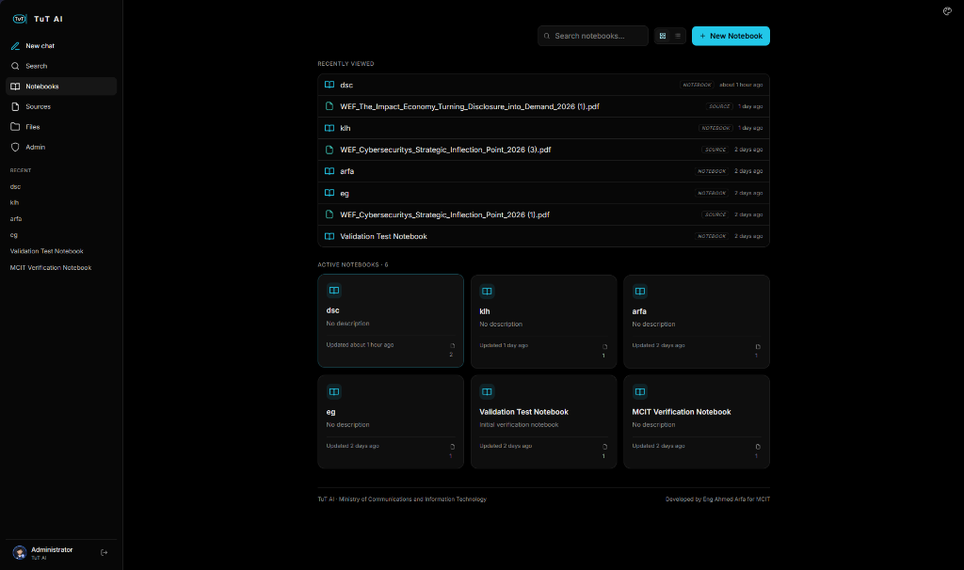
LIVE SYSTEM INTERFACE
Live Platform Showcase: Knowledge Notebooks & Multi-Source RAG
DATA INGESTION
Multi-Source Knowledge Ingestion
• Ingests massive governmental PDFs (e.g. WEF Global Risks Report 2024), decrees, and spreadsheets.
• Full-text search & vector embeddings extracted and stored 100% locally.
SECURITY & ISOLATION
Departmental Notebook Sandboxing
• Isolated sovereign workspaces ('dsc', 'klh', 'arfa', 'eg') protect departmental boundaries.
• Prevents data cross-contamination with secure account-level isolation.
MCIT PROVENANCE
Sovereign National Attribution
• Custom-built for the Ministry of Communications & Information Technology.
• Verified interface attribution: 'Developed by Eng Ahmed Arfa for MCIT'.

Slide 8
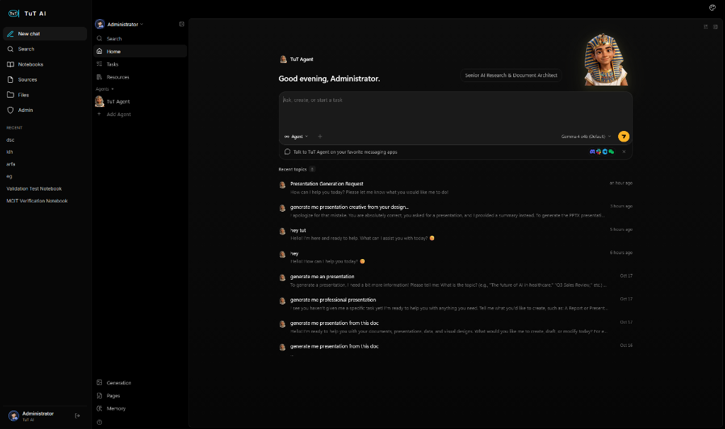
CONVERSATIONAL INTELLIGENCE
Live Agent Showcase: In-Chat Deck Generation & 3D Avatar
SOVEREIGN IDENTITY
3D Holographic Sovereign Avatar
• Interactive real-time 3D King Tut avatar blending Egyptian heritage with state-of-the-art AI.
• Dynamic state cues respond to thought cycles and generation stages.
DECKCRAFT ENGINE
In-Chat Autonomous Presentation Engine
• Live conversational workflow: User asks in Arabic for presentations on complex national topics.
• Generates genuine, fully editable PowerPoint decks (.pptx) right inside chat.
GPU ACCELERATION
Pinned Local Gemma 4 Engine
• Powered by Gemma 4 e4b pinned directly in NVIDIA RTX GPU VRAM.
• Instant token streaming with zero latency and 100% offline data privacy.

Slide 9
ENGINEERING RIGOR
Technical Breakthroughs: 131k Context & GPU Acceleration
MODEL CAPACITY
131k Context Window
• PostgreSQL database tables unlocked to 131,072 context tokens.
• 16,384 maximum output tokens for exhaustive document generation.
• Eliminates memory truncation: Ingest entire decree books without losing context.
• Reasoning mode: 'pro' with 8,192 dedicated thinking budget.
VELOCITY
NVIDIA RTX 4050 GPU VRAM
• Pinned local gemma4:e4b weights in dedicated 5.1 GB GPU VRAM.
• Configured keep_alive: '-1' to completely eliminate cold-start unloading.
• Instant response velocity: First token streamed in milliseconds.
• Optimized for smooth pair programming and multi-turn conversational agents.
RESILIENCE
Self-Healing Docker Stack
• 11 isolated Docker services: Agent, Platform, ONLYOFFICE, SurrealDB, Postgres, Redis, Kokoro.
• Built-in runtime self-patching in startServer.js guarantees TRPC stability on container boot.
• Turnkey 1-click bootstrap scripts (.ps1 and .sh) launch the full ecosystem in under 15 seconds.
• All source code versioned on GitHub: MCIT-DEPI/DEPI-PPTX.

Slide 10
ENGINEERING MILESTONES
The Development Journey: 4 Evolutionary Phases
PHASE 1: INCEPTION
Phase 1: Foundation & Sovereign Identity
• Transitioned away from generic third-party code to 100% Egyptian sovereign platform.
• Engineered the TuT AI identity: 10 historical personas & 3D holographic cartouche.
PHASE 2: ARCHITECTURE
Phase 2: Core Engines & Resilient Fixes
• Engineered the 3 pillars: Deep Summarization, DeckCraft (.pptx), and VectorCraft (infographics).
• Resolved TRPC runtime crashes via intelligent local Ollama fallback proxy.
PHASE 3: INTELLIGENCE
Phase 3: Model Intelligence & GPU Velocity
• Unlocked database to 131,072 context tokens, 16,384 output tokens, and 'pro' reasoning.
• Pinned gemma4:e4b into NVIDIA RTX 4050 GPU VRAM (keep_alive: '-1') for instant streaming.
PHASE 4: PRODUCTION
Phase 4: Turnkey Production & GitHub Release
• Built self-healing Docker architecture and turnkey 1-click setup scripts (.ps1 and .sh).
• Integrated ONLYOFFICE document server and published full production repo to GitHub.

Slide 11
INSTITUTIONAL VALUE
Strategic & Economic Impact for MCIT & Government
SOVEREIGNTY
100% Data Sovereignty
• Zero cloud leakage: Classified ministerial files remain within the state firewall.
• Full compliance with national cybersecurity and data protection frameworks.
• Immune to foreign sanctions, cloud pricing hikes, or global connection blackouts.
• Total ownership of code, weights, data, and fine-tuned domain models.
PRODUCTIVITY
10x Operational Speed
• Reduces 4-hour document reading to a 30-second verified executive summary.
• Eliminates external design delays: Generates ready-to-present PowerPoint decks on demand.
• Instant ONLYOFFICE co-editing: Staff collaborate inside the platform without license costs.
• Empowers leadership with real-time strategic briefs during meetings.
COST EFFICIENCY
Zero Recurring SaaS Costs
• No per-seat licensing fees (saving thousands of dollars annually on Copilot / ChatGPT Plus).
• Runs on existing departmental GPUs and workstations without expensive cloud clusters.
• Built on robust open-source foundations (SurrealDB, ParadeDB, Next.js, Fastify).
• Future-proof modularity: swap underlying open models seamlessly.

Slide 12
EVOLUTION
Strategic Future Roadmap: Expanding TuT AI
SPEED
1. Ultra-Fast Inference via vLLM
• Integrate containerized vLLM with PagedAttention to achieve 60–80+ tokens/sec on RTX GPUs.
• Support concurrent multi-user streaming for entire ministerial departments.
SPECIALIZATION
2. Egyptian Governmental LoRA Fine-Tuning
• Fine-tune specialized LoRA adapters on official ministerial circulars, decrees, and laws.
• Guarantees 100% authentic Egyptian administrative protocol and terminology.
VISION
3. Multimodal Vision for Scanned PDFs
• Deploy Qwen2-VL or Llama-3.2-Vision to process historical Arabic manuscripts, stamps, and blueprints.
• Direct table extraction from paper scans directly into Excel and charts.
MULTI-AGENT
4. Autonomous Multi-Agent Swarms
• Autonomous delegation: Thoth researches, Imhotep audits data, and TuT delivers the final slides.
• Zero human micromanagement on complex multi-step state projects.

Slide 13
PEOPLE & GOVERNANCE
Project Leadership & Development Team
MINISTRY HEADS & SUPERVISION
Ministry Leadership & Guidance
🎖️ Dr. Mohamed Rehan
🎖️ Eng. Reham Metwally
🎖️ Eng. Mohamed Khalid Mohamed Roshdy
ENGINEERING & DEVELOPMENT TEAM
TuT AI Core Team
⭐ Ahmed Gamal Sophi Arfa
• Abdelrhman Mahmoud Fawzy
• Saja Raafat Gaber
• Mohamed Hamdy Abdelazez
• Asmaa Samy Hagag
• Mohamed Abd elhgani el kwatihy

Slide 14
SOVEREIGNTY IS OUR FOUNDATION
TuT AI is Ready for Institutional Deployment
Delivering national data security, autonomous PowerPoint presentations, deep document summarization, and vector infographics on local Egyptian hardware.
GitHub Repository: https://github.com/MCIT-DEPI/DEPI-PPTX
Local Endpoints: http://localhost:3210 (TuT Agent) | http://localhost:8502 (Platform)

