Slide 1


End-to-End Translation of Contemporary Egyptian Arabic Dialect
Presented by:
Eman Ahmed Abdelaziz Mohamed, 300327227
Alaa Tohamy Mohamed Abdelwahab, 300327217
Sondos Mohammed Hussein Ali, 300327219
Ahmed Abdo Amin Abdo, 300327219
Youmna Mohamed Sayed, 300327306
Project ID: AI_Microsoft1_May2022
Team ID: AI-5
Supervised by
Dr. Soha Makady DR. Wail Mardidni

Slide 2
Agenda
1. Problem Definition
2. Proposed solution/Methodology
3. Data/Testing Plan
5. Time plan.
4.Project Context

Slide 3

1
Problem Definition

Slide 4

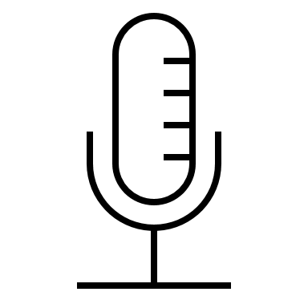
PROBLEM DEFINITION
Problem
Egyptian Dialect is not popular between other languages. So, we need to make the communication betweenEgyptian and other people easier.
Project Mentor:
•Dr. Soha Makady
Project Sponsor:
•Dr. Ahmed Tawfik
Project uOttawa Support:
•Dr. Wail Mardidni
Soultion
Machine translation systems based on deep learning techniques allows users to translate from Egyptian Dialect to English.
Sponsor/Users: organizations , Tourists
Benefits:
• A simple web interface to be used by all users
• People can communicate easily without studying the entire language
• companies can offer training and other eLearning in a multilingual format
Notes:
“The limits of my language mean the limits of my world.”
— Ludwig Wittgenstein
Based on the cultural diversity among people of the same language and The big Developing in AI technologies it is a must to make communication between people from different cultures with different languages much easier
Speech recognition, also known as automatic speech recognition (ASR):
is a capability which enables a program to process human speech into
a written format.
analyze the audio;
break it into parts;
digitize it into a computer-readable format; and
use an algorithm to match it to the most suitable text representation.

Slide 5
Proposed solution/Methodology
2

Slide 6
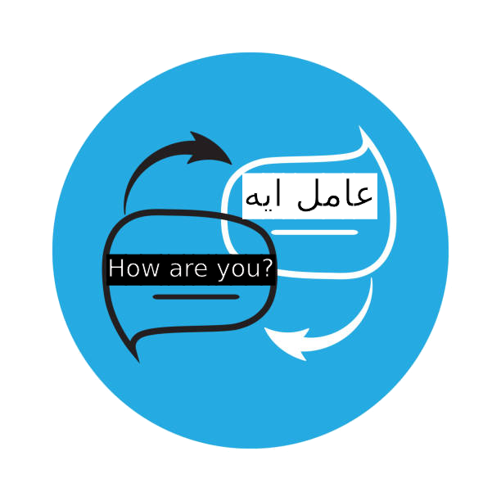
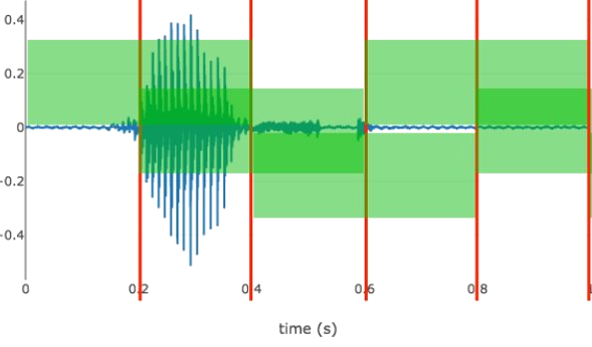
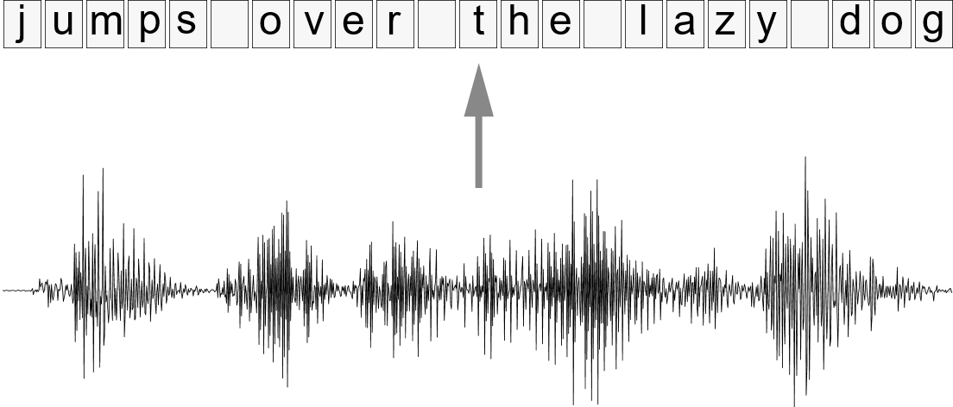
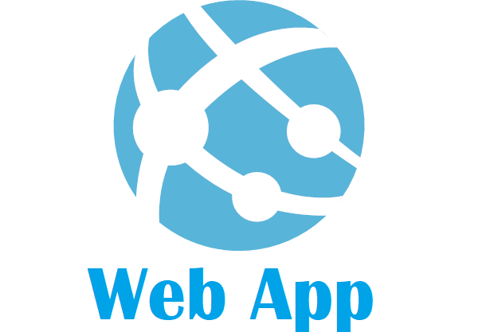


Methodology
Data Collection & Preprocessing
Speech Recognition
Translation (Text)
Deployment
Input: Speech With Noise
Tools:[1]
stft (Short-Time Fourier Transform)
Librosa.stft
MFCC (Mel Frequency Cepstral Coefﬁcient)[2]
python_speech_features.mfcc()
Reason: capturing the information
and the differences sound.
Output: Denoised speech
Input: Denoised speech
algorithms:
Sequence Modeling With CTC [3]
CNN AND BIGRU (Tensorflow.keras)
Reason: complex data and (CTC) makes Deep Learning model to understand alignments between inputs and outputs.[4]
Output: Text
Input:
(Egyptian dialect or English ) Text
algorithms: [5][6]
FastText Model (fasttext.util)
CNN, BIGRU, AND ATTENTION MODEL
Tensorflow.keras
REASON: complex data
Evaluation:
Word Error Rate (WER)
nltk.translate.bleu_score
Bleu Score
nltk.translate.bleu_score
Output: target Text as English or
Egyptian dialect
Tool: Visual Studio IDE with
Microsoft .Net C#.
Reason: Display Result Of
translation.
references
[1] Audio Pre-Processing For Deep Learning​
Link: https://www.researchgate.net/publication/347356900_Audio_Pre-Processing_For_Deep_Learning​
[2]Denoising Speech for MFCC Feature Extraction Using Wavelet Transformation in Speech Recognition System DOI: 10.1109/ICITEED.2018.8534807 ​
[3] Improving CTC Using Stimulated Learning for Sequence Modeling DOI: 10.1109/ICASSP.2019.8682700​
[4]Sequence ModelingWith CTC​ Link: https://distill.pub/2017/ctc/​
[5] Neural Machine Translation from Jordanian Dialect to Modern Standard Arabic DOI: 10.1109/ICICS49469.2020.239505​
[6] CRAN: A Hybrid CNN-RNN Attention-Based Model for Arabic Machine Translation link: https://rdcu.be/cUtyt
​

Slide 7
3
Data/Testing Plan:

Slide 8

Data overview:
we will collect the data from movies that dubbed to Egyptian Dialect as audio and its translation from English subtitles,
As shown in the following table
Audio | Translation
 | you didn't think that we're going to get the whole ocean, did you? Huh?
 | Now, you sure want to go to school this year? There's no problem if you don't.
Testing Plan:
we will test our project by using it on web interface to record an audio with Egyptian Dialect language and the output will be text translated to English language

Slide 9

4
Project Context

Slide 10
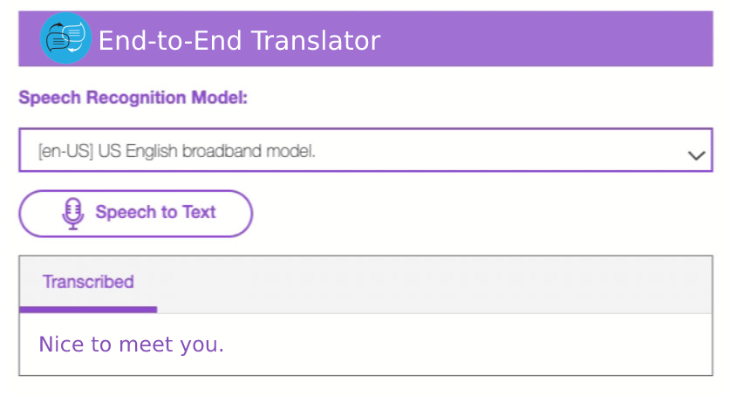
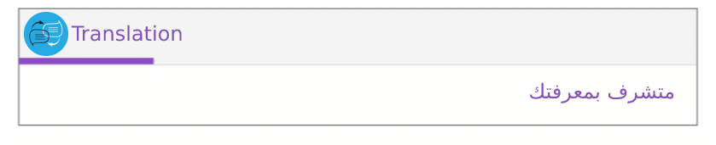
PROJECT CONTEXT​
We Will Create a Website To Interface With User.
Output:
TOOLS:
Microsoft .net C#, HTML, CSS, and JavaScript
We will communicate with speech team in Microsoft to guide us with some technical tools and methods.
The end user: Anyone who Arabic is not its native language and the Egyptian dialect speaker, needs to communicate with its speakers without studying the entire language e.g.: tourists
Anyone can open our simple web page and record the sentences in Egyptian dialect then the English translation text will appear.

Slide 11
5
Time plan

Slide 12


TIME PLAN
Beta Release Version
Beta Demo
Test Results
Evaluation
Get sponsored Validation
93 H/student
Project Proposal and Presentation
Development Environment (Tools and Resources)
Datasets and Environment
Definition of Methodology, Algorithms, Models, …etc.
Detailed expected Project
Plan
57 H/student
November
December
Release Final Report, Internship Evaluation, (Team Peer Review)
Final Release
Deployment of Technology and Handoff of Documentation
Evaluation
68 H/student
September
October
Minimum Viable Prototype Presentation
82 H/student
Total Hours For each student: 300

Slide 13
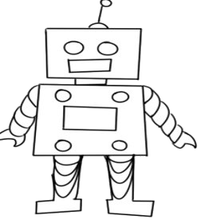
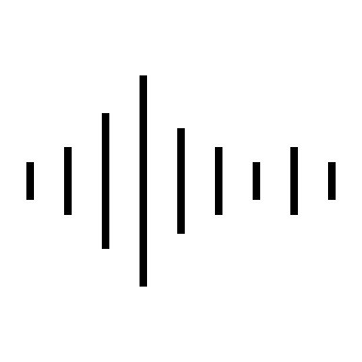

Thank You, Any Questions ?

