Slide 1
MOVIE RECOMMENDER SYSTEM

Slide 2
TABLE OF CONTENTS
I.
Intro to recommendation sys
II.
Types of recommendation sys
III.
IV.
Error Analysis
Chatbot live demo

Slide 3
INTRODUCTION
A recommender system or a recommendation system is a subclass of information filtering systems that seeks to predict the “rating” or “preference” a user would give to an item.
In the last decade, companies have invested a lot of money in their development. Netflix awarded a $1 million prize to a developer team in 2009 for an algorithm that increased the accuracy of the company’s recommendation engine by 10 percent.
There are two main types of recommender systems – personalized and non-personalized.

Slide 4
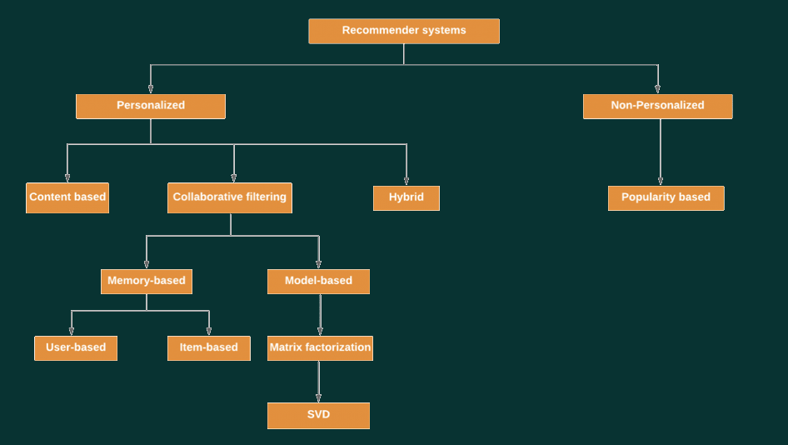
Types of recommendation system

Slide 5
Prepressing of data
Using TMDB Data Set
Merging two data sets
Cleaning the data
Dropping duplicated columns

Slide 6
Feature Engineering
Applying TF-IDF
Then Applying the Count vectorizer

Slide 7
NON- PERSONALIZED
Demographic Filtering
They offer generalized recommendations to every user, based on movie popularity and/or genre.

Slide 8
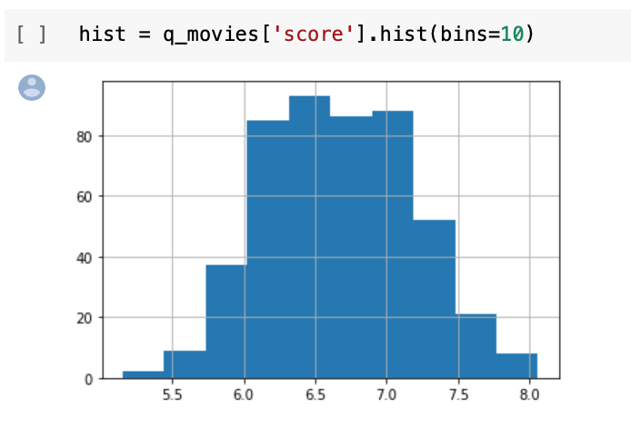
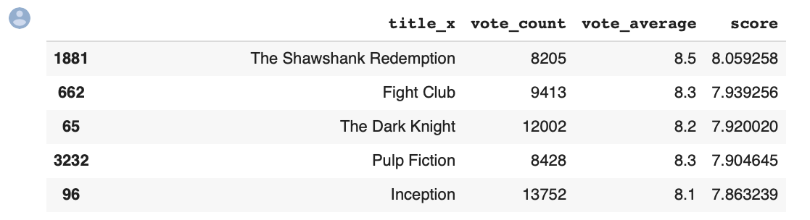
Demographic Filtering
It depends on the weighted rate equation of IMDB to rate the films…

Slide 9
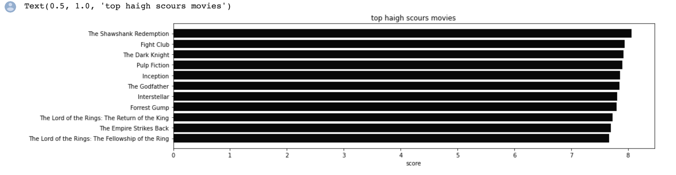
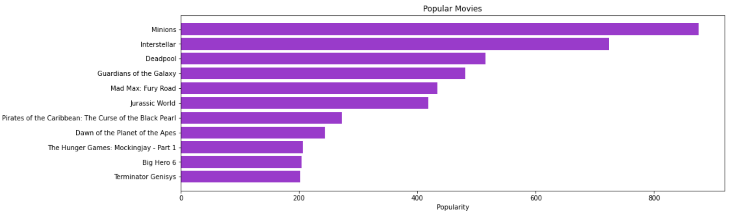

Slide 10
PERSONALIZED
Content-Based
Content-Based Filtering
Collaborative Filtering
Collaborative

Slide 11
Content-Based Filtering
FIRST STEP
SECOND STEP
Filtering depending on the movies overview similarity using cosine similarity
Filtering depending on the movie cast, keywords, director, and genres similarity using cosine similarity

Slide 12
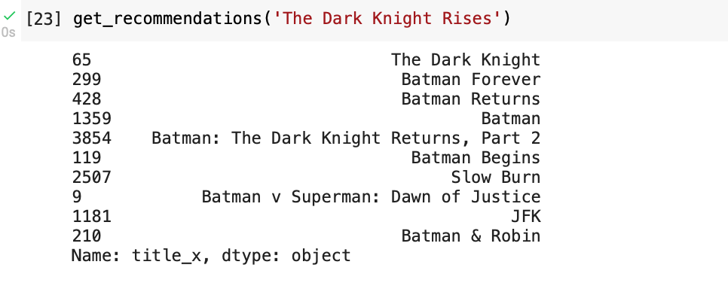
Content-Based Filtering
depending on the movies overview similarity using cosine similarity

Slide 13
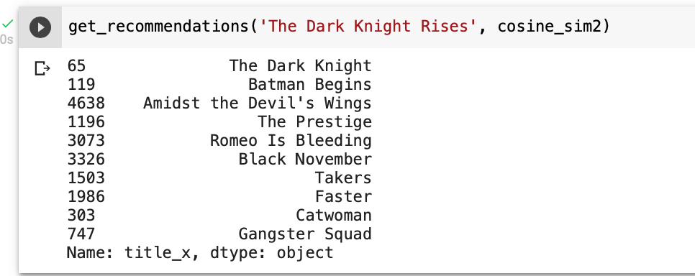
Content-Based Filtering
depending on the movie meta data similarity using cosine similarity
Meta data :
cast, keywords, director, and genres

Slide 14
Collaborative Filtering
This system matches persons with similar interests and provides recommendations based on this matching. Collaborative filters do not require item metadata like its content-based counterparts.
We used :
Matrix Factorization-base models : SVD(), SVDpp()
Classification : KNNBaseline(), KNNBasic(), KNNWithMeans(), KNNWithZScore()
Cluster : CoClustering()

Slide 15
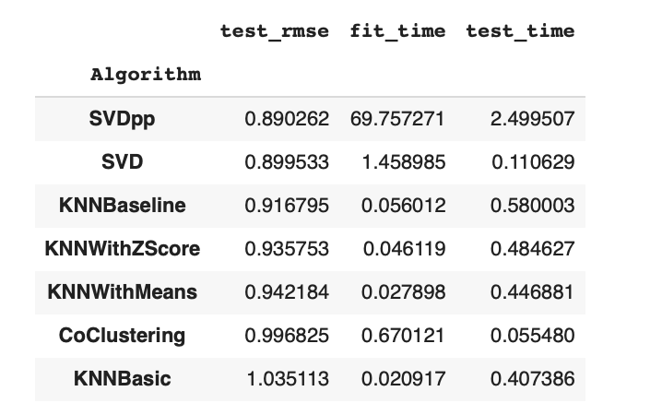
Collaborative Filtering
As we can see the winner champ is SVDpp as it’s the smallest test_rmse
But it takes a lot if time to fit so we will apply GridSearch CV to it to reduce the time .

Slide 16
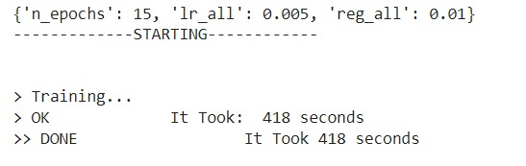
Collaborative Filtering
Applying The best parameters for reducing time in the training of SVDpp algorithm

Slide 17
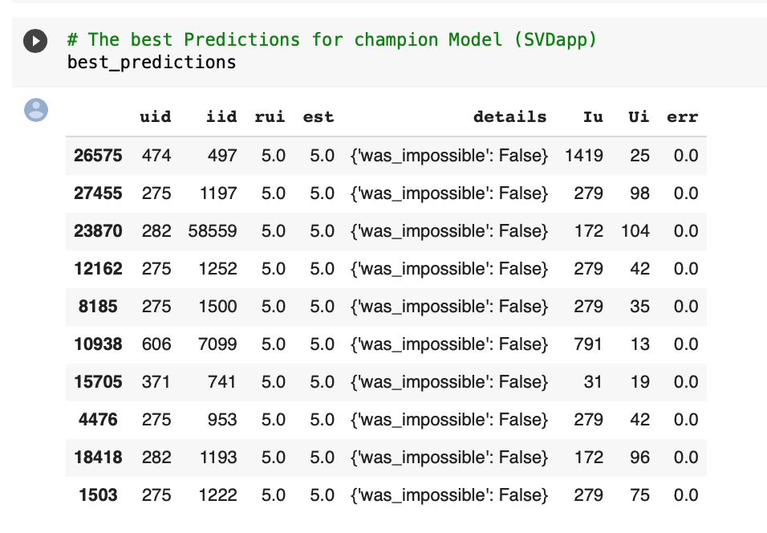
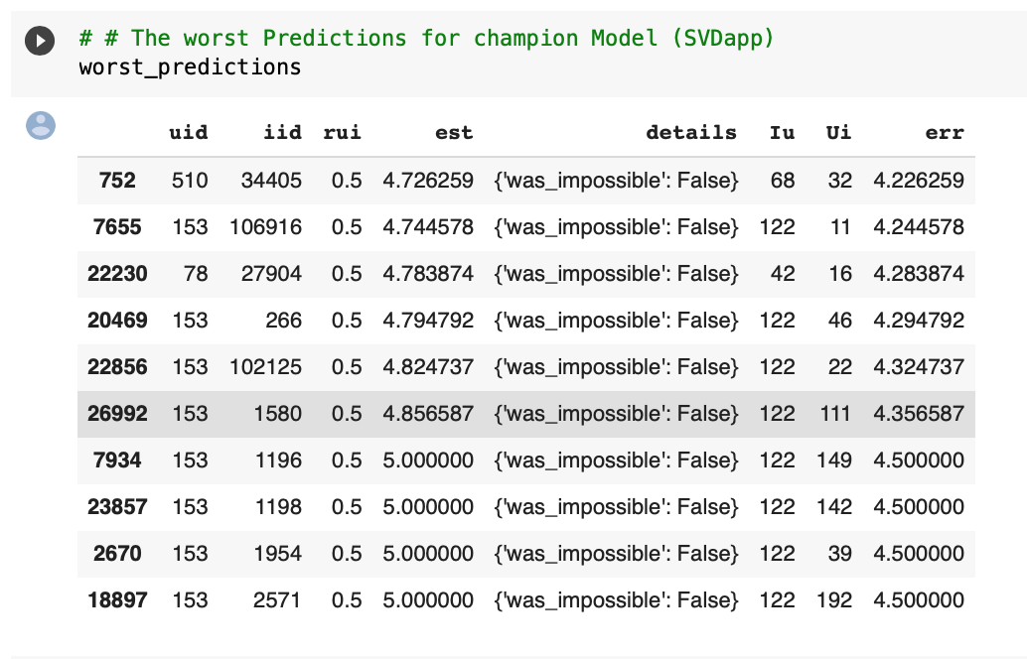
Collaborative Filtering
Best and worst prediction according to SVDpp :

Slide 18
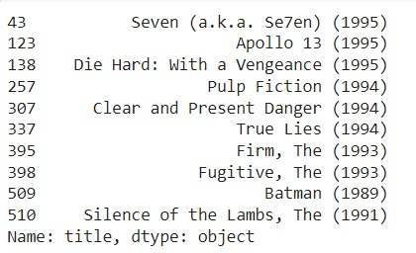
Collaborative Filtering
Those are the liked movies for the user with id 26

Slide 19
Error Analysis
We used :
Hit Rate by Rating Value By using the predicted rating values, we can deconstruct hit rate. In an ideal world, we would be able to predict how well-liked a movie will be by its audience
We are going to know how in the next slide….

Slide 20
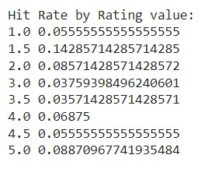
Error Analysis
How ?
1- Find all movies in this user’s history in the training data.
2- Remove one of these movies
(Leave-One-Out cross-validation).
3-Use all other movies to feed the recommender and ask for top 10 recommendations.
4-If the removed movie appear in the top 10 recommendations, it is a hit. If not, it’s not a hit

Slide 21

LIVE CHATBOT DEMO
And now we are going to see a live demo for our Chabot while functioning

Slide 22
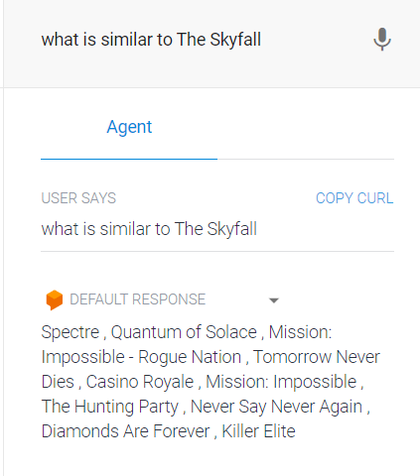
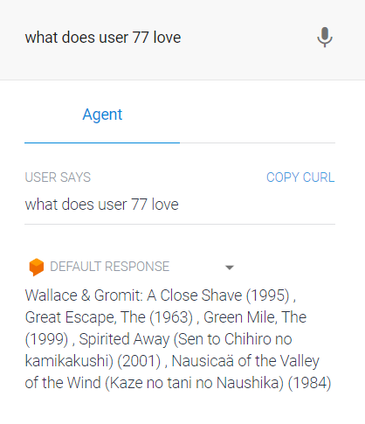
Chatbot demo
Content based filtering
Collaborative filtering

Slide 23
SEE YOU AGAIN

