Slide 1
Qt WiFi & Bluetooth manager

Slide 2
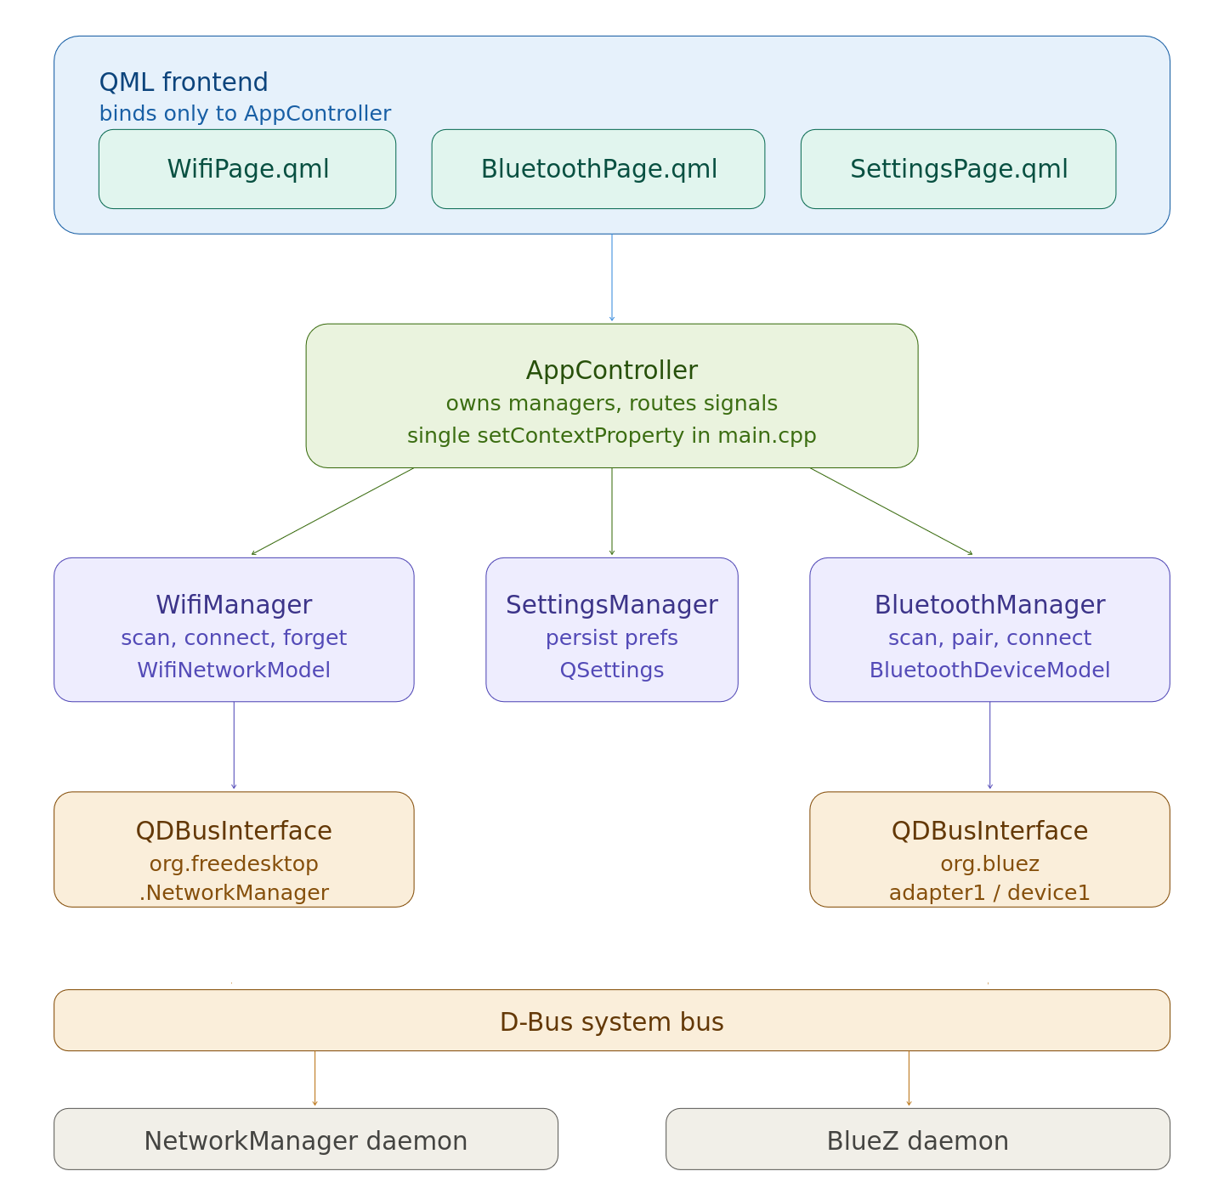
App Arch.

Slide 3
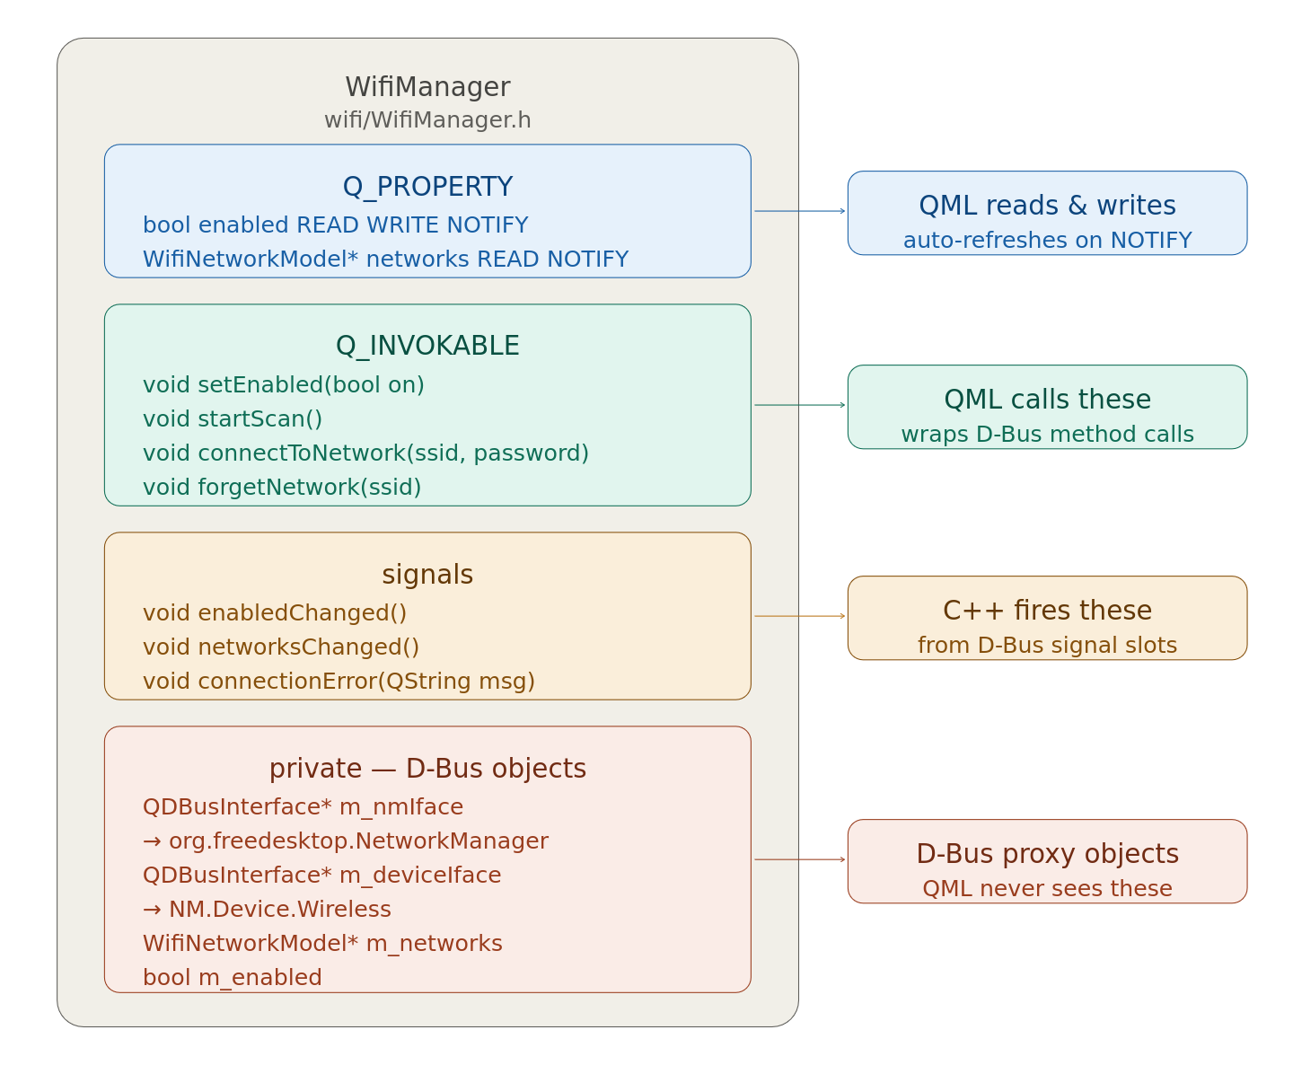
Wifi class

Slide 4
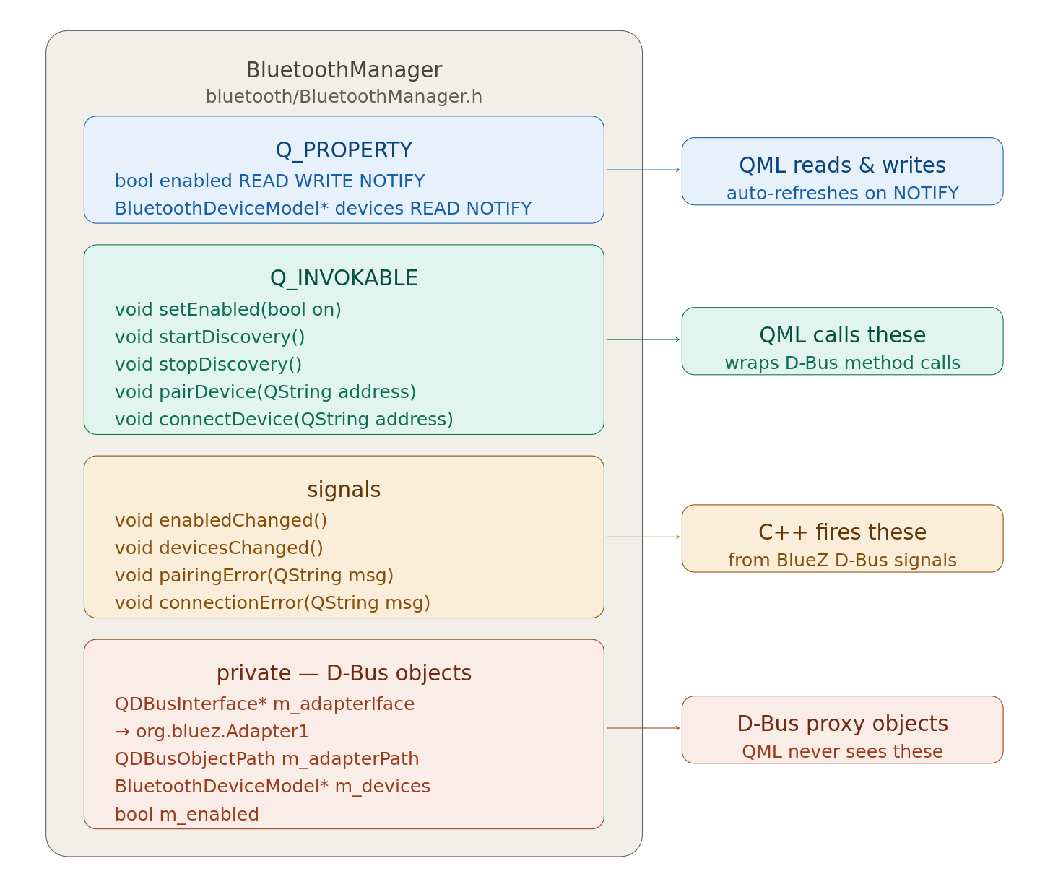
Bluetooth class

