Slide 1
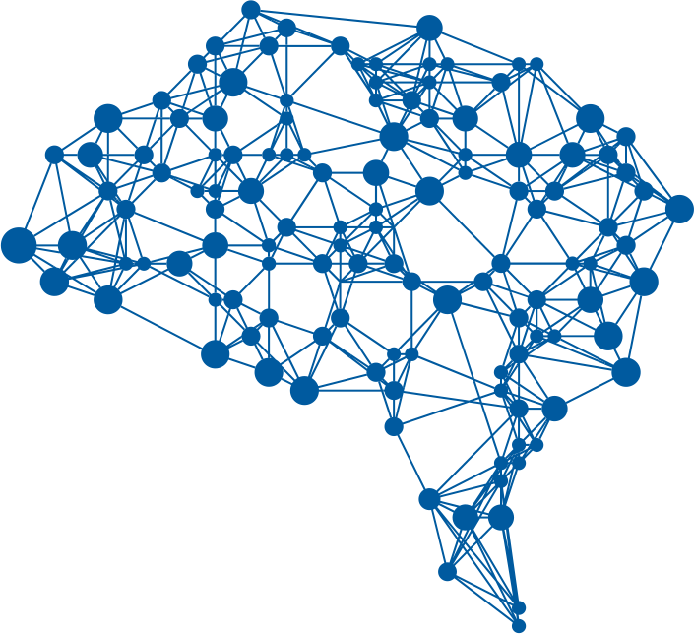

Slide 1
Dynamic Hand gestures recognition
Supervised By :-
Dr. Walid Hussein
Solution Proposed by :-
Ahmed Mohamed Abohegazy -158324-SE

Slide 2
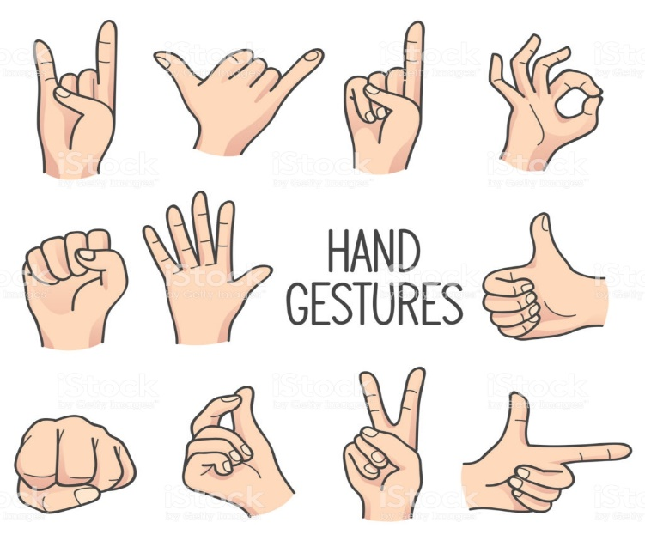
What is a gesture ?
Gesture can be described as the motion using the body with intention to communicate with other humans
Dynamic vs static gesture.
vision-based user interface is more comfortable, functional and realistic when compared to mouse and keyboard because of the intuitive gestures

Slide 3
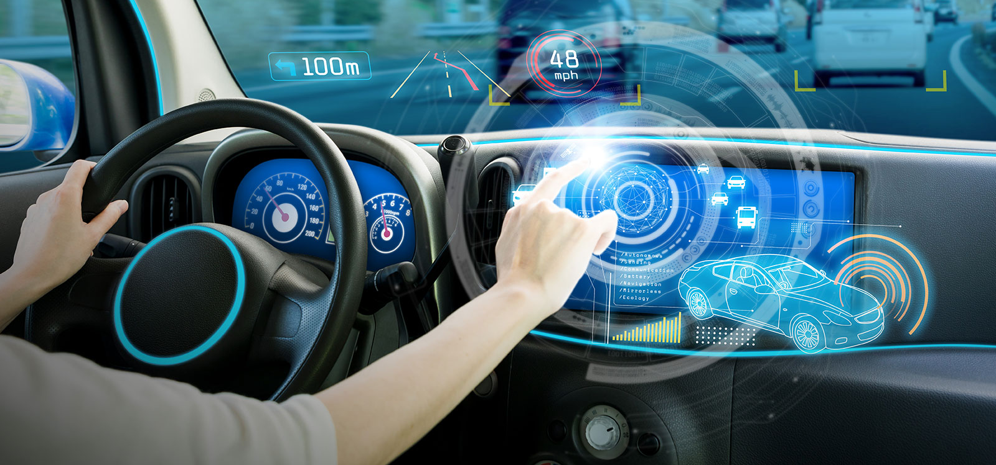
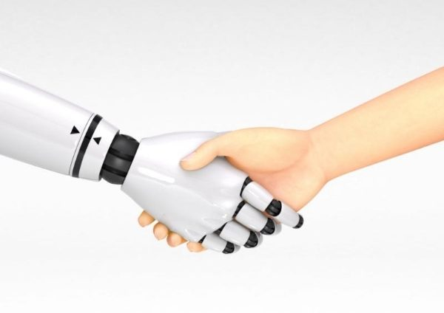
Applications of hand gesture recognition
Human robot interaction HRI
Assistive environments (touchless interfaces )
Virtual reality

Slide 4
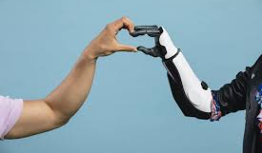
Two common technologies for hand gesture recognition
glove-based method:
Using special glove-based device to extract hand posture
vision-based method:
3D hand/arm modeling
Appearance modeling

Slide 5
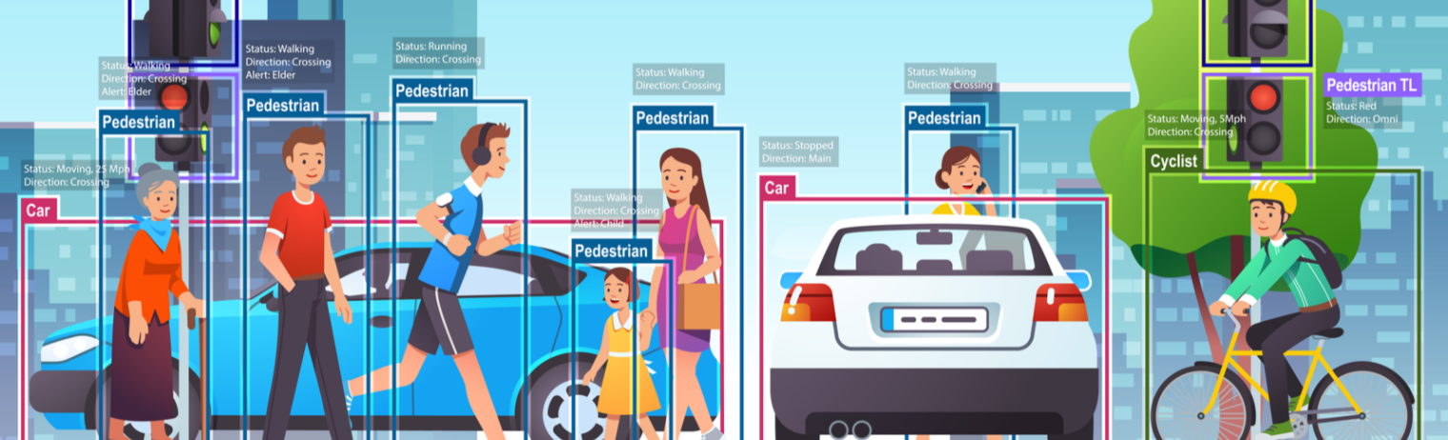
How computers see?
Computer vision is the field of computer science, which works on replicating aspects of the complexities of the human vision system and allowing machines to recognize and interpret objects in images and videos in the same way that humans

Slide 6
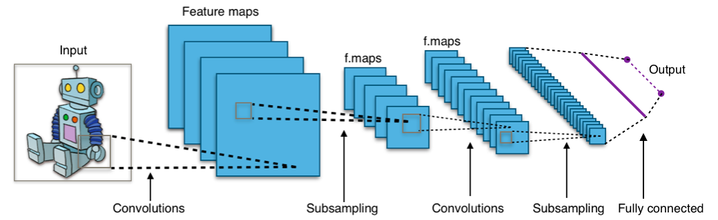
CNN is powerful but not suitable for the task of dynamic hand gesture recognition

Slide 7
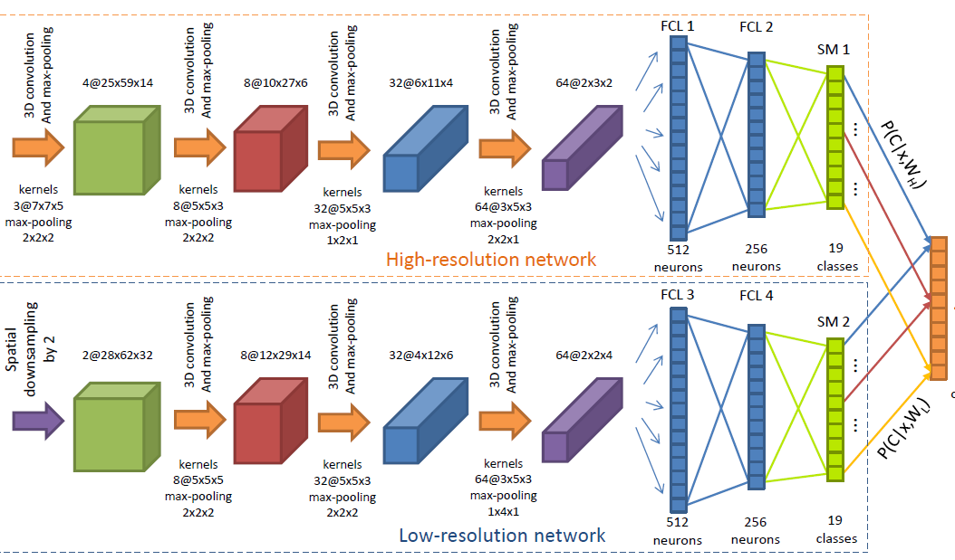
3D CNN + Lstm
3D CNN can extract temporal features by preserving the images spatial properties
3DCNN tends to fail when try to memorize long sequences
LSTM has the advantages of learning long-term dependencies like input, output, and forget gates that control long-term sequence pattern learning.
3DCNN architecture with the LSTM network used to extract spatial-temporal features

Slide 8
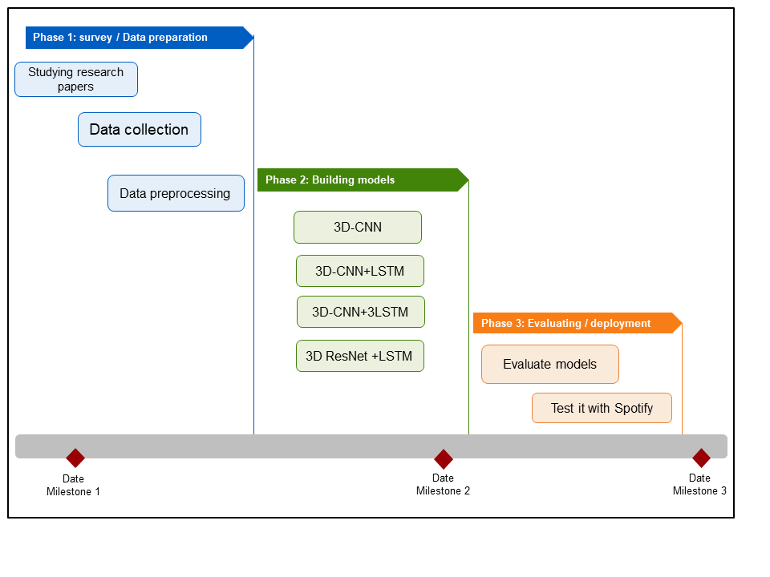
Develoment cycle

Slide 9
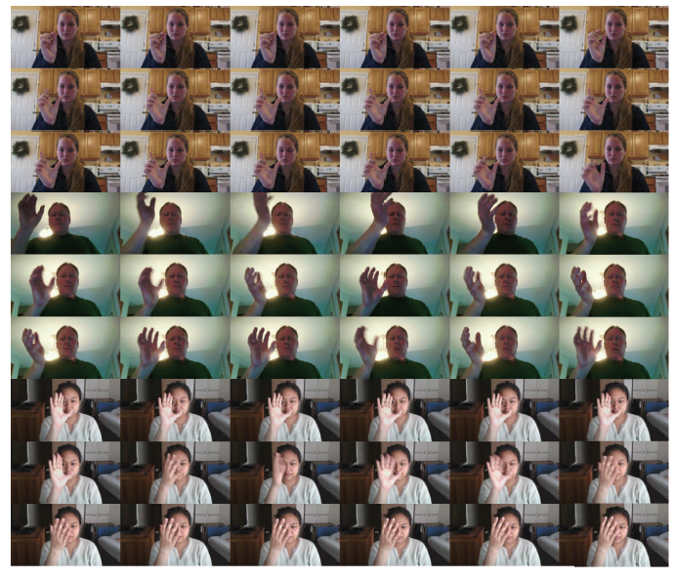
Jester Dataset
A Large-Scale Video Dataset of Human Gestures
contains 148, 092 short 3-second-length video images, which total over 5 million frames. The video clips show a human gesturing in front of the camera
25 classes of gesture , 5 which can be defined as static gestures. And 23 dynamic gesture
Current datasets has variation in size or the number of frames of gestures and their context, number of performers, metadata given and data collection quantity

Slide 10

Pre-processing data
Selecting subset from the dataset to train that contains 1800 video clips for 5 hand gestures
resize input frames to (100,100)
Specify the depth (frames to sample ) to 16
normalize all our inputs to a standard scale
Convert the input data into grayscale
Split the training sample into training and validation sets with ratio of 20% for the validation data

Slide 11
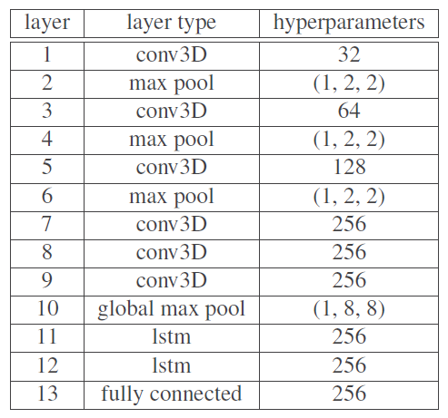
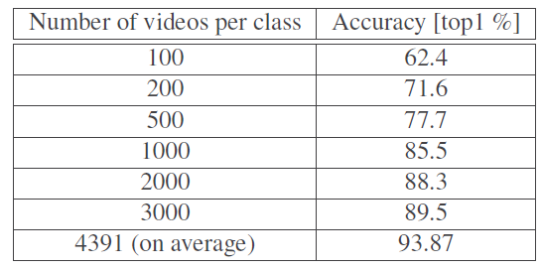
Suggested basic architecture
According to the authors of jester data set high accuracy could be obtained through implementing simple model but the need to feed sufficient data is a necessity to reach to high results

Slide 12
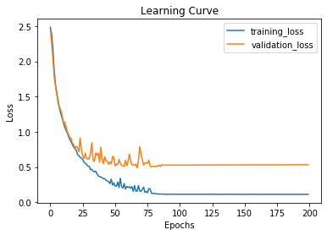
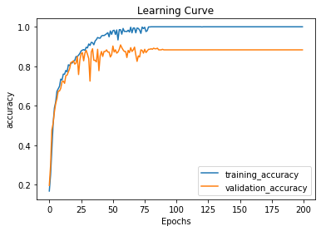
Experiment results
The model is trained on training sample contains 1800 video clips for 5 different gestures.
Model is a combination network between 3D CNN and LSTM
The gestures are combination of 2 static gestures and 3 dynamic gesture.
The model achieved 98% on the training accuracy and 90% on the validation accuracy.

Slide 13






Tools used

Slide 14
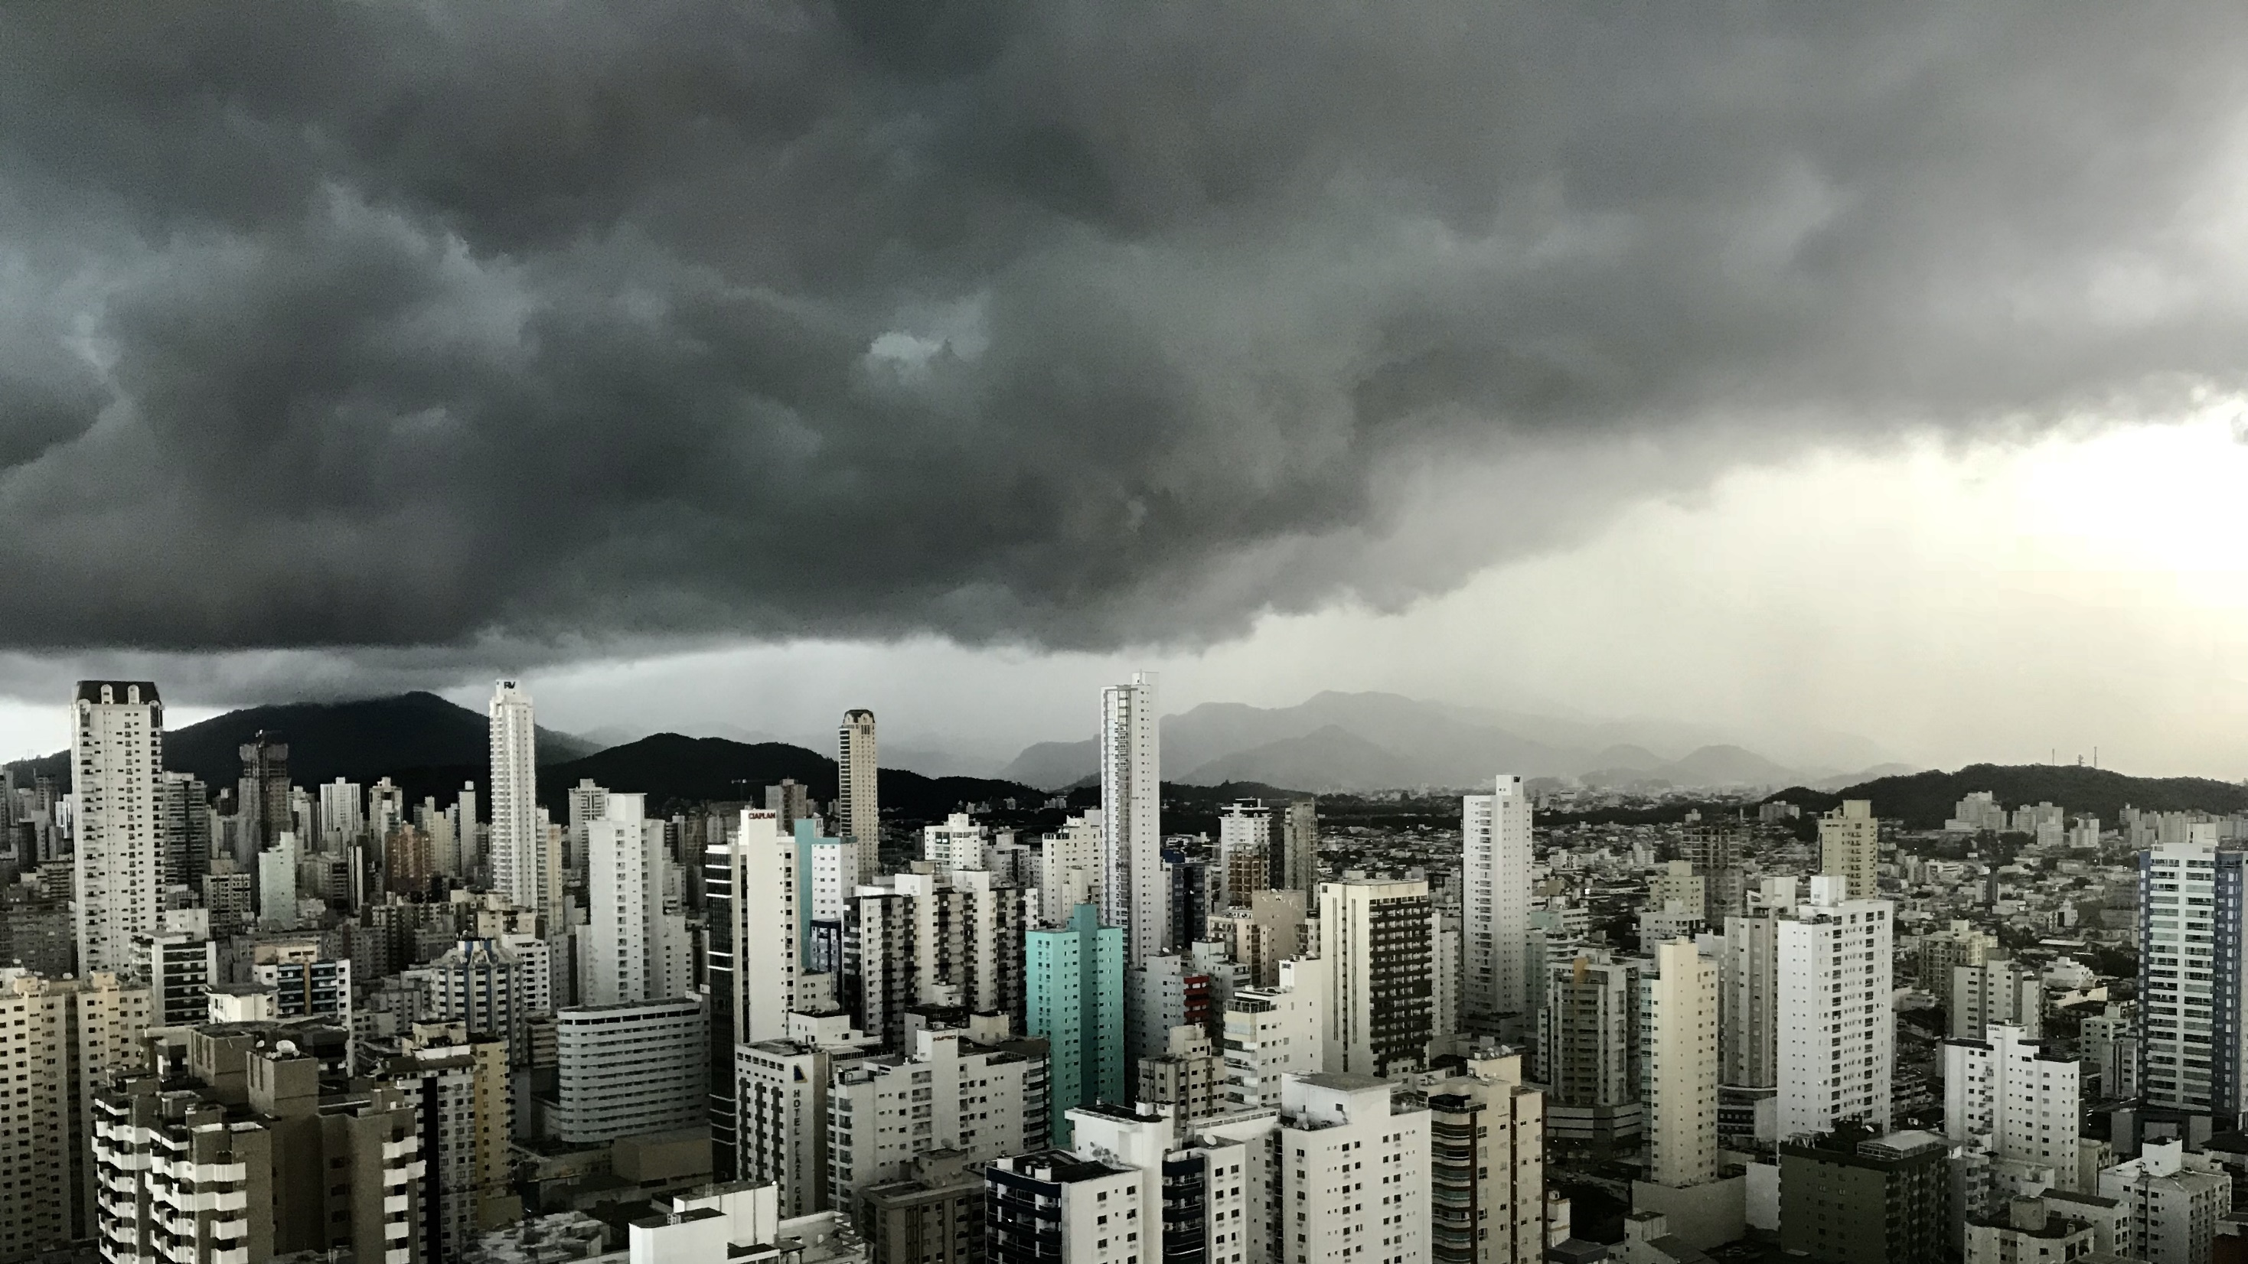
Slide 11
THANK YOU

