Slide 1
CET351 MACHINE LEARNING · LECTURE PROJECT 01
Routing for Agent KIO
A trained ML classifier vs. an open-source decision model for sending manufacturing customers to support or sales
Problem & dataset
Decision model
ML classifier & comparison
Ahmed Mohamed Aldamardash
Moaaz Abd Aljawwad
Omar Ahmed Ramadan
Elsewedy University of Technology · 26 October 2026
Notes:
AHMED (15 s): Good morning. We are Ahmed, Moaaz and Omar. Our question: should Agent KIO keep routing customers with a trained ML classifier, or switch to a decision model? I will explain the problem and our data, Moaaz the decision model, Omar the classifier and our recommendation.

Slide 2
Our block: message in, routing flag out
AHMED
THE PROBLEM
Customer message
KIO intent router
Flag 0 → Support agent
Problems, complaints, existing orders
“Our CNC lathe stopped and shows alarm 2031, please help.”
The block we built twice: ML classifier and decision model
Flag 1 → Sales agent
New purchases, packages, quotes
Routing picks the workflow; retrieval (RAG) then searches inside it. A wrong route means the wrong tools and knowledge base: a stopped machine reaches a salesperson, or a ready buyer waits in the support queue.
In our demo both agents are Python functions that print their names — the full chatbot and RAG are outside this project.
Notes:
AHMED (40 s): KIO is the chat entry point. Behind it are a support agent and a sales agent. Our job is only the router in the middle: read the message, output 0 for support or 1 for sales. Why it matters: routing selects the workflow, retrieval works inside it, so a wrong route sends the customer to the wrong knowledge base.

Slide 3
60 synthetic messages from a manufacturing supplier
AHMED
THE DATASET
30 + 30
1 rule
40 / 20
Generation
Labels
Split
Customers of a CNC, robot and compressor supplier. 15 intents per class, each written twice: an original and a paraphrase (same group_id). Drafted with an AI assistant, then reviewed line by line by the team.
0 = support: something the customer already has is wrong. 1 = sales: they want something new. Mixed intent goes to support (existing problems first). Agreed by the team before any test.
By intent group, random seed 42: 5 support + 5 sales groups held out. A paraphrase never crosses the split, so near-duplicates stay together. Train 20+20, test 10+10.
Hard cases on purpose: negation (6), mixed intent (4), late existing orders that use purchase words (2). Plus 8 new hard messages written after the split as a stress test.
Files: data/kio_routing_dataset.csv · data/stress_test.csv
Notes:
AHMED (50 s): We generated 60 English messages: 15 intents per class, each with a paraphrase. We used an AI assistant to draft them and reviewed every label together before testing. Labeling rule in one sentence. We split by group, not by message, so a paraphrase never leaks from training into test. On purpose we added negation, mixed intent and late orders that use purchase words.

Slide 4
Six rows from the dataset
AHMED
SAMPLE ROWS
ID | Message | Label | Case | Split
M01 | Our CNC lathe stopped mid-cycle and shows spindle alarm 2031, please help. | 0 support | paraphrase | test
M05 | I don’t want to buy a new compressor, I need the one we have repaired. | 0 support | negation | train
M08 | Before we talk about buying more robots, the welding robot we bought is misaligning every weld. | 0 support | mixed | train
M21 | We already ordered the packaging line, but delivery is two weeks late — where is it? | 0 support | existing order | train
M35 | No issues with our current robots; we want to add a third cell. | 1 sales | negation | train
M55 | Can your team quote a turnkey packaging line for 120 packs per minute? | 1 sales | paraphrase | test
Columns: id, message, label, label_name, group_id, case_type, split
Notes:
AHMED (25 s): Point at M05: negation flips the meaning. M08: a purchase and a problem in one message, our rule says support. These are exactly the rows where the two approaches will differ.

Slide 5
Learned from examples vs. told by instructions
AHMED
TWO APPROACHES, ONE FLAG
 | Trained ML classifier | Decision model (BART-MNLI)
Learns from | Our 40 labelled training messages | Pre-trained on language inference; no training by us
Input | 2 numbers per message (cue scores) | Raw message + two written routing options
Output | P(sales) → flag 0 / 1 | {route, p_support, p_sales} → flag 0 / 1
Changing a rule | Relabel data and retrain | Edit the option text or the threshold
Runs | Milliseconds, any laptop | ~1 s per message on CPU, 1.6 GB model
Licence | scikit-learn (BSD-3) | facebook/bart-large-mnli (MIT)
Jev from TypeSafe AI is the brief’s example decision API; it is paid and key-based, so we used an open-source model as the brief allows.
Notes:
AHMED (35 s): The classifier only knows what it saw in 40 examples turned into numbers. The decision model reads the sentence itself and compares it with written options, so a business rule is text, not new training data. Both end in the same flag. Moaaz will now show the decision model.

Slide 6
BART-large-MNLI as a zero-shot decision model
MOAAZ
DECISION MODEL · SETUP
How it decides
zsc = pipeline("zero-shot-classification",
model="facebook/bart-large-mnli")
OPTIONS = {
"customer_service": "has a problem, fault or
complaint about a product, order or service
they already have",
"sales": "wants to buy, lease, upgrade or get
a price for something new"}
TEMPLATE = "The customer {}."
def decide(message, t): # wrapper
p_sup, p_sal = scores(message)
route = "customer_service" if p_sup >= t else "sales"
assert route in FLAG # validation
return {"route": route, "p_support": p_sup,
"p_sales": p_sal} # any error -> support
For each option it scores how strongly the message entails “The customer …”. The routing instructions are the two option texts.
Threshold chosen on training data
Business rule “problems first”: support if p_support ≥ t. Best t on the 40 training messages: 0.90 (train accuracy 80%).
Licence and setup
MIT licence, Hugging Face transformers, runs on Google Colab CPU — no key, no cost.
Notebook: KIO_Routing.ipynb, section 3
Notes:
MOAAZ (45 s): We used facebook/bart-large-mnli, an open-source model under the MIT licence. It is a natural-language-inference model: for each of our two routing options it gives a probability that the message entails it. Our wrapper turns that into a structured answer, validates it, and anything invalid falls back to support. The threshold 0.90 was chosen on the 40 training messages only, never on the test.

Slide 7
Perfect on mixed intent, but cautious on sales
MOAAZ
DECISION MODEL · RESULTS
16 / 20
4 / 4
5 / 8
test set (80%)
mixed-intent messages
new hard messages
Test-set errors — all four are sales messages sent to support:
Message (true label: sales) | p_support | Route
What packages do you offer for predictive maintenance on 20 motors? | 0.98 | support ✗
I’d like to upgrade our maintenance contract to the premium tier. | 0.95 | support ✗
Can we move from the basic to the premium service package starting next month? | 0.94 | support ✗
We need your latest chiller brochure with prices. | 0.98 | support ✗
Confusion on test: support 10/10 correct · sales 6/10 correct (4 sent to support)
Notes:
MOAAZ (40 s): Results from our Colab run. Test 16 of 20, all four mixed-intent messages correct, 5 of 8 new hard messages. Every test error goes the same way: a sales message about maintenance or service contracts was sent to support. The words maintenance and service made the model think of an existing service.

Slide 8
It reads meaning, but its scores need care
MOAAZ
DECISION MODEL · WHAT IT SHOWS
Strengths
Weaknesses
Gets the “problems first” rule: 4/4 mixed intent
Errors lean to support — the safer mistake for KIO
No training data needed; rules are plain text
Free and open-source (MIT)
p_support is high for almost every message, so the threshold had to be 0.90
Words like “maintenance” or “service” pull sales messages to support
Slower: ~1 s per message on CPU vs. milliseconds
Only 28 scored messages — one error moves accuracy 4–12 points
Fix we would try next: rewrite the sales option to mention service contracts and upgrades, then re-tune t on training data.
Hand over to Omar
Notes:
MOAAZ (30 s): The model understands the problems-first rule and its mistakes are the safer kind. But it gives a high support score to almost every message, so we needed a strict threshold, and business words like maintenance confuse it. It is also slower. Omar will now show the trained classifier.

Slide 9
Two numbers per message, a curved boundary
OMAR
TRADITIONAL ML · MODEL
1 · features
2 · model
3 · training
support_score, sales_score
Logistic regression, degree 2
40 messages, scikit-learn
Count of problem cues (error, leak, late, warranty…) and purchase cues (quote, price, buy, demo…). A cue right after no / not / don’t counts −1.
StandardScaler → PolynomialFeatures(2): x₁, x₂, x₁², x₁x₂, x₂² → LogisticRegression(C = 1). Flag 1 if P(sales) ≥ 0.5.
Train 38/40. Learned weights: x₁ −1.72, x₂ +1.41 — problem cues push to support, purchase cues to sales.
We first tried learning a weight per word from the 40 messages: 40% on test. Forty examples are too few to learn vocabulary, so we moved to cue counts. An SVM with a degree-2 polynomial kernel on the same features scored 95% on test, 50% on the hard messages.
Notebook: KIO_Routing.ipynb, section 2
Notes:
OMAR (50 s): We chose logistic regression with degree-2 polynomial features, one of the allowed options. Each message becomes two numbers: problem cues and purchase cues, with negation counted as minus one. Scaling, degree 2, C equals 1. Our first attempt, learning word weights, only reached 40 percent because 40 messages are too few. We also checked an SVM with a polynomial kernel: 95 percent on test.

Slide 10
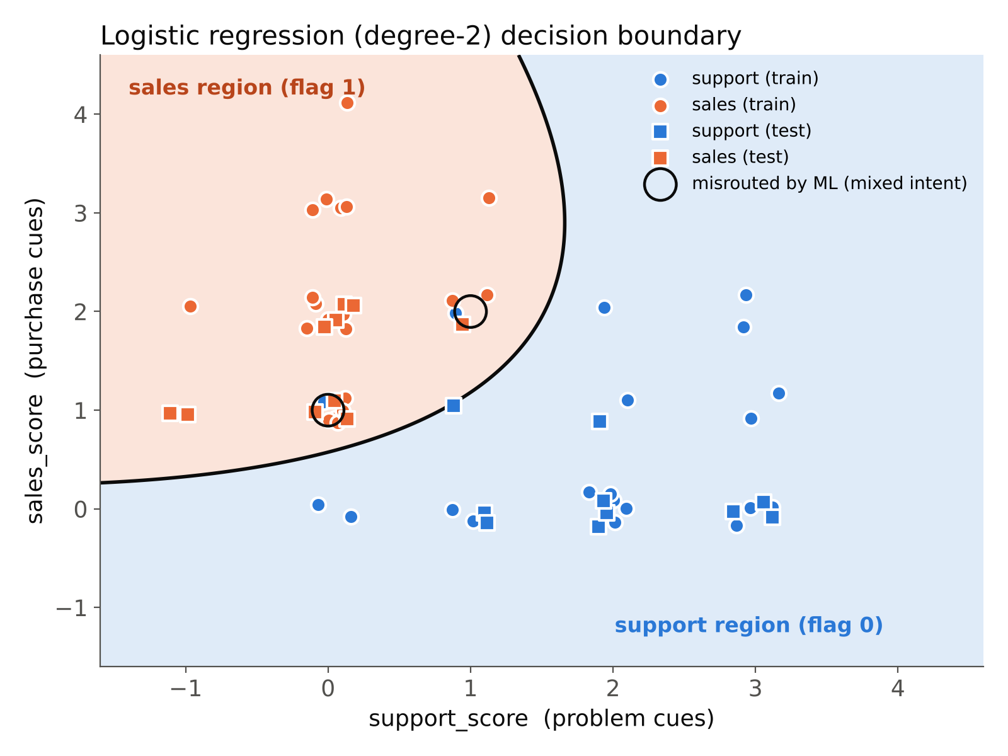
Sales only when purchase cues outweigh problem cues
OMAR
TRADITIONAL ML · BOUNDARY AND RESULTS
20 / 20
96%
test set
mean of 200 random splits (worst 85%)
The curve bends: as problem cues rise, a message needs more purchase cues to count as sales.
Weak spot: mixed intent 2/4. The circled messages have more purchase words than problem words, so it sends them to sales — it counts words, it cannot apply a priority rule.
Points are jittered slightly so overlapping messages stay visible
Notes:
OMAR (40 s): Blue region is support, orange is sales. On the test set the classifier is perfect, 20 of 20, and over 200 random splits it averages 96 percent. The circled points are mixed-intent messages: purchase words outnumber problem words, so it routes them to sales.

Slide 11
Each model wins where the other fails
OMAR
HEAD-TO-HEAD
Hard message | ML | Decision
“Your quote said 4 weeks… isn’t commissioned” (support) | ✗ | ✓
“Please quote the repair cost…” (support) | ✗ | ✓
“Not unhappy… want pricing for a second chiller” (sales) | ✓ | ✗
“Order 20 more filters like last time” (sales) | ✓ | ✗
“We can’t decide between… compressors” (sales) | ✗ | ✗
Same 5/8 on the hard set, but with different mistakes. Counts: ML 20/20 · 2/4 · 5/8 — decision model 16/20 · 4/4 · 5/8
Notes:
OMAR (40 s): On clear messages the classifier wins, 100 versus 80 percent. On mixed intent the decision model wins, 4 of 4 versus 2 of 4. On our hard messages both score 5 of 8, but they fail on different messages: the classifier is fooled by single keywords like quote, the decision model by friendly or repeat-purchase wording.

Slide 12
Keep the classifier as the main router, and call the decision model only for messages that mix both kinds of cues
RECOMMENDATION FOR KIO
1
2
3
Why
How
Caveat
The classifier is perfect on clear messages and instant; the decision model is the one that handles mixed intent.
If a message has both problem and purchase cues, ask the decision model; otherwise use the classifier. On our data this hybrid scored 19/20, 3/4 and 6/8.
The hybrid rule was designed after seeing our results, so it must be checked on a fresh, hand-labelled set of real KIO messages before launch.
Notes:
OMAR (35 s): Our recommendation is a hybrid. Keep the fast classifier for clear messages and send only mixed messages to the decision model. On our data that gave 19 of 20, 3 of 4 and 6 of 8. Honest caveat: we designed this rule after seeing the results, so it needs a fresh test on real KIO messages. Thank you, we are happy to take questions.

Slide 13
Everything runs in one notebook
OMAR
REPRODUCE IT
Google Colab → KIO_Routing.ipynb
Runtime → Run all (about 3 minutes)
1 Dataset 60 + 8 messages
2 ML classifier features, LogReg, boundary
3 Decision model BART-MNLI + wrapper
4 Comparison accuracy, confusion
5 KIO demo message → flag → agent
GitHub: github.com/Ahmed-Aldmrdash/ml-project01-agent-kio-routing
Live demo (if time allows): type a new customer message into the last cell and show which agent it reaches.
Backup slide — use during questions
Notes:
Backup. If the doctor asks how we got the numbers, open the notebook and run the demo cell with a new message.

Slide 14
What we used
OMAR
SOURCES AND TOOLS
CET351 Project 1 brief, “Routing for Agent KIO”, Elsewedy University of Technology, 2026
Lewis et al., BART (2019); facebook/bart-large-mnli on Hugging Face, MIT licence
Hugging Face transformers — zero-shot-classification pipeline (Apache-2.0)
scikit-learn 1.x (BSD-3-Clause): StandardScaler, PolynomialFeatures, LogisticRegression, SVC
TypeSafe AI, Jev decision model (the brief’s example): nexos.ai/blog/what-is-jev
AI assistant (Claude) used to draft the synthetic messages; labels reviewed by the team
Sources
Notes:
Backup slide for questions.

