Slide 1
Multilingual Neural Machine Translation
German, Arabic, French, and Italian to English

Slide 2
Team Members
احمد عزت عبدالمرضي محمد 20210077
زياد محمد احمد علي امبابي 20210370
شهاب خلف عبدالمنعم 20210459
بلال حنفي محمد ابو العطا 20210229
احمد على سالمان احمد 20210082
احمد محسن انور سعيد 20210094

Slide 3
Project Overview
Objective: Build and evaluate NMT models translating from German, Arabic, French, and Italian to English.
Approach: Sequence-to-sequence LSTM-based models using bilingual sentence datasets.
Dataset Source: https://www.kaggle.com/datasets/alincijov/bilingual-sentence-pairs

Slide 4
Dataset Summary
German-English: 227,080 sentence pairs
Arabic-English: 24,638 sentence pairs
Italian-English: 345,244 sentence pairs
French-English: 185,583 sentence pairs

Slide 5
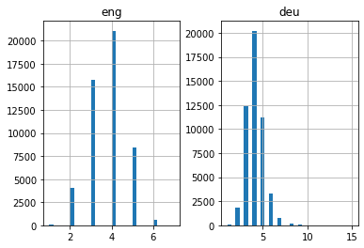
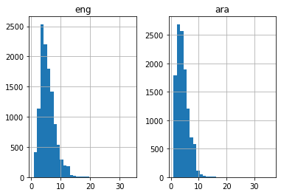
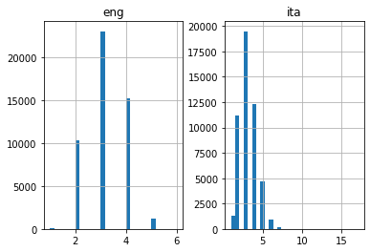
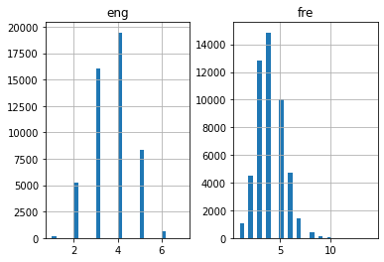

Slide 6
Preprocessing Steps
- Remove punctuation using translate()
- Convert all text to lowercase using lower()

Slide 7
Tokenization & Vocabulary
German-English: EN - 6,256 | DE - 10,329
Arabic-English: EN - 4,262 | AR - 12,926
French-English: EN - 6,042 | FR - 13,974
Italian-English: EN - 4,219 | IT - 9,706

Slide 8
Data Splitting
Training / Test Split: 80 / 20
Random State: 12
Ensures consistent reproducibility

Slide 9
Model Architecture
Embedding Layer -> Encoder LSTM -> RepeatVector -> Decoder LSTM -> Dense (Softmax)
LSTM-based sequence-to-sequence model with fixed context vector

Slide 10
Training Details
Loss Function: Categorical Crossentropy
Optimizer: Adam
Epochs: 30 | Batch Size: 512
Validation Split: 20%
Model Checkpoint based on lowest validation loss

Slide 11
Model Evaluation (Accuracy)
German-English: 0.7319
Arabic-English: 0.4856
French-English: 0.6818
Italian-English: 0.7198

Slide 12
Model Limitations
- Arabic model has low performance due to small dataset
- Limited vocabulary representation
- No attention mechanism included
- Minimal preprocessing (no lemmatization or stemming)

Slide 13
Potential Improvements
- Add attention mechanism or use Transformer models
- Use subword tokenization (e.g., BPE)
- Expand and balance dataset sizes
- Apply data augmentation for low-resource languages

Slide 14
Conclusion
Successfully developed LSTM-based NMT models for 4 language pairs.
Best performance from German and Italian; moderate from French; weak from Arabic.
Future improvements can enhance accuracy significantly.

