Slide 1
Object Oriented Programming (OOP)
Mohamed Ezz

Slide 2
Lecture 9

Slide 3
Lecture Objectives
Define reusable classes based on inheritance
Define abstract classes and abstract methods.
Understand how to interface with class specification
Differentiate the abstract classes and Java interface.
Understand Multiple Inheritance
Define Design pattern
Explore alternative Design patterns

Slide 4
Review
The following statement will give Syntax error or Semantic error :
Shape someShape= new Shape ();
Rectangle rec= (Circle) someShape;
Write the signature of the following methods:
equals
toString
clone
Why using the above methods?

Slide 5
Review: Use IS or Has-A
Which implementation is beter ?
Approach 1:
class Faculty extends ArrayList {
}
Approach 1:
class Faculty {
ArrayList students;
}

Slide 6
Review: Common mistakes
The Faculty class simply needs to reuse the service provided by the ArrayList class.
First approach called: code reuse by inheritance
Second approach called: reuse code by composition.
Suppose we need to modify the data structure class from ArrayList to HashMap for better performance as we did:
With the inheritance approach, any client that uses the inherited methods of ArrayList needs to be rewritten.
With the composition approach, the client that uses only the methods defined for the Faculty class will continue to work without change.

Slide 7
Review: Inheritance
class Shape{
protected int color = 0;
public void setColor(int color){
this.color=color;
}
public int getColor(){
return color;
}
public float computeArea (){
return 0;
}
}
class Circle extends Shape{
private int radius = 0;
public Circle (int r){
radius =r;
}
public float computeArea (){
return 22 /7* radius* radius;
}
public void doubleSize (){
radius= 2 * radius;
}
}
Are computeArea method implementation required?
Shape
Rectangle
Triangle
Circle

Slide 8
What we should do?
We need to improve the situation by preventing a developer from instantiating the Super class, because a developer has marked it as having missing functionality.
It also provides compile-time safety so that you can ensure that any class that extend your Super class provide the bare minimum functionality to work
Inheritors somehow have to magically know that they have to override a method in order to make it work.

Slide 9
Solution: Abstract Class
This is a class with at least one method without implementation (abstract)
You can not create instance from that class
The inherited class from this abstract may implement the abstract methods

Slide 10
Shape Abstract Example
abstract class Shape{
protected int color = 0;
public void setColor(int color){
this.color=color;
}
public int getColor(){
return color;
}
abstract public float computeArea() ;
// need to be implemented by //descendent class (child)
}
class Circle extends Shape{
private int radius = 0;
public Circle (int r){
radius =r;
}
public float computeArea (){
return 22 /7* radius* radius;
}
public void doubleSize (){
radius= 2 * radius;
}
}

Slide 11
Shape Abstract Example cont.
class Triangle extends Shape{
private int base = 0;
private int height = 0;
public Triangle (int h, int b){
base=b;
height=h;
}
public float computeArea (){
return 0.5 * base * height;
}
}
class Rectangle extends Shape{
private int width = 0;
private int height = 0;
public Rectangle(int h, int w){
width=w;
height=h;
}
public float computeArea (){
return width* height;
}
public void swap(){
int i= width;
width = height;
height = I;
}
}

Slide 12
Abstract Classes in Java
Abstract classes created using the abstract keyword:
public abstract class Shape{ … }
In an abstract class, several abstract methods are declared.
- An abstract method is not implemented in the class, only declared. The body of the method is then implemented in subclass.
- An abstract method is decorated with an extra “abstract” keyword.
Abstract classes can not be instantiated! So the following is illegal:
Shape s = new Shape();

Slide 13
Abstract methods Example
abstract class Shape{
protected int color = 0;
protected Point origin;
public void setColor(int color){
this.color=color;
}
public int getColor(){
return color;
}
abstract public float computeArea() ;
abstract public float computePerimeter () ;
abstract void draw();
abstract void resize();
public void move(Point newPlace) ? abstract
}
Abstract methods are declared but do not contain an implementation.
So Shape can NOT be instantiated
(ie., can not be used to create an object.)

Slide 14
Example of Abstract Classes
abstract class Stack {
abstract void push(Object o);
abstract Object pop();
}
public class ArrayStack extends Stack { .... // declare elems[] and top; void push(Object o) { elems[top++] = o; } Object pop() { return elems[--top]; }
}
class LinkedStack extends Stack { .... // declare ... void push(Object o) { .... } Object pop() { .... }
}
All methods abstract

Slide 15
What we should do?
Describe what operations can be performed on an object.
Provides compile-time safety so that you can ensure that any class that extend your Super class provide the bare all functionality to work
Inheritors somehow have to magically know that they have to override a method in order to make it work.

Slide 16
Interfaces
Defines a set of methods that a class must implement
An interface is like a class with nothing but abstract methods and final and static fields (constants).
An interface can also have fields, but the fields must be declared as final and static.
All methods are abstract implicitly.
Interface can be added to a class that is already a subclass of another class. (implements)
To declare an interface:
public interface ImportTax {
public double calculateTax( );
}
Use implement instead of extend when inherit from interface

Slide 17
Example of Interfaces (1/2)
interface Stack {
void push(Object o);
Object pop();
}
public class ArrayStack implements Stack { .... // declare elems[] and top; void push(Object o) { elems[top++] = o; } Object pop() { return elems[--top]; }
}
class LinkedStack implements Stack { .... // declare ... void push(Object o) { .... } Object pop() { .... }
}

Slide 18
Example of Interfaces (2/2)
public class TestStack{
public static void main (String arg[]){
ArrayStack as= new ArrayStack ();
LinkedStack ls= new LinkedStack ();
testStack(as);
testStack(ls);
}
static public int testStack(Stack s) { ....
s.push(5); s.push(4);
System.out.println(s.pop());
System.out.println(s.pop());
}
}

Slide 19
Interfaces definition Oracle
There are a number of situations in software engineering when it is important for disparate groups of programmers to agree to a "contract" that spells out how their software interacts.
Each group should be able to write their code without any knowledge of how the other group's code is written.
Generally speaking, interfaces are such contracts.
Try to anticipate all uses for your interface and specify it completely from the beginning?

Slide 20
Difference between Abstract Class and Interface
An abstract class is a class containing several abstract methods.
Each abstract method is prefixed with the keyword “abstract”.
An abstract class can not be instantiated but can be extended (subclassed).
An interface contains only abstract methods and constants. Each abstract method is not prefixed with the keyword “abstract”.
An interface can only be implemented.

Slide 21
Multiple inheritance
Class can inherit characteristics /features from more than one parent class.

Slide 22
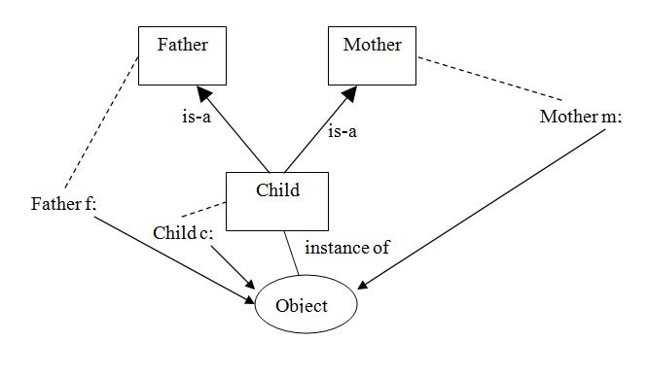
Multiple inheritance and using interface
The child class can extends only one class, and implements any no. of interfaces Where f, m ,c are references
Notes:
The child class can extends only one class, and implements any no. of interfaces
Where f, m ,c are references
22

Slide 23
Multiple inheritance
public Class Mother {
public void a()
{
System.out.println("Mother:a");
}
public void b()
{
System.out.println("Mother:b");
}
public void y()
{
System.out.println("Mother:y");
}
}
public interface Father{
public void c();
public void d();
public void y();
}

Slide 24
Multiple inheritance
public class Child extend Mother implements Father{
public void c(){
System.out.println("Child:c");
}
public void d(){
System.out.println("Child:d");
}
}

Slide 25
Multiple inheritance
public static void main(String arg[])
{
Child c= new Child();
Father f=(Father)c;
Mother m=(Mother)c;
c.a();
c.b();
c.c();
c.y();
m.a();
m.b();
m.y();
f.d();
f.y();
f.a(); // correct? no
}
Multiple inheritance can cause the diamond problem (Ambiguity Problem)
Using Java Multiple inheritance : NO Ambiguity Problem

Slide 26
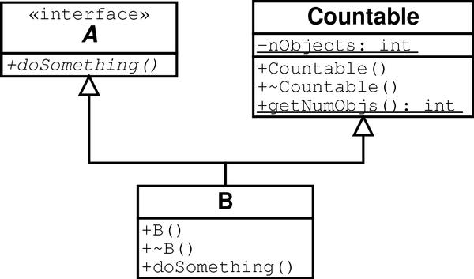
Multiple Inheritance (Java)
implements
extends
B implements the interface A and
is also a "countable" class since it
inherits class Countable
class B extends Countable implements A { /*…*/ }

Slide 27
Design Patterns
Design patterns represent the best practices used by experienced object-oriented software developers.
Design patterns are solutions to general problems that software developers faced during software development.
These solutions were obtained by trial and error by numerous software developers over quite a substantial period of time.

Slide 28
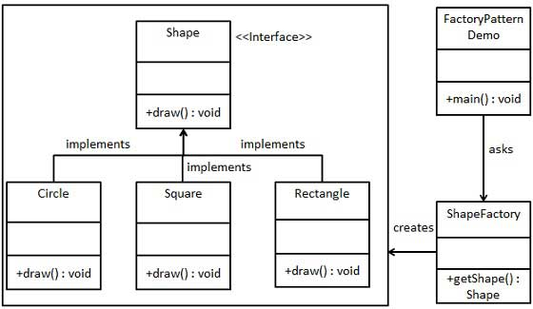
Design Pattern - Factory Pattern
In Factory pattern, we create object without exposing the creation logic to the client and refer to newly created object using a common interface.
will use ShapeFactory to get a Shape object. It will pass information (CIRCLE / RECTANGLE / SQUARE) to ShapeFactory to get the type of object it needs

Slide 29
Factory Pattern example
public class ShapeFactory {
public Shape getShape(String shapeType){
if(shapeType == null){
return null;
}
if(shapeType.equalsIgnoreCase("CIRCLE")){
return new Circle();
} else if(shapeType.equalsIgnoreCase("RECTANGLE")){
return new Rectangle();
} else if(shapeType.equalsIgnoreCase("SQUARE")){
return new Square();
}
return null;
}
}
public class FactoryPatternDemo {
public static void main(String[] args) {
ShapeFactory shapeFactory = new ShapeFactory();
//get an object of Circle.
Shape shape1 = shapeFactory.getShape("CIRCLE");
shape1.computeArea ();
Shape shape2 = shapeFactory.getShape("RECTANGLE");
shape2.computeArea ();
Shape shape3 = shapeFactory.getShape("SQUARE");
shape2.computeArea ();
}
}

Slide 30
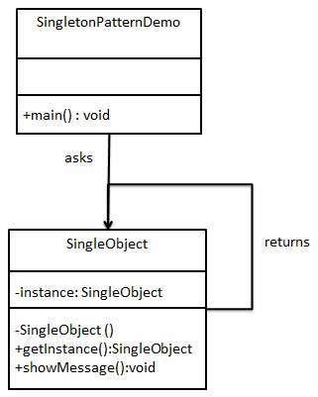
Design Pattern - Singleton Pattern
This pattern involves a single class which is responsible to create an object while making sure that only single object gets created.
This class provides a way to access its only object which can be accessed directly without need to instantiate the object of the class.

Slide 31
Singleton Pattern example
public class SingleObject {
//create an object of SingleObject
private static SingleObject instance;
//make the constructor private so that this class
//cannot be instantiated
private SingleObject(){ }
//Get the only object available
public static SingleObject getInstance(){
if (instance == null)
instance = new SingleObject();
return instance;
}
public void showMessage(){
System.out.println("Hello World!“ + this);
}
}
public class SingletonPatternDemo {
public static void main(String[] args) {
//illegal construct
//Compile Time Error: The constructor SingleObject()
//is not visible
//SingleObject object = new SingleObject();
//Get the only object available
SingleObject object = SingleObject.getInstance();
//show the message
object.showMessage();
//this will get same object
SingleObject object2= SingleObject.getInstance();
object2.showMessage();
}
}

Slide 32
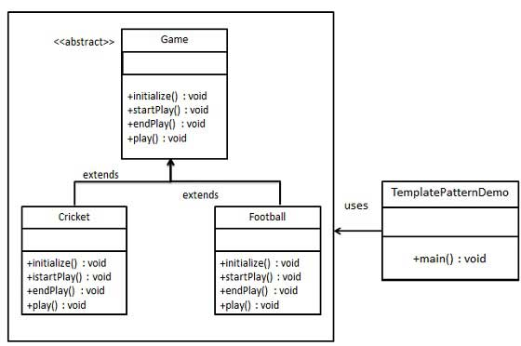
Design Patterns - Template Pattern
An abstract class exposes defined way(s)/template(s) to execute its methods.
Its subclasses can override the method implementation as per need but the invocation is to be in the same way as defined by an abstract class.

Slide 33
Template Pattern example
public abstract class Game {
abstract void initialize();
abstract void startPlay();
abstract void endPlay();
//template method
public final void play(){
initialize(); //initialize the game
startPlay(); //start game
endPlay(); //end game
}
}
public class Cricket extends Game {
void endPlay() {
System.out.println("Cricket Game Finished");
}
void initialize() {
System.out.println("Cricket Game Initialized! Start.");
}
void startPlay() {
System.out.println("Cricket Game Started");
}
}
public class Football extends Game {
void endPlay() {
System.out.println("Football Game Finished!");
}
void initialize() {
System.out.println("Football Game Initialized.");
}
void startPlay() {
System.out.println("Football Game Started.!");
}
}

Slide 34
Questions

