Slide 1
P2M project :
Using Machine Learning to recommend football transfer targets
Realised by : Supervised by :
Ahmed Ben Salem Dr. Amine BEN SALEM
Ayoub Sassi

Slide 2
TABLE OF CONTENTS
1
2
3
4
Project overview
Data Collection:
Self-education
Next steps

Slide 3
1
Project overview

Slide 4
INTRODUCTION
Our project is focused on developing a football transfer recommendation system. The goal of the system is to provide recommendations to football teams and managers looking to improve their squads through new transfers.

Slide 5

Data Source :
To achieve this goal, we are collecting data from Transfermarkt, a popular website that provides information on football transfers, player statistics, and team rankings. We are using web scraping techniques to extract data from Transfermarkt and preprocess it for use in our recommendation system.

Slide 6

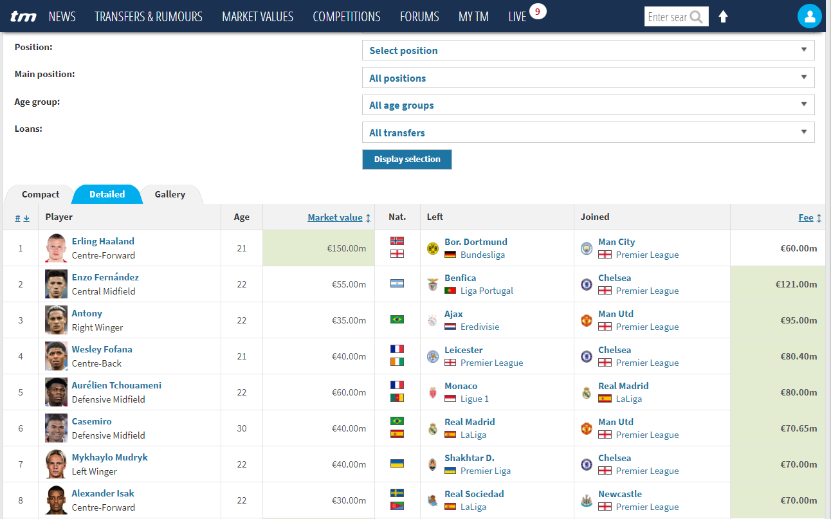
A PICTURE IS WORTH A THOUSAND WORDS

Slide 7
2
Data Collection

Slide 8
Web Scraping
We have made significant progress in collecting data from Transfermarkt. We have identified and extracted data from multiple sources, including player profiles, team statistics, and transfer histories.
During the web scraping process, we encountered several challenges, including inconsistencies in the data format, changes to the website layout, and limitations in our web scraping tools. However, we were able to overcome these challenges through creative solutions and persistence.
We have collected a substantial amount of data so far, including player and team statistics for multiple seasons and transfer data going back several years. We are confident that our data collection efforts will provide a solid foundation for our recommendation system.

Slide 9
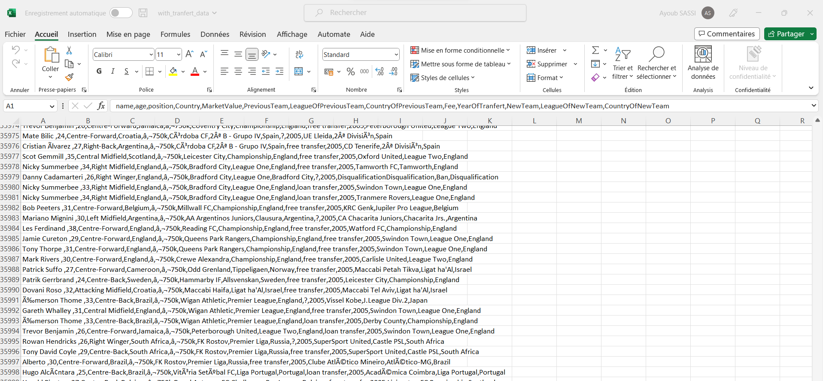
A PICTURE IS WORTH A THOUSAND WORDS

Slide 10
3
Self-education

Slide 11
We have completed the first two courses of the Machine Learning Specialization on Coursera. These courses covered topics such as supervised learning, linear regression, logistic regression, and neural networks.

Slide 12
4
Next steps

Slide 13
What is next ?
Complete the third and final Coursera course “supervised Learning, Recommenders, Reinforcement Learning”
We will use Python libraries such as Matplotlib and Seaborn to create visualizations of player and team statistics, transfer histories, and other relevant data.

Slide 14
Thank you!

