Slide 1

PEDIATRIC CARE, DIGITIZED
Little Roots
Clinic Reservation System for Children
A full-stack Laravel web application that lets Parents book, manage, and track their children's clinic appointments online.
National Telecom Institute (NTI) · Full Stack with PHP — Summer Internship

Slide 2


WHY THIS PROJECT
The Problem We Solve
Traditional pediatric clinics still rely on manual, paper-based scheduling — creating friction for parents and staff alike.
Long Wait Times
Paper Scheduling
Missed Appointments
No digital queue management means hours lost in waiting rooms.
Manual, error-prone records create chaos for clinic staff.
No reminders lead to no-shows and wasted doctor time.
LITTLE ROOTS · CLINIC RESERVATION SYSTEM
02

Slide 3



WHAT WE BUILT
Project Overview
A centralized digital platform that lets parents book, manage, and track their children's clinic appointments — anytime, anywhere.
1
2
3
Book
→
Manage
→
Track
Schedule appointments 24/7 online
View, reschedule, or cancel with ease
Access health records and visit history
LITTLE ROOTS · CLINIC RESERVATION SYSTEM
03

Slide 4





HOW IT'S BUILT
Tech Stack
Built with Laravel's MVC architecture — a mature, batteries-included PHP framework chosen for rapid, secure development.
Frontend
Blade Templates + Bootstrap 5
Backend
Laravel 10 (PHP 8) — MVC
Database
MySQL — Eloquent ORM
Authentication
Laravel Auth / Sanctum + Bcrypt
Environment
XAMPP (local) → Web Hosting
LITTLE ROOTS · CLINIC RESERVATION SYSTEM
04

Slide 5
UNDER THE HOOD
System Architecture
Client-Server Model
→
→
Blade / Bootstrap UI
Laravel App (MVC)
MySQL Database
Server-rendered views for parents, doctors & admins
Routes → Controllers → Models handle all business logic
Relational storage for records, bookings & users
LITTLE ROOTS · CLINIC RESERVATION SYSTEM
05

Slide 6



WHAT IT DOES
Key Features
Online Booking
Doctor Profiles
Reminders
Parents book appointments 24/7 from any device.
Browse pediatricians by specialty and availability.
Automated notifications reduce missed visits.
Medical Records
Admin Dashboard
Secure, centralized child health history.
Clinic staff manage every booking in one place.
LITTLE ROOTS · CLINIC RESERVATION SYSTEM
06

Slide 7
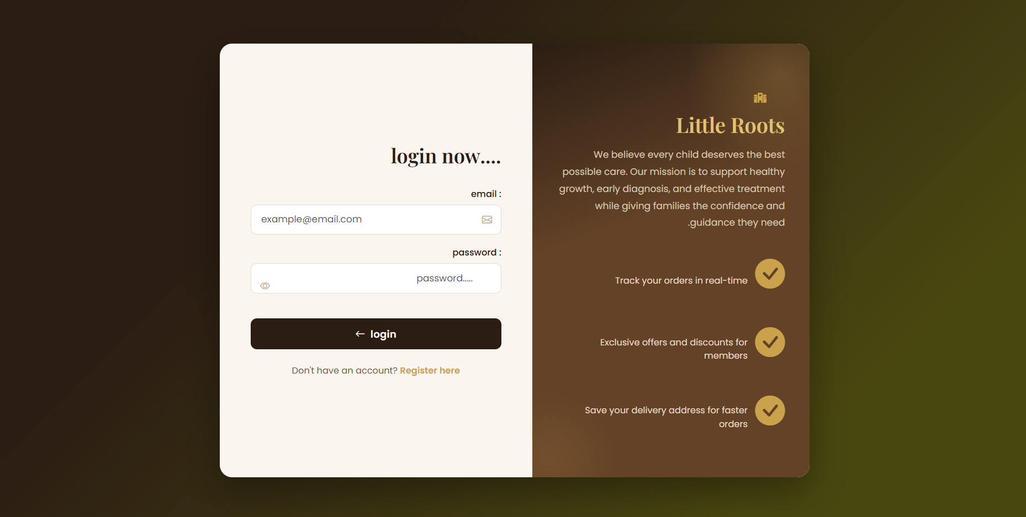
APP WALKTHROUGH · 1 OF 3
Secure Sign-In
Parents, doctors, and admins each sign in through one clean, branded entry point.
LITTLE ROOTS · CLINIC RESERVATION SYSTEM
07

Slide 8
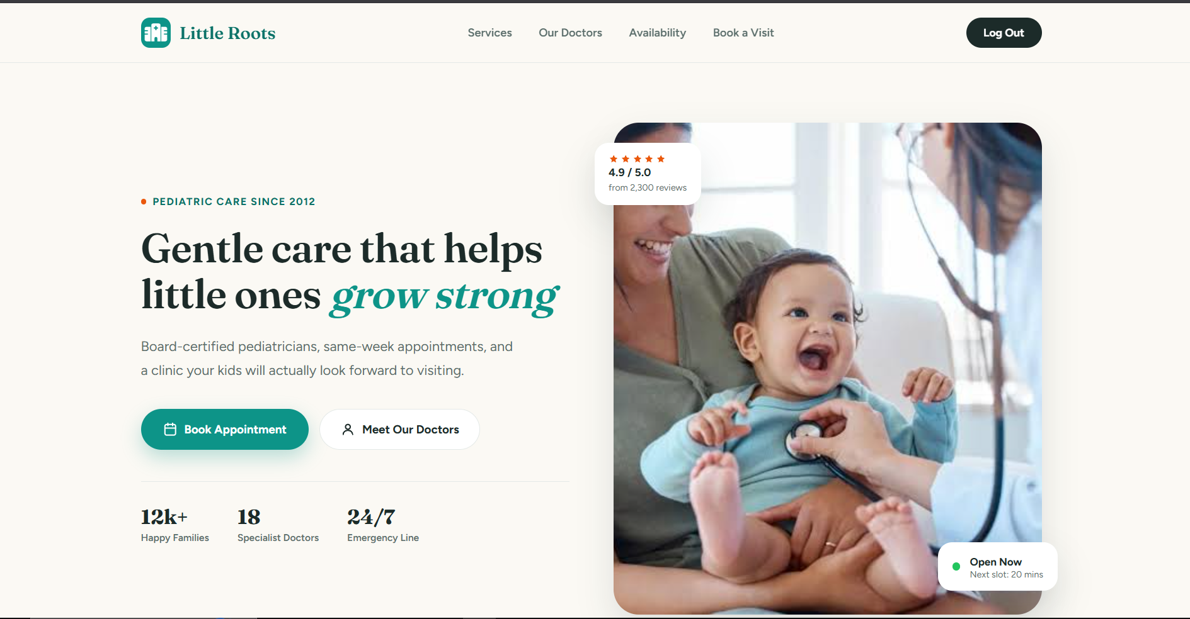
APP WALKTHROUGH · 2 OF 3
The Landing Page
A warm, trust-building homepage that speaks directly to parents — ratings, stats, and a clear call to action.
LITTLE ROOTS · CLINIC RESERVATION SYSTEM
08

Slide 9
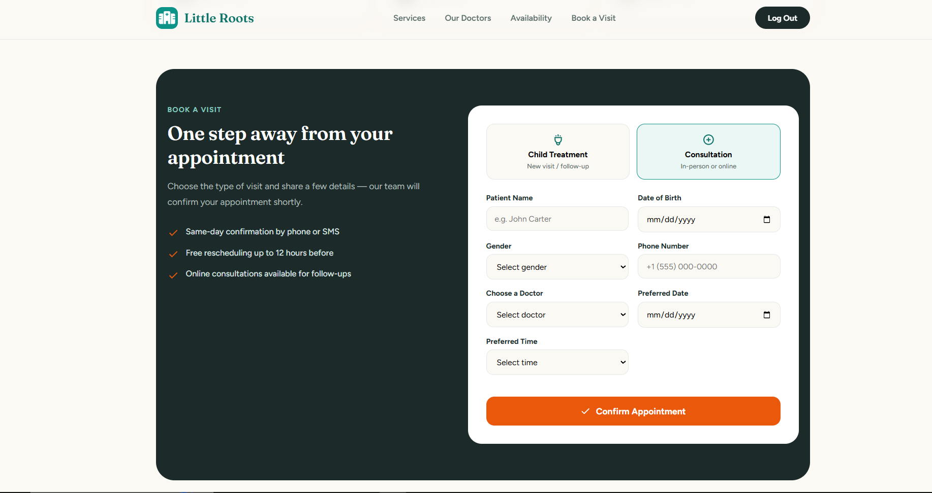
APP WALKTHROUGH · 3 OF 3
Book a Visit
Parents choose a visit type, pick a doctor and time, and confirm — all in a single guided form.
LITTLE ROOTS · CLINIC RESERVATION SYSTEM
09

Slide 10

FOR THE CLINIC STAFF
Admin Dashboard
A real-time control panel giving staff full visibility over every clinic operation.
Schedule Manager
Appointment Table
Patients List
Analytics
Manage doctor availability and shifts
Filter by status, doctor, or date
All the patients registered in the site
Booking trends and clinic performance
LITTLE ROOTS · CLINIC RESERVATION SYSTEM
10

Slide 11


TRUST & COMPLIANCE
Security & Data Privacy
Laravel's built-in protections keep every child's medical record safe by default.
Bcrypt Password Hashing
CSRF Protection
Every password is hashed and salted — never stored in plain text.
Laravel's token-based middleware blocks cross-site request forgery.
Role-Based Access
HTTPS Everywhere
Middleware guards ensure parents, doctors, and admins each see only what they need.
All data in transit is encrypted end-to-end.
LITTLE ROOTS · CLINIC RESERVATION SYSTEM
11

Slide 12
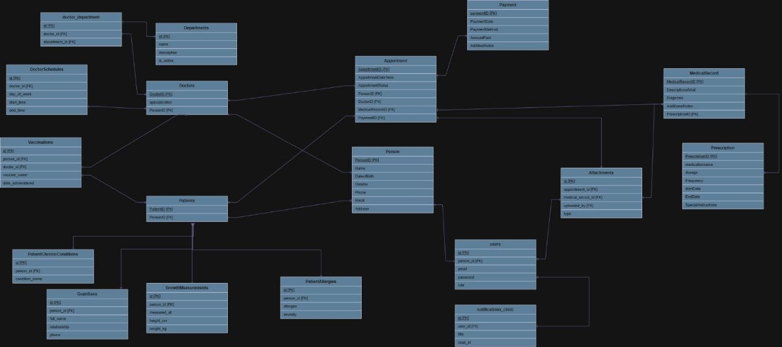
DATA MODEL
Entity Relationship Diagram
The ERD defines how doctors, patients, appointments, and departments relate to one another.
✓ Medical records, prescriptions, allergies, vaccinations & growth tracking
✓ Payments, user accounts, attachments, and notifications
✓ Data consistency enforced via primary & foreign key relationships
LITTLE ROOTS · CLINIC RESERVATION SYSTEM
12

Slide 13




WHAT'S NEXT
Future Roadmap
The system is built to grow — with planned features that make pediatric care smarter and more connected.
v2.0
v2.1
v2.2
v3.0
Telemedicine
AI Suggestions
Multi-Branch
Mobile App
Video consultations between doctors and parents
Smart, AI-powered appointment recommendations
Support for multiple clinics under one account
Native companion apps for iOS & Android
LITTLE ROOTS · CLINIC RESERVATION SYSTEM
13

Slide 14

WHO BUILT IT
Meet the Team
A 4-member team from the NTI Full Stack with PHP summer internship track.
Ahmed Eid
Ahmed Nabil
Hanan Reda
Abanoub Morqus
Backend & Database
Backend & Database
Frontend & Testing
Frontend & Testing
LITTLE ROOTS · CLINIC RESERVATION SYSTEM
14

Slide 15
Thank You
Questions & discussion welcome.
Little Roots — Clinic Reservation System for Children
Built with Laravel + MySQL · NTI Full Stack with PHP Summer Internship
LITTLE ROOTS · CLINIC RESERVATION SYSTEM
15

