Slide 1
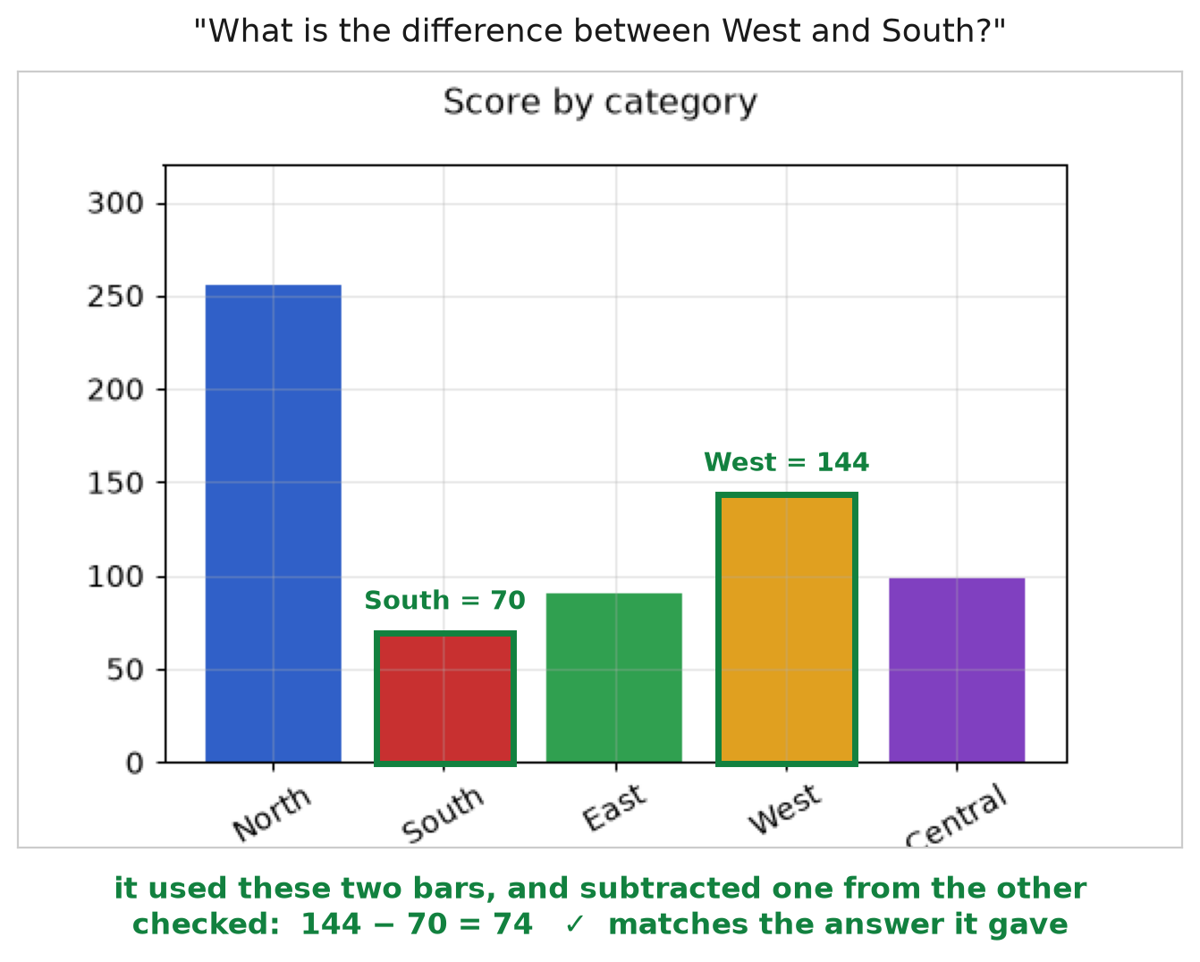
Grounded Chart
Question Answering
Making a model show where it looked, and how it calculated
WEEK 1 OF 4
Team: [name] · [name] · [name]

Slide 2
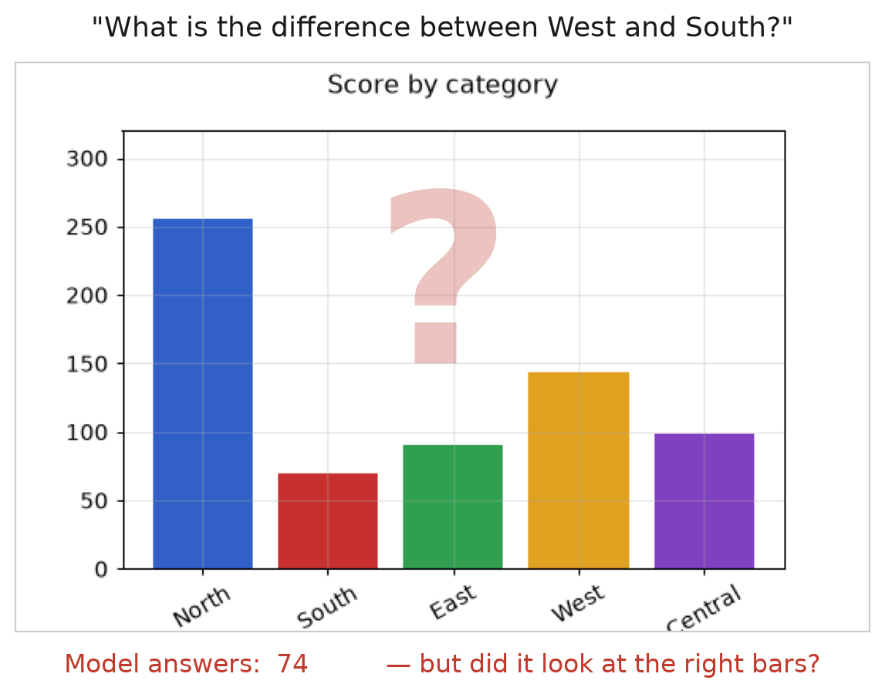
The problem
A right answer and a lucky guess look exactly the same
A chart model reads a chart and gives an answer.
That is all you get.
You cannot tell whether it:
read the right things on the chart
read the wrong things and got lucky
ignored the chart and guessed from the question
So nobody can check its work — not us, not a user, not the model itself.

Slide 3
Our idea
Ask for three things instead of one — then check them against each other
1
Where it looked
mark the parts of the chart it used
2
How it got there
state the calculation, not a paragraph of prose
3
The answer
the number itself
Because the calculation is written down, a small program can redo it and check it matches the answer.
No human needed. No correct answer needed.

Slide 4
The four-week plan
Week 1 is deliberately not about training
Week 1
Week 2
Week 3
Week 4
Data, measurement
and baselines
Train the model
Evaluate it properly
Analyse and write up
Weeks 2–4 all depend on data we trust and scoring we trust. Week 1 built both, then measured where the untouched model starts.

Slide 5
What week 1 delivered
BUILT
MEASURED
FOUND
a working data pipeline over two public datasets
an evaluation system, checked against the official one
a tool that recovers the calculation behind an answer
a chart generator that makes its own training data
how well the datasets are actually annotated
whether our scoring matches the official scoring
how small the things the model must find are
how the untouched model performs today
one chart type has no usable annotations at all
the datasets overlap far more than filenames suggest
most targets are too small for the model to locate
almost nothing in the data teaches reasoning
the model answers well but cannot justify itself
All of it is in the repository and reproducible. · Cost so far: $0 — free GPUs only.

Slide 6
BUILT
The data foundation
Two public datasets, version-locked so results stay reproducible
Dataset | Training | Validation | Test | What it marks on the chart
ChartQA | 28,299 | 1,920 | 2,500 | every element — each bar, each slice
RefChartQA | 55,789 | 6,223 | 11,690 | the regions each question needs
one dataset marks every element in the chart; the other marks what each question needs
every file locked to a specific version, so any number can be reproduced later
four different sources brought into one common format
test data set aside from day one and not looked at
About 86,000 chart questions in total. The test portions stay sealed until every decision is locked.

Slide 7
FOUND
The annotations are far patchier than advertised
We inspected 2,500 charts instead of trusting the documentation
How many charts actually come with usable annotations?
Bar charts (vertical)
96.8%
Where annotations do exist, we confirmed they are accurate.
The problem is coverage, not quality.
Bar charts (horizontal)
91.5%
Pie charts
54.8%
Line charts
0.0%
Line charts cannot be used to teach the model where to look. We found this before building on top of them.

Slide 8
MEASURED
Is the grounding data good enough to use?
A go / no-go check, with the pass mark set before we looked
What we checked, on a random sample
200 / 200
does the marked region actually contain part of the chart?
does it mark a specific element, not the whole picture?
does this hold across all question types?
sampled annotations were acceptable
Passed — so we can build on this data.
Had it failed, we would have had to build our own grounding data — a very different Week 2.

Slide 9
FOUND
The two datasets overlap almost completely
The second dataset is built from the first — but the files look different
0 of 4,000
99.9%
overlaps found by comparing
the image files
overlaps found by comparing
the pictures themselves
Re-saving an image changes the file completely while the picture stays identical. The obvious check finds nothing — and says so confidently.
Without catching this, we could train on a chart and then “test” on the same chart — and never know our results were inflated.

Slide 10
BUILT
Scoring we can actually trust
Built before the model, because you cannot fix a ruler after measuring with it
we use each dataset's own official scoring program for every reported number
we also wrote our own, so we can break results down and put error bars on them
then we checked the two against each other on 11,690 real predictions
11,690
0.07
0
predictions scored twice —
once by each program
largest gap between them,
in percentage points
disagreements on the
hardest answer cases
So any improvement we report later is a real improvement — not a bug in how we measure.

Slide 11
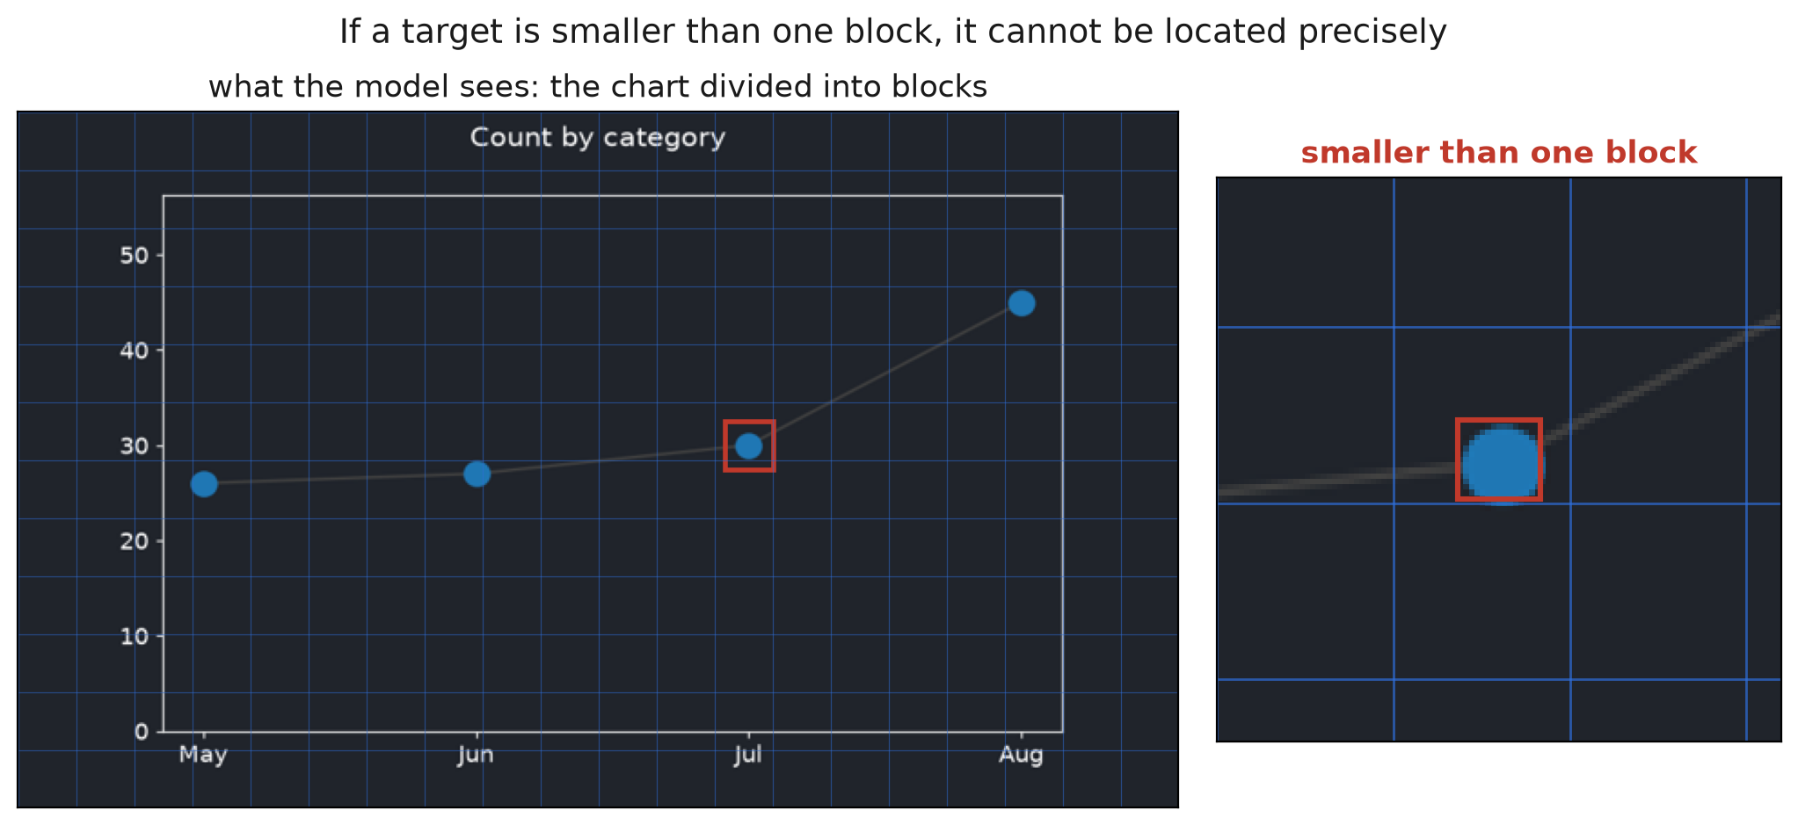
FOUND
Most targets are too small for the model to locate
The model does not see fine detail — it sees the chart in coarse blocks
67%
of targets are smaller than one
block the model can see
25%
are smaller than one block
in every direction
More training cannot fix this. It tells us exactly what to test in Week 3: give the model a sharper view.

Slide 12
FOUND
Almost nothing in the data teaches reasoning
We searched all 28,299 training questions for one where the calculation is clear
28,299
14%
74%
4 in 100
questions
searched
→
have one clear
calculation behind them
→
of those are just
“read one number off the chart”
→
actually teach
multi-step reasoning
Most questions are rejected because several different calculations would produce the same answer — so we cannot tell which one the question meant, and we refuse to guess.
The real data can barely teach reasoning at all. That is why we make our own.

Slide 13
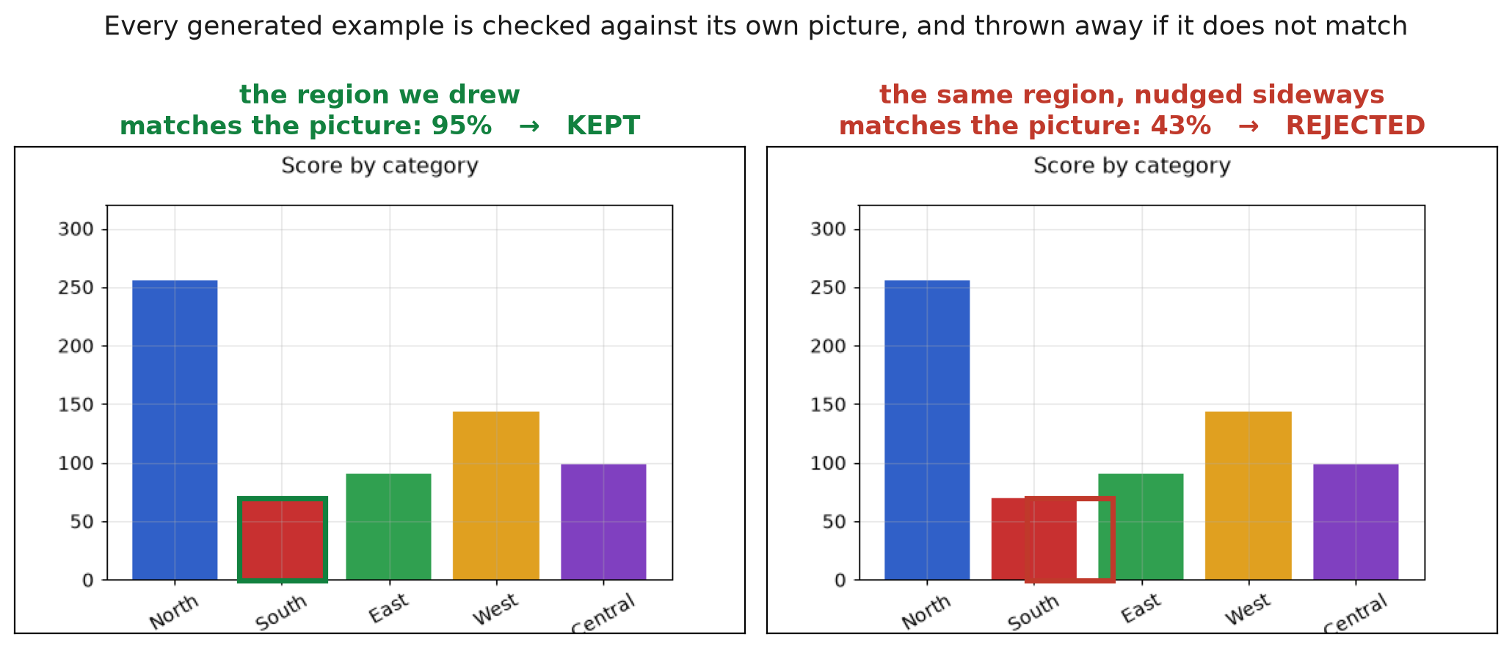
BUILT
So we generate our own charts
When we draw the chart ourselves, we know the answer and the regions for certain
8 chart styles at 4 difficulty levels
24,000 examples generated
6,000 of them are the multi-step kind that real data almost never provides
look and style randomised, so the model cannot memorise one appearance
Every generated example is automatically checked against its own picture before it is allowed into training.

Slide 14
MEASURED
Where the model stands today, before any training
200 held-out questions, asked in exactly the format we will train towards
50%
47%
69%
of questions answered
correctly
produce a properly
structured answer
of those: the stated calculation
matches the stated answer
Read together: the model can already read charts reasonably well. What it cannot yet do is produce an answer in a form anyone can check — and when it does, its own reasoning often does not support it.
This is the starting line. Every number we report in Week 3 is measured against it.

Slide 15
What is next
Week 2
Train the model — first to point at the right things,
then to point and reason together
Week 3
Measure it properly on the sealed test data,
and test whether a sharper view helps the small targets
Week 4
Separate seeing mistakes from reasoning mistakes,
and write it up
Test data stays sealed until every
decision is locked and written down
Cost so far: $0
free GPUs only

