Slide 1

CoreMark
An EEMBC Benchmark
Presented by: Omar Mahmoud Emad Eldin Aboadma
Presented to: Dr. Samir Shaheen
18 December 2018

Slide 2
Agenda
EEMBC
Coremark
Results
Conclusion

Slide 3
EEMBC

Slide 4
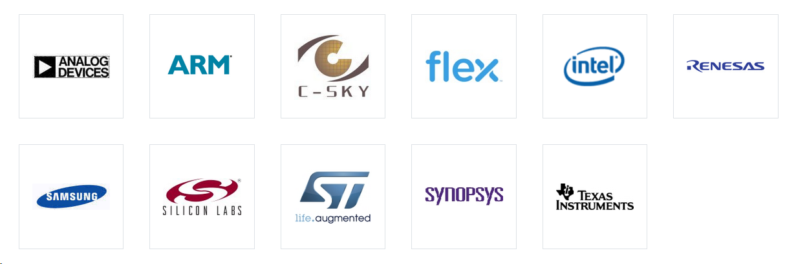
EEMBC
Embedded Microprocessors Benchmark Consortium
Develops benchmarks for automotive and embedded applications
Non-profit organization

Slide 5
EEMBC Benchmarks
Ultra low power and Internet of Things
Single-core Processor Performance
Multi-core Processor Performance
Phone and Tablet

Slide 6
Coremark

Slide 7
Coremark
Measures the performance of microcontrollers and central processing units used in embedded systems
Replaces the Dhrystone benchmark
Measures are:
1. Number of ticks of execution
2. Number of memory accesses

Slide 8
Coremark (continued)
Contains implementations of:
List processing (find and sort)
Matrix manipulation (common operations)
State machine
CRC
Notes:
The CRC algorithm serves a dual function; it provides a workload commonly seen in embedded applications and ensures correct operation of the CoreMark benchmark, essentially providing a self-checking mechanism.

Slide 9
Results

Slide 10
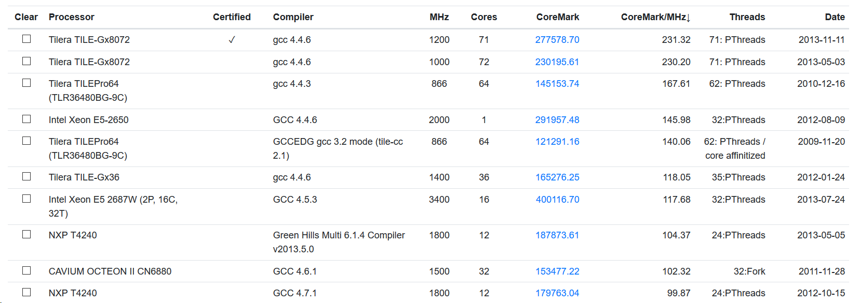
Results

Slide 11
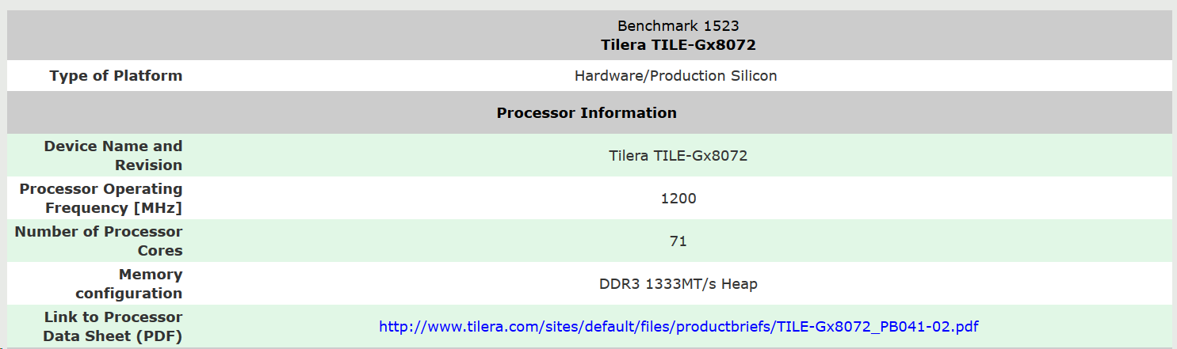
Results (continued)

Slide 12
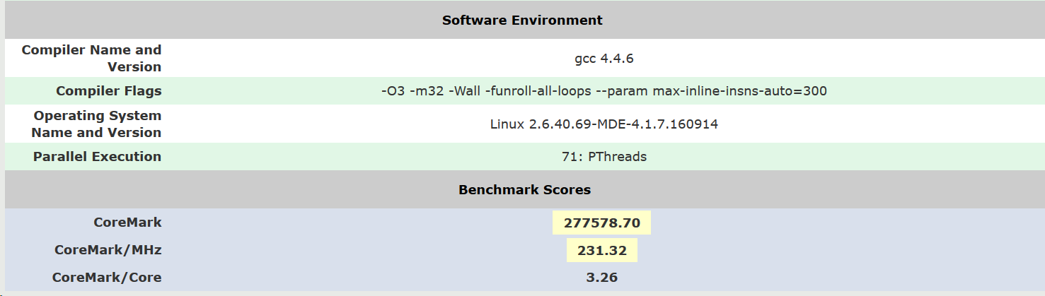
Results (continued)

Slide 13
Conclusion

Slide 14
Conclusion
The most important measure is the CoreMark/MHz and not the CoreMark.
You can visit the link below to get the benchmark:
https://github.com/eembc/coremark

Slide 15
Thanks !!

