Slide 1
Team12Cs
Youssef Moahmed – Moustafa Gamal – Ahmed Samir – Amr Ayman – Ali Fathi – Zyad el Sayed

Slide 2
PreProcessing(Models)
Dropping segment and color columns
Filling Nan values by mode in Drive unit column
Filling Nan values by mean in Volume column
Applying str.lower() function to (drive unit , Volume,FuelType) Columns
Splitting Car-info columns into 3 column (brand , model , year) then dropping brand and model columns

Slide 3
PreProcessing(Models)
Adding (mean Price) price column by getting the mean price for every unique value in car-info column from price(USD) column
Storing values in dictionary(Every Unique value in car info ,meanPrice)
Storing mean price of each brand in a dictionary (brand,MeanPrice)

Slide 4
PreProcessing(testing)
Mean Price Column is filled according to 4 scenarios
1 – our dictionary has the car-info key then we simply return the mean price
2 – our dictionary has same brand and model in car-info key but year is different then we simply return the mean price of closest year difference of same model
3 – our dictionary has same brand in car info key but model is different we simply return the mean price of brand
4-our dictionary has doesn’t contain Brand then we simply return mean price of Price(usd) column ☺

Slide 5
Categorical encoding
We apply hot one encoding to 4 columns (condition , fuel type, transmission, drive unit)

Slide 6
Feature scaling
We apply feature scaling to 3 coulmns (mean price – volume - mileage) using sklearn standard scaling

Slide 7
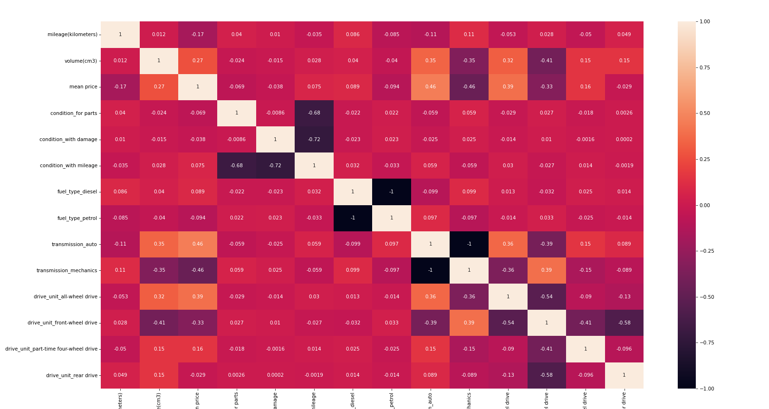
Correlation

Slide 8
Models used
We have tried different models 46 entries
The best preforming models were polynomial models with degrees 2 , 3 with (Train/Test) split (70/30)

Slide 9
conclusion
We have concluded that feature Engineering / selecting “make it or break it “ in machine learning models
Number of experiments to do with A Machine learning model is very high so we should automate (train test – random state ) selection to be the most accurate (computationally expensive)

