Slide 1
image segmentation techniques
Ahmed Ragab
Ahmed Eltaher
Youssef moataz

Slide 2
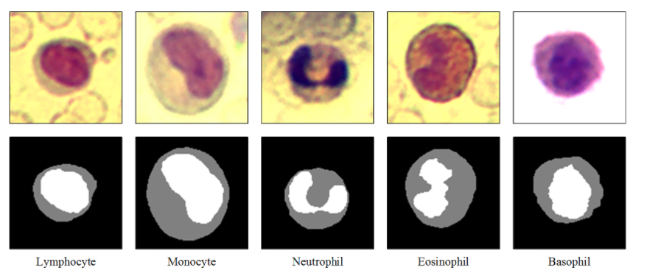
Problem
Segmenting different colored white blood cells (WBC) images into five different categories
(Lymphocyte – Monocyte – Neutrophil – Eosinophil – Basophil)

Slide 3
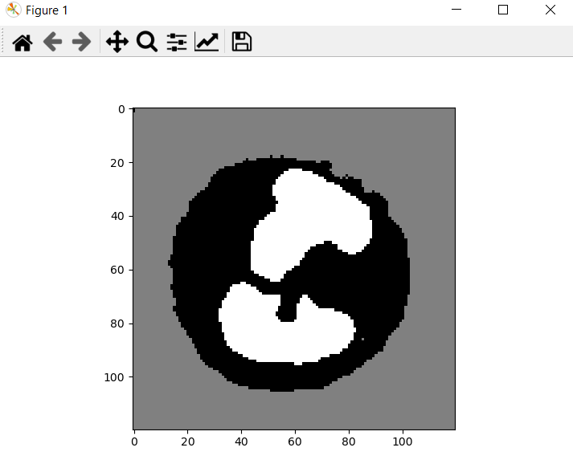
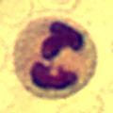
C- Means Clustering

Slide 4
Main advantages and disadvantages compared to k-means
Time
Decisiveness

Slide 5
The big picture
The problem is generally to form clusters to an image of a set of data
In order to find certain group of data of importance were in the case of an image to detect a cluster of certain importance, hence a tumor.
Clustering is an unsupervised ML technique which divides the data into clusters based on the distances between each other’s and the distance between the data point and a calculated centroid for a desired cluster.

Slide 6
Objective function

Slide 7
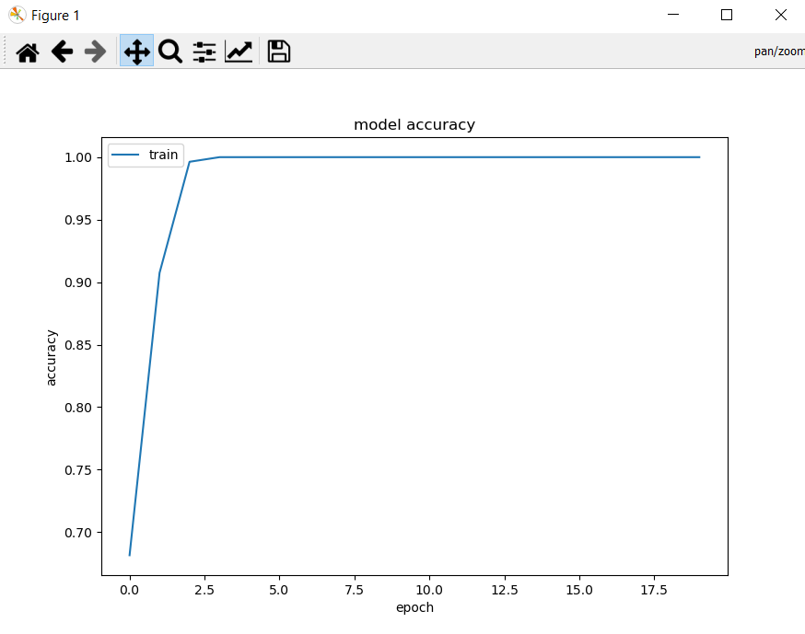
Shallow neural network

Slide 8
