Slide 1

National Bank of Egypt
Improve the design of alahly’s bank web page

Slide 2
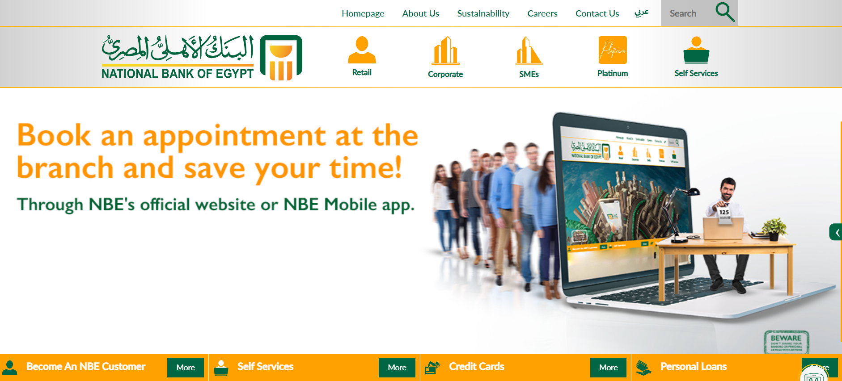
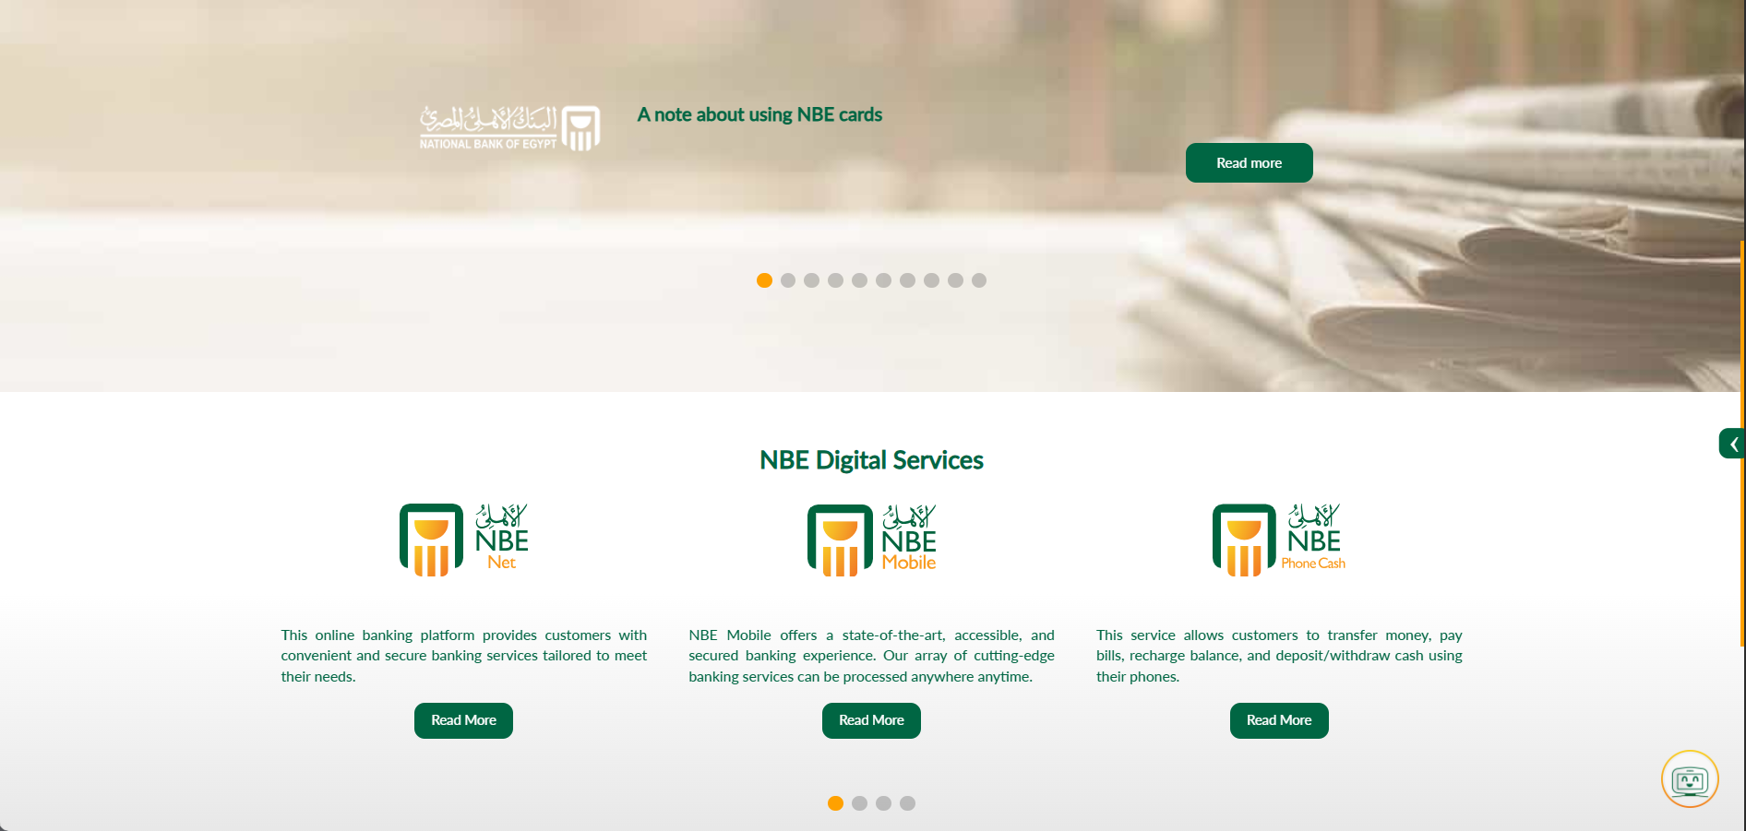
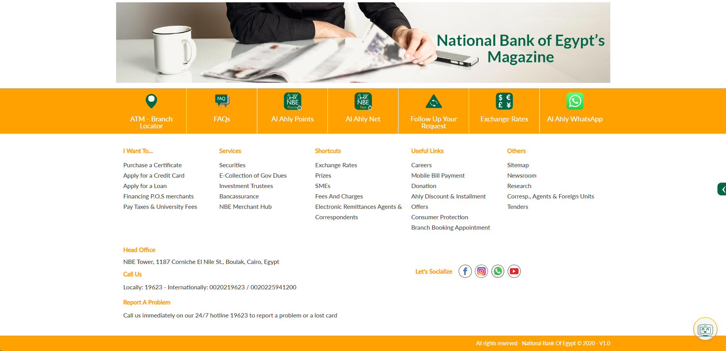
Old Design
the old design often lacked immediate visual appeal and could be overwhelming for new users. Our goal was to streamline, simplify, and elevate the overall aesthetic
The gradient background color at header and green title not good
The orange color and green icons in quick services and footer it is not comfortable for eyes
NBE Digital services the text is small and color green not good and not exist a border separate each service
Exist more links at footer it maybe distract

Slide 3
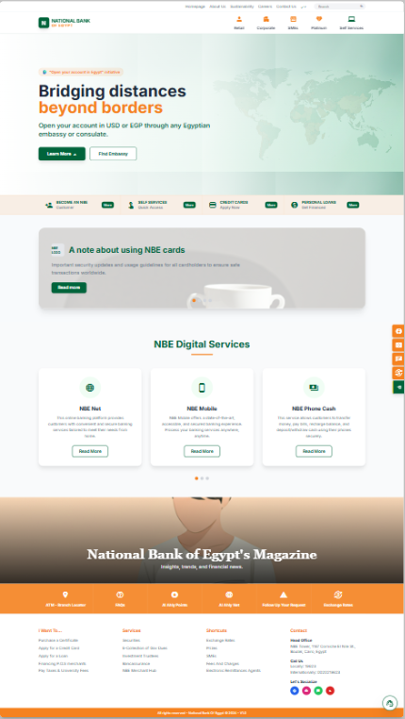
New Design
Our new design prioritizes clarity, intuitive navigation, and a modern aesthetic to create a more engaging and efficient user experience.
This new approach is built on principles of clean typography, ample white space, and a cohesive color palette, leading to a visually appealing and easy-to-understand interface.

Slide 4
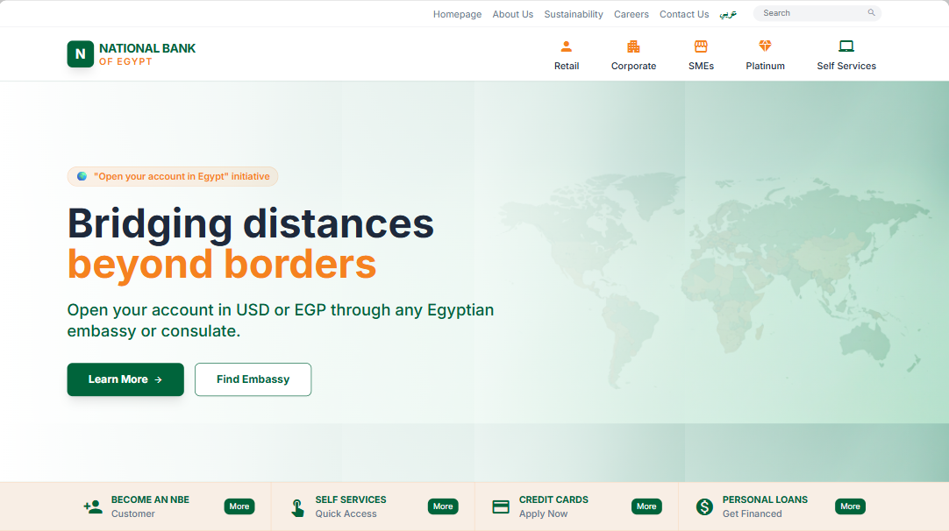
The header layout is cleaner and more balanced.
Text is clearer and easier to read (better typography).
The spacing is more organized, so the page feels modern.
Colors match better and feel less crowded
Icons is simple and modern and match with design

Slide 5
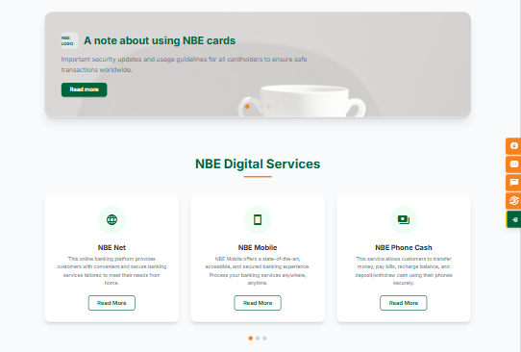
Cleaner & more modern: Card-based layout with clear spacing is easier on the eye.
Better scanability: Users quickly understand the three services without scrolling.
Stronger UX: Clear icons + short text + visible CTAs (“Read More”) improve interaction.
More responsive-friendly: Cards adapt better to different screen sizes.

Slide 6
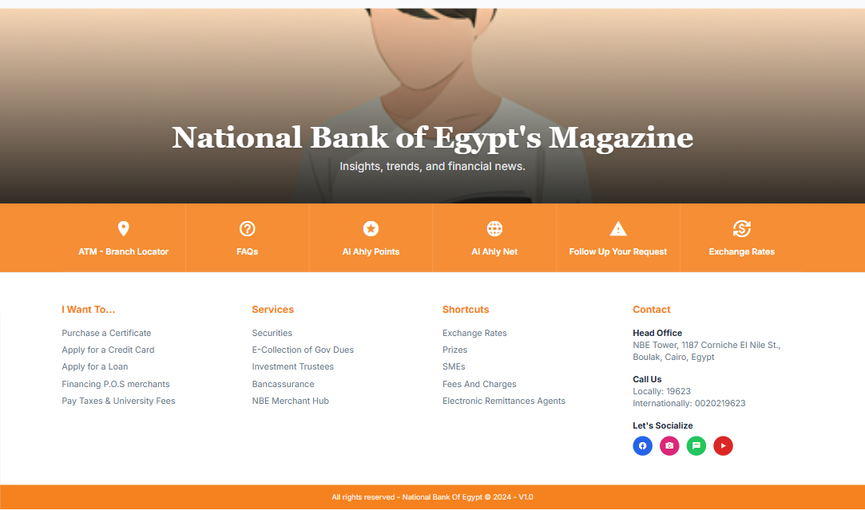
The header layout is cleaner and more balanced.
Text is clearer and easier to read (better typography).
The spacing is more organized, so the page feels modern.
The footer area is simplified and looks more professional.
Colors match better and feel less crowded

Slide 7
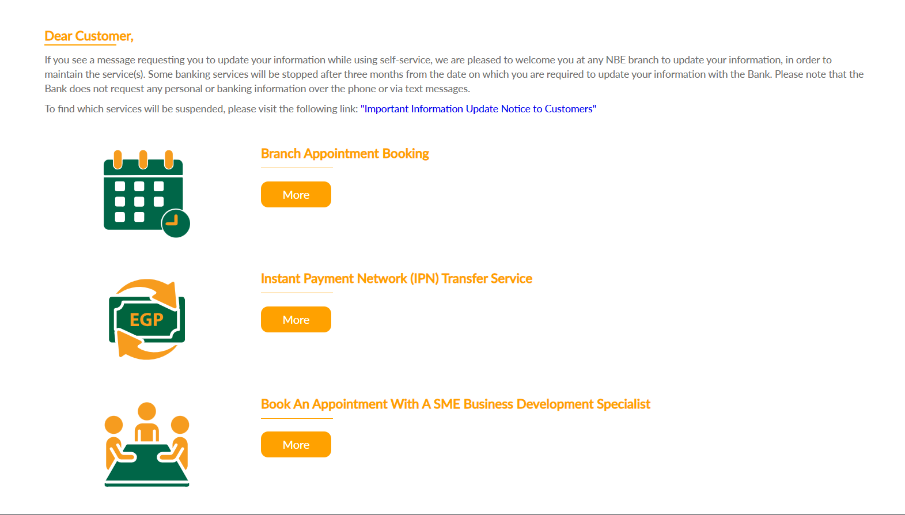
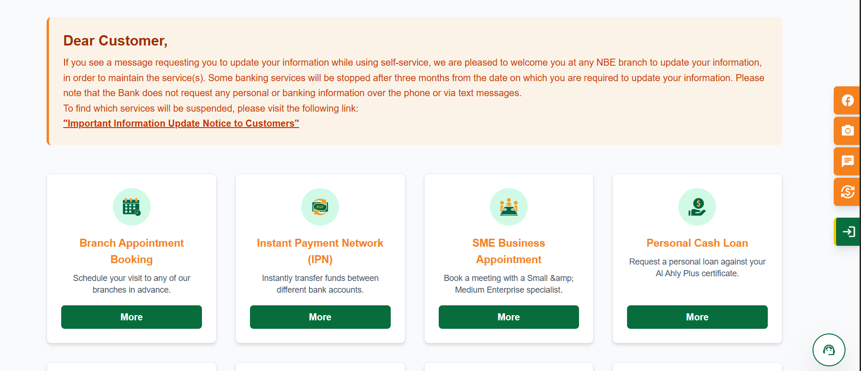
Dear Customer it is warning. We should use red color to attract attention of user to read it.
Each services at one line it take much space and user will boring when scroll every time to see more service.
We also make a body to each service help user know what this service do.

Slide 8
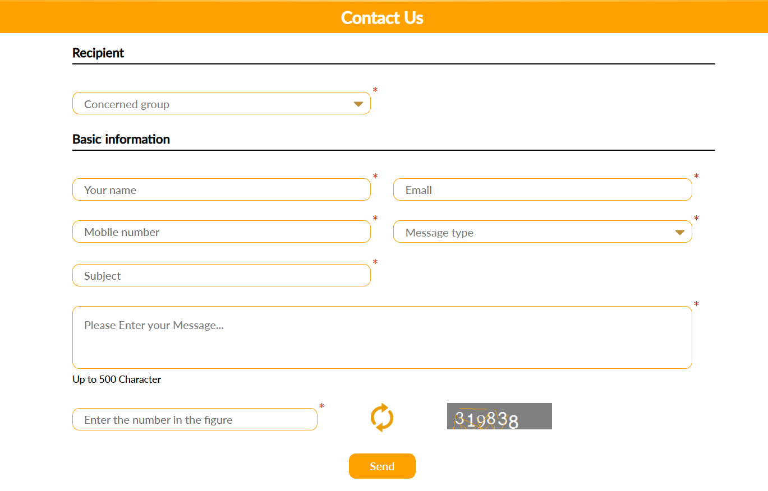
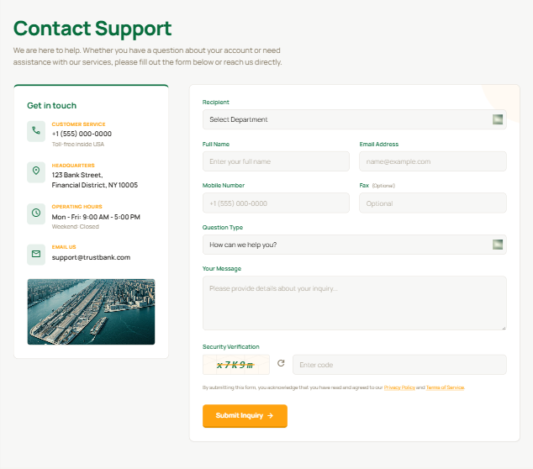
New design improve more contact approach (tele number, location of bank, working hours, and bank email).
Use grey background to be comfortable.
Remove orange border and use light color
Make a form in cord in make user eye focus on it

Slide 9
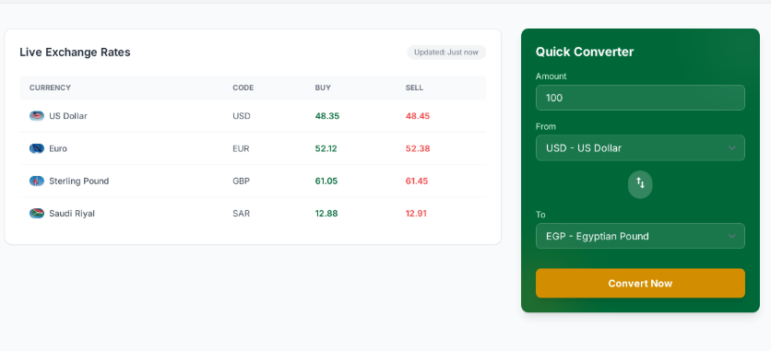
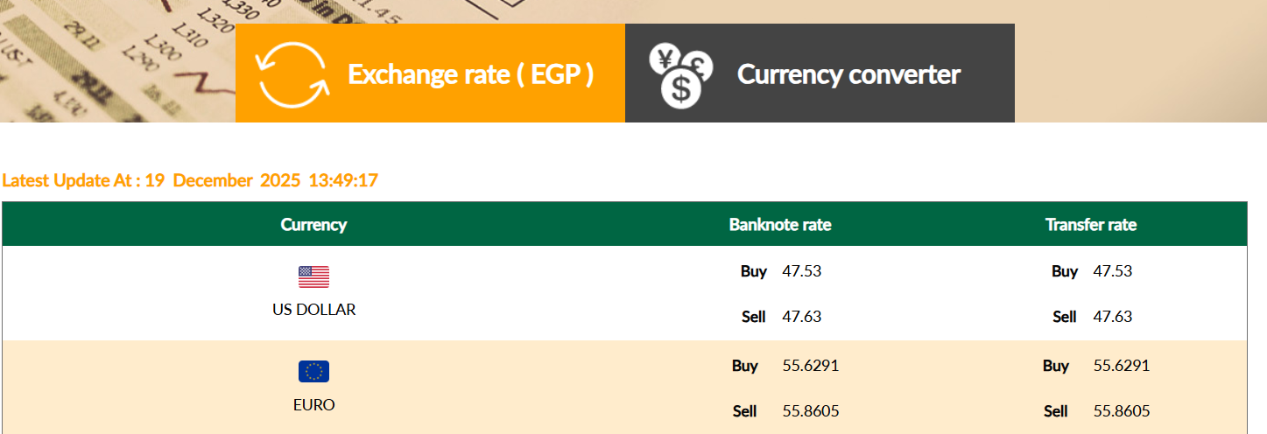
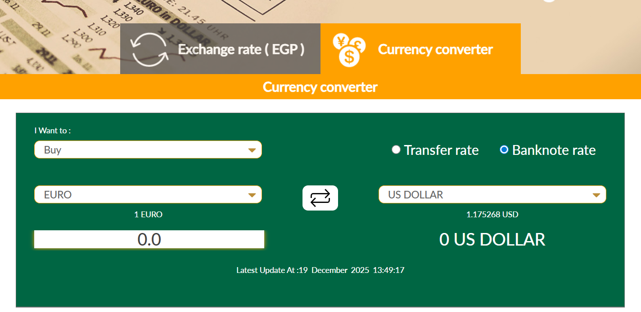
New design Reduce Cognitive Load.
The exchange rates and converter both are exist in front of user. And user will use what he wants and reduces time spent
The table in new design is more comfortable to eyes and easy to know exchanges rates

Slide 10

Thanks
احمد عيسوى السيد عيسوى مسعود 2023017
اسامه ابراهيم مصطفى المشد 2023031

