Slide 1
The Quantum Leap: Microsoft's 4D Codes and D-Wave's Annealing
Welcome to an exploration of cutting-edge advancements in quantum computing. We'll delve into Microsoft's innovative approach to error correction with 4D geometric codes and examine D-Wave's specialized quantum annealing technology, highlighting their impact on the future of computation.

Slide 2
Chapter 1: Advancements in Quantum Computing
Microsoft's 4D Geometric Codes
Microsoft is pioneering a novel approach to quantum error correction with 4D geometric codes. This technology aims to address the inherent instability of qubits, a critical challenge in building reliable quantum computers. By encoding quantum information across four dimensions, these codes offer a robust defence against errors caused by environmental noise.

Slide 3
The Problem: Quantum Fragility
Qubit Instability
Scaling Challenges
Quantum bits, or qubits, are incredibly fragile. Their quantum states are easily disrupted by external interference, a phenomenon known as decoherence. This leads to computational errors.
As quantum computers grow in size, managing and correcting these errors becomes exponentially more difficult, hindering the path to fault-tolerant quantum computation.
The Error Bottleneck
Without effective error correction, the potential of quantum computers to solve complex problems remains largely theoretical. It's the primary bottleneck for widespread adoption.

Slide 4
1.News : Microsoft's Solution: 4D Geometric Codes
Solution:
Microsoft's 4D geometric codes represent a significant theoretical leap. Instead of traditional 2D surface codes, these codes extend into higher dimensions, allowing for a more intricate and resilient encoding of quantum information.
Enhanced Protection: The multi-dimensional structure provides redundant storage for quantum data, making it less susceptible to single-point errors.
Topological Resilience: Based on topological principles, these codes inherently protect quantum information by making it dependent on global properties rather than local ones.
Future of Fault-Tolerance: This approach is critical for building a truly fault-tolerant quantum computer, capable of performing complex computations with high accuracy.

Slide 5
Chapter 2: Company Activities
D-Wave Systems: Quantum Annealing
D-Wave Systems stands out in the quantum computing landscape for its unique and highly specialized approach: quantum annealing. While many companies focus on universal, gate-based quantum computers, D-Wave has carved a niche in solving optimization problems.

Slide 6
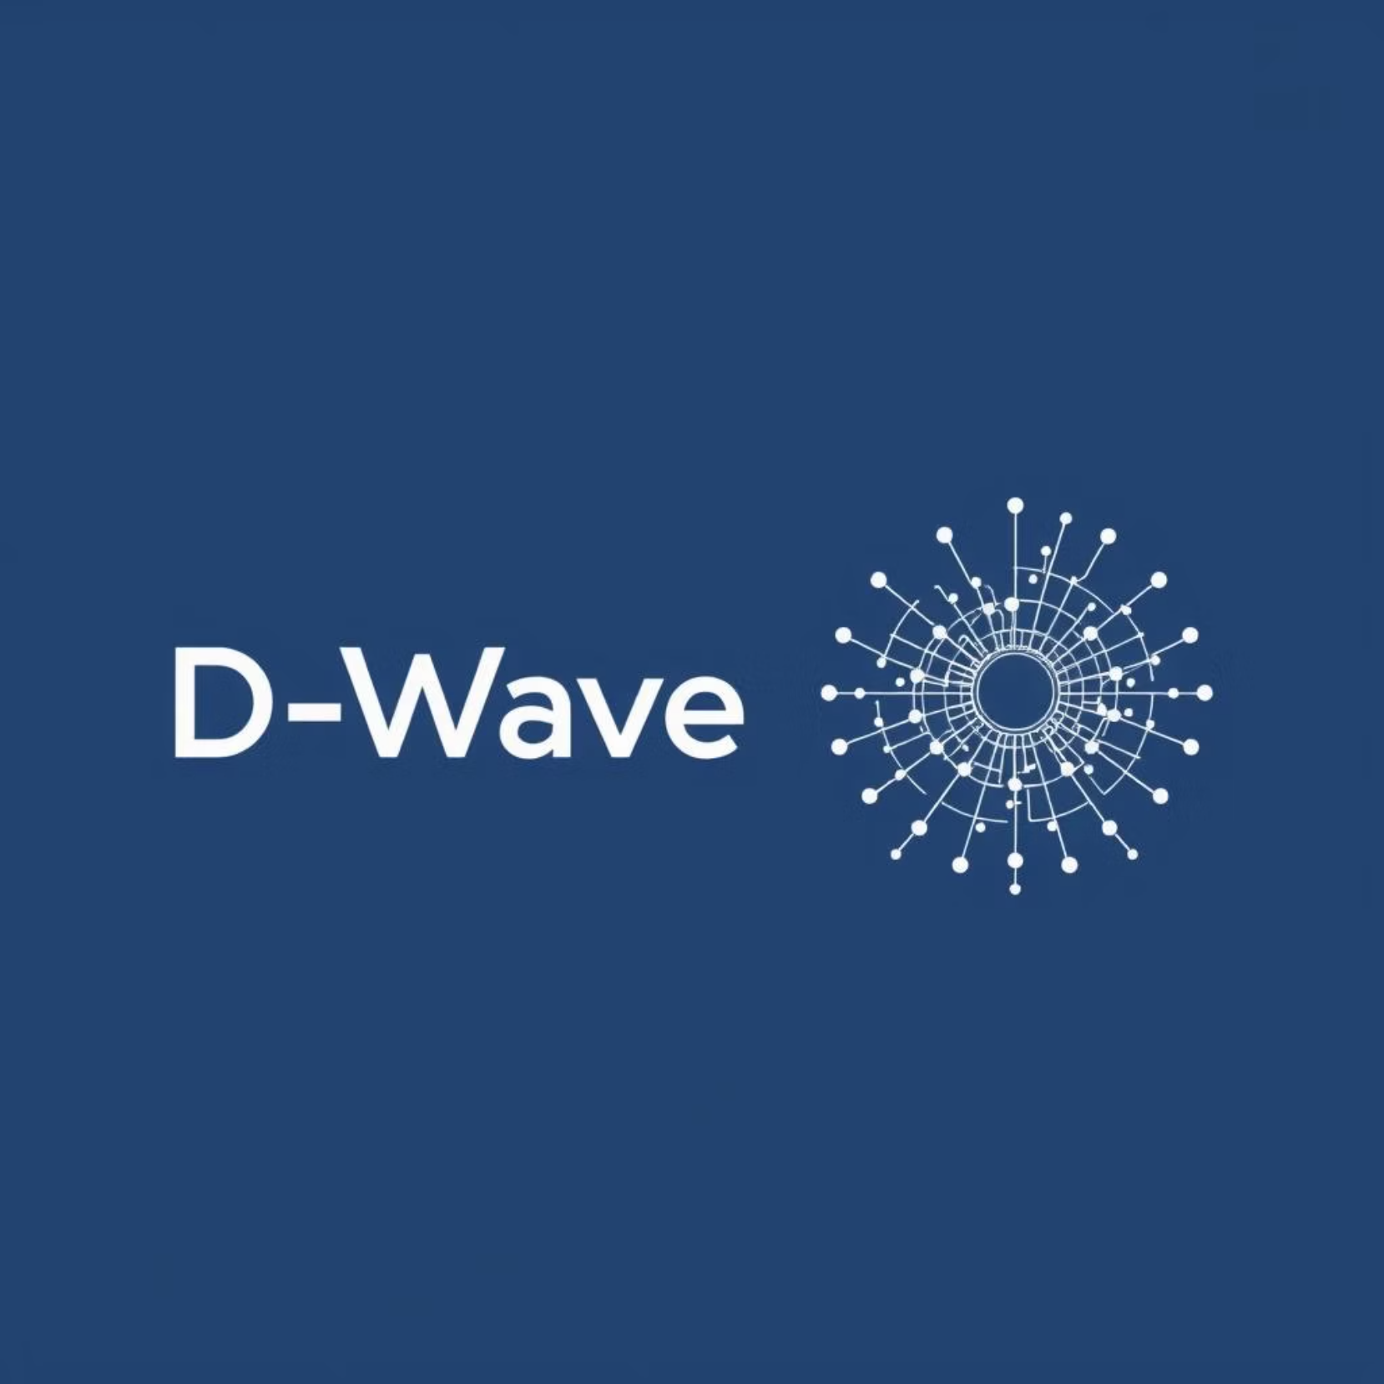
Understanding Quantum Annealing
Quantum annealing is a process inspired by classical annealing in metallurgy, where a material is slowly cooled to find its lowest energy state. In quantum computing, this translates to finding the global minimum of a complex energy landscape, which corresponds to the optimal solution for an optimization problem.
Unlike traditional gate-based quantum computers that manipulate qubits through a series of logical operations, quantum annealers leverage quantum phenomena like superposition and tunnelling to explore vast solution spaces simultaneously and efficiently.

Slide 7



D-Wave's Specialized Focus
Optimization Problems
Commercial Viability
Unique Approach
D-Wave's technology excels at finding the single best solution from an astronomically large number of possibilities. This includes logistics, financial modelling, and drug discovery.
This focused specialisation has allowed D-Wave to be a leader in delivering commercially viable quantum systems and applications today, giving them a distinct market advantage.
By not chasing the 'universal' quantum computer, D-Wave addresses specific, real-world problems where quantum speedup can be immediately realised.

Slide 8
Applications of Quantum Annealing
Supply Chain Optimisation: Finding the most efficient routes and logistics for complex global networks.
Financial Modelling: Optimising portfolios, risk assessment, and fraud detection.
Drug Discovery: Accelerating the search for new molecules and understanding protein folding.
Machine Learning: Enhancing optimisation for training complex machine learning models.
Traffic Management: Reducing congestion and improving flow in urban environments.

Slide 9
The Broader Quantum Landscape
While D-Wave's quantum annealing and Microsoft's error correction research target different facets of quantum computing, both are crucial for the field's advancement. D-Wave offers practical applications today for specific problems, while Microsoft is building the foundational layers for future universal quantum computers.
"The future of quantum computing is not a single path, but a convergence of diverse approaches, each pushing the boundaries of what's computationally possible."

