Slide 1
Few Shot Text Classification
Performance Analysis
Ananya Subhra Trisha
Miftahul Zannat Maliha
Foysal Ahmed
Gazi Mashrur Rahman
Farhin Rahman
Md Humaion Kabir Mehedi
Md Sabbir Hossain
Supervisor:
Annajiat Alim Rasel
School Of Data And Sciences
BRAC University

Slide 2
Content
Research Objective
Literature review
Dataset
Methodology
Findings
Conclusion

Slide 3
The Research Objectives
Text Classification
Pre-Trained model
Neural Network
Zero-shot text classification
Few shot Text Classification
Test train data episode classification
SetFit
GPT-2
BERT
Recurrent neural Network (RNN)
Convolutional neural network (CNN)
Long and Short term Memory (LSTM)
.

Slide 4
Literature Review
LM prompting is a method for few-shot text categorization in which can be either given the LM examples or fine-tune the prompt embeddings in the continuous space.
Research on language models based on few-shot learners suggests utilizing a language model (LM) based on a collection of practice data for few-shot learning without parameter adjustments.
the target task is fundamentally unlike language modeling or the LM is insufficiently big, in-context learning with an LM underperforms.

Slide 5
Dataset
Movie review dataset
Customer review
Subjective movie Review
Sentiment Analysis

Slide 6
Methodology
Dataset collection
SetFit
Lstm- Binary classification
Collected dataset from various papers, lebel the dataset into 0, 1
Sentence transformer
Fine tuning
prediction
Confusion Matrix
Binary Classification
Tokenization to test
F1 score
Prediction

Slide 7
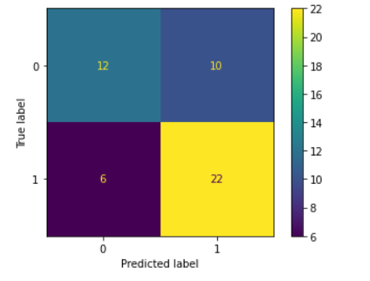
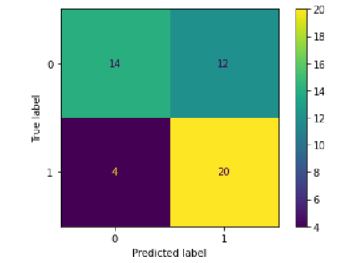
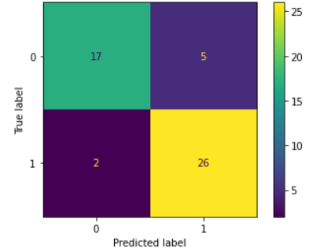
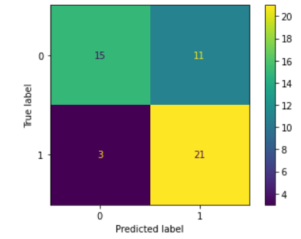
Setfit out perform neural network Lstm in few shot text classification
Setfit
Lstm
86%>70%
86%>58%
68%>62%
72%>69%

Slide 8
Conclusion :
Sentence transformer fine tuning out performs the fastest text classification neural network model lstm.
More research can be conducted with multi-labeled dataset.

Slide 9
THANK YOU

