Slide 1


Hardening Real-Time Operating Systems
Real-time operating systems (RTOS) are critical components in a wide range of embedded systems.
These systems often handle sensitive data and control critical functions, making security a paramount concern.

Slide 2
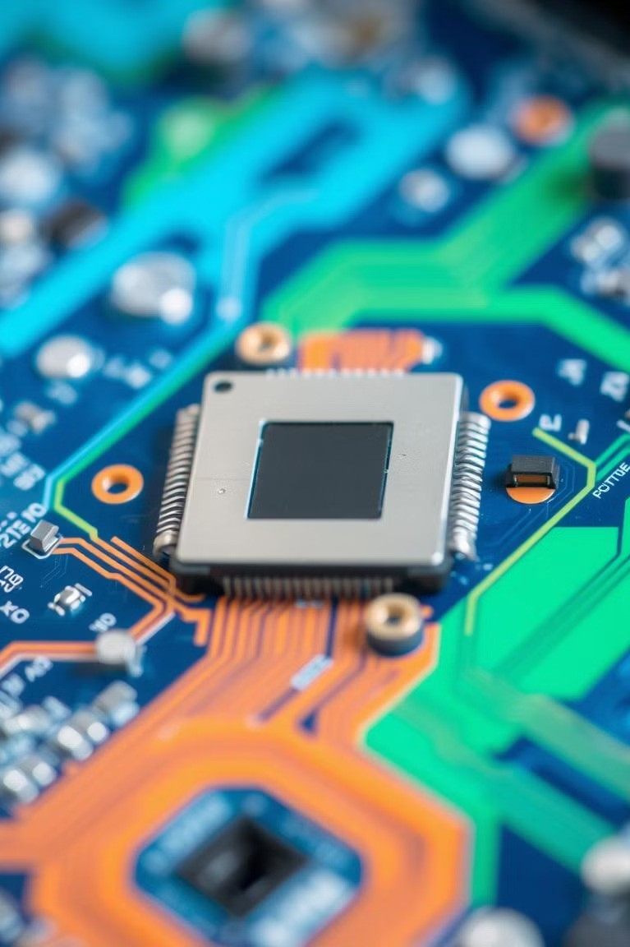
Introduction to Real-Time Operating Systems
1
Time-Critical Applications
RTOS are designed to meet strict timing requirements, crucial for tasks like controlling motors or responding to sensor inputs.
2
Embedded Systems
RTOS are used in devices where general-purpose operating systems are too resource-intensive, like medical devices, automotive systems, and industrial control systems.
3
Deterministic Behavior
RTOS prioritize predictable and consistent performance, enabling tasks to be completed within a defined time frame.

Slide 3
Security Challenges in RTOS Environments
Limited Resources
RTOS often have limited memory and processing power, making it challenging to implement complex security features.
Real-Time Constraints
Security measures must be carefully designed to avoid impacting the real- time performance of the system.
Legacy Systems
Many RTOS-based systems are based on older technologies, posing challenges for updating security features.

Slide 4
Principle of Least Privilege
Minimize Permissions
Limit user privileges to the minimum necessary for their tasks, restricting access to sensitive data and system resources.
1
Separate User Accounts
Establish separate user accounts for different tasks, reducing the impact of a compromised account.
2
3
Role-Based Access Control
Implement access control mechanisms based on user roles, ensuring appropriate permissions for different functions.

Slide 5
Secure Boot and Firmware Integrity
Verified Boot
Ensure that the operating system and applications are loaded from trusted sources, preventing malicious code injection.
1
Firmware Updates
Regularly update firmware to patch vulnerabilities and ensure the integrity of the boot process.
2
Secure Bootloader
Implement a secure bootloader that verifies the authenticity and integrity of the operating system before loading it.
3

Slide 6
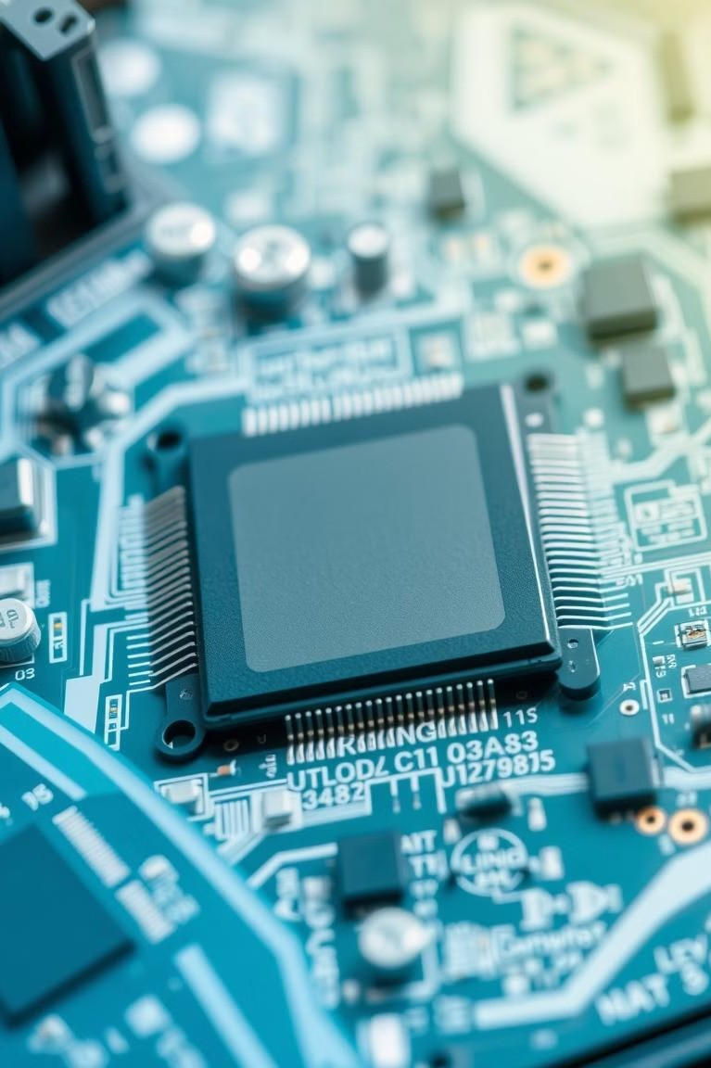
Memory Protection and Address Space Isolation
Memory Segmentation
Divide memory into segments with different access permissions, protecting sensitive data from unauthorized access.
Address Space Layout Randomization
Randomize the memory layout to make it harder for attackers to exploit memory vulnerabilities.
Memory Protection Units
Use hardware-based memory protection units (MPUs) to enforce memory access rules and prevent unauthorized access.

Slide 7




Secure Communications and Cryptography
Data Encryption
Encrypt sensitive data in transit and at rest to prevent unauthorized access.
Secure Communication Protocols
Implement secure communication protocols, such as TLS/SSL, to protect data during transmission.
Digital Signatures
Use digital signatures to verify the authenticity and integrity of software and data.

Slide 8
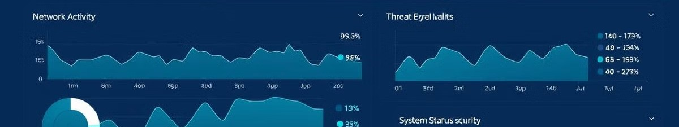
Monitoring, Logging, and Incident Response
Security Monitoring
Continuously monitor the system for suspicious activity and potential threats.
Incident Response Plan
Develop a plan to handle security incidents, including steps for containment, remediation, and recovery.
1
2
3
Log Analysis
Record system events and analyze logs to detect and investigate security incidents.

Slide 9

Conclusion and Best Practices
1
Secure RTOS
Least privilege, secure boot, memory shields, encrypted comms, vigilant monitoring
2
Security Lifecycle
Prioritize security from design to deployment and maintenance

