Slide 1
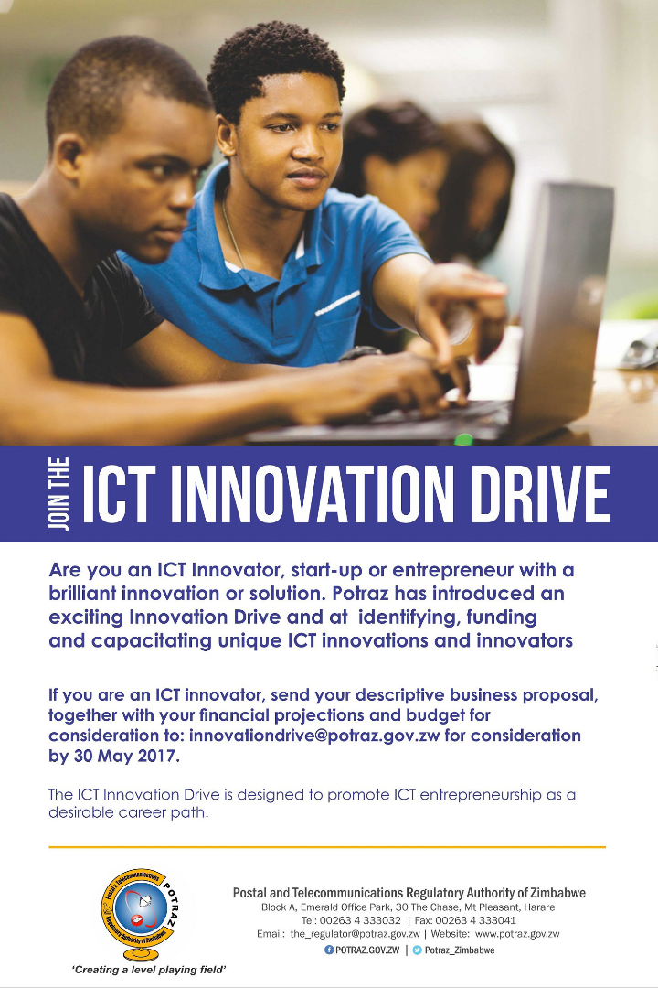
Promoting ICT in Education: A Strategic Approach
In an era of rapid technological advancement, the integration of Information and Communication Technology (ICT) in education has emerged as a transformative force. This document explores insights from the research paper "Implementing Small Scale ICT Projects in Developing Countries" to underscore the significance of promoting ICT in education.
by Ahmed fraz

Slide 2

Enhancing Student Engagement with Technology
In today's digital age, student engagement is key to effective learning. Explore how the integration of technology in classrooms can captivate students' attention, foster collaboration, and promote active participation. Discover practical strategies and success stories of schools leveraging technology to create engaging learning environments.

Slide 3
Key Areas of Development
User Capacity Building
Organizational Support
Stakeholder Willingness
Financial and Resource Support
The paper emphasizes the need for enhancing ICT skills among educators and stakeholders. Capacity-building initiatives play a crucial role in empowering users to navigate and leverage ICT tools effectively.
Successful ICT integration requires strong support from top management and strategic planning. Organizations need to align their processes with ICT initiatives, fostering a flexible environment that encourages innovation and adaptation.
The positive attitudes of teachers and students towards ICT initiatives are paramount. The paper highlights the importance of stakeholder willingness in accepting and actively participating in online learning activities, reflecting a shift from traditional teaching methodologies.
Adequate funding and resources are vital for the implementation of ICT projects. Whether internal or external, financial support ensures the sustainability of projects, covering costs related to training, infrastructure, and ongoing activities.

Slide 4
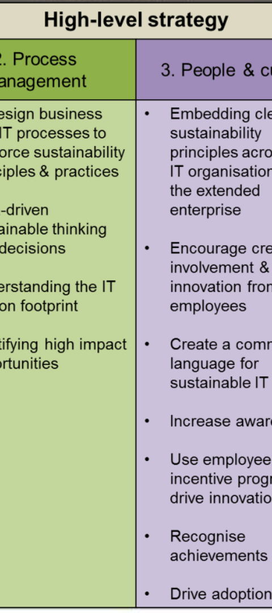
Expertise in ICT as a Success Factor
1
Use of Expert Knowledge
2
ICT Tools Proficiency
Engaging experts in the organization and leveraging external advice significantly contributes to project success.
Proficiency in using ICT tools enhances the efficiency and effectiveness of project implementation.
3
Support for Updating Knowledge
Continuous support for updating ICT skills is identified as a
critical success factor.

Slide 5
Personal Contribution to Project Deliverables
1
Capacity Building
I can design and conduct targeted training workshops for educators, focusing on enhancing their ICT skills and adapting to new teaching methodologies.
2
ICT Tools Utilization
With proficiency in various ICT tools, I can facilitate the effective use of project management tools, audio/video editing, and communication platforms, ensuring seamless collaboration.
3
Strategic Planning
Leveraging my strategic thinking, I can assist in aligning ICT projects with the organization's master plan, ensuring a cohesive integration that supports long-term goals.
4
Training and Support
I am committed to providing ongoing support for updating knowledge, conducting regular training sessions, and addressing any challenges that may arise during project implementation.

Slide 6
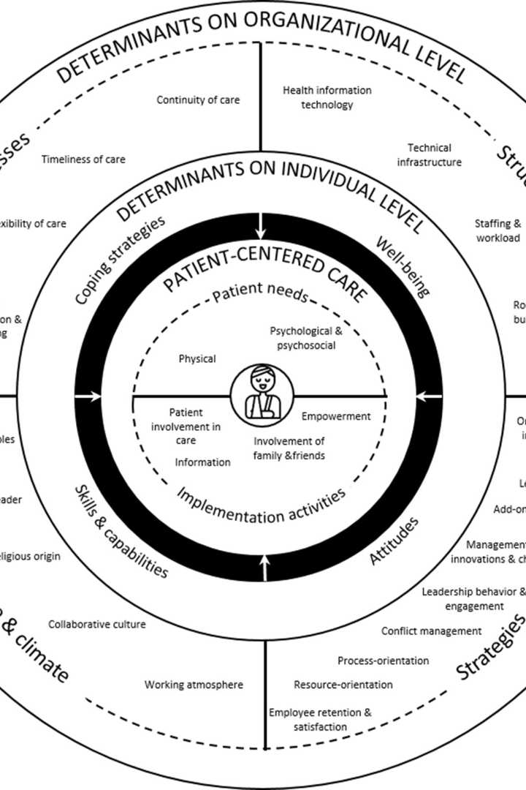
Implementing Student-Centered Learning
Discover the benefits of student-centered learning and explore effective strategies to implement this approach in your classroom. Learn how to empower students to take ownership of their learning, foster critical thinking skills, and promote collaboration among peers.

Slide 7

Conclusion
Transformational Approach
Challenges and Solutions
Promoting ICT in education is not just a technological upgrade; it's a holistic transformation that requires careful planning, stakeholder engagement, and continuous support.
By leveraging expertise in ICT, we can navigate these challenges and contribute to the success of projects that pave the way for a technologically advanced and educationally enriched future.

