Slide 1

Uv-vis spectroscopy
Presented by 3rd Nano boys

Slide 2
Outlines
Introduction
Principle of Uv-Vis
Components of UV-Vis
Types of Uv-Vis
Applications of UV-Vis

Slide 3
Introduction

Slide 4

What is uv-vis spectroscopy
It is an optical characterization method that utilizes UV-Vis light to study how this light interacts with the material by measuring the absorption or transmission at different wavelengths.

Slide 5
Principle of Uv-Vis spectroscopy

Slide 6
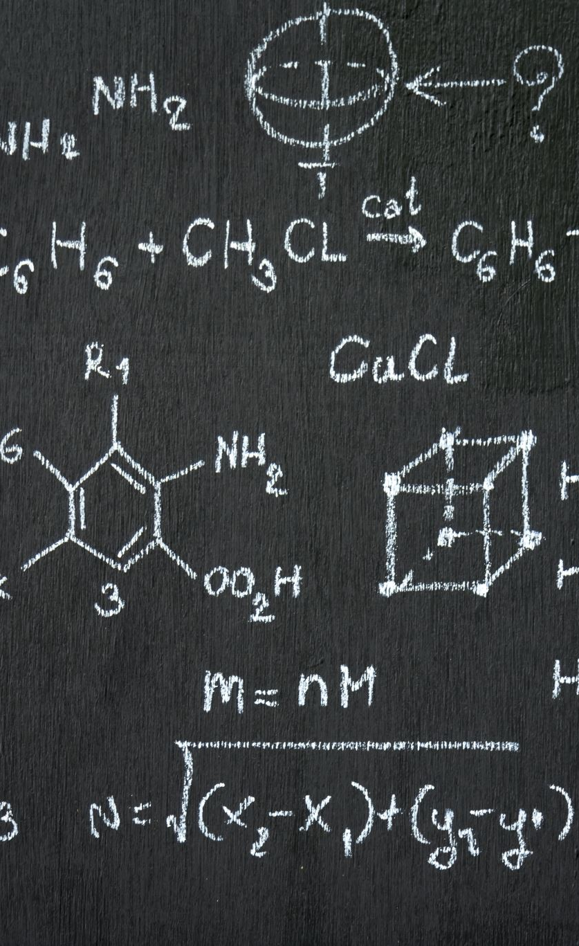
Principle of uv-vis spectrSocopy
Electronic Transitions: Molecules absorb light, causing electrons to move to higher energy states:
π → π*: Double bonds (alkenes), aromatic rings (benzene).Moderate UV.
n → π*: Lone pairs (ketones, amines).
σ → σ*: Single bonds (methane).Less than 200nm
Beer-Lambert Law: Absorbance (A) is proportional to concentration (c), path length (l), and molar absorptivity (ε).𝐴=𝜖⋅𝑐⋅𝑙
Absorption Spectrum: Molecules absorb light at specific wavelengths, producing absorption peaks (λmax) related to electronic transitions.

Slide 7
Components of uv-vis

Slide 8
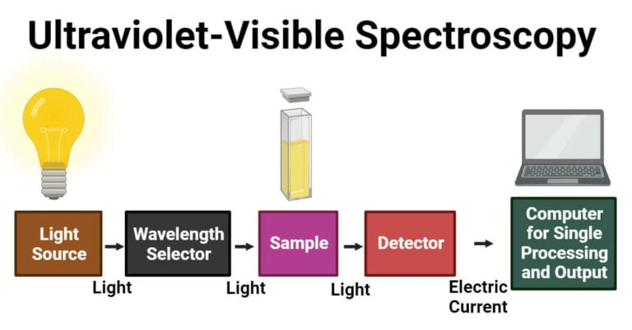
Components of uv-vis spectroscopy
Light source
Entrance slit
Dispersive element
Exit slit
Sample cell
detector

Slide 9
Types of uv-vis

Slide 10
Types of uv-vis spectroscopy
Single Beam Spectrophotometer : Uses a single light path; the light passes through either the sample or the blank (reference), but not both simultaneously. Simple and low-cost.
Double Beam Spectrophotometer : It splits the light beam into two paths—one passing through the sample and the other through the reference (blank)—and compares both beams simultaneously.

Slide 11
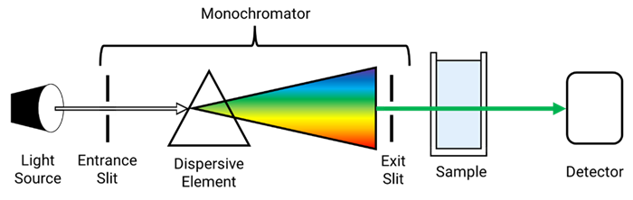
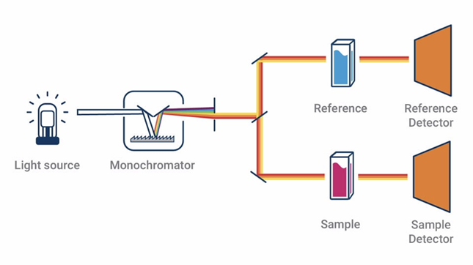

Slide 12
Applications of uv-vis
Determine the concentration of a substance in a solution
Characterize chemical compounds based on their absorption spectra
Detect and measure pollutants or contaminants in the environment
Calculating band gap for electronic materials through Tauc Plot

Slide 13
TAUC equation
Used to determine the Energy band gap of the material .
(αhν)^(1/n) =A(hν−Eg​)
α is the absorption coefficient.
h is Planck's constant
𝜈 is the frequency of the incident light.
ℎ𝜈 is the photon energy.
n is a constant that depends on the type of material (semiconductor or insulator).Transitions of the material
𝐴 is a proportionality constant
E g​ is the optical band gap energy of the material.

Slide 14
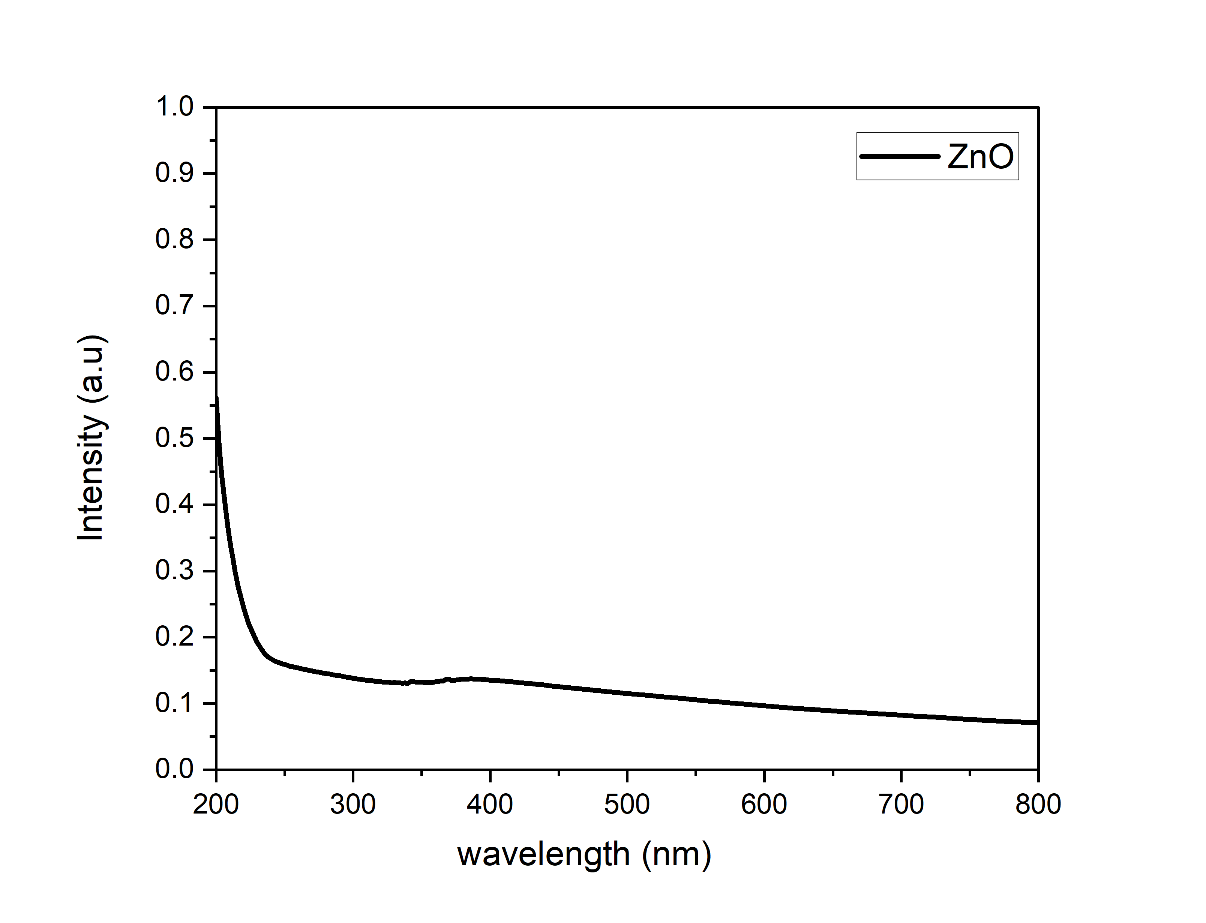
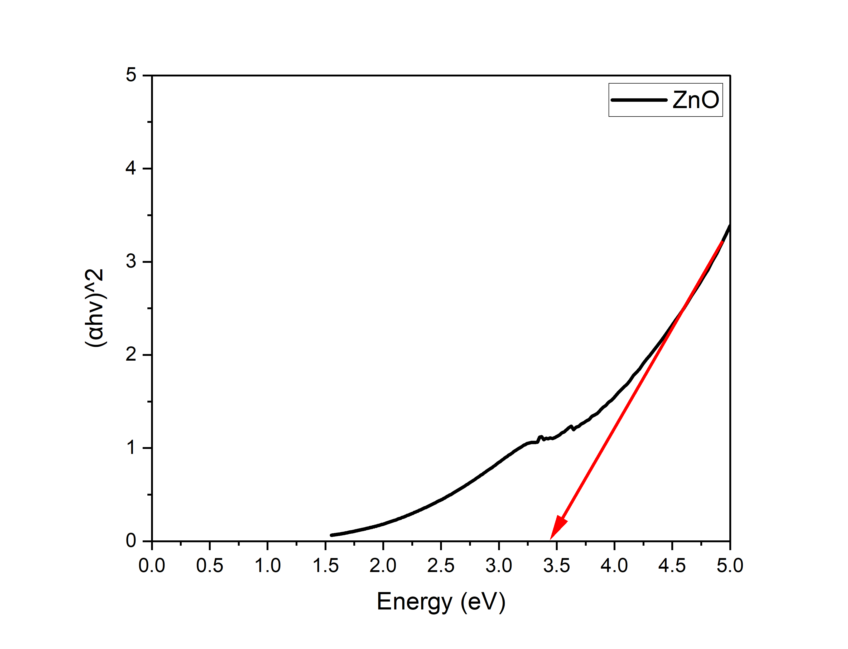
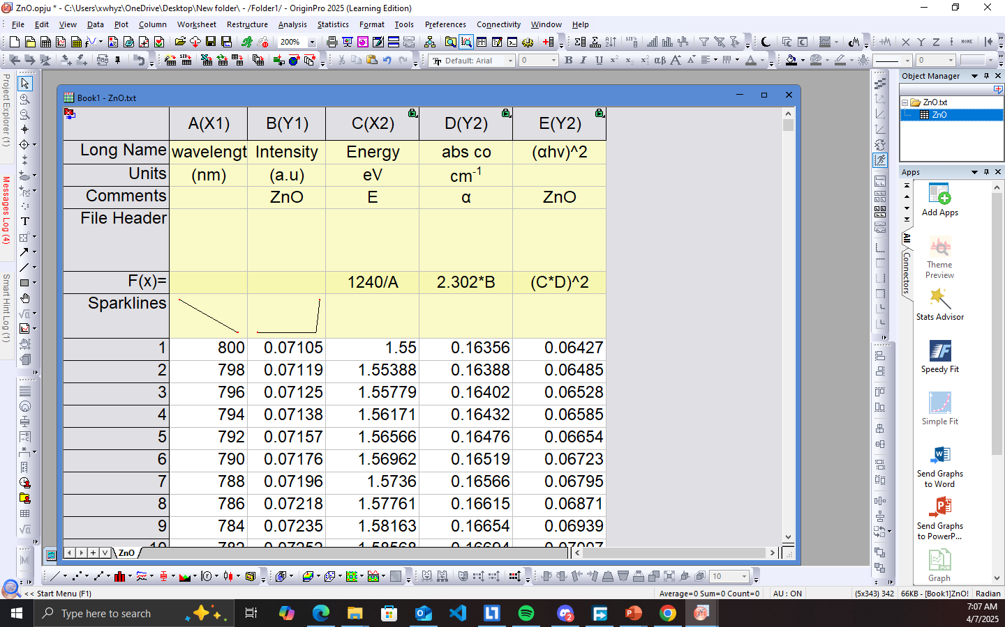
Calculating band gap in origin

