Slide 1
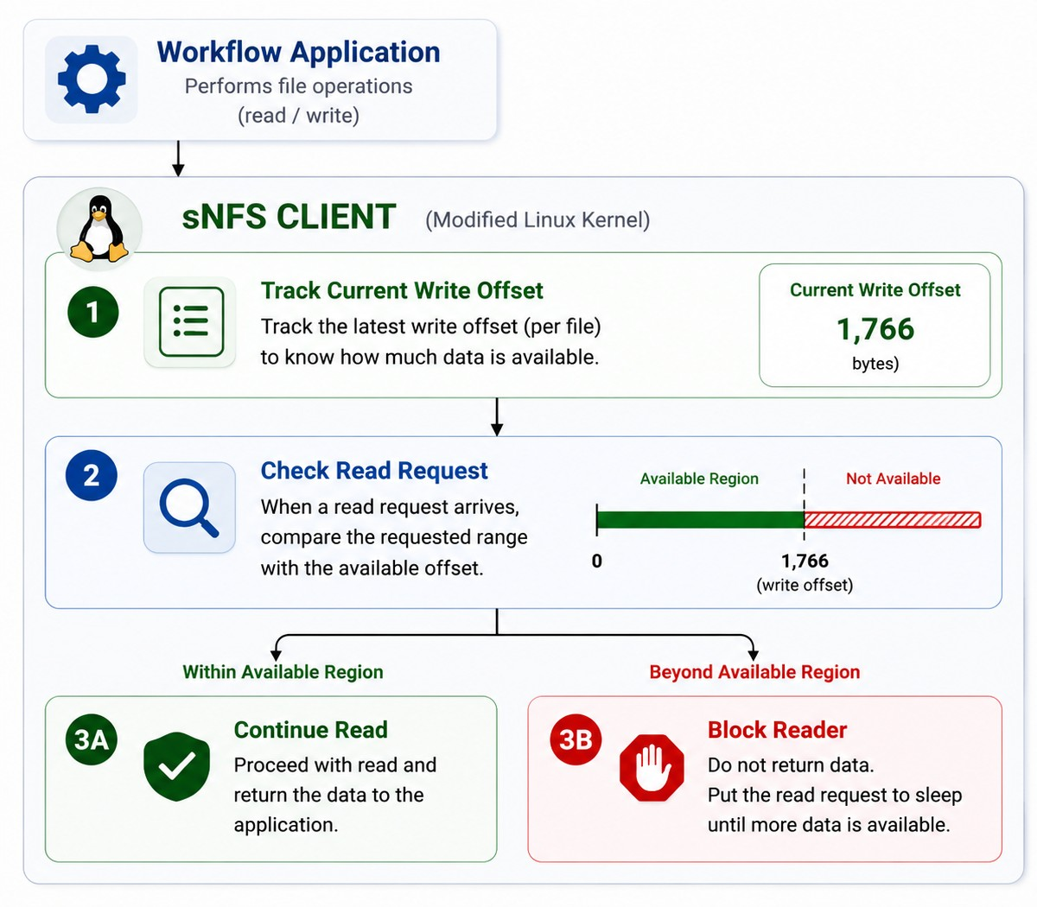
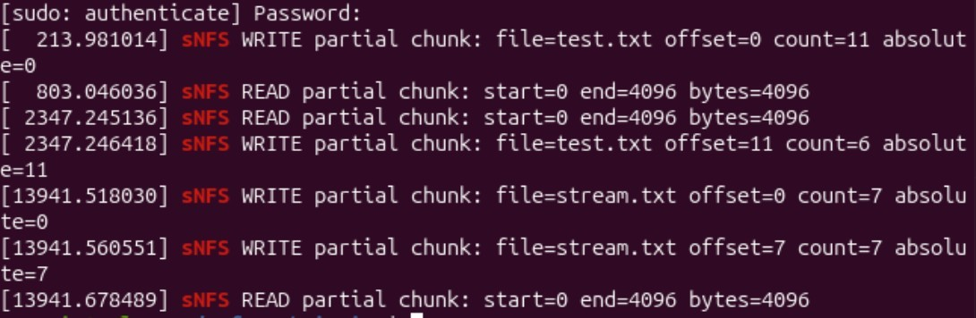
sNFS: Kernel-Level Foundation for Partial
File Streaming
Ahmed Wahba
Design Workshop — Lab/Project Summer 2026, Technical University of Darmstadt
Motivation
Why wait for an entire file to arrive before reading it?
Traditional NFS follows a file-oriented model where readers typically consume data only after it has been written.
sNFS (Streaming Network File System) remove this limitation by allowing data to be consumed incrementally as it becomes available.
This work presents an experimental kernel-level prototype that tracks available data, synchronizes readers and writers,
and explores the foundations of streaming behavior in NFS.
Problem Statement Traditional NFS clients operate on complete files and provide no information about partial file availability.
As a result, downstream tasks cannot start processing data before the entire file has been transferred.
Current Implementation
Current State
• Kernel-level NFS tracing
• Available data offset tracking
• Reader blocking mechanism
• Wake-up synchronization mechanism
• Experimental streaming prototype
Validation Results
✓
NFS read requests detected
✓
NFS write requests detected
✓
Available offset tracking verified
✓
Reader blocking verified
✓
Reader wake-up verified
✓
Runtime kernel testing completed Streaming
Status
Ongoing Development
• Per-file streaming state management
• Advanced synchronization mechanisms
• Streaming performance evaluation
• Full sNFS architecture
Figure 1: Architecture of the sNFS streaming prototype showing available data tracking, read request validation, and reader blocking beyond the available region.
Experimental Validation
.
Test Environment
• Ubuntu 25.04 VM
(VirtualBox)
• Custom Linux Kernel
(v7.1.0-rc5+)
• Modified NFS Client
• Local NFS Server
Test Environment
• Kernel Log Monitoring
using dmesg
• Validation using File
Read/Write Workloads
Figure 2: Live kernel output showing successful detection of partial NFS read and write operations.
.
.
.
Next Step : Implement per-file streaming state management to support scalable and efficient sNFS data streaming..
Resources
Communication Networks Lab (KOM)
[1] Linux Kernel Documentation. https://docs.kernel.org
Technical University of Darmstadt
[2] Linux NFS Client Source Code (Linux Kernel v7.1-rc5), fs/nfs/read.c and fs/nfs/write.c.
[3] Ahmed Wahba, sNFS Kernel Monitoring Repository. https://github.com/Ahmed-Gonga/sNFS-kernel-monitor

