Slide 1
TPc-H
Transaction Processing Performance Council

Slide 2
TPC-H
Benchmark name
TPC-H Benchmark
Link
website: https://www.tpc.org/tpch/
Document: https://www.tpc.org/TPC_Documents_Current_Versions/pdf/TPC-H_v3.0.1.pdf
NAME
Ahmed Hany Farouk Tawfik
Mail
ahmed.tawfik011@eng-st.cu.edu.eg

Slide 3
TPC Transaction Processing Performance Council
Acceptable
non-profit organization
TPC-H
Dedicated to developing industry-standard benchmarks for evaluating the performance of transaction processing and database systems.
Evaluates the performance of various decision support systems by the execution of sets of queries against a standard database under controlled conditions
By companies like:
DELL
AMD
CISCO
REDHAT
And many others…

Slide 4
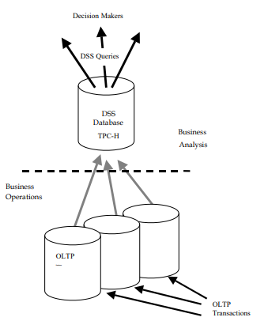
Benchmark Execution
TPC-H employs crafted ad-hoc queries
The TPC-H benchmark evaluates performance through the Composite Query-per-Hour Performance Metric (QphH@Size).

Slide 5
The Flow of the Algorithm
Populating the database with a synthetic dataset generated by the DBGEN data generation program.
2. Executing a suite of twenty-two (22) complex queries against the populated database.
3. In addition to the queries, the benchmark includes two concurrent data modification operations, which insert and delete data from the database.
4. The performance of a system under the TPC-H benchmark is measured using the TPC-H Composite Query-per-Hour Performance Metric (QphH@Size).
5. The results of the benchmark are reported in terms of the QphH@Size metric and the TPC-H Price/Performance metric.

Slide 6
SAMPLE RESULTS
10,000 GB Results
100 GB Results
1,000 GB Results
KTNF KR580S1
HPE ProLiant DL385 Gen11
Dell PowerEdge R7515
Dell PowerEdge R6525
HPE ProLiant DL380 Gen11

Slide 7
Conclusion
Importance
future research
Standardized Testing
Complex Queries
Scalability
Comprehensive Metrics
Industry Recognition
Benchmarking New Technologies
Real-Time Analytics
Big Data
Machine Learning

