Slide 1

Introduction to Plots of Land
- Plots of land are defined areas of land that can be used for various purposes.
- They can be categorized into residential, commercial, industrial, and agricultural.
- Understanding land plots is crucial for real estate and urban planning.

Slide 2

Types of Land Plots
- Residential plots are used for housing developments.
- Commercial plots are designated for businesses and retail.
- Agricultural plots are used for farming and crop production.

Slide 3
Factors Influencing Land Value
- Location is a key factor; land in urban areas tends to be more valuable.
- Zoning laws dictate what can be built on a plot of land.
- Infrastructure such as roads and utilities can increase land value.

Slide 4
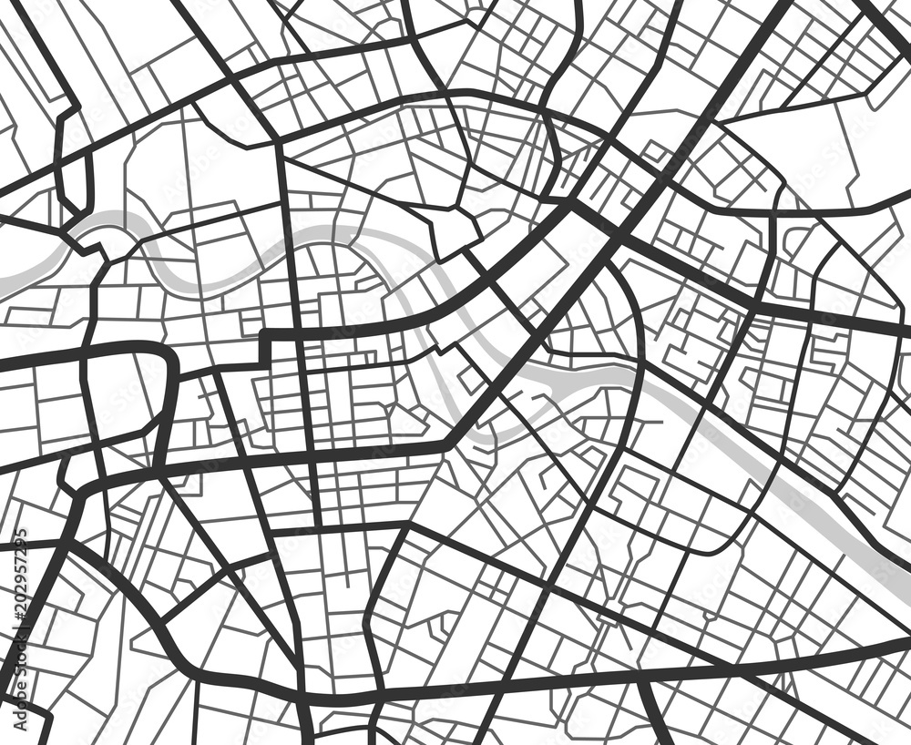
Land Use Planning
- Land use planning involves managing how land is used and developed.
- It aims to balance economic growth with environmental protection.
- Zoning maps help visualize land use regulations.

Slide 5

Conclusion
- Investing in land can be a profitable venture.
- Sustainable land use is essential for future generations.
- Community involvement in land planning leads to better outcomes.

