Slide 1
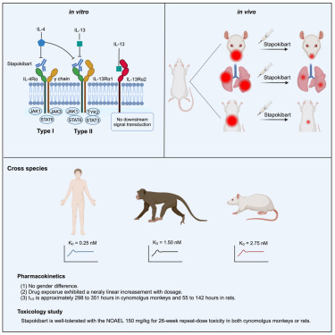
Introduction
- This presentation discusses the dangers of drug use in monkeys, specifically focusing on Almawz Kam and the drug Girish.
- Understanding the implications of drug use is crucial for the health of animals.
- We will explore the side effects and consequences of Almawz Kam's choices.

Slide 2
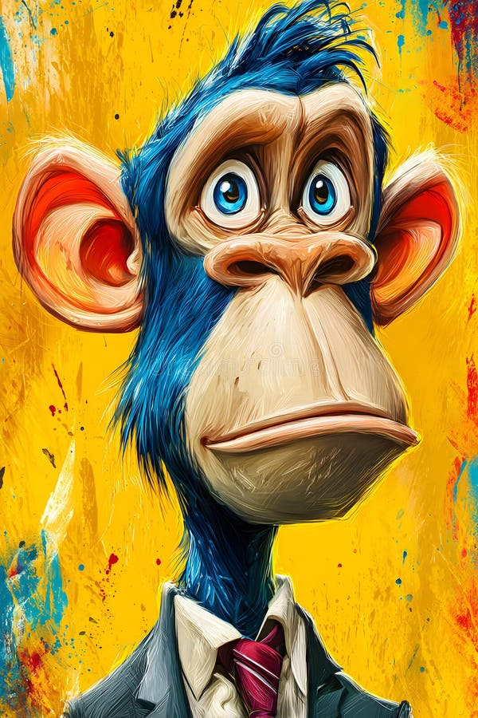
Who is Almawz Kam?
- Almawz Kam is a fictional monkey who becomes involved with drugs.
- His story serves as a cautionary tale about drug addiction.
- Monkeys, like humans, can suffer from the effects of drug abuse.

Slide 3

The Drug - Girish
- Girish is a harmful substance sold by a drug dealer.
- It is important to understand what Girish is and its effects.
- The drug is illegal and poses serious risks to Almawz Kam's health.

Slide 4
Side Effects of Girish
- Girish can cause severe physical and mental health issues.
- Common side effects include:
- Increased heart rate and anxiety.
- Impaired cognitive function.
- Risk of addiction and withdrawal symptoms.

Slide 5
Consequences of Drug Use
- Almawz Kam faces numerous consequences from using Girish.
- These include:
- Deterioration of physical health.
- Social isolation from other monkeys.
- Legal issues with the drug dealer, Girish.

Slide 6
The Role of the Drug Dealer
- The drug dealer, Girish, exploits vulnerable individuals like Almawz Kam.
- Understanding the role of dealers is crucial in addressing drug problems.
- Awareness can help prevent others from falling into the same trap.

Slide 7

Prevention and Awareness
- Educating monkeys and their communities about the dangers of drugs is vital.
- Prevention programs can help reduce drug use among animals.
- Support systems are essential for those struggling with addiction.

Slide 8

Conclusion
- Almawz Kam's story is a reminder of the dangers of drug use.
- It highlights the importance of awareness and prevention.
- Together, we can work towards a drug-free environment for all animals.

